Slide 1
Things To Consider When
Selling Your House
WINTER 2024
EDITION

Slide 2
Table of Contents
3 Should I Sell My House This Winter?
5 What Are the Real Reasons You Want To Move Right Now?
8 The Perks of Selling Your House When Inventory Is Low
11 Home Prices Are Not Falling
13 Your Home Equity Can Offset Affordability Challenges
16 Why Setting the Right Price for Your House Still Matters
18 A Checklist for Selling Your House
20 Top Skills You Need Your Listing Agent To Have
22 Key Reasons To Hire a Real Estate Agent When You Sell

Slide 3
Should I Sell My House This Winter?
With everything going on in the housing market lately, you might have some questions about selling your house. Here are a few things you might be wondering, and the answers to help you feel confident about your decision.
1. Are There Still Buyers Looking for Homes?
Are you putting off selling your house because you’re worried no one’s buying due to where mortgage rates are? If so, know this: plenty of buyers are still out there, and they’re purchasing homes today. As Realtor Magazine says:
“. . . consider the life-changing events that took place during the past two years: 3 million marriages, 1.5 million divorces, 7 million births, 4 million deaths, and 7 million Americans reaching 65. Staying put isn’t an option for many growing families or divorcing couples. The dream of retiring to a home requiring less maintenance can’t be postponed indefinitely. People need and want to move.”
It’s simple. Buyers will always need to buy, and those who can afford to move at today’s rates are going to do so. That means buyer demand hasn’t disappeared.
Notes:
https://www.realtormagdigital.com/realtor/library/item/fall_2023/4139952/

Slide 4
2. Is It Worth It To Sell Now?
The supply of homes for sale is still low, so we’re still in a seller’s market today (see graph below). With more buyers than homes today, buyers crave more options, and your house may be just what they’re looking for. Selling while inventory is this low means if you price your house right, it’s likely to be in demand. The graph below puts today’s inventory into perspective.
3. Are Home Prices Falling?
Put simply, they are not. Recent data shows home prices are on the rise at a normal pace in many parts of the country. And while prices vary by market, experts project they’ll continue to rise at typical levels of appreciation in the years ahead.
So, with the worst home price declines behind us and prices appreciating today, you can still sell with confidence this season.
Months’ Inventory of Homes for Sale
2008
2010
Buyer’s
Market
(> 7 Months)
2007
2006
Neutral Market (6-7 Months)
1999
Today
Seller’s
Market
(< 6 Months)
Source: NAR
Bottom Line If you're thinking about selling your house this winter, let’s chat so you have the advice and information you need to make the right choice.
Notes:
https://www.nar.realtor/research-and-statistics/housing-statistics/existing-home-sales

Slide 5
What Are the Real Reasons You Want To Move Right Now?
If you’re considering selling your house right now, it’s likely because something in your life has changed – not because of the current market conditions.
While things like mortgage rates play a big role in your decision, you don’t want that to overshadow why you thought about making a move in the first place.
It’s true mortgage rates are higher right now, and that has an impact on affordability. As a result, some homeowners are deciding they’ll wait to sell because they don’t want to move and have a higher mortgage rate on their next home.
But your lifestyle and your changing needs matter, too. As a recent article from Realtor.com says:
“No matter what interest rates and home prices do next, sometimes homeowners just have to move—due to a new job, new baby, divorce, death, or some other major life change.”
Here are a few of the most common reasons people choose to sell right now. You may find any one of these resonates with you and may be reason enough to move, even today.
1. Relocation
Some of the things that can motivate a move to a new area include changing jobs, a desire to be closer to friends and loved ones, wanting to live in your ideal location, or just looking for a change in scenery.
For example, if you just landed your dream job in another state, you may be thinking about selling your current home and moving for work.
Notes:
https://www.realtor.com/advice/sell/should-i-sell-my-house-now-reasons-to-list-times-to-wait/

Slide 6
2. Upgrading
Many homeowners decide to sell to move into a larger home. This is especially common when there’s a need for more room to entertain, a home office or gym, or additional bedrooms to accommodate a growing number of loved ones.
For example, if you’re living in a condo and your household is growing, it may be time to find a home that better fits those needs.
3. Downsizing
Homeowners may also decide to sell because someone’s moved out of the home recently and there’s now more space than needed. It could also be that they’ve recently retired or are ready for a change.
For example, you’ve just kicked off your retirement and you want to move somewhere warmer with less house to maintain. A different home may be better suited for your new lifestyle.
4. Change in Relationship Status
Divorce, separation, or marriage are other common reasons individuals sell.
For example, if you’ve recently separated, it may be difficult to still live under one roof. Selling and getting a place of your own may be a better option.
5. Health Concerns
If a homeowner faces mobility challenges or health issues that require specific living arrangements or modifications, they might sell their house to find one that works better for them.
For example, you may be looking to sell your house and use the proceeds to help pay for a unit in an assisted-living facility.
With higher mortgage rates and rising prices, there are some affordability challenges right now – but your needs and your lifestyle matter too.
Bottom Line If you want to sell your house and find a new one that better fits your needs, let’s connect. That way, you’ll have someone to guide you through the process and help you find a home that works for you.

Slide 7
Deciding whether it’s the right time to sell your home is a very personal decision. There are numerous important questions to consider, both financial and lifestyle-based, before putting your home on the market. . . . Your future plans and goals should be a significant part of the equation . . .
- Bankrate
Notes:
https://www.bankrate.com/real-estate/should-i-sell-my-house-now-or-wait/#sell-now

Slide 8
The Perks of Selling Your House When Inventory Is Low
Are you thinking about selling your house? If so, know today’s market benefits you because there are very few homes for sale.
When it comes to selling your house, you’re probably trying to juggle current market conditions and your own needs as you plan your move.
One thing that may be working in your favor is how few homes there are for sale right now. Here’s what you need to know about the current inventory situation and what it means for you.
The Supply of Homes for Sale Is Far Below the Norm
When you’re selling something, it helps if what you’re selling is in demand, but is also in low supply. Why? That makes it even more desirable, since there’s not enough to go around. That’s exactly what’s happening in the housing market today. There are more buyers looking to buy than there are homes for sale.
The graph below uses data from Realtor.com to look at active listings this year compared to what’s more typical in the market. It doesn’t include 2020-2022 because those weren't normal years for the market.
As you can see in the graph, if you look at the last normal years for the market (shown in the blue bars) versus the numbers for this year (shown in the red bar), it’s clear inventory is still far lower than the norm.
The Supply of Homes for Sale Is Still Low Active Monthly Listings Counts, November of Each Year
Source: Realtor.com
Notes:
https://www.realtor.com/research/data/

Slide 9
What That Means for You
Buyers have fewer choices now than they did in more typical years. And that’s why you could still see some great perks if you sell today. Because there aren’t enough homes to go around, homes that are priced right are still selling fast and the average seller is getting multiple offers from eager buyers. Based on data from the Confidence Index from the National Association of Realtors (NAR):
66% of homes sold in less than a month.
2.5 offers: the average number of offers on recently sold homes.
An article from Realtor.com also explains how the limited number of houses for sale benefits you if you’re selling:
“The typical home spent 52 days on the market this November . . . more than two weeks (17 days) less than the average November from 2017 to 2019. . . . as still-limited supply spurs homebuyers to act quickly . . .”
Bottom Line Because the supply of homes for sale is so low, buyers desperately want more options – and your house may be just what they’re looking for. Let’s connect to get your house listed at the right price for today’s market. You could still see it sell quickly and potentially get multiple offers.
Notes:
https://www.nar.realtor/research-and-statistics/research-reports/realtors-confidence-index
https://cdn.nar.realtor/sites/default/files/documents/2023-10-realtors-confidence-index-11-21-2023.pdf
https://www.realtor.com/research/november-2023-data/

Slide 10
A lack of housing options creates a very competitive market, in which many buyers must compete for few available properties.
- Bankrate
Notes:
https://www.bankrate.com/real-estate/low-inventory-housing-shortage/#affects

Slide 11
Home Prices Are Not Falling
In late 2022, some experts said home prices would crash in 2023. That made a lot of people worried about the strength of the residential real estate market. If you’re one of them, here's what you should understand.
Home Prices Never Crashed
Disregard what you saw in the headlines. The actual data shows home prices were remarkably resilient and performed far better than the media would have you believe (see graph below):
This graph uses reports from three trusted sources to clearly illustrate prices have already rebounded after experiencing only slight declines nationally. That’s a far cry from the crash so many articles called for.
Percent Change in Home Values Month-Over-Month
Case-Shiller
Freddie Mac
CoreLogic
Notes:
https://www.spglobal.com/spdji/en/indices/indicators/sp-corelogic-case-shiller-us-national-home-price-nsa-index/#news-research
https://www.freddiemac.com/research/indices/house-price-index
https://www.corelogic.com/category/intelligence/reports/home-price-insights/

Slide 12
The declines that did happen, weren’t drastic but were short-lived. As Nicole Friedman, a reporter at the Wall Street Journal (WSJ), says:
“Home prices aren’t falling anymore . . . The surprisingly quick recovery suggests that the residential real-estate downturn is turning out to be shorter and shallower than many housing economists expected . . .”
Even though some media coverage made a big deal about home prices pulling back, the slight correction that happened is already in the rearview mirror. Basically, this data shows you, nationally, home prices aren’t falling anymore – they’re actually going back up.
What’s Next for Home Prices?
The consensus from experts is that home price growth will continue in the years ahead and is returning to normal levels for the market. That means we’ll still see home prices appreciating, just at a slower pace than the last few years – and that’s a good thing.
Some news sources will see home price growth slowing and put out stories that make you think prices are falling again. In their coverage, you’ll likely see industry terms like these:
Appreciation: when prices increase.
Deceleration of appreciation: when prices continue to appreciate, but at a slower or more moderate pace.
Depreciation: when prices decrease.
Don’t let the terminology confuse you or let any misleading headlines cause unnecessary fear. The rapid pace of home price growth the market saw in recent years was unsustainable. It had to slow down at some point and that’s what we’re starting to see – deceleration of appreciation, not depreciation.
Remember, it’s normal to see home price growth slow down as the year goes on. And that definitely doesn’t mean home prices are falling. They’re just rising at a more moderate pace.
Bottom Line Even though the media may make things sound doom and gloom, the data shows home prices aren’t falling anymore. So, don’t let the headlines scare you or delay your plans. Let’s connect so you have a trusted resource to cut through the noise and tell you what’s really happening in our area.
Notes:
https://www.wsj.com/economy/housing/the-fall-in-home-prices-may-already-be-over-3496d6bb

Slide 13
Your Home Equity Can Offset Affordability Challenges
Are you thinking about selling your house? If so, today’s mortgage rates may be making you wonder if that’s the right decision. But your equity can help with some of those affordability concerns.
Some homeowners are reluctant to sell and take on a higher mortgage rate on their next home. If you’re worried about this too, know that even though rates are high right now, so is home equity. Here’s what you need to know.
Bankrate explains exactly what equity is and how it grows:
“Home equity is the portion of your home that you’ve paid off and own outright. It’s the difference between what the home is worth and how much is still owed on your mortgage. As your home’s value increases over the long term and you pay down the principal on the mortgage, your equity stake grows.”
In other words, equity is how much your home is worth now, minus what you still owe on your home loan.
Recently, your equity has been growing faster than you might think. That’s because, over the past few years, home prices went up significantly – and those rising prices helped your equity to accumulate faster than usual. While the market has started to normalize, there are still more people wanting to buy homes than there are homes available for sale. This high demand is causing home prices to go up again.
Notes:
https://www.bankrate.com/home-equity/reasons-to-use-home-equity/

Slide 14
According to the Federal Housing Finance Agency (FHFA), the Census, and ATTOM, a property data provider, just over two-thirds (68.7%) of homeowners have either fully paid off their mortgages or have at least 50% equity (see chart below):
Americans Sitting on Tremendous Equity 68.7% Have Paid Off Their Mortgage or Have at Least 50% Equity
Sources: FHFA, Census, ATTOM
That means nearly 70% of homeowners have a tremendous amount of equity right now.
How Equity Helps with Your Affordability Concerns
With today’s affordability challenges, your equity can make a big difference when you decide to move. After you sell your house, you can use the equity you’ve built up in your home to help you buy your next one. Here’s how:
Be an all-cash buyer: If you’ve been living in your current home for a long time, you might have enough equity to buy a new house without having to take out a loan. If that’s the case, you won’t need to borrow any money or worry about mortgage rates.
Make a larger down payment: Your equity could be used toward your next down payment. It might even be enough to let you put a larger amount down, so you won’t have to borrow as much money so today’s rates become less of a sticking point. Experian explains:
“Increasing your down payment lowers your principal loan amount and, consequently, your loan-to-value ratio, which could lead to a lower interest rate offer from your lender.”
Bottom Line If you're thinking about moving, the equity you've built up can make a big difference, especially today. To find out how much equity you've got in your current house and how you can use it for your next home, let’s connect.
Notes:
https://www.fhfa.gov/Media/Blog/Pages/Homeowners-Equity-Remains-High.aspx
https://data.census.gov/all?q=mortgage
https://www.attomdata.com/news/market-trends/home-sales-prices/attom-q2-2023-u-s-home-equity-and-underwater-report/
https://www.experian.com/blogs/ask-experian/does-your-down-payment-affects-your-mortgage/

Slide 15
. . . the average U.S. homeowner now has about $290,000 in equity.
- CoreLogic
Notes:
https://www.corelogic.com/press-releases/home-equity-increases-winter-spring-reducing-underwater-properties-q2/

Slide 16
Why Setting the Right Price for Your House Still Matters
It's important to set the right price for your house. Rely on an expert to make sure it’s priced appropriately for today’s market.
While this isn’t the frenzied market we saw over the past few years, homes that are priced right are still selling quickly and seeing multiple offers right now.
To set yourself up to see advantages like these, you need to rely on an agent. Only an agent has the expertise needed to find the right asking price for your house. Here’s what’s at stake if that price isn’t accurate for today’s market value.
The price you set for your house sends a message to potential buyers.
Price it too low and you might raise questions about your home’s condition or lead buyers to assume something is wrong with it. Not to mention, if you undervalue your house, you could leave money on the table, which decreases your future buying power.
Notes:
https://www.nar.realtor/research-and-statistics/research-reports/realtors-confidence-index

Slide 17
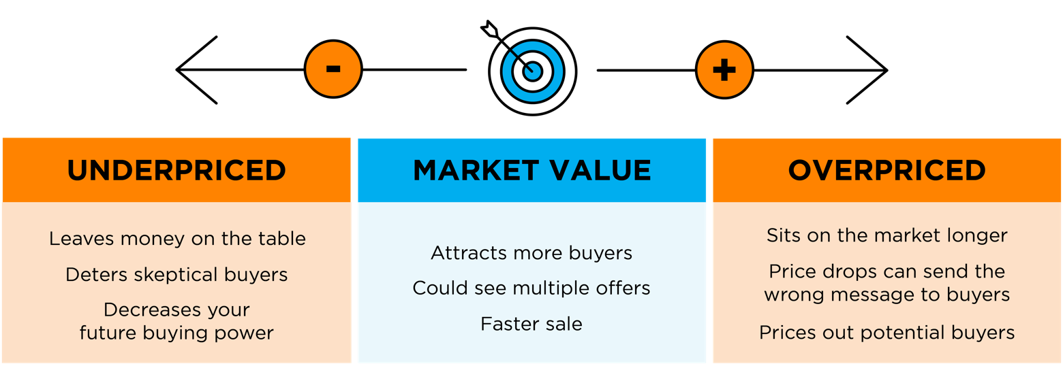
On the other hand, price it too high and you run the risk of deterring buyers from ever touring it in the first place. When that happens, you may have to do a price drop to try to re-ignite interest in your house when it sits on the market for a while. Just be aware that a price drop can be seen as a red flag for some buyers who will wonder why the price was reduced and what that means about the home.
A recent article from NerdWallet sums it up like this:
“Your house’s market debut is your first chance to attract a buyer and it’s important to get the pricing right. If your home is overpriced, you run the risk of buyers not seeing the listing. . . . But price your house too low and you could end up leaving some serious money on the table. A bargain-basement price could also turn some buyers away, as they may wonder if there are any underlying problems with the house.”
Think of pricing your home as a target. Your goal is to aim directly for the center – not too high, not too low, but right at market value.
Pricing your house fairly based on market conditions increases the chance you’ll have more buyers who are interested in purchasing it. That makes it more likely you’ll see multiple offers too. Plus, when homes are priced right, they still tend to sell quickly.
To get a high-level look into the potential downsides of over or underpricing your house and the perks that come with pricing it at market value, see the chart below:
Bottom Line Setting the right price for your house is very important. Don't just guess. Let's talk to ensure your house is priced correctly for today's market.
Notes:
https://www.nerdwallet.com/article/mortgages/price-home-sell

Slide 18
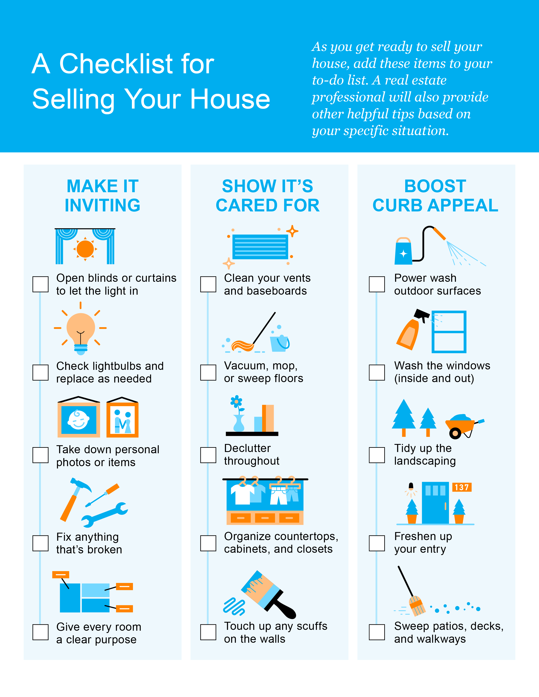

Slide 19
After all, if people drive by, but aren’t interested enough to walk through the front door, you’ll never sell your house.
- U.S. News
Notes:
https://realestate.usnews.com/real-estate/articles/how-to-sell-your-home-while-living-in-it

Slide 20
Top Skills You Need Your Listing Agent To Have
Selling your house is a big decision. And that can make it feel both exciting and a little bit nerve-wracking. But the key to a successful sale is finding the perfect listing agent to work with you throughout the process. A listing agent, also known as a seller’s agent, helps market and sell your house while advocating for you every step of the way.
They Price Your House Based on the Latest Data
While it may be tempting to pick the agent who suggests the highest asking price for your house, that strategy may cost you. It’s easy to get caught up in the excitement when you see a bigger number, but overpricing your house can have consequences. It could mean it’ll sit on the market longer because the higher price is actually deterring buyers.
Instead, you want to pick an agent who’s going to have an open conversation about how they think you should price your house and why. A great agent will base their pricing strategy on solid data. They won’t throw out a number just to win your listing. Instead, they’ll show you the facts, explain their pricing strategy, and make sure you’re on the same page. As NerdWallet explains:
“An agent who recommends the highest price isn’t always the best choice. Choose an agent who backs up the recommendation with market knowledge.”
Notes:
https://www.nerdwallet.com/article/mortgages/are-all-real-estate-agents-the-same-which-realtor-is-right-for-you

Slide 21
They Manage Liability and Legal Considerations
Today, more disclosures and regulations are mandatory when selling a house. And all the paperwork and legal aspects of selling a home can be a lot to manage. Selling a house without professional guidance exposes homeowners to potential liability risks and legal complications.
Real estate agents are well-versed in the contracts, disclosures, and regulations necessary during a sale. Their expertise helps minimize the risk of errors or omissions that could lead to legal disputes or delays.
They’re a Great Negotiator
The home-selling process can be emotional, especially if you’ve been in your house for a long time. You’re connected to it and have a lot of memories there. This can make the negotiation process harder. That’s where a trusted professional comes in.
A skilled listing agent will be calm under pressure and will be your point-person in all of those conversations. Their experience in handling the back-and-forth gives you the peace of mind that you’ve got someone on your side who’s got your best interests in mind throughout this journey.
They’re a Skilled Problem Solver
At the heart of it all, a listing agent’s main priority is to get your house sold. A great agent never loses sight of that goal and will help you prioritize your needs above all else. If they identify any necessary steps you need to take, they’ll be open with you about it. Their commitment to your success means they’ll work with you to address any potential roadblocks and find creative solutions to anything that pops up along the way.
Bankrate explains it like this:
“Just as important as the knowledge and experience agents bring is their ability to guide you smoothly through the process. Above all, go with an agent you trust and will feel comfortable with . . .”
Bottom Line Whether you're a first-time seller or you’ve been through selling a house before, a great listing agent is the key to success. Let’s connect so you have a skilled local expert by your side to guide you through every step of the process.
Notes:
https://www.bankrate.com/real-estate/finding-best-real-estate-agent/#go-with-your-gut

Slide 22
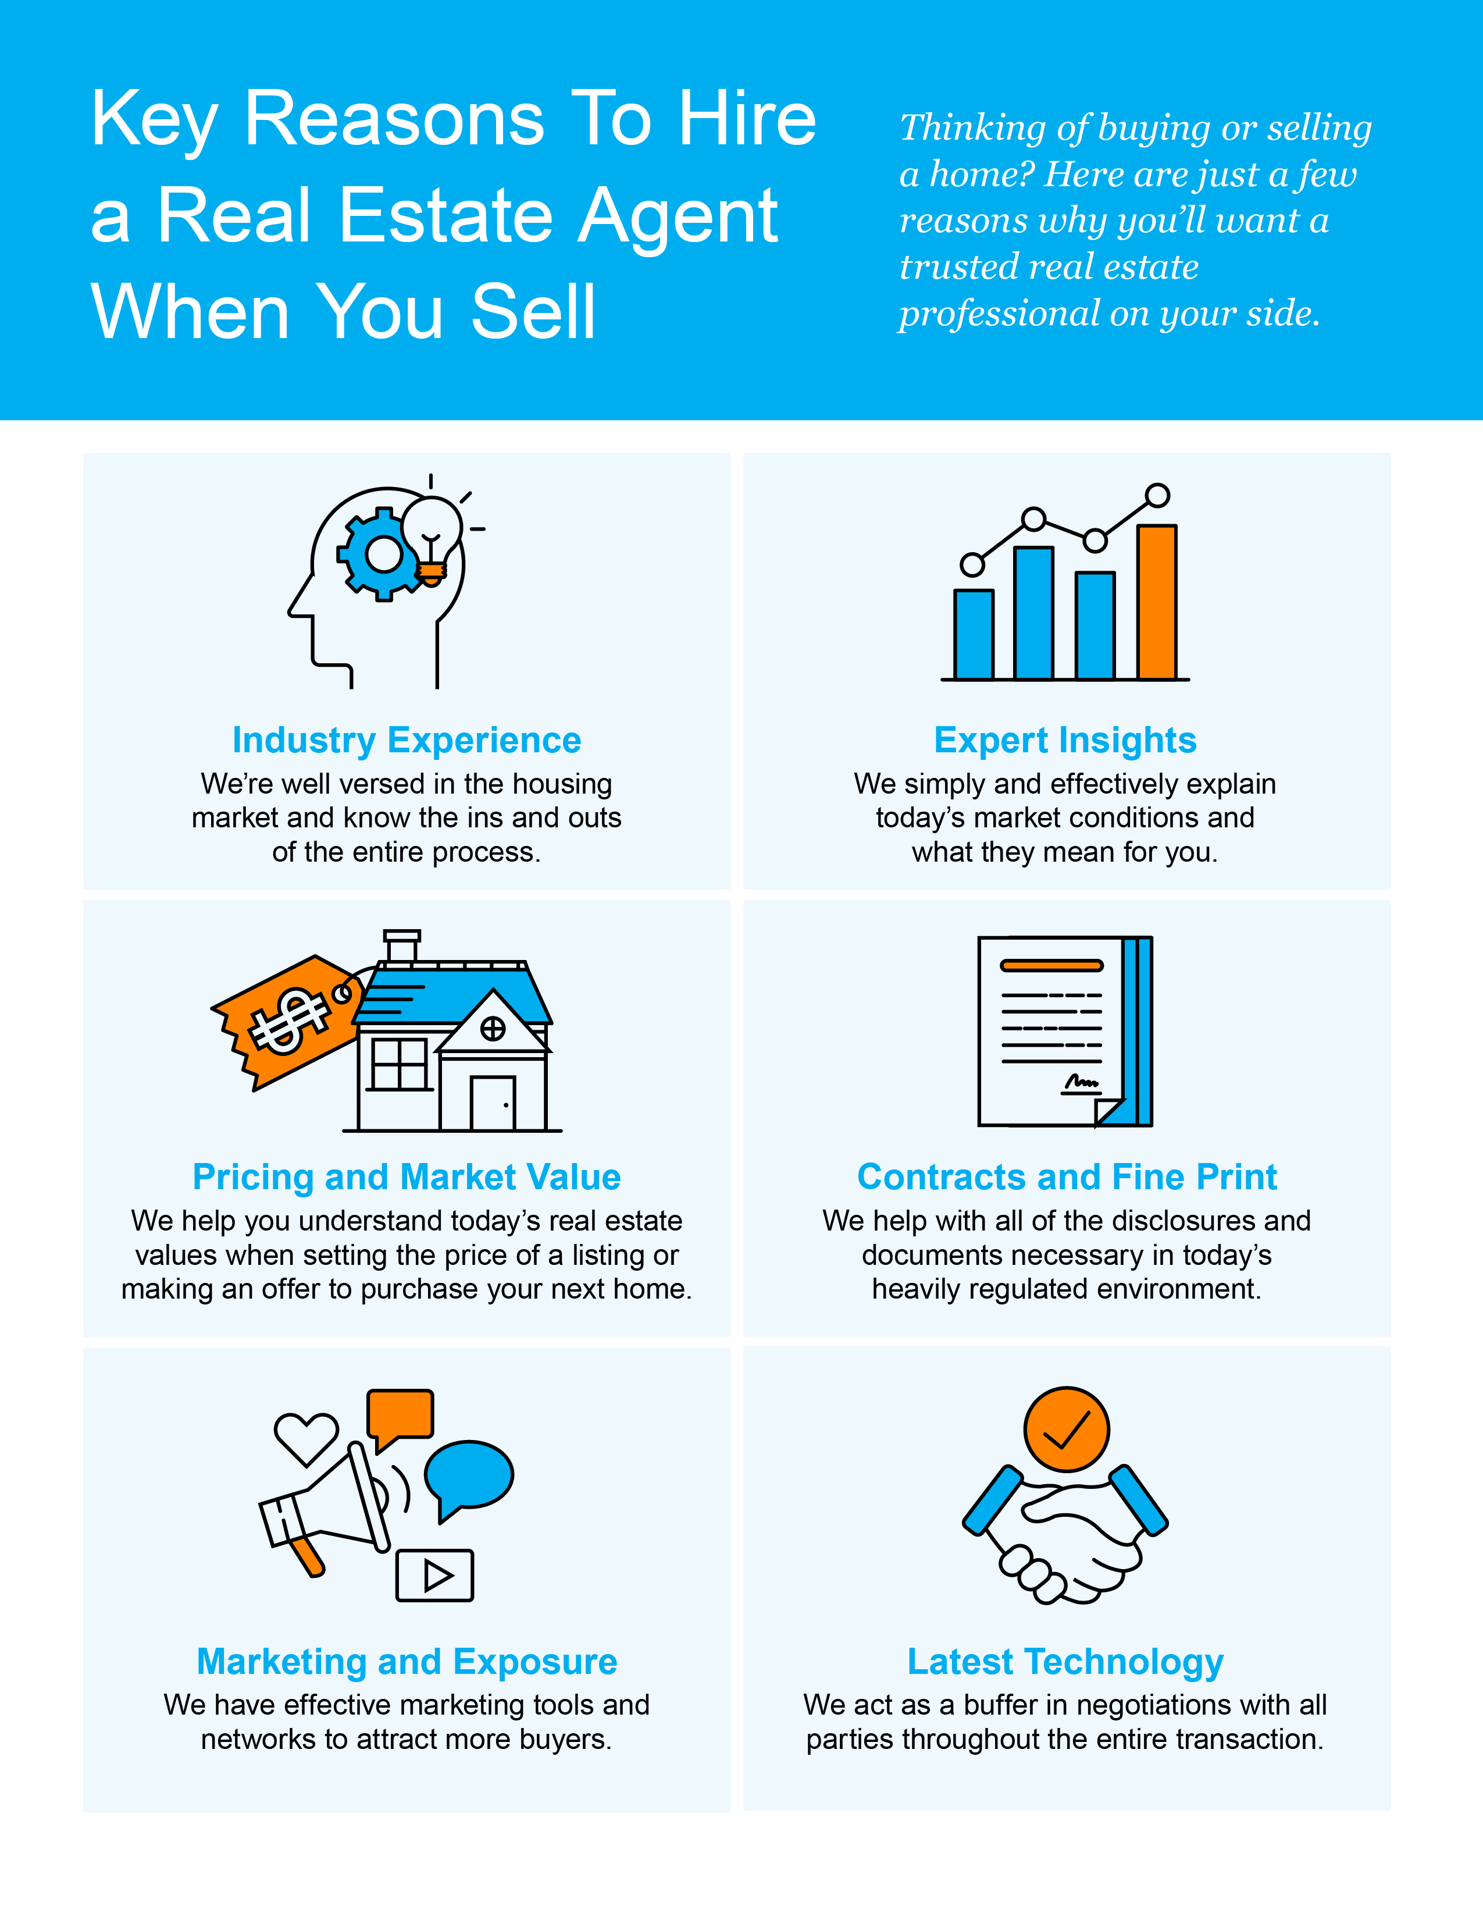

Slide 23
“Real estate agents help people buy and sell homes. Agents educate their clients about current market conditions, guide them through each step of the process and make referrals to other professionals, such as home stagers and real estate attorneys.”
- NerdWallet
Notes:
https://www.nerdwallet.com/article/mortgages/are-all-real-estate-agents-the-same-which-realtor-is-right-for-you

Slide 24
Let’s Chat.
I’m sure you have questions and thoughts about the real estate process.
I’d love to talk with you about what you’ve read here and help you on the path to selling your house. My contact information is below, and I look forward to working with you.
CRAIG LESCOE
Broker | Owner
C 734 . 722 . 7244
E craig@nrc.email
O www.craiglescoe.com
116 W Main St, Northville MI 48167
WINTER 2024 EDITION

