Slide 1


Things To Consider When
Buying a Home
FALL 2023
EDITION

Slide 2

Table of Contents
3 What’s Going On in the
Housing Market Right Now?
6 Top Reasons To Own Your Home
7 Two Questions To Ask Yourself if You’re Considering Buying a Home
9 The Impact of Changing Mortgage Rates
11 Homeownership Helps Protect You
From Inflation
12 Why Homeownership Wins in the
Long Run
15 Ways To Overcome Affordability Challenges in Today’s Housing Market
16 The Importance of Getting Pre-Approved
18 Things To Avoid After Applying
for a Mortgage
19 Tips for Making Your Best Offer
on a Home
21 Get Clarity on the Housing Market with Help from a Real Estate Expert

Slide 3
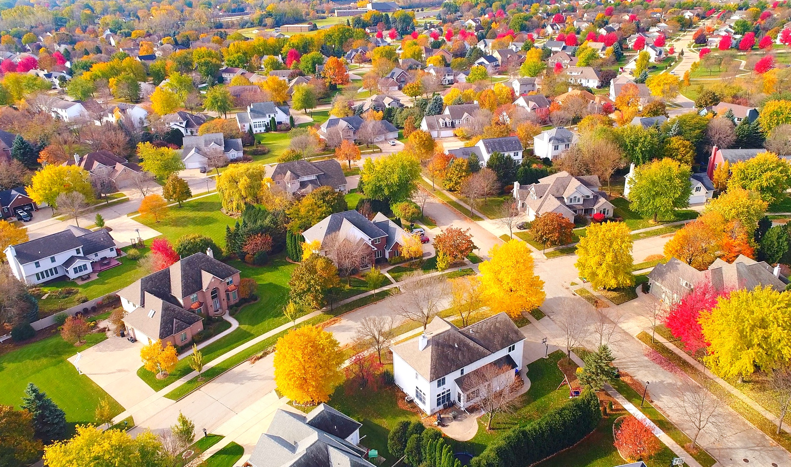
What’s Going On in the
Housing Market Right Now?
You’re probably wondering what the latest housing market news means for your homebuying plans this fall. Here are the three top things to remember.
1. There Aren’t Many Homes Available for Sale Right Now
Housing inventory is measured by the number of available homes on the market. It’s also measured by months’ supply, meaning the number of months it would take to sell all those available homes based on current demand. In a balanced market, there’s usually about a six-month supply – but today, we only have about half of that. With inventory that low, buyer competition is up, and that means many homes often receive multiple offers. Working with a professional can help you be more competitive in this kind of market.
2. Mortgage Rates Near 6% or 7% Are the New Normal
Mortgage rates more than doubled in the 2022 calendar year. That’s never happened before, and the rapid rise caused some buyers to delay their plans. But since last October, rates have settled a bit in roughly the 6% to 7% range.
It's time to understand rates around 6% or 7% are the new normal. The rates we experienced a few years ago, like 3%, are now a thing of the past.
Notes:
https://www.freddiemac.com/pmms

Slide 4
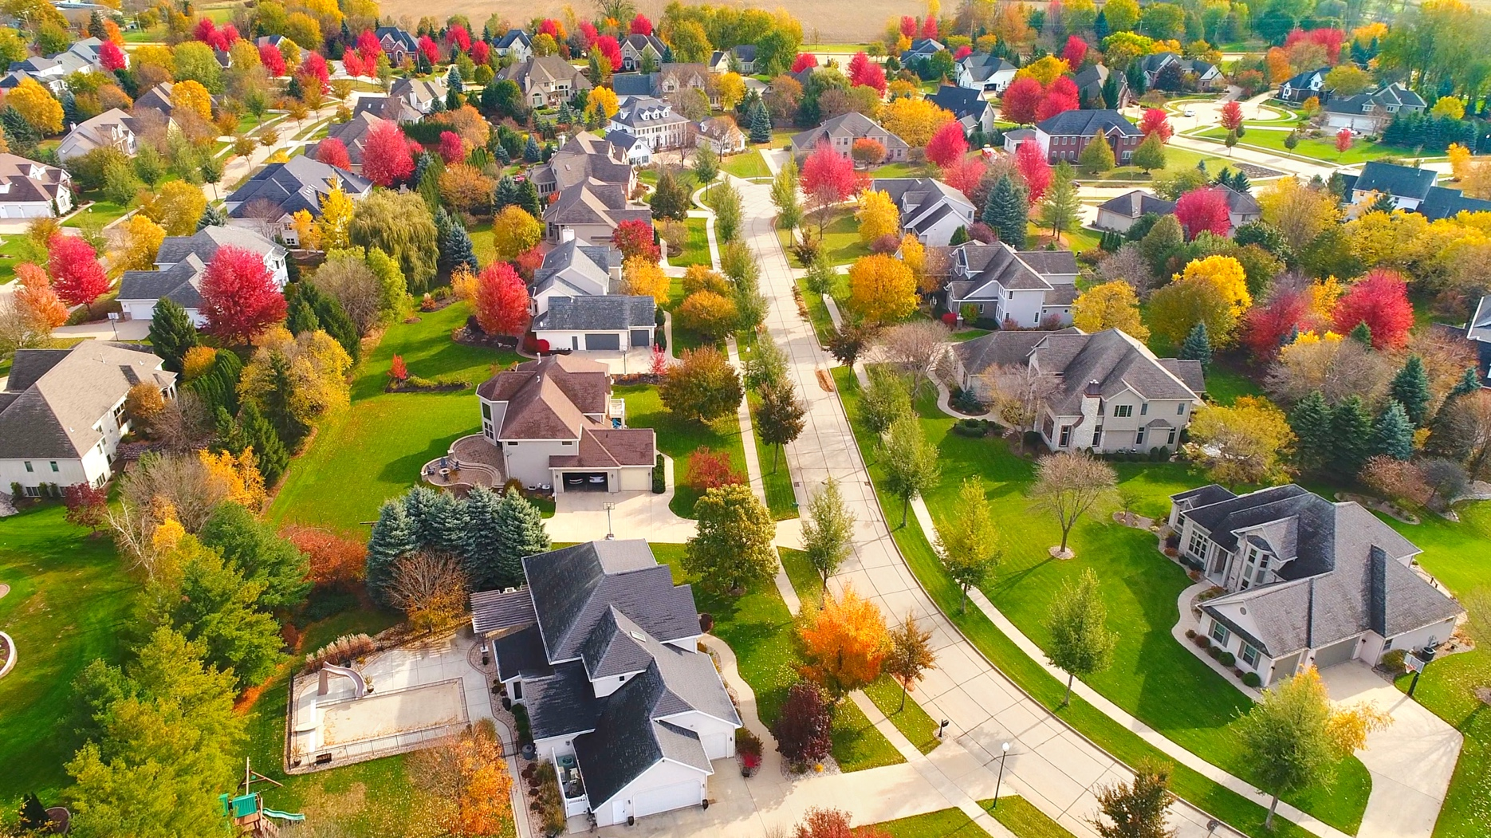
3. Home Prices Are Going Up Again
If you’re keeping up with the news, you might be uncertain about what’s happening with home prices and worried if things will get worse. Well know this, the worst home price declines are behind us and prices are appreciating nationally.
But it's important to know prices differ depending on where you live. Overall, low inventory and relatively strong buyer demand are going to keep upward pressure on prices. Doug Duncan, SVP and Chief Economist at Fannie Mae, says this about home prices right now:
“. . . housing prices continue to show stronger growth than what was previously expected . . . Housing’s performance is a testimony to the strength of demographic-related demand . . .”
So, with prices going up again, if you find a home that suits your needs, it’s probably not the best idea to wait.
Bottom Line Let’s connect so you have an expert to help with all your questions about the housing market. We’ll go over your goals and what’s happening in our area, giving you the knowledge to make a strong and confident decision.
Notes:
https://www.fanniemae.com/newsroom/fannie-mae-news/mixed-data-complicates-economic-forecast-though-recession-remains-likely

Slide 5


If you’re thinking about shopping for a home this fall, give yourself plenty of time to find a property, and then bring your
A-game to the negotiating table.
- NerdWallet
Notes:
https://www.nerdwallet.com/article/mortgages/buying-a-house-whats-changed

Slide 6


Slide 7
Two Questions To Ask Yourself if
You’re Considering Buying a Home
If you’re thinking of buying a home, chances are you’re paying attention to home prices and mortgage rates. Here are the top two questions you need to ask yourself – and what the data says – as you make your decision.
1. Where Do I Think Home Prices Are Heading?
One reliable place you can turn to for that information is the Home Price Expectation Survey from Pulsenomics – a survey of a national panel of over one hundred economists, real estate experts, and investment and market strategists.
According to the latest release, the experts surveyed are projecting between 2.17% and 4.18% appreciation every year for the next five years (see the graph below). The worst price declines are already behind us, and prices are appreciating again.
The green in the graph below shows prices are expected to keep appreciating this year and beyond.
Estimated Home Price Performance
December to December, as Forecasted in Q3 2023
Source: HPES
So, why does this matter to you? It means your home will likely grow in value and you should gain home equity in the years ahead, but only if you buy now. If you wait, based on these forecasts, the home will only cost you more later on.
Notes:
https://pulsenomics.com/surveys/#home-price-expectations

Slide 8
2. Where Do I Think Mortgage Rates Are Heading?
We know based on the latest reports that inflation has moderated from its peak. This is an encouraging sign for the market and for mortgage rates. Here’s why.
When inflation cools, mortgage rates generally fall in response. This may be why some experts are saying mortgage rates will pull back slightly over the next few quarters.
Mortgage Rate Projections
Quarter | Fannie Mae | MBA | NAR | Average of All Three
2023 Q4 | 6.70% | 6.20% | 6.30% | 6.40%
2024 Q1 | 6.50% | 5.90% | 6.10% | 6.17%
2024 Q2 | 6.30% | 5.60% | 6.00% | 5.97%
2024 Q3 | 6.20% | 5.30% | 6.00% | 5.83%
But not even the experts can say with absolute certainty where mortgage rates will be next year, or even next month. That’s because there are so many factors that can impact what happens. So, to give you a lens into the various possible outcomes, here’s what you should consider:
If you buy now and mortgage rates don’t change: You made a good move since home prices are projected to grow with time, so at least you beat rising prices.
If you buy now and mortgage rates fall (as projected): You probably still made a good decision because you got the house before home prices appreciated more. And you can always refinance your home later if rates are lower.
If you buy now and mortgage rates rise: You made a great decision because you bought before both the price of the home, and the mortgage rate went up.
Bottom Line If you want to buy a home, it's essential to stay informed on home prices and mortgage rates. Experts can provide helpful projections to guide you. Let's connect so you have an expert opinion on our local market.
Notes:
https://www.fanniemae.com/media/48726/display
https://www.mba.org/docs/default-source/research-and-forecasts/forecasts/2023/mortgage-finance-forecast-aug-2023.pdf
https://cdn.nar.realtor/sites/default/files/documents/forecast-q3-2023-us-economic-outlook-07-27-2023.pdf

Slide 9
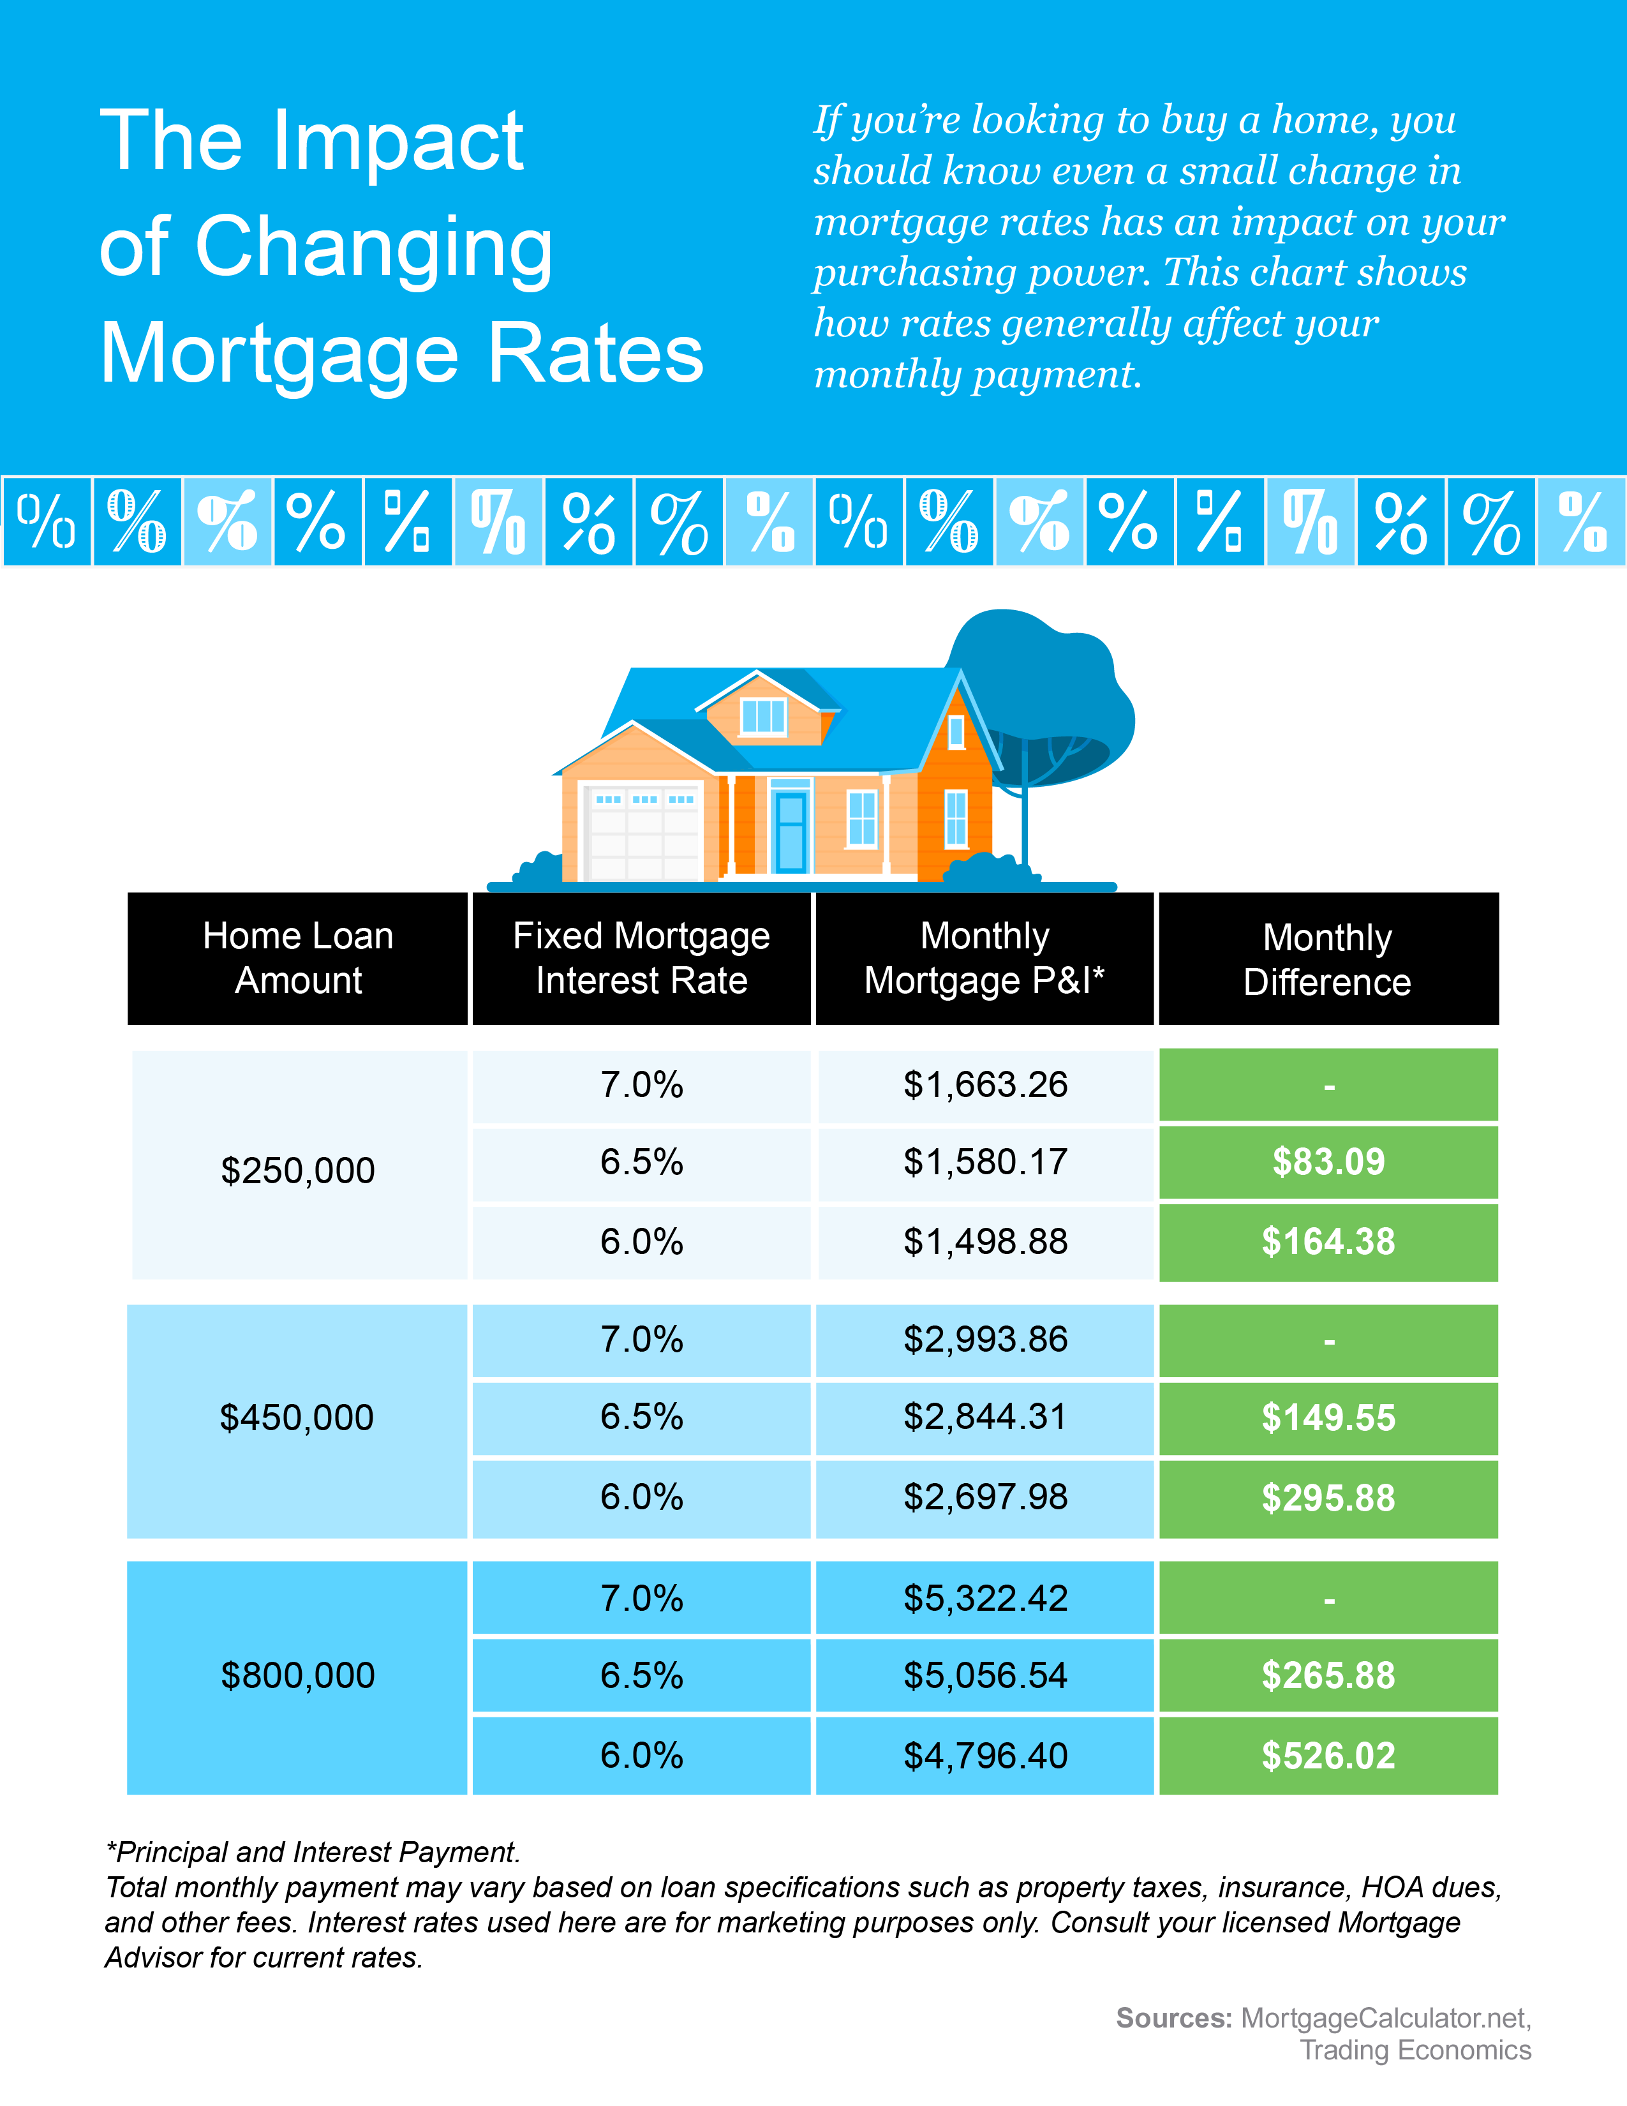
Notes:
https://www.mortgagecalculator.net/
https://tradingeconomics.com/united-states/average-mortgage-size

Slide 10

At the point where core inflation
gets better, mortgage rates will, too.
- Greg McBride, Chief Financial Analyst, Bankrate
Notes:
https://www.bankrate.com/mortgages/will-mortgage-rates-go-up-in-july-2023/

Slide 11
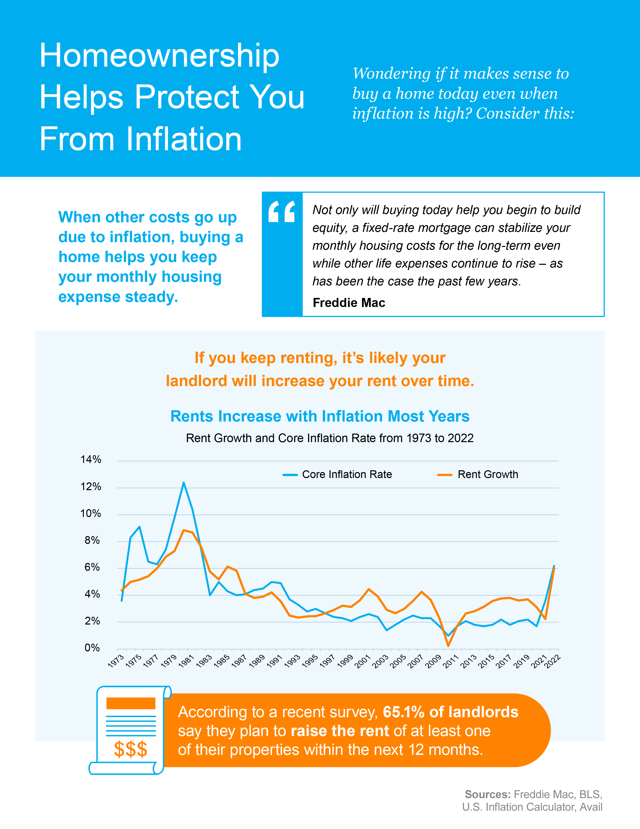
Notes:
https://myhome.freddiemac.com/blog/homebuying/should-inflation-change-your-homebuying-plans
https://fred.stlouisfed.org/series/CUUR0000SEHA#0
https://www.usinflationcalculator.com/inflation/united-states-core-inflation-rates/
https://www.avail.co/blog/avail-rental-report-landlords-aim-to-keep-rentals-occupied-while-renters-grapple-with-financial-challenges

Slide 12

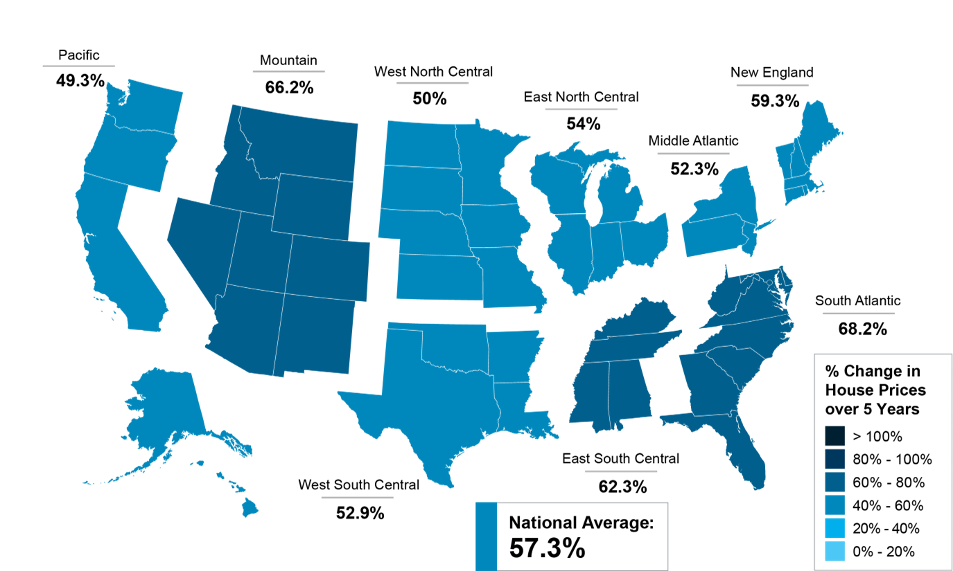
Why Homeownership
Wins in the Long Run
Before deciding if you’re going to buy a home right now, think about the advantages it can bring you in the long run.
If you ask current homeowners, you’d probably have a hard time finding someone who regrets their decision to buy a home. That’s because home values grow with time. Here’s a look at how home price appreciation can really add up over the years.
Home Price Growth over Time
The map below uses data from the Federal Housing Finance Agency (FHFA) to show home price gains over the last five years. The map is broken out regionally to convey larger market trends.
You can see home prices grew on average by about 57% nationwide in a five-year period. Different regions vary, but overall, home prices gained solid ground in a short time.
Percent Change in Home Prices
Over 5 Years, Q2 2023
Source: FHFA
Notes:
https://www.fhfa.gov/DataTools/Tools/Pages/House-Price-Index-(HPI).aspx

Slide 13
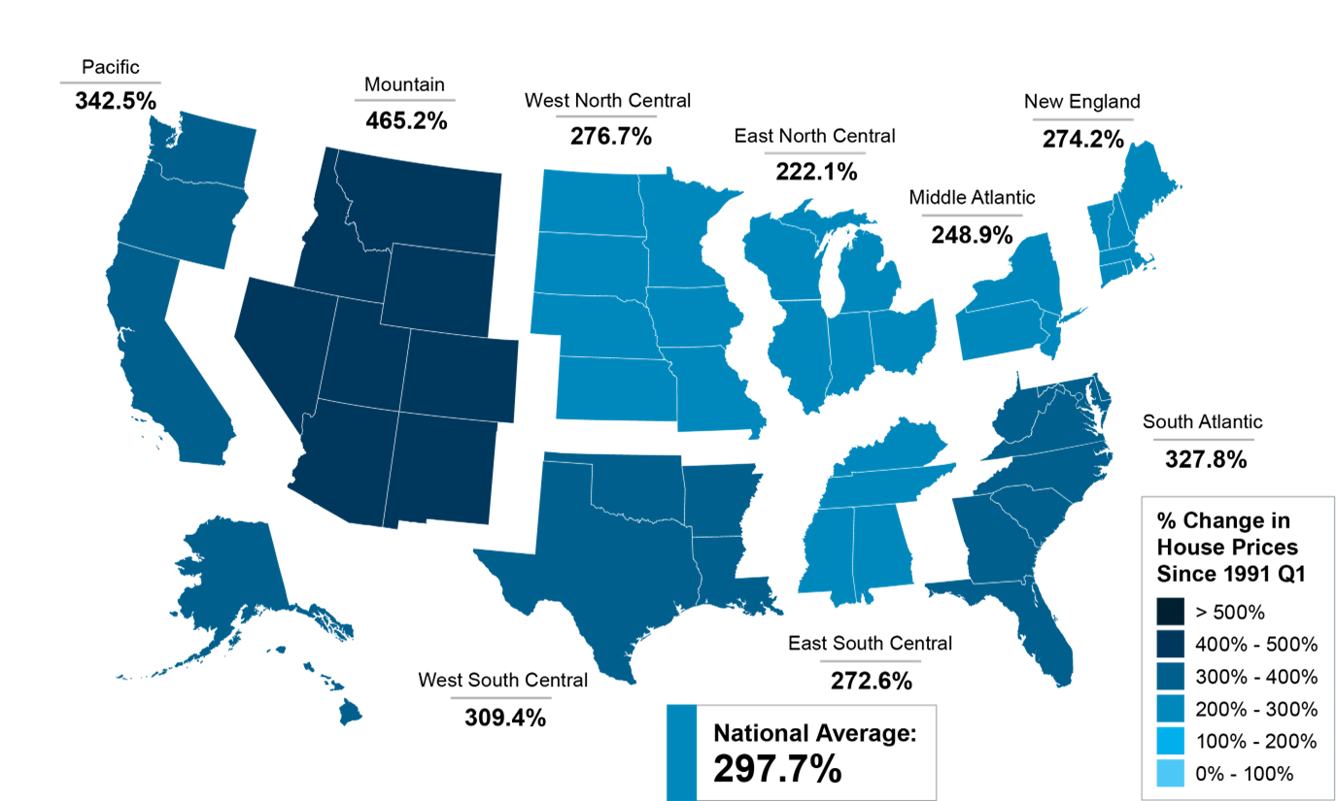
And if you expand that time frame even more, the benefit of homeownership and the drastic gains homeowners made over the years become even clearer (see map below):
The second map shows, nationwide, home prices appreciated by an average of over 297% over a roughly 30-year span.
This nationwide average tells you the typical homeowner who bought a house 30 years ago saw their home almost triple in value over that time. That’s a key factor in why so many homeowners who bought their homes years ago are still happy with their decision.
And while you may have heard talk in late 2022 that home prices would crash, it didn’t happen. Even though home prices have moderated from the record peak we saw during the ‘unicorn’ years, prices are already rebounding today. That means your home should grow in value over the next year.
Percent Change in Home Prices
Since Q1 1991, Q2 2023
Source: FHFA
Bottom Line Before you make up your mind about whether to buy a home this fall or not, remember the incredible long-term benefits of homeownership. If you’re ready to start the conversation, let’s connect today.
Notes:
https://www.fhfa.gov/DataTools/Tools/Pages/House-Price-Index-(HPI).aspx

Slide 14

. . . homeownership is a catalyst for building wealth for people from all walks of life. A monthly mortgage payment is often considered a forced savings account that helps homeowners build a net worth about 40 times higher than that of a renter.
- Lawrence Yun, Chief Economist, National Association of Realtors
Notes:
https://www.nar.realtor/magazine/real-estate-news/study-homeowner-wealth-is-40-times-higher-than-renters

Slide 15
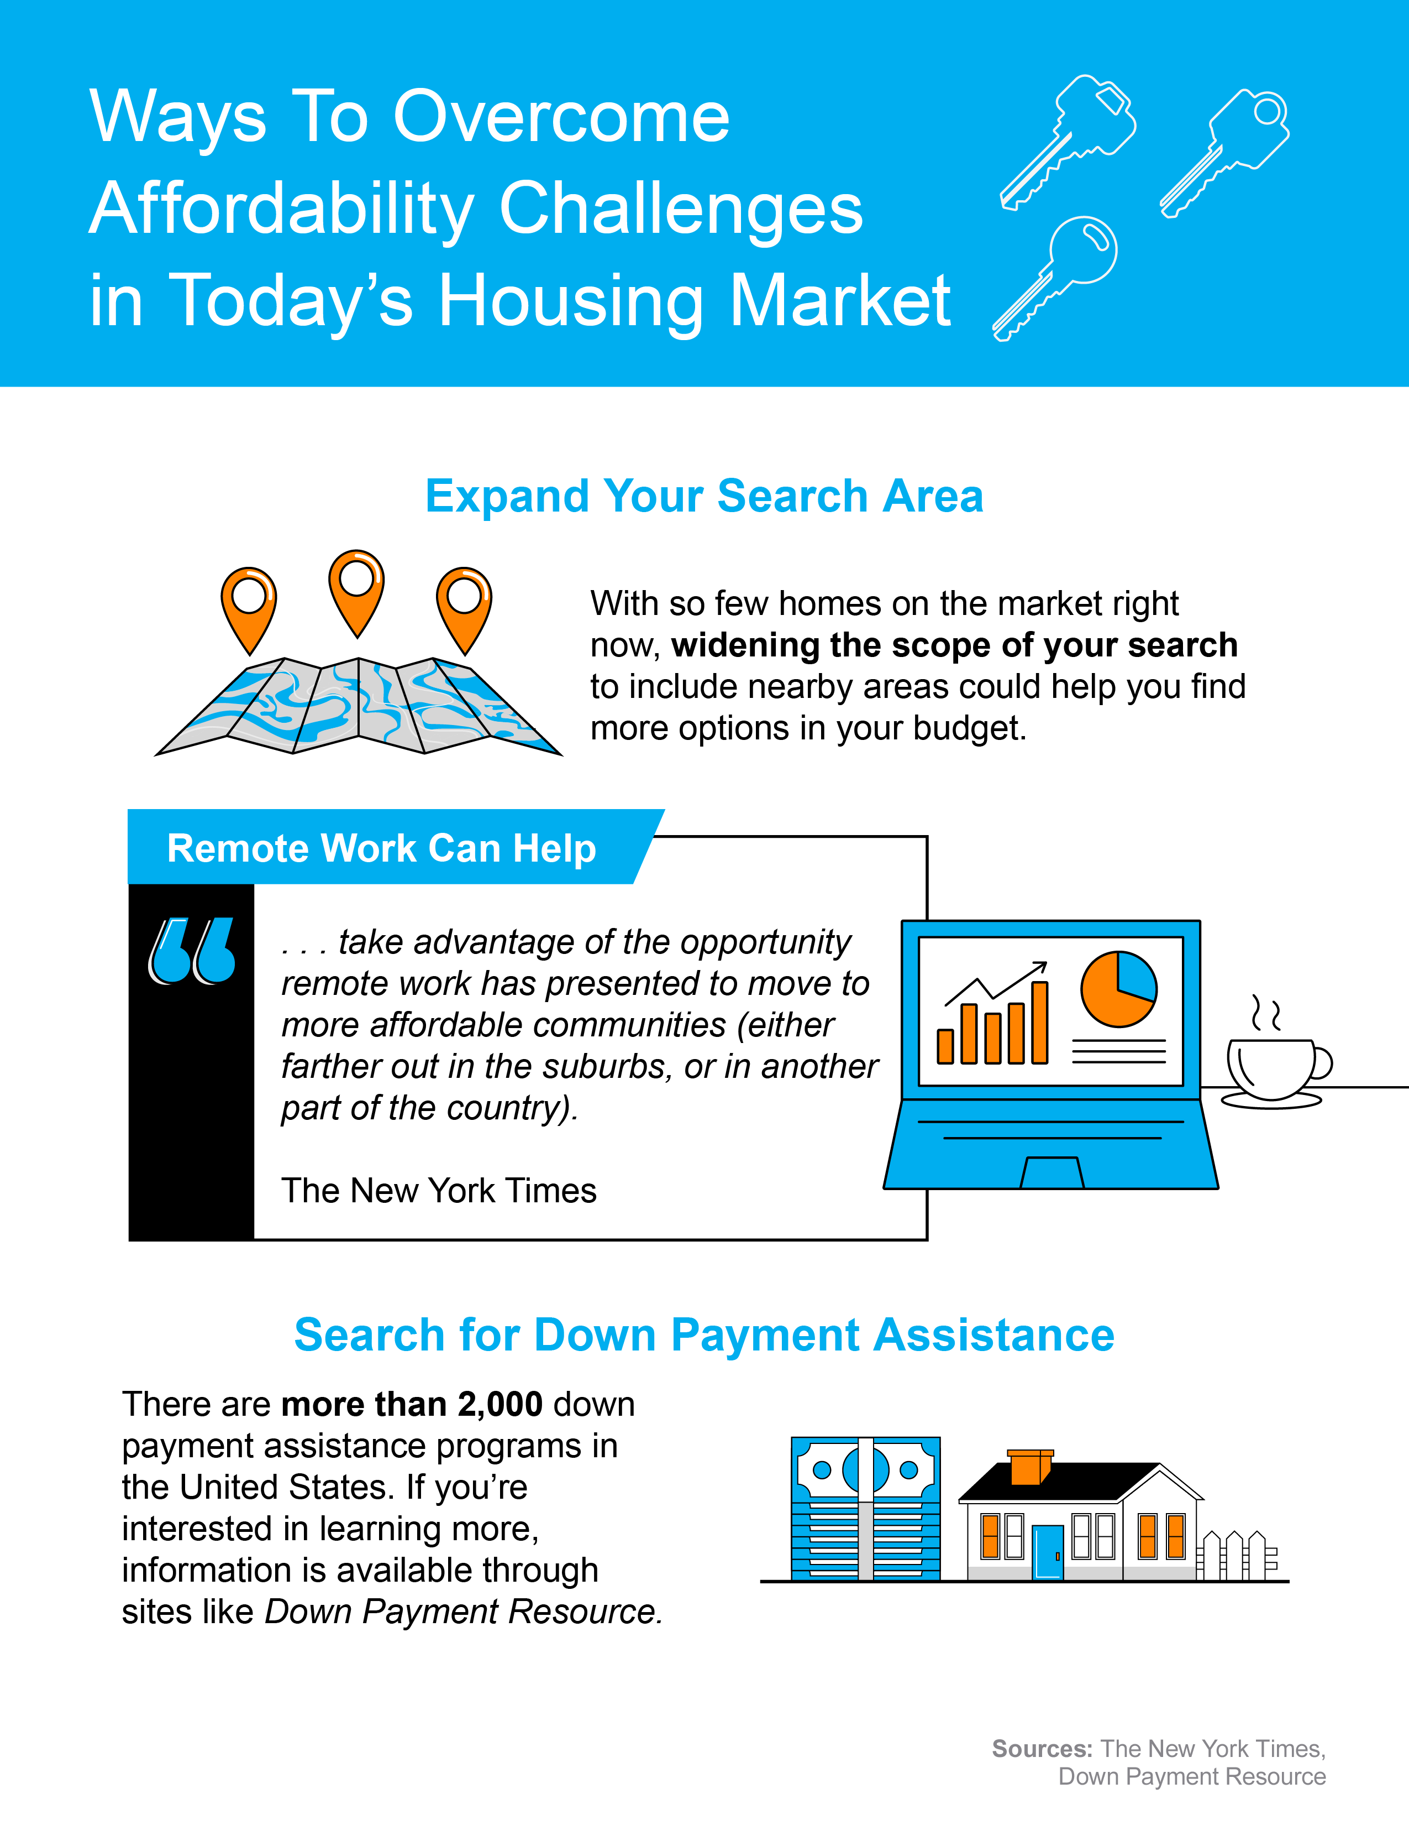
Notes:
https://www.nytimes.com/interactive/2023/06/17/upshot/17migration-patterns-movers.html
https://downpaymentresource.com/

Slide 16



The Importance of Getting
Pre-Approved
When you want to buy a home, one of the first things you need to do is get pre-approved. But why is this step so important? To find out, let's understand what pre-approval is and how it helps you.
What Is Pre-Approval?
Experian explains it like this:
“A mortgage preapproval is a document from a lender indicating you are conditionally approved for a mortgage loan—up to a specific amount—to buy a house. It usually specifies the type of loan you qualify for and the interest rate the lender would charge you upon completion of a full mortgage application.”
Basically, pre-approval gives you critical information about the homebuying process that’ll help you understand how much you may be able to borrow so you have a stronger grasp of your options.
How Does It Work?
As part of the pre-approval process,
a lender looks at your finances to decide what they’d be willing to loan you. From there, your lender will give you a pre-approval letter to help you understand how much money you can borrow.
That can make it easier when you set out to search for homes because you’ll know your overall numbers. And with higher mortgage rates impacting affordability for many buyers today, a solid understanding of your numbers is even more important.
Notes:
https://www.experian.com/blogs/ask-experian/how-long-does-a-mortgage-preapproval-last/

Slide 17

Pre-Approval Helps Show You’re a Serious Buyer
Pre-approval can help a seller feel more confident in your offer because it shows you’re serious about buying their house. And, with sellers seeing a slight increase in the number of offers, making a strong offer when you find the perfect house
is key.
A recent article from CNBC says:
  “A pre-approval letter shows that you can secure a mortgage. This alone gives you an advantage over potential buyers without pre-approval, especially in competitive markets where real estate agents and sellers can afford to be picky about with whom
  they work.”
Bottom Line Getting pre-approved is a big deal when you want to buy a home. It helps you figure out how much money you can borrow, and it also shows sellers you're serious about buying their house.
Notes:
https://www.cnbc.com/select/why-you-need-a-mortgage-pre-approval/

Slide 18
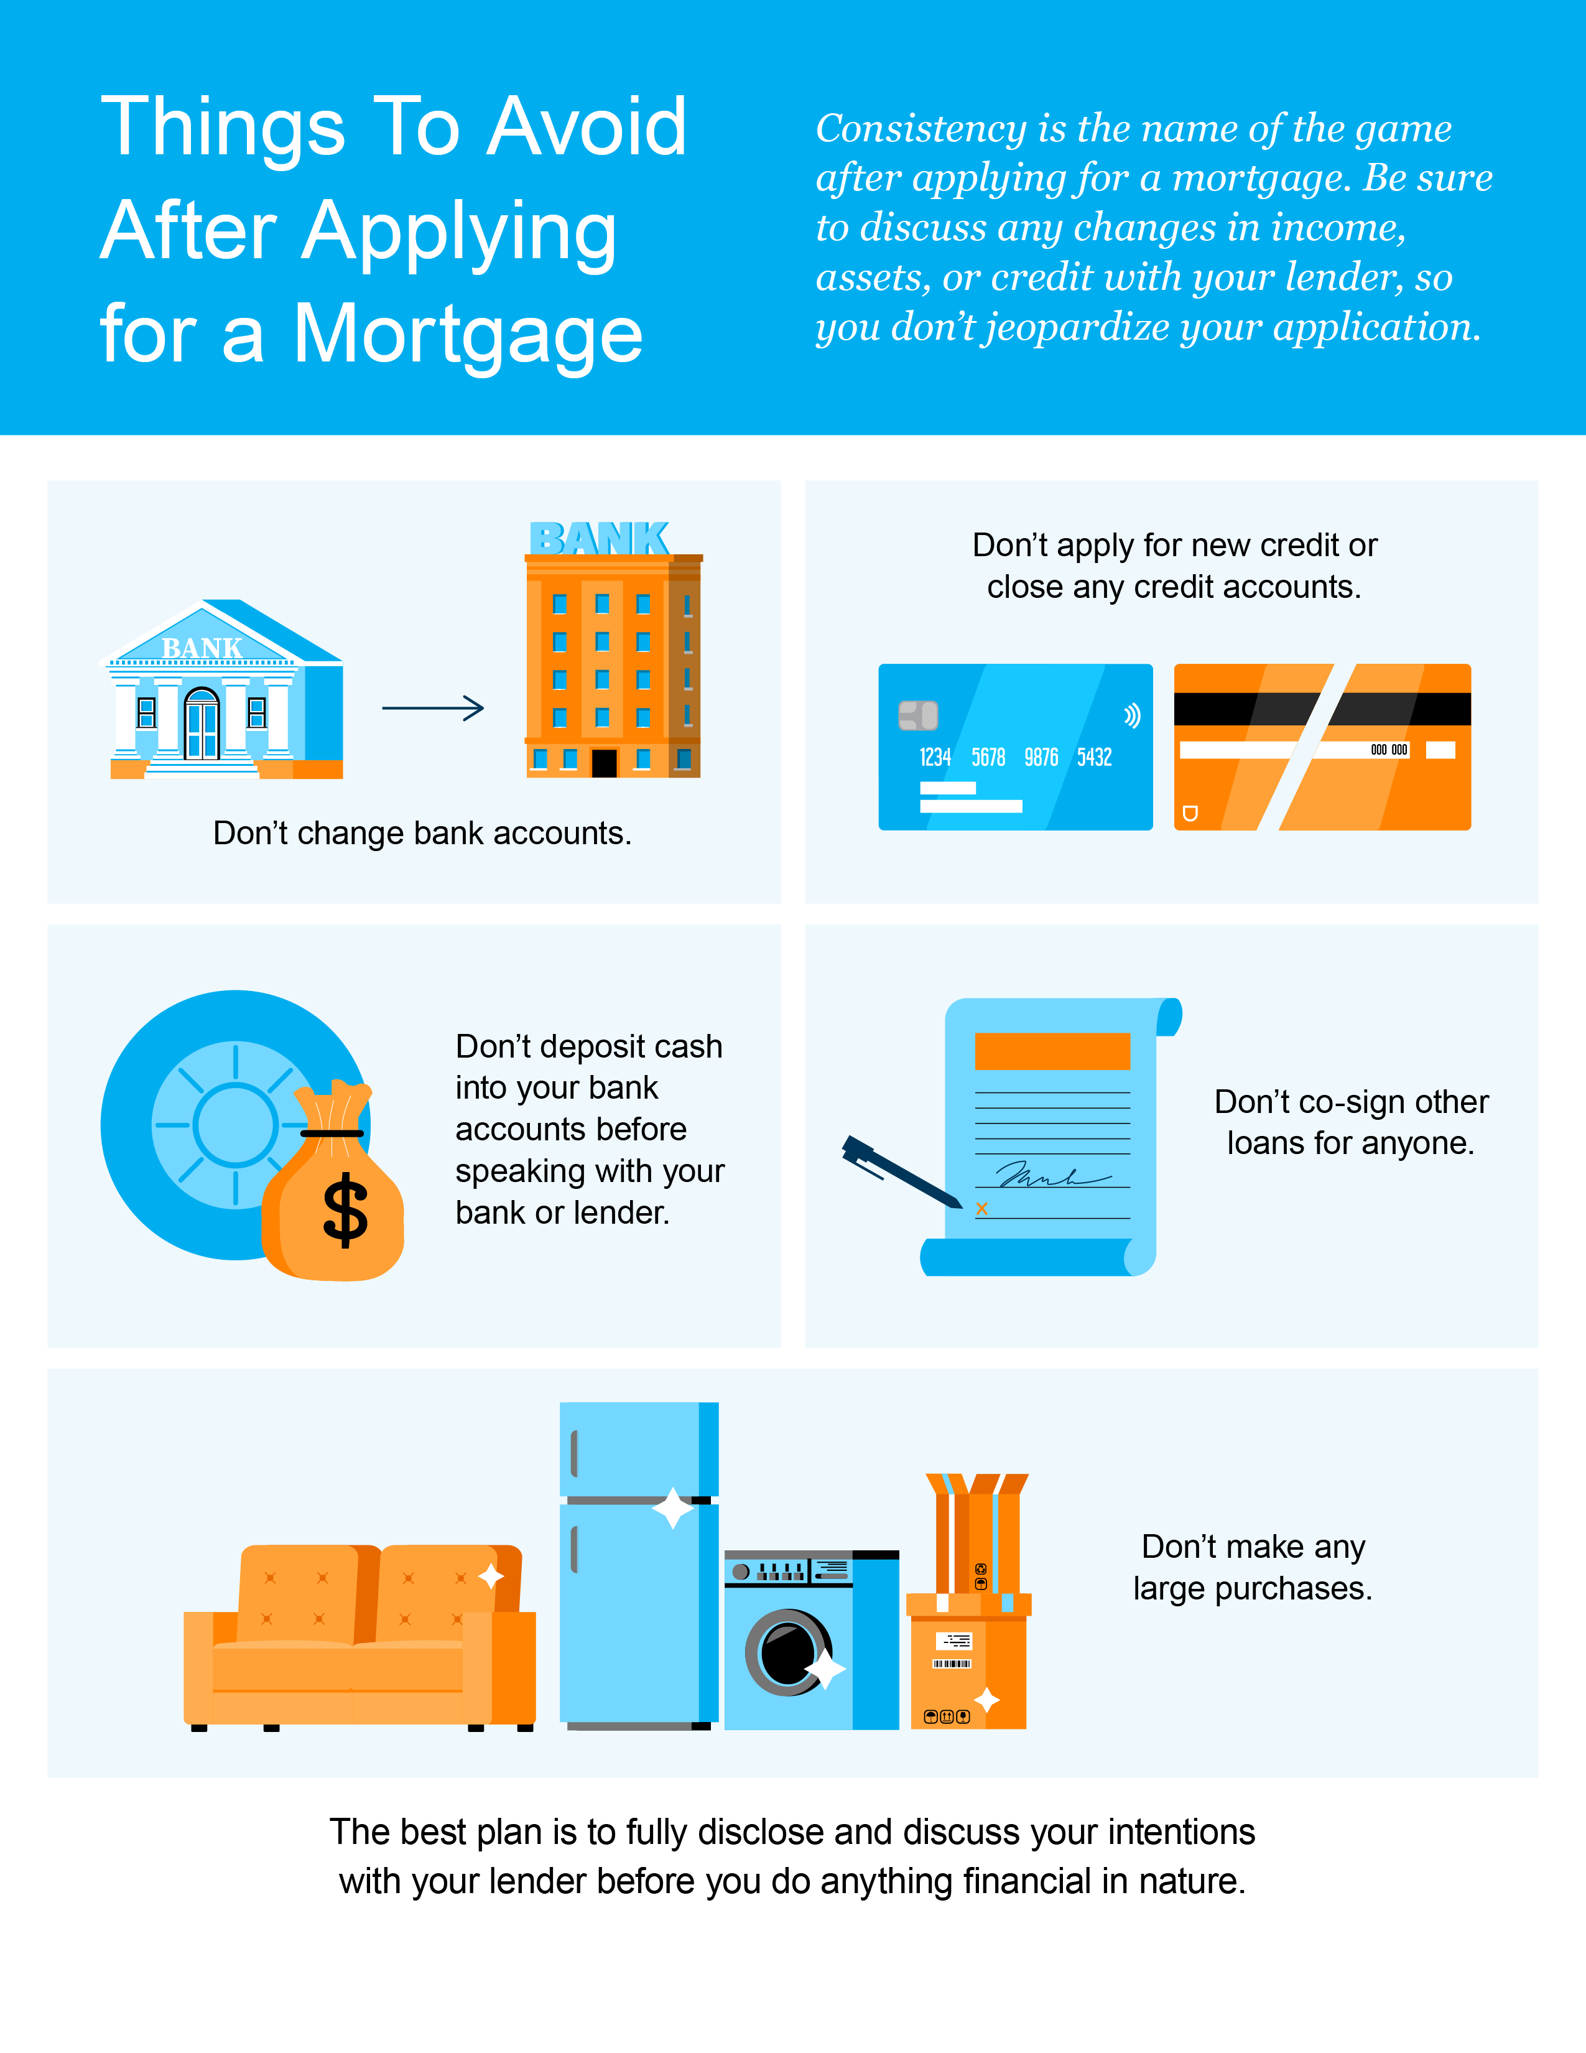

Slide 19

Tips for Making Your Best Offer
on a Home
Today’s market is still competitive in many areas because the supply of homes for sale is still low. If you're buying a home this fall, here are some tips to make a good offer.
1. Lean on a Real Estate Professional
Rely on an agent who can support your goals and help you understand what’s happening in today’s housing market. Agents are experts in the local market and on the national trends too. They’ll use both of those areas of expertise to make sure you have all the information you need to move with confidence.
Plus, they know what’s worked for other buyers in your area and what sellers may be looking for in an offer. It may seem simple, but catering to what a seller needs can help your offer stand out. As an article from Forbes says:
"Getting to know a local realtor where you’re hoping to buy can also potentially give you a crucial edge in a tight housing market.“
2. Get Pre-Approved for a Home Loan
Having a clear budget in mind is especially important right now given current affordability challenges. The best way to get a clear picture of what you can borrow is to work with a lender so you can get pre-approved for a home loan.
That’ll help you be more financially confident because you’ll have a better understanding of your numbers, and it shows sellers you’re serious too. And that can give you a competitive edge if you do get into a multiple offer scenario.
Notes:
https://www.forbes.com/advisor/mortgages/real-estate/housing-market-predictions/

Slide 20

3. Make a Fair Offer
It’s only natural to want the best deal you can get on a home. However, submitting an offer that’s too low does have some risks. You don’t want to make an offer that will be tossed out as soon as it’s received just to see if it sticks. As Realtor.com explains:
“. . . an offer price that’s significantly lower than the listing price, is often rejected by sellers who feel insulted . . . if a seller is offended by a buyer or isn’t taking the buyer seriously, there’s not much you, or the real estate agent, can do.”
The expertise your agent brings to this part of the process will help you stay competitive and find a price that’s fair to you and the seller.
4. Trust Your Agent’s Expertise Throughout Negotiations
Over the past few years, some buyers skipped home inspections or didn’t ask for concessions from the seller in order to submit the winning bid on a home. An article from Bankrate explains this isn’t happening as often today and that’s good news:
“It’s in the buyer’s best interest to have a home inspected . . . Inspections alert you to existing or potential problems with the home, giving you not just an early heads up but also a useful negotiating tactic.”
Fortunately, today’s market is different, and you may have more negotiating power than before. When putting together an offer, your trusted real estate advisor will help you think through what levers to pull and which ones you may not want to compromise on.
Bottom Line When you buy a home this fall, let’s connect so you have an expert on your side who can help you make your best offer.
Notes:
https://www.realtor.com/advice/buy/five-tips-successful-lowball-offer/
https://www.bankrate.com/real-estate/smart-way-to-waive-home-inspection/

Slide 21

Get Clarity on the Housing Market with Help from a Real Estate Expert
A real estate expert knows a lot about what's going on with home prices, the number of houses available, and what the experts predict. They use this knowledge to help you when you're buying a home.
Why You Want To Lean on a Trusted Professional
Jay Thompson, Real Estate Industry Consultant, explains:
“Housing market headlines are everywhere. Many are quite sensational, ending with exclamation points or predicting impending doom for the industry. Clickbait, the sensationalizing of headlines and content, has been an issue since the dawn of the internet, and housing news is not immune to it.”
Unfortunately, when information in the media isn’t clear, it can generate a lot of fear and uncertainty in the market. As Jason Lewris, Co-Founder and Chief Data Officer at Parcl, says:
“In the absence of trustworthy, up-to-date information, real estate decisions are increasingly being driven by fear, uncertainty, and doubt.”
Notes:
https://www.realestatenews.com/2022/11/18/agents-decoded-making-sense-of-the-headlines
https://www.parcllabs.com/articles/q3-real-estate

Slide 22

But it doesn’t have to be that way. Buying a home is a big decision, and it should be one you feel confident making. You can lean on an expert to help you separate fact from fiction and get the answers
you need.
The right agent can help you understand what’s happening at the national and local levels.
Plus, they can debunk the headlines using data you can trust. Experts have in-depth knowledge of the industry and can provide context, so you know how current trends compare to the normal ebbs and flows in the industry, historical data, and more.
Then, in order to ensure you understand everything completely, an agent can inform you whether your local area is following the national trend, or if they’re noticing something distinct in your market. Together, you can use all that information to make the best possible decision.
After all, making a move is a potentially life-changing milestone. It should be something you feel ready for and excited about. And that’s where a trusted guide comes in.
Bottom Line If you want to get the best advice and stay updated on what's happening in the housing market, let's connect.

Slide 23

“A buyer’s agent will have your back in negotiations and can help you make an appropriately competitive offer on a home.
- Bankrate
Notes:
https://www.bankrate.com/real-estate/should-i-buy-house-without-realtor/

Slide 24


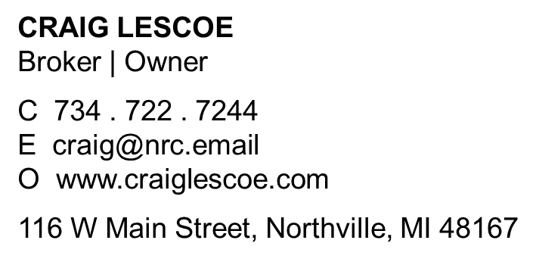


Let’s Chat.
I’m sure you have questions and thoughts about the
real estate process.
I’d love to talk with you about what you’ve read here and help you on the path to buying your new home. My contact information is below, and I look forward to working with you.
FALL 2023 EDITION

