Slide 1
Things To Consider When
Selling Your House
SUMMER 2023
EDITION

Slide 2
Table of Contents
3 Should I Sell My House This Summer?
6 The Big Advantage If You Sell Now
8 The Worst Home Price Declines Are Behind Us
10 Two Reasons You Should Sell Your House
12 A Checklist for Selling Your House
14 Want To Sell Your House This Summer? Price It Right.
17 Leverage Your Equity When You Sell
20 Reasons To Hire a Real Estate Professional
21 An Expert Makes All the Difference When You Sell

Slide 3
Should I Sell My House This Summer?
With everything going on in the housing market lately, you may have some questions about selling your house. Here are a few things you may be wondering about, and the answers to help you make a confident, informed decision.
1. Should I Wait To Sell?
The supply of homes for sale is still low, so we’re still in a sellers’ market today (see graph below). Selling while inventory is this low means if you price your house right, it is likely to be in high demand. The graph below puts today’s inventory into perspective.
Months’ Inventory of Homes for Sale
2008
2010
Buyers’
Market
(> 7 Months)
2007
2006
Neutral Market (6-7 Months)
1999
Sellers’
Market
(< 6 Months)
Today
Source: NAR
Notes:
https://cdn.nar.realtor/sites/default/files/documents/ehs-04-2023-overview-2023-05-18.pdf

Slide 4
2. Are Buyers Still Out There?
If you’re thinking of selling your house but worry people aren’t buying homes with mortgage rates higher than they were during the pandemic, you should know that isn’t the case for everyone. Lawrence Yun, Chief Economist at the National Association of Realtors (NAR), explains:
“Inventory levels are still at historic lows. Consequently, multiple offers are returning on a good number of properties.”
There are more buyers out there than there are available homes on the market. And your house may be just what they’re looking for.
3. Can I Still Get a Good Price for My House?
Nationally, home prices have come down a bit since their peak last summer, but recent data shows that home prices appear to have bottomed out and are now on the rise again in much of the country. And while prices vary by market, experts at the national level project they’ll rise and return to more normal, pre-pandemic levels of appreciation – around 4% per year – after 2023.
So, even though the average home isn’t growing in value as fast as it did a year ago, you can still sell with confidence this season.
Bottom Line If you’re thinking about selling your house this summer, let’s connect so you have the expert insights you need to make the best possible move today.
Notes:
https://www.cnn.com/2023/03/21/homes/existing-home-sales-february/index.html

Slide 5
Housing markets have cooled slightly, but demand hasn’t disappeared, and in many places remains strong largely due to the shortage of homes on the market.
- U.S. News
Notes:
https://realestate.usnews.com/real-estate/articles/when-will-the-housing-market-crash

Slide 6
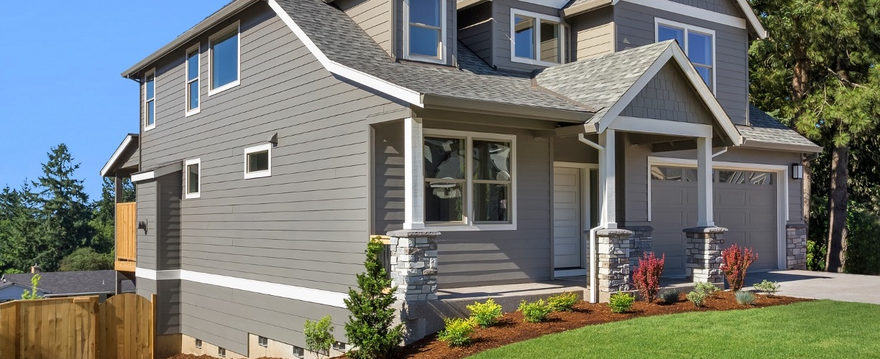
The Big Advantage If You Sell Now
Thinking about selling your house? If you’ve been waiting for the right time, it could be now while the supply of homes for sale is so low.
The National Association of Realtors (NAR) confirms today’s housing inventory is low by looking at the months’ supply of homes on the market. Months’ supply means the number of months it would take the current inventory of homes on the market to sell at the current sales pace. In a balanced market, about a six-month supply is needed. Anything lower is a sellers’ market. And today, the number is much lower.
Why Does Low Inventory Make It a Good Time To Sell?
The less inventory there is on the market when you sell, the less competition you’re likely to face from other sellers. That means your house will get more attention from the buyers looking for a home this summer. And since there are significantly more buyers in the market than there are homes for sale, you could even receive more than one offer on your house (see graph below):
Average Number of Offers Received on the Most Recent Closed Sale
3.1
Offers
Source: NAR
Notes:
https://cdn.nar.realtor//sites/default/files/documents/2023-04-realtors-confidence-index-05-18-2023.pdf

Slide 7
If you get more than one offer on your house, it becomes a bidding war between buyers – and that means you have greater leverage to sell on your terms. But if you want to maximize the opportunity for a bidding war to spark, be sure to lean on your expert real estate advisor. While we’re still in a strong sellers’ market, it isn’t the frenzy we saw a couple of years ago, and today’s buyers are focused on the houses with the greatest appeal. Clare Trapasso, Executive News Editor at Realtor.com, explains:
“Well-priced, move-in ready homes with curb appeal in desirable areas are still receiving multiple offers and selling for over the asking price in many parts of the country. So . . . it’s especially important for sellers to make their homes as attractive as possible to appeal to as many buyers as possible.”
Bottom Line If you’ve been waiting for the right time to sell your house, low inventory this summer sets you up with a big advantage. Let’s connect to make sure your house is ready to sell.
Notes:
https://news.move.com/2023-03-30-Realtor-com-R-March-Housing-Report-Spring-Thaw-Lures-Buyers-Back-into-the-Housing-Market

Slide 8
The Worst Home Price Declines Are Behind Us
If you’re following the news today, you may feel a bit unsure about what’s happening with home prices and fear whether or not the worst is yet to come. Local home price trends still vary by market, but here’s what the national data tells us.
Today’s headlines are painting an unnecessarily negative picture of home prices. Contrary to those headlines, home prices aren’t in a freefall. The latest data tells a very different and much more positive story.
The monthly graphs below use recent reports from three sources to show the worst home price declines are already behind us, and prices are on their way back up nationally.
Home Prices Are Stabilizing
Month-Over-Month Percent Change in Home Values (Seasonally Adjusted)
Case-Shiller
Jul
Aug
Sep
Oct
Nov
Dec
Jan 23
FHFA
Jul
Aug
Nov
Dec
CoreLogic
Jul
Aug
Sep
Oct
Nov
Dec
Jan 23
Notes:
https://www.spglobal.com/spdji/en/indices/indicators/sp-corelogic-case-shiller-us-national-home-price-nsa-index/#news-research
https://www.fhfa.gov/DataTools/Downloads/Pages/House-Price-Index.aspx
https://www.corelogic.com/category/intelligence/reports/home-price-insights/

Slide 9
The story this detailed monthly view tells us is that the last year has been a tale of two halves. In the first half of 2022, homes prices were climbing, and they peaked in June. Then, in July, home prices started to decline (shown in red in the graphs on the previous page). And by roughly August or September, the trend began to stabilize. As we look at the most recent data for the early part of 2023, these graphs also show a recent rebound in momentum with prices ticking back up. Monthly changes in home prices are gaining steam.
While one to two months doesn’t make a trend, the fact that all three reports show prices have stabilized is an encouraging sign for the housing market. The month-over-month data conveys a clear, but early, consensus that a national shift is taking place today.
In essence, home prices are starting to tick back up.
Andy Walden, Vice President of Enterprise Research at Black Knight, says this about home price trends:
“Just five months ago, prices were declining on a seasonally adjusted month-over-month basis in 92% of all major U.S. markets. Fast forward to March, and the situation has done a literal 180, with prices now rising in 92% of markets from February.”
Selma Hepp, Chief Economist at CoreLogic, explains the limited supply of homes available for sale is contributing to this positive turn:
“. . . prices in many large metros appeared to have turned the corner, with the U.S. recording a second month of consecutive monthly gains. . . . The monthly rebound in home prices underscores the lack of inventory in this housing cycle.”
Here’s What This Means for You
If you’ve been holding off on selling because you’re worried about what was happening with home prices and how it would impact the value of your home, it may be time to jump back in and reprioritize getting your house on the market. You don’t have to put your needs on hold any longer because the latest data shows a turn in your favor.
Bottom Line If you put off your plans to move because you were worried about home prices falling, data shows the worst is already behind us and prices are actually rising nationally. Let’s connect so you have an expert to explain what’s happening with home prices in our area.
Notes:
https://www.prnewswire.com/news-releases/black-knight-home-prices-up-again-in-march-on-worsening-inventory-shortages-and-modest-rise-in-demand-301814349.html
https://www.corelogic.com/intelligence/us-home-price-insights-may-2023/

Slide 10
Two Reasons You Should Sell Your House
Wondering if you should sell your house this year? As you make your decision, think about what’s motivating you to consider moving.
A recent survey from Realtor.com asked why homeowners are thinking about selling their houses this year. Here are the top two reasons (see graphic below):
Let’s break those reasons down and explore how they might resonate with you.
33%
32%
I want to take advantage of the current market; I think I can make a profit
My home no longer meets the needs of my family (space, features, location)
Notes:
https://www.realtor.com/research/2023-q1-sellers-survey/

Slide 11
1. I Want To Take Advantage of the Current Market and Make a Profit
When you decide to sell your house, how much you’ll make from the sale will likely be top of mind. So, here’s some good news: according to the latest data, the average seller can expect a strong return on their investment when they make a move. ATTOM explains:
“The $112,000 profit on median-priced home sales in 2022 represented a 51.4% return on investment compared to the original purchase price, up from 44.6% last year and from 32.8% in 2020.”
Even though home prices have declined slightly in some markets, they’re still much higher overall than they were just a few years ago.
2. My Home No Longer Meets My Needs
The average person has been in their house for ten years. That’s a long time when you think about how much may have changed in your life since you moved in. And typically, those changes have a direct impact on what you need in a home. Whether it’s more (or less) space, different features, or a location closer to your work or loved ones, your current house may no longer check all the boxes of what feels like home to you. If that’s the case, it could be time to work with a real estate agent to find a better fit.
Bottom Line If you’re thinking about selling your house, there’s probably a good reason for it. Let’s connect so you can make a move that’ll help you accomplish your goals this year.
Notes:
https://www.attomdata.com/hnr/us-home-seller-profits-top-50-percent-in-2022-despite-market-slowdown/

Slide 12
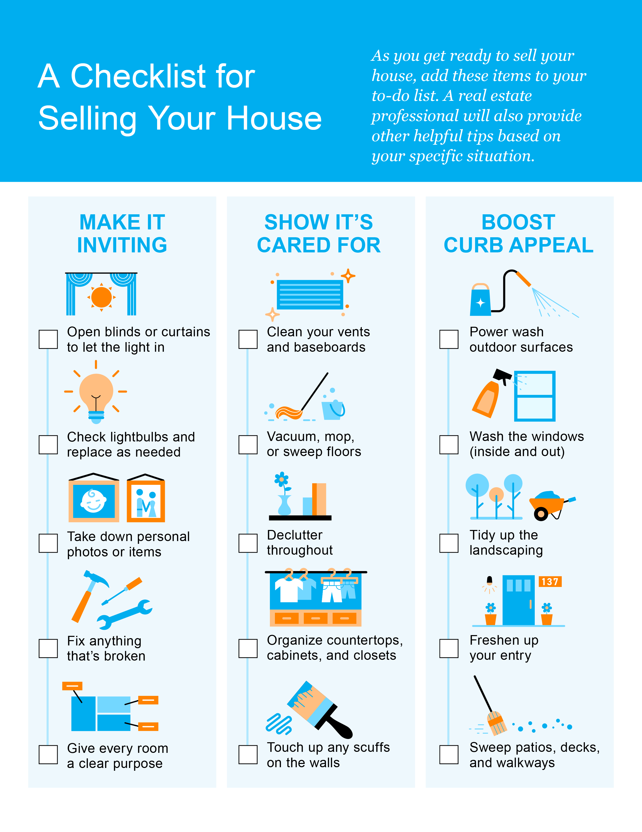

Slide 13
Curb-appeal projects make the property look good as soon as prospective buyers arrive. While these projects may not add a considerable amount of monetary value, they will help you home sell faster–and you can do a lot of the work yourself to save money and time.
- Investopedia
Notes:
https://www.investopedia.com/investing/types-home-renovation-which-ones-boost-value/

Slide 14
Want To Sell Your House This Summer? Price It Right.
Pricing your house right is especially important right now. If you’re thinking of selling your house this summer, you need to have an accurate understanding of how much you should expect to sell for.
Over the last year, the housing market’s gone through significant change. While it’s still a sellers’ market, homes that are priced right are selling, and they get the most attention from buyers right now. If you’re thinking of selling soon, it’s important to lean on your expert real estate advisor when it comes to setting a list price.
In today’s market, how you price your house will not only make a big difference to your bottom line, but to how quickly your house will sell.
Why Pricing Your House Right Matters
Your asking price sends a message to potential buyers, especially today.
If your house is priced too low, you may leave money on the table or discourage buyers who may see a lower-than-expected price tag and wonder if that means something is wrong with the home.

Slide 15
If it’s priced too high, you run the risk of deterring buyers. When that happens, you may have to lower the price to drive interest when your house sits on the market for a while. But be aware that a price drop can be seen as a red flag by some buyers who will wonder what it means about the home.
To avoid either headache, price it right from the start. A real estate professional knows how to determine the ideal asking price. They balance the value of homes in your neighborhood, current market trends, buyer demand, the condition of your house, and more to find the right price. This helps lead to stronger offers and a greater likelihood your house will sell quickly.
The visual below helps summarize the impact your asking price can have:
Bottom Line Homes priced at the current market value are selling faster, at a better price, and with less hassle right now. To make sure you price your house appropriately, maximize your sales potential, and minimize your hassle, let’s connect.

Slide 16
. . . sellers who price and market their home competitively shouldn’t have a problem finding a buyer.
- Jeff Tucker, Senior Economist, Zillow
Notes:
https://www.forbes.com/sites/brendarichardson/2023/02/16/expect-the-spring-housing-market-to-be-calm-but-competitive/?sh=6fc73d8357bd

Slide 17
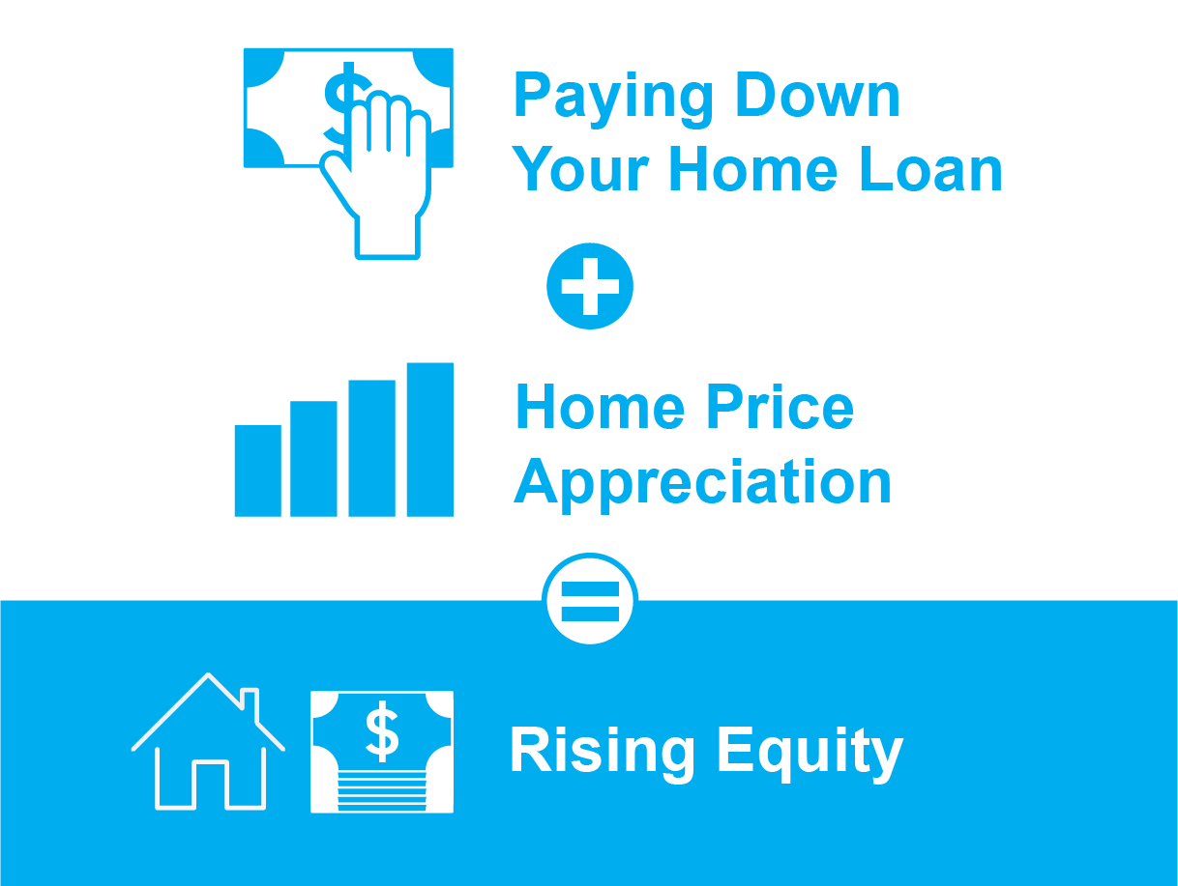
Leverage Your Equity When You Sell
One of the benefits of selling your house is that you can use the equity you’ve built to power your move. Here’s how it works.
By selling your house, your equity can be used toward purchasing your next home. But before you can put it to use, you should understand exactly what equity is and how it grows.
What Is Home Equity?
Equity is the current value of your home minus what you owe on the loan.
Over time, you build equity as you make your monthly mortgage payments and as home prices appreciate. It works like this:

Slide 18
Majority of Americans Have a Large Amount of Equity
If you’ve owned your home for a while, you’ve likely built up some equity – and you may not even realize how much. Based on data from the U.S. Census Bureau and ATTOM, the majority of Americans have a substantial amount of equity right now (see graph below):
Americans Sitting on Tremendous Equity
67.7% Have Paid Off Their Mortgage or Have at Least 50% Equity
Source: Census, ATTOM
And having such large amounts of equity is a benefit to homeowners in more ways than one. Rick Sharga, Founder and CEO at CJ Patrick Company, explains:
“Record levels of home equity provide security for millions of families, and minimize the chance of another housing market crash like the one we saw in 2008.”
Over time, your home equity grows. In addition to providing financial stability while you own your house, when you’re ready to sell it, that money could go a long way toward paying for your next home.
Bottom Line By selling your house and leveraging your equity, it can be easier to pay for your next home. Let’s connect so you can find out how much home equity you have and start planning your next move.
Notes:
https://data.census.gov/cedsci/all?q=mortgage
https://www.attomdata.com/news/market-trends/home-sales-prices/attom-q1-2023-u-s-home-equity-and-underwater-report/
https://www.housingwire.com/articles/almost-45-of-homeowners-are-now-equity-rich/

Slide 19
While equity gains contracted in late 2022 . . . U.S. homeowners on average still have about $270,000 in equity, nearly $90,000 more than they had at the onset of the pandemic.
- Selma Hepp, Chief Economist, CoreLogic
Notes:
https://www.corelogic.com/intelligence/homeowner-equity-insights-q4-2022/

Slide 21
An Expert Makes All the Difference When You Sell
If you’re thinking of selling your house, it’s important to work with someone who understands how the market is changing and what it means for you. Here are five reasons working with a professional can ensure you’ll get the most out of your sale.
1. Local Agents Are Experts on Market Trends
Leslie Rouda Smith, 2022 President of the National Association of Realtors (NAR), explains:
“During challenging and changing market conditions, one thing that’s calming and constant is the assurance that comes from a Realtor® being in your corner through every step of the home transaction. Consumers can rely on Realtors®’ unmatched work ethic, trusted guidance and objectivity to help manage the complexities associated with the home buying and selling process.”
An expert real estate advisor has the latest information about national trends and your local area too. More importantly, they’ll know what all of this means for you, so they’ll be able to help you make a decision based on trustworthy, data-bound information.
2. A Local Professional Knows How To Set the Right Price for Your Home
If you sell your house on your own, you may be more likely to overshoot your asking price because you’re not as aware of where home prices are today. Pricing your house too high can deter buyers or cause your house to sit on the market for longer.
Real estate professionals look at a variety of factors, like the condition of your home and any upgrades you’ve made, with an unbiased eye. They compare your house to recently sold homes in your area to find the best price for today’s market, so your house sells quickly.
Notes:
https://www.nar.realtor/newsroom/nar-finds-share-of-first-time-home-buyers-smaller-older-than-ever-before

Slide 22
3. A Real Estate Advisor Helps Maximize Your Pool of Buyers
Real estate professionals have a wide range of tools at their disposal, such as social media followers, agency resources, and the Multiple Listing Service (MLS) to ensure your house gets in front of people looking to make a purchase. Investopedia explains why it’s risky to sell on your own without the network an agent provides:
“You don’t have relationships with clients, other agents, or a real estate agency to bring the largest pool of potential buyers to your home.”
Without access to your agent’s tools and marketing expertise, your buyer pool – and your home’s selling potential – is limited.
4. A Real Estate Expert Will Read – and Understand – the Fine Print
Today, more disclosures and regulations are mandatory when selling a house. That means the number of legal documents you’ll need to juggle is growing. NAR explains it like this:
“There’s a lot of jargon involved in a real estate transaction; you want to work with a professional who can speak the language.”
5. A Local Professional Is a Skilled Negotiator
If you sell without an expert, you’ll be responsible for any back-and-forth during the homebuying process. That means you’ll have to coordinate with:
The buyer, who wants the best deal possible
The buyer’s agent, who will use their expertise to advocate for the buyer
The inspection company, which works for the buyer and will almost always find concerns with the house
The appraiser, who assesses the property’s value to protect the lender
Instead of going toe-to-toe with these parties alone, lean on an expert. They’ll know what levers to pull, how to address everyone’s concerns, and when you may want to get a second opinion.
Bottom Line Don’t go at it alone. If you’re planning to sell your house this summer, let’s connect so you have an expert by your side to guide you in today’s market.
Notes:
https://www.investopedia.com/articles/personal-finance/071514/8-reasons-not-sell-your-home-without-agent.asp#toc-4-agents-access-large-networks
https://www.nar.realtor/magazine/tools/client-education/handouts-for-sellers/8-reasons-to-work-with-a-realtor

Slide 23
“. . . working with an agent when selling your home is likely to land you a higher selling price, and a more favorable deal.”
- Bankrate
Notes:
https://www.bankrate.com/real-estate/why-use-a-realtor/

Slide 24
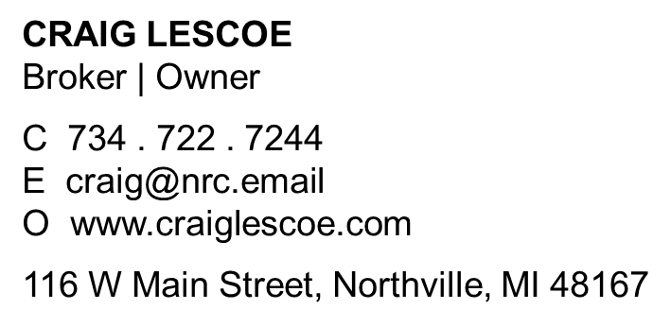
Let’s Chat.
I’m sure you have questions and thoughts about the real estate process.
I’d love to talk with you about what you’ve read here and help you on the path to selling your house. My contact information is below, and I look forward to working with you.
SUMMER 2023 EDITION

