Slide 1
Things To Consider When
Buying a Home
SUMMER 2023
EDITION

Slide 2
Table of Contents
3 What’s Happening in the Housing Market?
6 Why Buying a Home May Make More Sense Than Renting
8 The 3 Factors Affecting Home Affordability Today
11 Ways To Overcome Affordability Challenges in Today’s Housing Market
12 Why Today’s Housing Market Is Not About To Crash
15 Top Reasons To Own Your Home
16 4 Tips for Making Your Best Offer on a Home
18 The Power of Pre-Approval
20 Things To Avoid After Applying for a Mortgage
21 A Real Estate Expert Gives You Clarity in Today’s Housing Market

Slide 3
What’s Happening in the Housing Market?
You’re probably wondering what recent changes in the housing market mean for your homebuying plans this summer. Here are the top three things to keep in mind.
1. The Supply of Homes for Sale Is Still Low
The number of homes for sale this year is still low. Housing inventory is measured by the number of available homes on the market. It’s also measured by months’ supply, meaning the number of months it would take to sell all those available homes based on current demand. In a balanced market, there’s usually about a six-month supply – and today, we only have about half of that. With inventory that low, buyer competition is ticking back up, meaning multiple offers are returning on a good number of properties. Partnering with a professional can help you be competitive in a market like the one we have today.
2. Mortgage Rates Are Less Volatile Than Last Year
Last year, mortgage rates more than doubled within the calendar year. That’s never happened before, and the rapid rise caused many buyers to put their plans on hold. This year, however, many buyers are reentering the market as rates have settled a bit in roughly the 6% to 7% range.
No one knows for sure where rates will go from here, but experts say they may drop some if inflation continues to cool. Any drop boosts your purchasing power by bringing down your expected monthly mortgage payment. Even a change as small as 0.25% can have a big impact on what you’ll pay for your home.

Slide 4
3. The Worst Home Price Declines Are Behind Us
Headlines about home prices can be confusing. Home price appreciation has cooled from its peak last summer.
However, prices vary by area. And if you’ve been waiting for prices in your area to come down, you should know the shortage of homes available is going to keep upward pressure on prices. In fact, we’ve seen prices starting to rise again, indicating the worst home price declines are behind us. Andy Walden, VP of Enterprise Research at Black Knight, says this about home price trends:
“Just five months ago, prices were declining on a seasonally adjusted month-over-month basis in 92% of all major U.S. markets. Fast forward to March, and the situation has done a literal 180, with prices now rising in 92% of markets from February.”
So, if you find the home that’s right for you, waiting for a price drop isn’t the best strategy.
Bottom Line If you’re ready to buy this summer, don’t let market uncertainty delay your plans. Let’s connect so you have an expert on your side to answer all your housing market questions. Together, we’ll review your goals and what’s happening in our market, so you have the information you need to make a powerful and confident decision.
Notes:
https://www.prnewswire.com/news-releases/black-knight-home-prices-up-again-in-march-on-worsening-inventory-shortages-and-modest-rise-in-demand-301814349.html

Slide 5
If inflation pressures ease and we see a meaningful pullback in mortgage rates, this will ease some of the strain on buyers . . .
- Greg McBride, Chief Financial Analyst, Bankrate
Notes:
https://www.bankrate.com/real-estate/housing-market-predictions-2023/#home-values

Slide 6
Notes:
https://www.census.gov/housing/hvs/files/currenthvspress.pdf
https://www.federalreserve.gov/econres/scf/dataviz/scf/chart/#series:Net_Worth;demographic:housecl;population:1,2;units:median
https://www.buildiumstaging.com/resource/2023-property-management-industry-report/

Slide 7
Building equity through your monthly principal payments and appreciation is a critical part of homeownership that can help you create financial stability.
- Freddie Mac
Notes:
https://myhome.freddiemac.com/owning/equity-and-appreciation

Slide 8
The 3 Factors Affecting Home Affordability Today
The dramatic increase in mortgage rates last year led many buyers to put their plans on hold. However, affordability is impacted by more than just mortgage rates. To understand affordability, you have to look at three factors.
1. Mortgage Rates
While mortgage rates are higher than they were a year ago, they’ve hovered primarily between 6% and 7% this year. Within that range, rates have bounced around a lot, but where will they go from here? Mortgage rates are hard to project, but many experts agree they’ll start to come down by the end of the year if inflation continues to cool. No one can know for sure what’ll happen next, so trying to time the market, especially mortgage rates is difficult. This makes it extra important to lean on your team of real estate professionals to stay up to date on what’s happening.
2. Home Prices
Over the past few years, home prices appreciated rapidly as the record-low mortgage rates we saw during the pandemic led to a surge in buyer demand. The heightened buyer demand happened while the supply of homes for sale was at record lows, and that imbalance put upward pressure on home prices. And today, we still have more buyers in the market than homes available for sale.
But, home price appreciation varies by market. Some areas are seeing slight declines while others have prices that are climbing. As Selma Hepp, Chief Economist at CoreLogic, explains:
“The divergence in home price changes across the U.S. reflects a tale of two housing markets. Declines in the West are due to the tech industry slowdown and a severe lack of affordability after decades of undersupply. The consistent gains in the Southeast and South reflect strong job markets, in-migration patterns and relative affordability due to new home construction.”
Notes:
https://www.corelogic.com/intelligence/us-home-price-insights-april-2023/

Slide 9
3. Wages
The most positive factor in affordability right now is rising income. The graph below uses data from the Bureau of Labor Statistics (BLS) to show how wages have grown over time:
Higher wages improve affordability because they reduce the percentage of your income it takes to pay your mortgage since you don’t have to put as much of your paycheck toward your monthly housing cost.
Average Hourly Earnings of All Employees
Dollars per Hour, Seasonally Adjusted
Source: BLS
Bottom Line It’s important to know that your ability to afford a home comes down to more than just mortgage rates and home prices. If you’re thinking about buying a home, let’s go over your budget and explore affordable options in our area.
Notes:
https://www.bls.gov/

Slide 10
The soaring housing market has finally come back down in much of the U.S., at least for now, while worker pay is growing. That’s produced some benefits for home seekers in the form of slightly better affordability . . . the scenario is becoming more favorable for buyers.
- Rob Barber, CEO, ATTOM
Notes:
https://themortgagereports.com/102879/housing-affordability-improves-in-2023

Slide 11
Notes:
https://www.consumerfinance.gov/about-us/blog/mortgage-financing-options-in-a-higher-interest-rate-environment/
https://downpaymentresource.com/

Slide 12
Why Today’s Housing Market Is Not About To Crash
There’s been some concern lately that the housing market is headed for a crash. The data clearly shows today’s market is very different than it was before the housing crash in 2008. Here’s why.
It’s Harder To Get a Loan Now
It was much easier to get a home loan during the lead-up to the 2008 housing crisis than it is today. Back then, banks had different lending standards, making it easy for just about anyone to qualify for a home loan or refinance an existing one. As a result, lending institutions took on much greater risk in both the person and the mortgage products offered. That led to mass defaults, foreclosures, and falling prices.
Things are different today as purchasers face increasingly higher standards from mortgage companies. The graph below uses data from the Mortgage Bankers Association (MBA) to show this difference. The lower the number, the harder it is to get a mortgage. The higher the number, the easier it is.
Lending Regulations Are Steady
Historical Data from the Mortgage Credit Availability Index (MCAI), Each June
Housing Bubble:
868.7
Now: 99.6
Source: MBA
Notes:
https://www.mba.org/news-and-research/newsroom/news/2023/05/09/mortgage-credit-availability-decreased-in-april

Slide 13
Unemployment Recovered Faster This Time
While the pandemic caused unemployment to spike over the last couple of years, the jobless rate has already recovered back to pre-pandemic levels (see the blue line in the graph below). Things were different during the Great Recession as a large number of people stayed unemployed for a much longer period of time (see the red in the graph below):
Here’s how the quick job recovery this time helps the housing market. Because so many people are employed today, there’s less risk of homeowners facing hardship and defaulting on their loans. This helps put today’s housing market on stronger footing and reduces the risk of more foreclosures coming onto the market.
There Are Far Fewer Homes for Sale Today
There were also too many homes for sale during the housing crisis (many of which were short sales and foreclosures), and that caused prices to fall dramatically. Today, there’s a shortage of inventory available overall, primarily due to years of underbuilding homes.
The graph below uses data from the National Association of Realtors (NAR) and the Federal Reserve to show how the months’ supply of homes available now compares to the crash. Today, unsold inventory sits at just a 2.9-months’ supply. There just isn’t enough inventory on the market for home prices to come crashing down like they did in 2008.
Length of Crisis Different Than Last Time
Time It Took for Unemployment Rate To Recover to Pre-Crisis Percentage
November 2007
4.7%
Unemployment Rate
Was Over 6% for Over 6 Years
November 2016
4.7%
January 2020
3.5%
July 2022
3.5%
Source: The Fed
Housing Supply Is Lower Than Before
Annual Average of Months’ Supply of Homes for Sale, 1999-Present
Sources: NAR, The Fed
Notes:
https://fred.stlouisfed.org/series/UNRATE
https://www.nar.realtor/research-and-statistics/housing-statistics/existing-home-sales
https://fred.stlouisfed.org/series/HOSSUPUSM673N

Slide 14
Equity Levels Are Near Record Highs
That low inventory of homes for sale helped keep upward pressure on home prices over the course of the pandemic. As a result, homeowners today have near-record amounts of equity (see graph below):
And, that equity puts them in a much stronger position compared to the Great Recession. Molly Boesel, Principal Economist at CoreLogic, explains:
“Most homeowners are well positioned to weather a shallow recession. More than a decade of home price increases has given homeowners record amounts of equity, which protects them from foreclosure should they fall behind on their mortgage payments.”
Americans Have Record Amounts of Equity
Total U.S. Homeowner Equity (in Trillions of Dollars), 2006-2022
Now: $3.1T
Source: The Fed
Bottom Line If you’ve been waiting to buy because you’ve been worried today’s housing market is headed for a crash, the graphs above should ease any fears you may have. The most current data clearly shows that today’s market isn’t like it was in 2008.
Notes:
https://fred.stlouisfed.org/series/OEHRENWBSHNO#0
https://www.corelogic.com/intelligence/loan-performance-insights-january-2023/

Slide 16
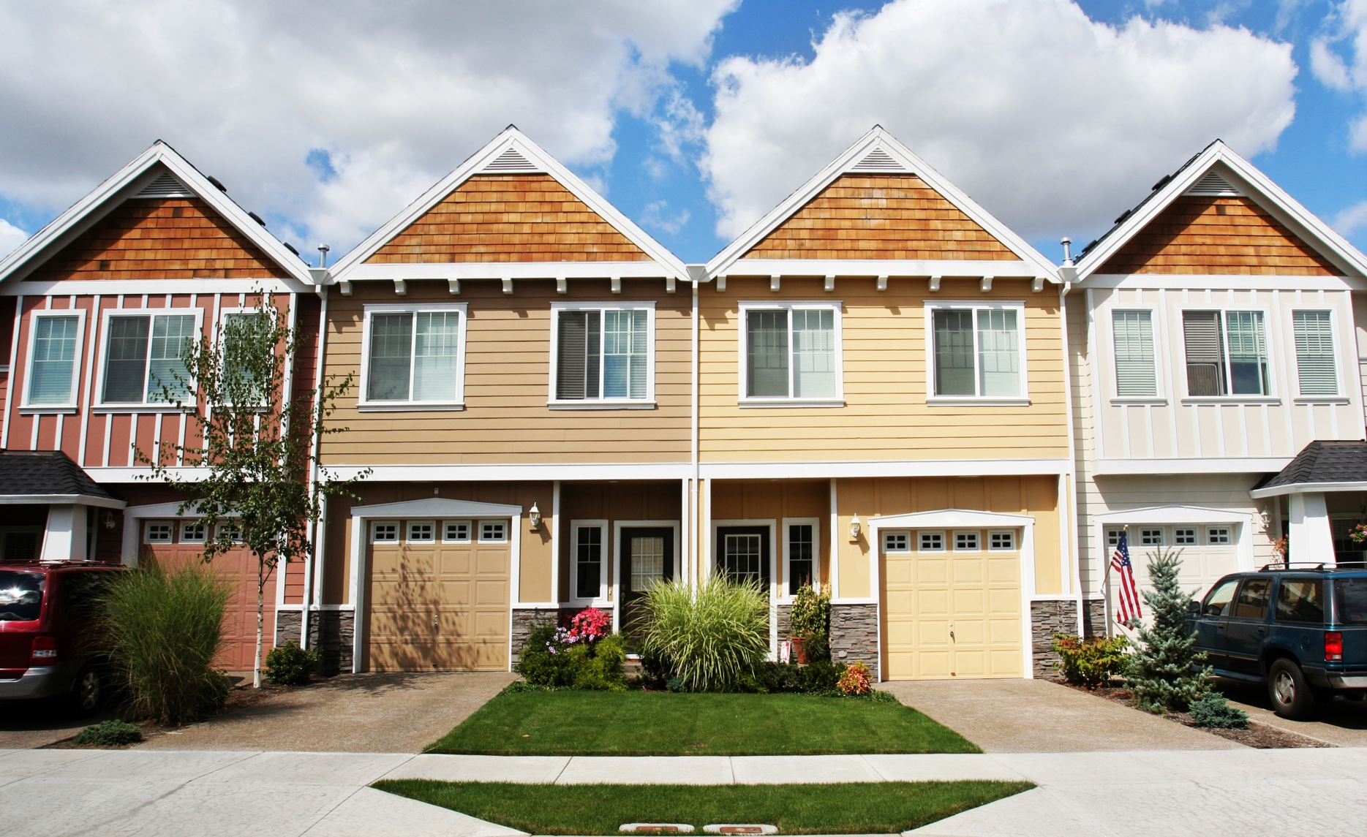
4 Tips for Making Your Best Offer on a Home
Since there are more buyers in the market than there are homes for sale, the number of homes receiving multiple offers is on the rise. So, when you find the home you want to buy, remember these four tips to make your best offer.
1. Lean on a Real Estate Professional
Agents are local market experts. They know what’s worked for other buyers in your area and what sellers may be looking for in an offer. It may seem simple, but catering to what a seller needs can help your offer stand out.
2. Know Your Budget
Understanding your budget is especially important right now. As Sandy Higgins, Senior Wealth Advisor at Capstone Financial Advisors, puts it:
“Understand your current budget … what are your expenses, how’s your spending, would you need to make changes?”
The best way to understand your numbers is to work with a lender so you can get pre-approved for a loan. It helps you be more financially confident, and it shows sellers you’re serious. That can give you a competitive edge.
Notes:
https://www.cnbc.com/2022/10/26/how-to-buy-a-home-in-a-cooling-market-according-to-top-ranked-advisors.html

Slide 17
3. Think Through Everything Before Making an Offer
Today’s market isn’t moving at the record pace it did during the pandemic. That means you may have a bit more time to think before you need to make an offer. While it’s still important to stay on top of the market and be prepared to move quickly, there can be more flexibility today.
4. Work with Your Advisor To Negotiate
During the pandemic, some buyers skipped home inspections in order to submit the winning bid on a home. But skipping the home inspection is a risky move. The inspection is an important part of your purchase. Home inspections help give you a picture of the condition of the home and what repairs it may need. The inspection findings can also be a negotiation tool for you.
If it does turn up anything big, you should lean on your agent to help you negotiate with the seller on any potential repairs. Resist the urge to waive the inspection to try and make your offer more appealing to sellers.
Bottom Line When you buy a home this summer, let’s work together to make sure you put your best offer forward.

Slide 18
The Power of Pre-Approval
One of the first steps when buying a home is getting pre-approved. To understand why it’s such an important step, you need to understand what pre-approval is and what it does for you.
What Is Pre-Approval?
Freddie Mac explains it like this:
“A pre-approval is an indication from your lender that they are willing to lend you a certain amount of money to buy your future home. . . . Keep in mind that the loan amount in the pre-approval letter is the lender’s maximum offer. Ultimately, you should only borrow an amount you are comfortable repaying.”
Basically, pre-approval gives you critical information about the homebuying process that’ll help you understand how much you may be able to borrow so you have a stronger grasp of your options.
How Does It Work?
As part of the pre-approval process, a lender looks at your finances to decide what they’d be willing to loan you. From there, your lender will give you a pre-approval letter to help you understand how much money you can borrow. That can make it easier when you set out to search for homes because you’ll know your overall numbers. And with higher mortgage rates impacting affordability for many buyers today, a solid understanding of your numbers is even more important.
Notes:
https://myhome.freddiemac.com/blog/homebuying/how-do-i-get-pre-approved-mortgage

Slide 19
Pre-Approval Helps Show You’re a Serious Buyer
Pre-approval can help a seller feel more confident in your offer because it shows you’re serious about buying their house. And, with sellers seeing a slight increase in the number of offers, making a strong offer when you find the perfect house is key.
A recent article from the Wall Street Journal (WSJ) says:
“If you plan to use a mortgage for your home purchase, preapproval should be among the first steps in your search process. Not only can getting preapproved help you zero in on the right price range, but it can give you a leg up on other buyers, too.”
Bottom Line Getting pre-approved is an important first step toward buying a home. It lets you know what you can borrow and shows sellers you’re a serious buyer.
Notes:
https://www.wsj.com/buyside/personal-finance/mortgage-pre-approval-25dd076c

Slide 20
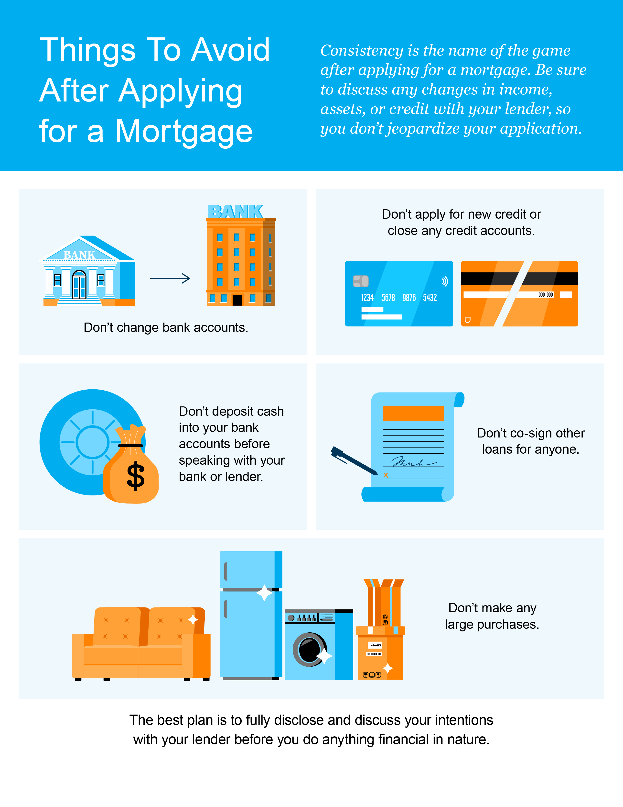

Slide 21
A Real Estate Expert Gives You Clarity in Today’s Housing Market
A real estate expert uses their knowledge of what’s really happening with home prices, housing supply, expert projections, and more to guide you throughout the homebuying process.
Why You Want To Lean on a Trusted Professional
Jay Thompson, Real Estate Industry Consultant, explains:
“Housing market headlines are everywhere. Many are quite sensational, ending with exclamation points or predicting impending doom for the industry. Clickbait, the sensationalizing of headlines and content, has been an issue since the dawn of the internet, and housing news is not immune to it.”
Unfortunately, when information in the media isn’t clear, it can generate a lot of fear and uncertainty in the market. As Jason Lewris, Co-Founder and Chief Data Officer at Parcl, says:
“In the absence of trustworthy, up-to-date information, real estate decisions are increasingly being driven by fear, uncertainty, and doubt.”
Notes:
https://www.realestatenews.com/2022/11/18/agents-decoded-making-sense-of-the-headlines
https://www.parcllabs.com/articles/q3-real-estate

Slide 22
But it doesn’t have to be that way. Buying a home is a big decision, and it should be one you feel confident making. You can lean on an expert to help you separate fact from fiction and get the answers you need.
The right agent can help you understand what’s happening at the national and local levels, and they can debunk the headlines using data you can trust. Experts have in-depth knowledge of the industry and can provide context, so you know how current trends compare to the normal ebbs and flows in the industry, historical data, and more.
Then, to make sure you have the full picture, an agent can tell you if your local area is following the national trend or if they’re seeing something different in your market. Together, you can use all that information to make the best possible decision.
After all, making a move is a potentially life-changing milestone. It should be something you feel ready for and excited about. And that’s where a trusted guide comes in.
Bottom Line For expert advice and the latest housing market insights, let’s connect.

Slide 23
“Buying a home can be a complicated, intimidating process, so you’ll need a professional on your side to answer questions and look out for your best interests.”
- The Mortgage Reports
Notes:
https://themortgagereports.com/68062/8-things-to-do-now-to-prepare-to-buy-a-house

Slide 24
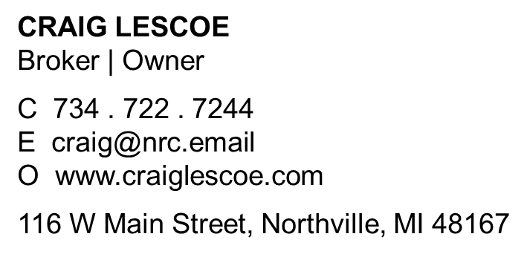
Let’s Chat.
I’m sure you have questions and thoughts about the real estate process.
I’d love to talk with you about what you’ve read here and help you on the path to buying your new home. My contact information is below, and I look forward to working with you.
SUMMER 2023 EDITION

