Slide 1
Things To Consider When
Selling Your House
SPRING 2023
EDITION

Slide 2
Table of Contents
3 Should I Sell My House This Spring?
6 What’s Ahead for Mortgage Rates and Home Prices?
8 Number of Homes for Sale Up, but Below Pre-Pandemic Years
10 Top Reasons Homeowners Are Selling
12 Today’s Homeowners Still Have Positive Equity Gains
15 Want To Sell Your House? Price It Right.
18 An Expert Makes All the Difference When You Sell
21 A Checklist for Selling Your House
22 Reasons To Hire a Real Estate Professional

Slide 3
Should I Sell My House This Spring?
There’s a lot going on in the housing market this season, and you may have some questions about selling your house. Here are a few of the top things you may be wondering about, and the answers that can help you make a confident, informed decision.
1. Should I Wait To Sell?
There are more homes for sale today than there were at this time last year, but it’s important to keep in mind there are still fewer homes available than there were before the pandemic. So, selling while inventory is low means if you price your house right, it is likely to be in high demand. That means you can take advantage of more options for your move and list your house in a true sweet spot. The graph below puts today’s inventory into perspective.
Months’ Supply of Homes for Sale
Source: NAR
Notes:
https://www.nar.realtor/topics/existing-home-sales
https://cdn.nar.realtor/sites/default/files/documents/ehs-01-2023-overview-2023-02-21.pdf

Slide 4
2. Are Buyers Still out There?
If you’re thinking of selling your house but worry buyer demand is disappearing in the face of higher mortgage rates, you should know that isn’t the case for everyone. Mark Fleming, Chief Economist at First American, explains:
“The housing market, once adjusted to the new normal of higher mortgage rates, will benefit from continued strong demographic-driven demand relative to an overall, long-run shortage of supply.”
If you’re wondering if buyers are still out there, know there are still people searching for a home to buy. And your house may be exactly what they’re looking for.
3. Can I Still Get a Good Price for My House?
Home price growth has moderated in recent months as buyer demand has pulled back in response to higher mortgage rates. While home prices in some local markets may have declined slightly, national home values are still up compared to this time last year.
While it is slowing, today’s annual rate of price appreciation is still above the rate of growth we saw during more normal years in the market. So, even though the average home isn’t growing in value as fast as it did a year ago, you can still sell with confidence this season.
Bottom Line If you’re thinking about selling your house this spring, let’s connect so you have the expert insights you need to make the best possible move today.
Notes:
https://blog.firstam.com/economics/why-the-housing-market-may-begin-to-stabilize-in-2023

Slide 5
. . . sellers can have success in this market as long as they approach with reasonable expectations that are very different from what was the norm less than a year ago.
- Danielle Hale, Chief Economist, realtor.com
Notes:
https://www.realtor.com/research/2023-national-housing-forecast/

Slide 6
What’s Ahead for Mortgage Rates and Home Prices?
As you make plans to sell your house and move this spring, you may be thinking about what lies ahead for mortgage rates and home prices. Here’s a look at expert insights on where both may be headed so you can make the most informed decision possible.
Mortgage Rates Will Continue To Respond to Inflation
Last year, mortgage rates more than doubled within the calendar year. That’s never happened before, and the rapid rise caused many buyers to put their plans on hold. Today, rates are still quite volatile. With experts projecting rates will stabilize this year, that could be good news for you as it may mean more buyers jumping back into the market. And any drop in interest rates would boost your purchasing power for your next home by bringing your expected monthly mortgage payment down.
But you shouldn’t expect them to drop all the way to the record lows we saw in 2021. Greg McBride, Chief Financial Analyst at Bankrate, explains:
“I think we could be surprised at how much mortgage rates pull back this year. But we’re not going back to 3 percent anytime soon, because inflation is not going back to 2 percent anytime soon.”
Notes:
https://www.bankrate.com/mortgages/mortgage-rate-forecast/#forecast

Slide 7
Home Prices Will Remain Relatively Flat
Homes prices will always be defined by supply and demand. When there are more buyers than homes on the market, home prices will rise. And that’s exactly what we saw during the pandemic.
But things have changed. We’ve seen home prices moderate and housing supply grow as buyer demand pulled back due to higher mortgage rates last year. The level of moderation has varied by local area – with the biggest changes happening in overheated markets. But do experts think that will continue?
The graph below shows the latest national home price forecasts. As the different colored bars indicate, some experts are saying home prices will appreciate this year, and others are saying home prices will come down. But again, if we take the average of all the forecasts (shown in gray), we can get a feel for what 2023 may hold.
The truth is probably somewhere in the middle. That means nationally, we’ll likely see relatively flat or neutral appreciation. As Lawrence Yun, Chief Economist at the National Association of Realtors (NAR), says:
“After a big boom over the past two years, there will essentially be no change nationally . . . Half of the country may experience small price gains, while the other half may see slight price declines.”
Home Price Forecasts for 2023
Average of All 4 Forecasts
MBA
NAR
Fannie Mae
Bottom Line If you want to know what’s happening in the market, let’s connect so you have the latest on what experts are saying and what that means for our area this spring.
Notes:
https://news.move.com/2022-11-30-Realtor-com-R-Housing-Forecast-Homebuying-Costs-Arent-Coming-Down-in-2023
https://www.mba.org/docs/default-source/research-and-forecasts/forecasts/2023/mortgage-finance-forecast-feb-2023.pdf?sfvrsn=ca85e6b4_1
https://cdn.nar.realtor//sites/default/files/documents/forecast-q1-2023-us-economic-outlook-02-27-2023.pdf
https://www.fanniemae.com/media/46346/display
https://www.nar.realtor/magazine/real-estate-news/2023-real-estate-forecast-market-to-regain-normalcy#:~:text=Housing%20inventory%20is%20expected%20to,appreciation%20will%20slow%2C%20he%20added.

Slide 8
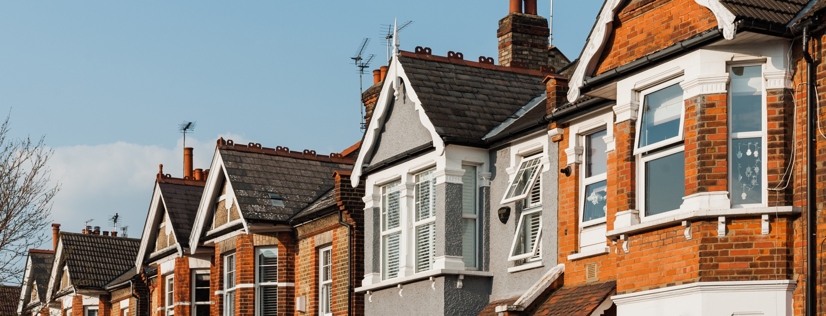
Number of Homes for Sale Up, but Below Pre-Pandemic Years
There aren’t enough homes for sale today to meet buyer demand. This spring could be the ideal time to make a move if you’ve been thinking about selling your house.
The biggest challenge in the housing market right now, and likely for years to come, is how few homes there are for sale compared to the number of people who want to buy. That’s why, if you’re thinking about selling your house, now is a great time to do so. Your house would be welcome in a market that has fewer homes for sale than it did in the years leading up to the pandemic.
According to realtor.com:
“While the number of homes for sale is increasing, it is still 43.2% lower than it was before the pandemic in 2017 to 2019. This means that there are still fewer homes available to buy on a typical day than there were a few years ago.”
The graph below shows how today’s inventory of homes for sale compares to recent years:
C
Active Monthly Listing Counts
Last 6 Januarys
Source: realtor.com
Notes:
https://www.realtor.com/research/january-2023-data/
https://www.realtor.com/research/data/

Slide 9
What Does This Mean for You?
Fewer homes for sale than we had before the pandemic means buyers have fewer choices—and that frustration is leading some to give up on the homebuying process altogether. But with mortgage rates sitting lower than they were at their peak last fall, more buyers are willing to come back into the process now—they just need to find homes to buy. This is welcome activity for the spring market, especially if you’re thinking of selling your house.
With many people finding a renewed interest in buying a home, the New York Times (NYT) reports:
“Home buyers are edging back into the market after being sidelined last year. . .”
So, if you want to take advantage of a sweet spot in the market, this spring could be your shot.
Bottom Line The housing market needs more homes for sale to meet the demand from today’s buyers. If you’ve thought about selling, now’s the time to get ready to make a move this spring.
Notes:
https://www.nytimes.com/2023/02/02/business/mortgage-rates-housing-market.html

Slide 10
Top Reasons Homeowners Are Selling
You have a lot to consider when thinking about moving. While mortgage rates and wealth building are important, there are plenty of non-financial reasons to factor in too.
Many of today’s homeowners bought or refinanced their homes during the pandemic when mortgage rates were at history-making lows. Since rates doubled in 2022, some of those homeowners put their plans to move on hold, not wanting to lose the low mortgage rate they have on their current house. And while today’s rates have started coming down from last year’s peak, they’re still higher than they were a couple of years ago.
Today, 93% of outstanding mortgages have a rate at or below 6%. That means a strong majority of homeowners with mortgages have a rate below what they’d get if they moved right now. But if you’re a homeowner in that position, remember that mortgage rates aren’t the only thing to consider when making a move. Your mortgage rate is important, but there are plenty of reasons you may still need or want to move. RealTrends explains:
“The most common sellers will be: Homeowners downsizing . . . people moving to get more space, families looking for better schools…etc.”
Notes:
https://blog.firstam.com/economics/why-housing-market-potential-increased-for-the-second-straight-month
https://www.realtrends.com/articles/15-predictions-to-help-you-plan-your-real-estate-business

Slide 11
So, if you’re on the fence about selling your house, consider the other reasons homeowners like you are choosing to make a move. A recent report from the National Association of Realtors (NAR) breaks down why homeowners have decided to sell over the past year:
21%
11%
10%
9%
Want to move closer to loved ones
Moving due to retirement
House is
too small
Change of structure in household
As the visual shows, the most commonly cited reasons for selling were the desire to move closer to loved ones, followed by moving due to retirement. Additionally, the need for more space factored in, as did a change in household structure.
If you want a change in location or need space your current house just can’t provide, it may be time to sell.
What you want and need in a home can be reason enough to move. To find out what’s right for you, work with a trusted real estate professional who will offer advice and expert guidance throughout the process. They’ll be able to lay out all your options – giving you what you need to make a confident decision.
Bottom Line When deciding whether or not to move, you have a lot to consider. There are plenty of non-financial reasons to factor in. Let’s connect so I can help you weigh the benefits of selling your house.
Notes:
https://www.nar.realtor/research-and-statistics/research-reports/highlights-from-the-profile-of-home-buyers-and-sellers

Slide 12
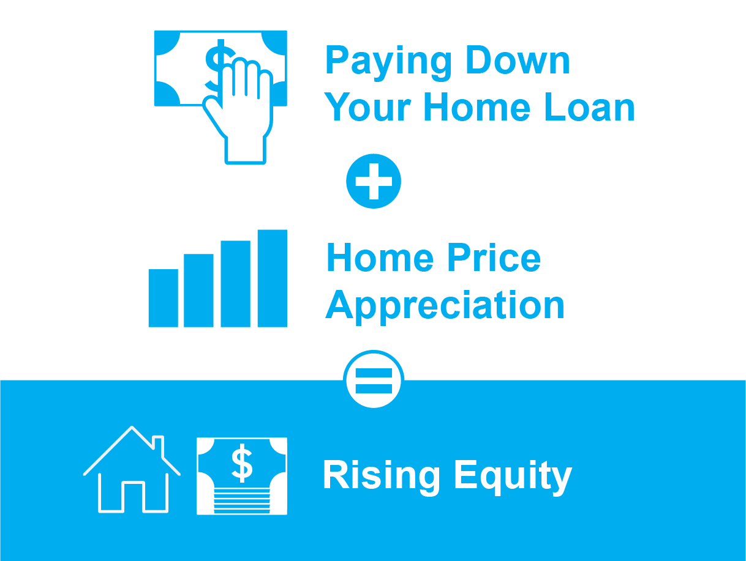
Today’s Homeowners Still Have Positive Equity Gains
If you’re a homeowner, your net worth got a big boost over the past few years thanks to rapidly rising home prices. Here’s how it happened and what it means for you, even as the market moderates.
What Is Home Equity?
Equity is the current value of your home minus what you owe on the loan.
Over time, you build equity as you make your monthly mortgage payments and as home prices appreciate. It works like this:
Why Your Equity Has Grown in Recent Years
Because of the imbalance between how many homes were for sale and the number of homebuyers over the past few years, home prices appreciated substantially.
And while home price appreciation has moderated, and even depreciated slightly in some markets, that doesn’t mean you’ve lost all the equity you gained.
In fact, Homeowner Equity Insights from CoreLogic finds the average homeowner’s equity has grown by $34,300 over the past year alone.
And if you’ve been in your home for longer than a year, chances are you have even more equity than you realize.
Notes:
https://www.corelogic.com/intelligence/homeowner-equity-insights-q3-2022/

Slide 13
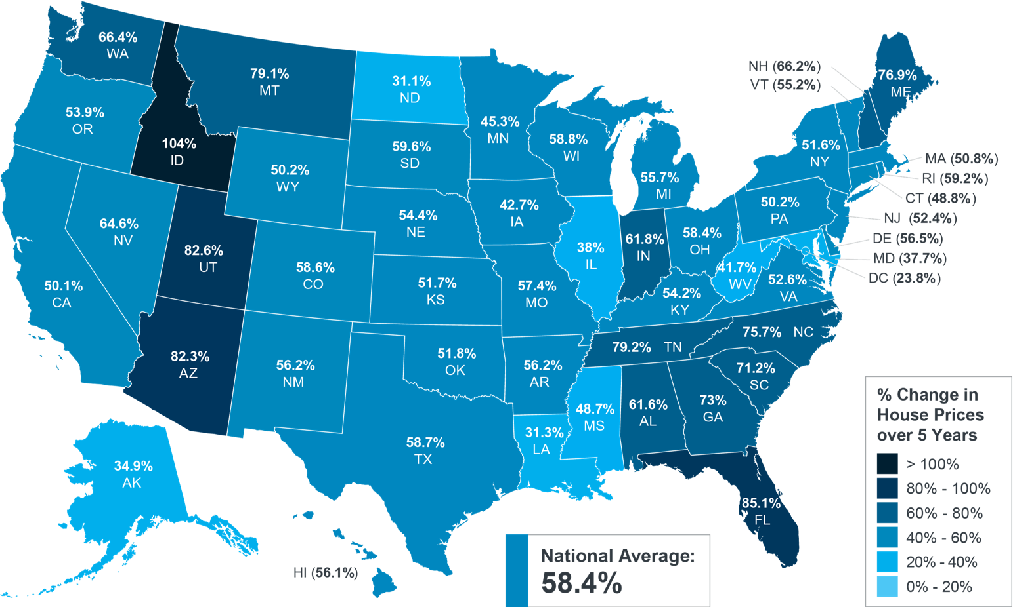
While that’s the national number, if you want to know what happened over the past five years in our area, look at the map below from the Federal Housing Finance Agency (FHFA). It shows how much home prices have risen recently, and that’s been a major driver behind equity growth.
Percent Change in Home Prices
Over 5 Years, Q4 2022
Source: FHFA
Why This Is So Important Right Now
While equity helps increase your overall net worth, it can also help you achieve other goals, like buying your next home. When you sell your current house, the equity you’ve built up comes back to you in the sale, and it may be just what you need to cover a large portion – if not all – of the down payment of your next home.
So, if you’ve been holding off on selling, rest assured you’ve gained equity in recent years, and it can help fuel your move.
Bottom Line If you’re planning to make a move, the equity you’ve gained over time can make a big impact. To find out just how much equity you have in your current home and how you can use it to fuel your next purchase, let’s connect.
Notes:
https://www.fhfa.gov/DataTools/Tools/Pages/House-Price-Index-(HPI).aspx

Slide 14
Potential home sellers gained significant amounts of equity over the pandemic, so even as affordability-constrained buyer demand spurs price declines in some markets, potential sellers are unlikely to lose all that they have gained.
- Mark Fleming, Chief Economist, First American
Notes:
https://blog.firstam.com/economics/house-prices-decline-but-equity-buffers-remain-robust

Slide 15
Want To Sell Your House? Price It Right.
Last year, the housing market slowed down in response to higher mortgage rates, and that had an impact on home prices. If you’re thinking of selling your house soon, that means you’ll want to adjust your expectations accordingly.
In a more moderate market, how you price your house will make a big difference to not only your bottom line, but to how quickly your house could sell. And the reality is, homes that are priced right are still selling in today’s market. As realtor.com explains:
“. . . some of the more prominent pandemic trends have changed, so sellers might wish to adjust accordingly to get the best deal possible.”
Why Pricing Your House at Market Value Matters
Especially today, your asking price sends a message to potential buyers.
If it’s priced too low, you may leave money on the table. It could also discourage buyers who may see a lower-than-expected price tag and wonder if that means something is wrong with the home.
Notes:
https://www.realtor.com/advice/sell/home-selling-rules-youve-heard-lately-that-you-might-want-to-break/

Slide 16
If it’s priced too high, you run the risk of deterring buyers. When that happens, you may have to lower the price to try to reignite interest in your house when it sits on the market for a while. On the other hand, be aware that a price drop can be seen as a red flag by some buyers who will wonder what that means about the home.
To avoid either headache, price it right from the start. A real estate professional knows how to determine the ideal asking price. They balance the value of homes in your neighborhood, current market trends, buyer demand, the condition of your house, and more to find the right price. This helps lead to stronger offers and a greater likelihood your house will sell quickly.
The visual below helps summarize the impact your asking price can have:
Greg McBride, Senior Vice President and Chief Financial Analyst at Bankrate, also gives this advice:
“Price your home realistically. . . . Appropriately priced homes are still selling quickly.”
Bottom Line Homes that are priced at current market value are still selling. To make sure you price your house appropriately, maximize your sales potential, and minimize your hassle, let’s connect.
Notes:
https://www.bankrate.com/real-estate/housing-trends/

Slide 17
If it’s a good home in the resale market, it’s selling quickly. The buyer who is buying today is not the same buyer buying 12 months ago. If [they’re] paying this much, it needs to be a nice home.
- Ali Wolf, Chief Economist, Zonda
Notes:
https://www.realtor.com/news/trends/a-tale-of-2-housing-markets-why-some-homes-still-cause-heated-bidding-wars-while-others-sit-unsold/

Slide 18
An Expert Makes All the Difference When You Sell
If you’re thinking of selling your house, it’s important to work with someone who understands how the market is changing and what it means for you. Here are five reasons working with a professional can ensure you’ll get the most out of your sale.
1. We’re Experts on Market Trends
Leslie Rouda Smith, 2022 President of the National Association of Realtors (NAR), explains:
“During challenging and changing market conditions, one thing that’s calming and constant is the assurance that comes from a Realtor® being in your corner through every step of the home transaction. Consumers can rely on Realtors®’ unmatched work ethic, trusted guidance and objectivity to help manage the complexities associated with the home buying and selling process.”
An expert real estate advisor has the latest information about national trends and your local area too. More importantly, they’ll know what all of this means for you, so they’ll be able to help you make a decision based on trustworthy, data-bound information.
2. A Local Professional Knows How To Set the Right Price for Your Home
Home price appreciation has moderated this year. If you sell your house on your own, you may be more likely to overshoot your asking price because you’re not as aware of where prices are today. Pricing your house too high can deter buyers or cause your house to sit on the market for longer.
Real estate professionals look at a variety of factors, like the condition of your home and any upgrades you’ve made, with an unbiased eye. They compare your house to recently sold homes in your area to find the best price for today’s market, so your house sells quickly.
Notes:
https://www.nar.realtor/newsroom/nar-finds-share-of-first-time-home-buyers-smaller-older-than-ever-before

Slide 19
3. A Real Estate Advisor Helps Maximize Your Pool of Buyers
Since buyer demand has cooled this year, you’ll want to do what you can to help bring in more buyers. Real estate professionals have a wide range of tools at their disposal, such as social media followers, agency resources, and the Multiple Listing Service (MLS) to ensure your house gets in front of people looking to make a purchase. Investopedia explains why it’s risky to sell on your own without the network an agent provides:
“You don’t have relationships with clients, other agents, or a real estate agency to bring the largest pool of potential buyers to your home.”
Without access to your agent’s tools and marketing expertise, your buyer pool – and your home’s selling potential – is limited.
4. A Real Estate Expert Will Read – and Understand – the Fine Print
Today, more disclosures and regulations are mandatory when selling a house. That means the number of legal documents you’ll need to juggle is growing. NAR explains it like this:
“There’s a lot of jargon involved in a real estate transaction; you want to work with a professional who can speak the language.”
5. A Local Professional Is a Skilled Negotiator
In today’s market, buyers are regaining some negotiation power. If you sell without an expert, you’ll be responsible for any back-and-forth. That means you’ll have to coordinate with:
The buyer, who wants the best deal possible
The buyer’s agent, who will use their expertise to advocate for the buyer
The inspection company, which works for the buyer and will almost always find concerns with the house
The appraiser, who assesses the property’s value to protect the lender
Instead of going toe-to-toe with these parties alone, lean on an expert. They’ll know what levers to pull, how to address everyone’s concerns, and when you may want to get a second opinion.
Bottom Line Don’t go at it alone. If you’re planning to sell your house this spring, let’s connect so you have an expert by your side to guide you in today’s market.
Notes:
https://www.investopedia.com/articles/personal-finance/071514/8-reasons-not-sell-your-home-without-agent.asp#toc-4-agents-access-large-networks
https://www.nar.realtor/magazine/tools/client-education/handouts-for-sellers/8-reasons-to-work-with-a-realtor

Slide 20
If you’re getting ready to sell your house, you may want to make some repairs and upgrades so your property makes a great impression on buyers.
- realtor.com
Notes:
https://www.realtor.com/sell/seller-guides/how-to-prepare-your-home-for-sale

Slide 22
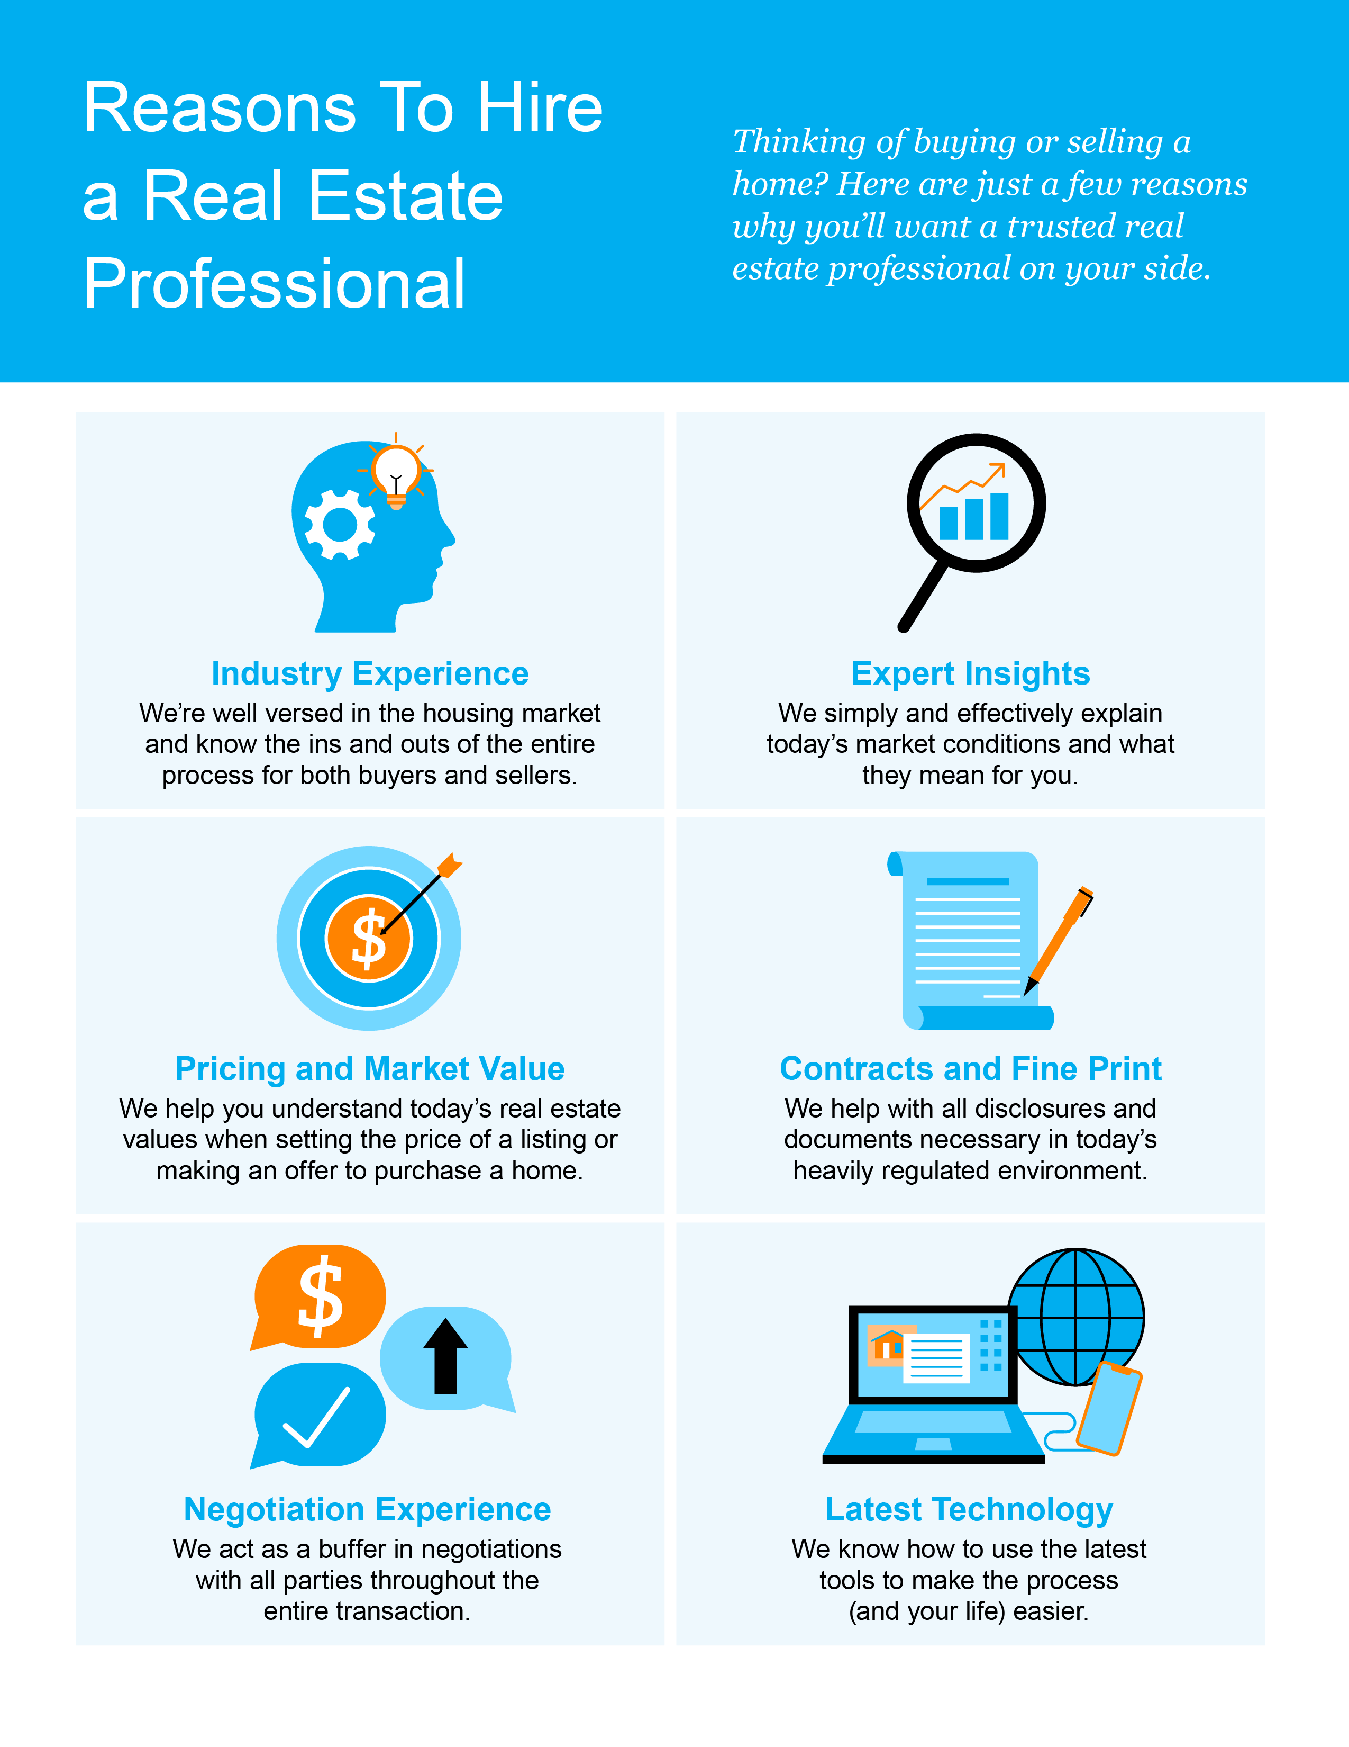

Slide 23
“Because your home is probably the biggest asset you have, it’s important to lean on your real estate agent for your next step. Their experience and knowledge of your local market conditions and personal/financial goals are key. Let them guide you.”
- Freddie Mac
Notes:
https://myhome.freddiemac.com/selling/negotiating-offers

Slide 24
Let’s Chat.
I’m sure you have questions and thoughts about the real estate process.
I’d love to talk with you about what you’ve read here and help you on the path to selling your house. My contact information is below, and I look forward to working with you.
SPRING 2023 EDITION

