Slide 1
Things To Consider When
Buying a Home
SPRING 2023
EDITION

Slide 2
Table of Contents
3 What’s Happening in the Housing Market?
6 How the Supply of Homes for Sale Is Changing
9 What Past Recessions Tell Us About the Housing Market
12 Top Reasons To Own Your Home
13 Why Buying a Home May Make More Sense Than Renting
14 Homeownership Wins over Time
17 Tips To Reach Your Homebuying Goals This Spring
18 Pre-Approval in 2023: What You Need To Know
20 Things To Avoid After Applying for a Mortgage
21 A Real Estate Expert Gives You Clarity in Today’s Housing Market

Slide 3
What’s Happening in the Housing Market?
With so much recent change in the housing market, you probably have questions about what it all means for your homebuying plans this spring. Here are two things that are likely top of mind for you.
1. What’s Going on with Mortgage Rates?
Last year, mortgage rates more than doubled within the calendar year. That’s never happened before, and the rapid rise caused many buyers to put their plans on hold. Today, rates are still quite volatile. With experts projecting rates will stabilize this year, that could be great news for you if you’re ready to buy a home. Any drop in interest rates helps boost your purchasing power by bringing your expected monthly mortgage payment down.
But you shouldn’t expect rates to drop all the way down to the record lows we saw in 2021. Experts agree that isn’t a range buyers should expect. Greg McBride, Chief Financial Analyst at Bankrate, explains:
“I think we could be surprised at how much mortgage rates pull back this year. But we’re not going back to 3 percent anytime soon, because inflation is not going back to 2 percent anytime soon.”
It’s important to have a realistic vision for what you can expect this spring. Though we’re not going back to 3% mortgage rates, you may be surprised by the impact even a mild drop in rates has on your budget.
Notes:
https://www.bankrate.com/mortgages/mortgage-rate-forecast/#forecast

Slide 4
2. What’s Happening with Home Prices?
Headlines about home prices can be confusing. While home price appreciation has cooled, where home prices go from here will vary based on supply and demand in our local market.
That may be why some experts say prices will decline slightly and others say they’ll continue to climb, just more moderately than they did in the frenzy of the pandemic. The important thing is, overall, experts say price appreciation will be relatively neutral or flat this year.
Bottom Line Don’t let market uncertainty delay your goals. Let’s connect so you have an expert on your side to answer all your housing market questions. Together, we’ll review your goals and what’s happening in our market, so you have the information you need to make a powerful and confident decision.

Slide 5
KEY TAKEAWAY
If you’re thinking about pausing your home search because of mortgage rates, you may want to reconsider. This could actually be an opportunity to buy the home you’ve been searching for. The rise in mortgage rates is leading some potential homebuyers to pull back on their search for a new home. So, if you stay the course, you’ll likely face less competition among other buyers when you’re looking for a home. This is welcome relief in a market that has so few homes for sale.

Slide 6
How the Supply of Homes for Sale Is Changing
One of the biggest challenges in the housing market today is how few homes there are for sale. However, there are more options to choose from than there were at this time last year. Here’s what that means for you.
The Number of Homes for Sale Is Up from Last Year, but Below Pre-Pandemic Levels
During the pandemic, housing supply hit a historic low at the same time buyer demand skyrocketed. This combination made it difficult to find a home because there just weren’t enough homes available for sale to meet buyer demand.
Today, the supply of homes for sale has increased by 65.5% compared to this time last year. That’s a welcome increase for buyers, but it’s important to note that housing supply is still below where it was in the years leading up to the pandemic. In a recent report, realtor.com explains:
“While the number of homes for sale is increasing, it is still 43.2% lower than it was before the pandemic in 2017 to 2019. This means that there are still fewer homes available to buy on a typical day than there were a few years ago.”
Notes:
https://www.realtor.com/research/january-2023-data/

Slide 7
What Does This Change Mean for You?
Here’s the good news: an increase in the number of homes for sale means you have more options for your search. Not only do you have more options to choose from, but sellers may be more willing to negotiate with you than they were over the last couple of years.
Just keep in mind, while a rise in home inventory is welcome, inventory is still lower than a more normal year in the housing market. That means it’s still important to lean on your expert advisor for advice on how to navigate your local market. This can include being flexible and open to negotiations, balancing your wants and needs in a home, and taking the right financial steps to be confident in your options.
Bottom Line Housing supply is still well below pre-pandemic norms. However, as buyer demand has slowed, inventory has started to grow. Let’s connect so you have the latest information on the homes available in our local market.

Slide 8
“If you’re seeing a property on the market today, you’re probably seeing a motivated seller.”
- Rick Sharga, Founder, CJ Patrick Company
Notes:
https://www.investopedia.com/us-housing-faces-ugly-transition-in-2023-7111840

Slide 9
What Past Recessions Tell Us About the Housing Market
Although experts project any recession for the housing market would be short and mild, as recession talk grows this year, you may be wondering what it could mean for the housing market. Here’s a look at the historical data that shows what’s happened in real estate during previous recessions.
A Recession Doesn’t Mean Falling Home Prices
The 2008 housing crisis can lead many of us to connect a recession with home prices crashing. But as the graph below shows, home prices appreciated in four of the last six recessions in this country. So historically, when the economy slows, it doesn’t always mean home prices will fall.
Home Price Change During Last 6 Recessions
Sources: CoreLogic, The Balance
Notes:
https://www.corelogic.com/blog/2019/03/housing-recessions-and-recoveries.aspx​
https://www.thebalance.com/the-history-of-recessions-in-the-united-states-3306011​
https://www.corelogic.com/intelligence/find-stories/corelogic-hpi-posted-record-year-over-year-growth-in-2021/​

Slide 10
A Recession Means Falling Mortgage Rates
How does a recession affect the cost of financing a home? As the the next graph shows, historically, each time the economy has slowed down, mortgage rates declined.
Fortune also explains mortgage rates typically fall during an economic slowdown:
“Over the past five recessions, mortgage rates have fallen an average of 1.8 percentage points from the peak seen during the recession to the trough. And in many cases, they continued to fall after the fact as it takes some time to turn things around even when the recession is technically over.”
The big takeaway is, you don’t need to fear the word recession when it comes to the housing market.
Mortgage Rate Change During Last 6 Recessions
Sources: Freddie Mac, Mortgage Specialists
Bottom Line According to historical data, in most recessions, home values have appreciated, and mortgage rates have declined. If you’re thinking about buying a home this spring, let’s connect so you have expert advice on what’s happening in the housing market and what that means for your homeownership goals.
Notes:
https://mtg-specialists.com/2022/05/11/recession-interest-rates-and-real-estate/
https://www.freddiemac.com/pmms/archive
https://fortune.com/2019/06/19/next-recession-assets-mortgage-rates/

Slide 11
“So be advised…this may be the one and only window for the next few years to get into a buyer’s market. And remember…as the Federal Reserve data shows…home prices only go up and always recover from recessions no matter how mild or severe. Long term homeowners should view this market…right now…as a unique buying opportunity.”
- David Stevens, Former Assistant Secretary of Housing
Notes:
https://www.linkedin.com/pulse/reminder-home-prices-always-rise-over-time-david-h-stevens-cmb/?trackingId=v4Fg7EqLTTCx94toGrR%2Ffw%3D%3D

Slide 13
Notes:
https://www.census.gov/housing/hvs/files/currenthvspress.pdf
https://cdn.nar.realtor/sites/default/files/documents/2022-snapshot-of-race-and-home-buying-in-the-us-report-02-23-2022_0.pdf
https://www.buildiumstaging.com/resource/2023-property-management-industry-report/

Slide 14
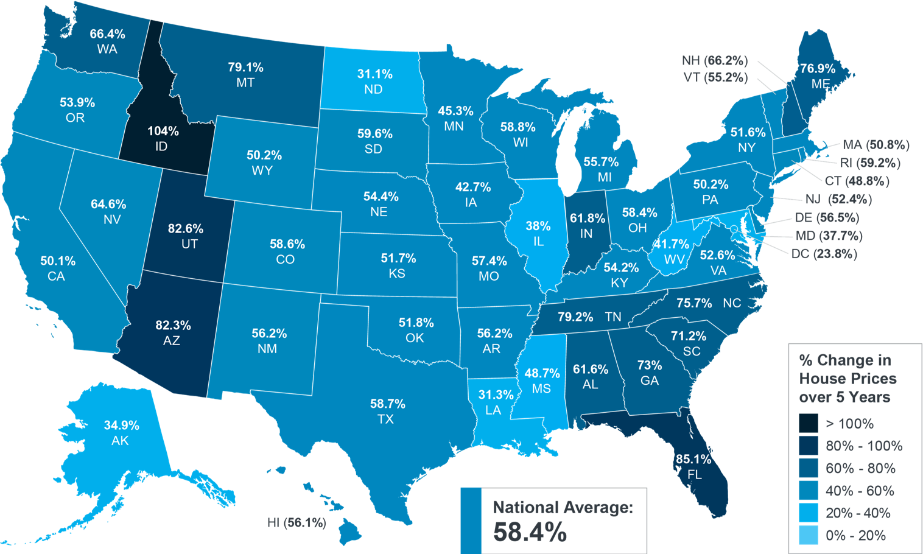
Homeownership Wins over Time
Do you know people who bought a home 5, 10, or even 30 years ago? If you do, then you know they most likely don’t regret it. Why is that? The reason is homeowners gain equity and wealth as their home value grows over time.
Home Price Growth over Time
Over the past year, home price appreciation has slowed throughout the country, but having perspective on the longer-term look on home values is key. While the extent of recent price moderation varies by local market, going forward, experts project home price appreciation in 2023 to be roughly flat or neutral nationwide – not a drastic decline. There just aren’t enough homes on the market for prices to crash.
And when we look at homeownership gains over time, it’s important to see the bigger picture. The map below uses data from the Federal Housing Finance Agency (FHFA) to show just how noteworthy the cumulative gains have been over the last five years:
Percent Change in Home Prices
Over 5 Years, Q4 2022
Source: FHFA
If you look at the percent change in home prices, you can see they grew, on average, by 58.4% nationwide over the last five years. So, while prices may go slightly up or slightly down over shorter periods of time, the long-term benefits are where homeowners truly win.
Notes:
https://www.fhfa.gov/DataTools/Tools/Pages/House-Price-Index-(HPI).aspx

Slide 15
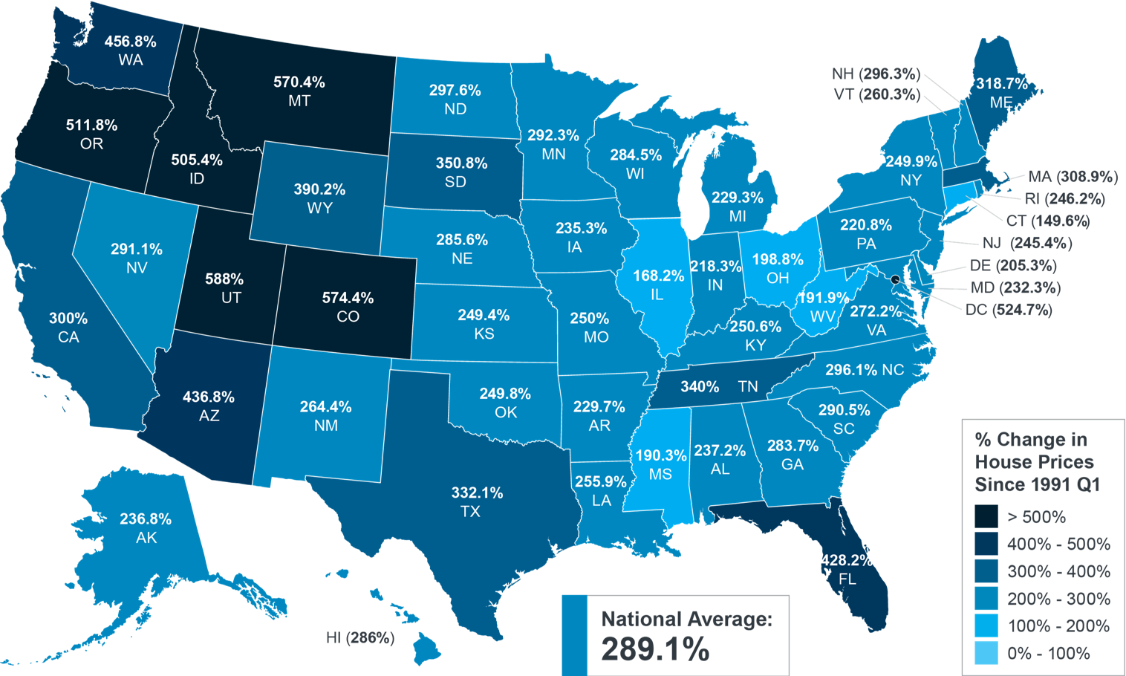
And if you expand that time frame even more, the benefits of homeownership become even clearer (see map below):
Percent Change in Home Prices
Since 1991, Q4 2022
Source: FHFA
This map shows, nationwide, home prices appreciated by an average of almost 300% since 1991.
While home price growth always varies by state and local area, the nationwide average indicates the typical homeowner who bought a house 30 years ago saw their home increase significantly in value over that time. This is why homeowners who bought their homes years ago are still happy with their decision. And while the past won’t always dictate the future of home price appreciation, it can most certainly teach us quite a bit.
And don’t forget – the alternative to buying a home is renting, and rental prices have been climbing for decades. So why rent and deal with annual lease increases and no long-term financial benefits? Instead, if you’re ready, consider buying a home. It’s an investment in your future that could set you up for significant long-term gains.
Bottom Line Data shows home values historically appreciate in the long run, which gives your net worth potential a nice boost. If you’re ready to buy a home, let’s connect today.
Notes:
https://www.fhfa.gov/DataTools/Tools/Pages/House-Price-Index-(HPI).aspx

Slide 16
“The success of your homebuying journey largely depends on the company you keep. As you set out to find the right home . . . be sure to select experienced, trusted professionals who will help you make informed decisions and avoid any pitfalls.”
- Freddie Mac
Notes:
https://myhome.freddiemac.com/buying/finding-your-team

Slide 17
Notes:
https://www.nerdwallet.com/article/mortgages/home-buying-checklist-steps-to-buying-house
https://downpaymentresource.com/

Slide 18
Pre-Approval in 2023: What You Need To Know
One of the first steps when buying a home is getting pre-approved. To understand why it’s such an important step, you need to understand what pre-approval is and what it does for you.
How Does It Work?
As part of the pre-approval process, a lender looks at your finances to decide what they’d be willing to loan you. From there, your lender will give you a pre-approval letter to help you understand how much money you can borrow. That can make it easier when you set out to search for homes because you’ll know your overall numbers. And with higher mortgage rates impacting affordability for many buyers today, a solid understanding of your numbers is even more important.
What Is Pre-Approval?
Business Insider explains:
“In a preapproval [sic], the lender tells you which types of loans you may be eligible to take out, how much you may be approved to borrow, and what your rate could be.”
It gives you critical information about the homebuying process that’ll help you understand your options and what you may be able to borrow.
Notes:
https://www.businessinsider.com/personal-finance/mortgage-preapproval

Slide 19
Pre-Approval Helps Show You’re a Serious Buyer
Pre-approval can help a seller feel more confident in your offer because it shows you’re serious about buying their house. A recent article from Forbes notes:
“From the seller’s perspective, a preapproval letter from a reputable local lender often can make the difference between accepting and rejecting an offer.”
This goes to show, even though you may not face the intense bidding wars you saw if you tried to buy during the pandemic, pre-approval is still an important part of making a strong offer. In fact, Christy Bieber, Personal Finance Writer at The Motley Fool explains it may be the most important part of making an offer:
“The fact that a pre-approval gives you a better chance of getting your offer accepted is undoubtedly the most important reason to complete this step . . .”
Bottom Line Getting pre-approved is an important first step toward buying a home. It lets you know what you can borrow and shows sellers you’re a serious buyer.
Notes:
https://www.forbes.com/advisor/mortgages/what-it-takes-to-be-preapproved-for-a-mortgage-and-why-it-matters/
https://www.nasdaq.com/articles/this-is-the-most-important-reason-to-get-pre-approved-according-to-dave-ramsey.-but-is-he

Slide 20
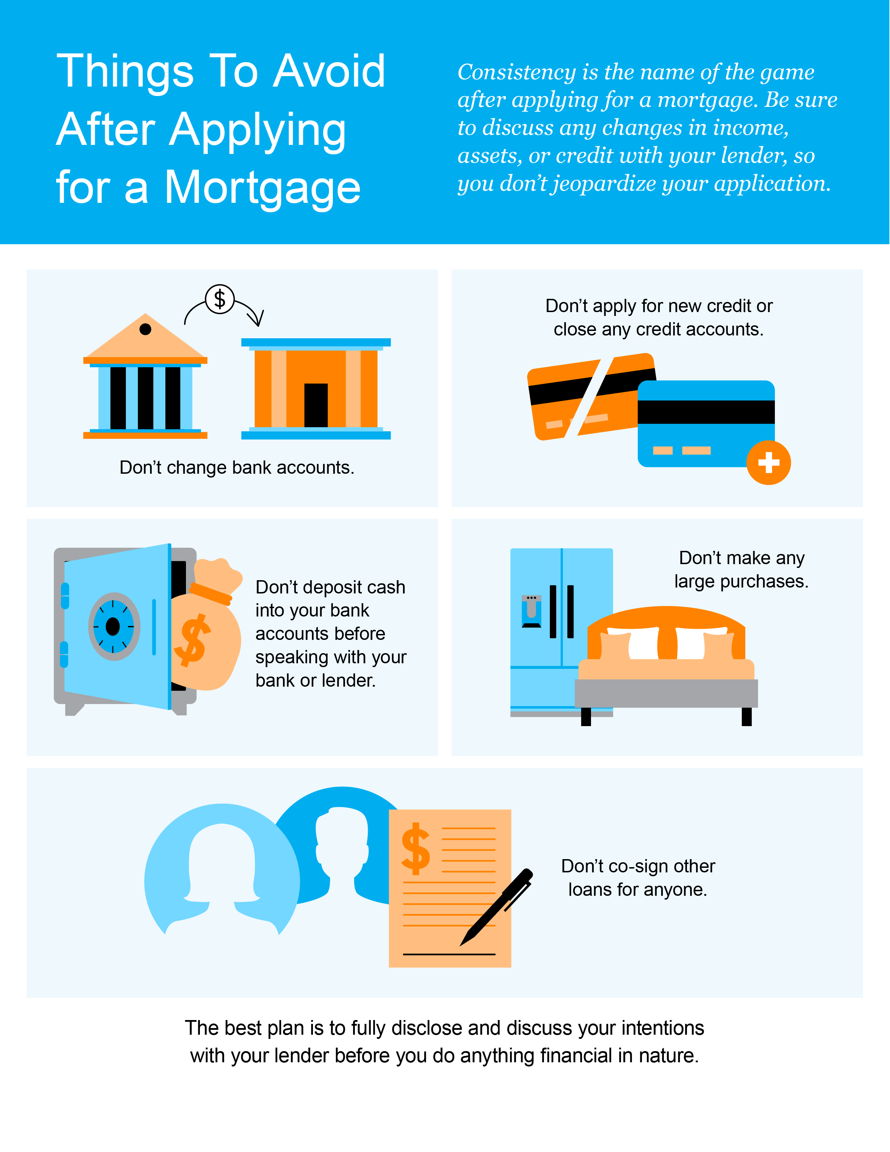

Slide 21
A Real Estate Expert Gives You Clarity in Today’s Housing Market
A real estate expert uses their knowledge of what’s really happening with home prices, housing supply, expert projections, and more to guide you throughout the homebuying process.
Why You Want To Lean on a Trusted Professional
Jay Thompson, Real Estate Industry Consultant, explains:
“Housing market headlines are everywhere. Many are quite sensational, ending with exclamation points or predicting impending doom for the industry. Clickbait, the sensationalizing of headlines and content, has been an issue since the dawn of the internet, and housing news is not immune to it.”
Unfortunately, when information in the media isn’t clear, it can generate a lot of fear and uncertainty in the market. As Jason Lewris, Co-founder and Chief Data Officer at Parcl, says:
“In the absence of trustworthy, up-to-date information, real estate decisions are increasingly being driven by fear, uncertainty, and doubt.”
Notes:
https://www.realestatenews.com/2022/11/18/agents-decoded-making-sense-of-the-headlines
https://www.parcllabs.com/articles/q3-real-estate

Slide 22
But it doesn’t have to be that way. Buying a home is a big decision, and it should be one you feel confident making. You can lean on an expert to help you separate fact from fiction and get the answers you need.
The right agent can help you understand what’s happening at the national and local levels, and they can debunk the headlines using data you can trust. Experts have in-depth knowledge of the industry and can provide context, so you know how current trends compare to the normal ebbs and flows in the industry, historical data, and more.
Then, to make sure you have the full picture, an agent can tell you if your local area is following the national trend or if they’re seeing something different in your market. Together, you can use all that information to make the best possible decision.
After all, making a move is a potentially life-changing milestone. It should be something you feel ready for and excited about. And that’s where a trusted guide come in.
Bottom Line For expert advice and the latest housing market insights, let’s connect.

Slide 23
“Buying a home is no small feat, and it’s one of the biggest financial decisions of your life. When you’re ready to buy, finding a real estate agent with experience to guide you through the homebuying process is key.”
- Bankrate
Notes:
https://www.bankrate.com/real-estate/finding-best-real-estate-agent/

Slide 24
Let’s Chat.
I’m sure you have questions and thoughts about the real estate process.
I’d love to talk with you about what you’ve read here and help you on the path to buying your new home. My contact information is below, and I look forward to working with you.
SPRING 2023 EDITION

