Slide 1
Things To Consider When
Selling Your House
WINTER 2023
EDITION

Slide 2
Table of Contents
3 Should I Sell My House This Winter?
5 Expert Insights for Today’s Sellers
6 What’s Ahead for Mortgage Rates and Home Prices?
8 Top Reasons Homeowners Are Selling
10 What You Need To Know About Home Equity
13 What Increased Housing Supply Means for Current Homeowners
15 Your Home’s Asking Price Matters More Now Than Ever
18 How an Agent Helps Sell Your House
21 A Checklist for Selling Your House
22 Reasons To Hire a Real Estate Professional

Slide 3
Should I Sell My House This Winter?
There’s no denying there’s a lot going on in the housing market this season. That may leave you with some questions about whether it still makes sense to sell your house. Here are three of the top questions you may be asking, and the data that helps answer them so you can make a confident decision.
1. Should I Wait To Sell?
Even though the supply of homes for sale has grown in 2022, inventory is still low overall. The graph below helps put the inventory growth into perspective to show we’re still in sellers’ market territory in terms of housing supply and aren’t near a neutral or buyers’ market. That means you haven’t missed your chance.
As Supply Grows, It’s Still a Sellers’ Market
Months’ Supply of Homes for Sale
2008
2010
Buyers’
Market
(> 7 Months)
2007
2006
Neutral Market (6-7 Months)
Today
Sellers’
Market
(< 6 Months)
1999
Source: NAR
Notes:
https://www.nar.realtor/research-and-statistics/housing-statistics/existing-home-sales
https://www.nar.realtor/newsroom/existing-home-sales-slumped-5-9-in-october

Slide 4
2. Are Buyers Still Out There?
If you’re thinking of selling your house but are hesitant because you’re worried that buyer demand has disappeared in the face of higher mortgage rates, know that isn’t the case for everyone. While demand has eased in 2022, millennials are still looking for homes. As an article in Forbes explains:
“At about 80 million strong, millennials currently make up the largest share of homebuyers (43%) in the U.S., according to a recent National Association of Realtors (NAR) report. Simply due to their numbers and eagerness to become homeowners, this cohort is quite literally shaping the next frontier of the homebuying process. Once known as the ‘rent generation,’ millennials have proven to be savvy buyers who are quite nimble in their quest to own real estate. In fact, I don’t think it’s a stretch to say they are the key to the overall health and stability of the current housing industry.”
While the millennial generation has been dubbed the renter generation, that namesake may not be appropriate anymore. Millennials, the largest generation, are actually a significant driving force for buyer demand in the housing market today. If you’re wondering if buyers are still out there, know that there are still people who are searching for a home to buy. And your house may be exactly what they’re looking for.
3. Can I Afford To Buy My Next Home?
If current market conditions have you worried about how you’ll afford your next move, consider this: you may have more equity in your current home than you realize. Homeowners have gained significant equity over the past few years, and that equity can be a game changer when it comes time to sell and make a move. According to Mark Fleming, Chief Economist at First American:
“. . . homeowners, in aggregate, have historically high levels of home equity. For some of those equity-rich homeowners, that means moving and taking on a higher mortgage rate isn’t a huge deal—especially if they are moving to a more affordable city.”
Bottom Line If you’re thinking about selling your house this season, let’s connect so you have the expert insights you need to make the best possible move today.
Notes:
https://www.forbes.com/sites/forbesbusinesscouncil/2022/05/25/the-power-to-drive-change-how-millennials-are-affecting-the-housing-market/?sh=6d09dd06716c
https://blog.firstam.com/economics/whats-the-outlook-for-housing-market-potential-for-the-rest-of-2022

Slide 5
Expert Insights for Today’s Sellers
Thinking of making a move this winter? Here’s what experts have to say about the market and where it’s headed so you can make a confident decision.
“ | For homeowners deciding whether to make a move this year, remember that listing prices – while lower than a few months ago – remain higher than in prior years, so you’re still likely to find opportunities to cash-in on record-high levels of equity, particularly if you’ve owned your home for a longer period of time. - Danielle Hale, Chief Economist, realtor.com
“ | Demographic trends are creating new buyers: There’s strong demand for homes on many fronts. Many Americans who already owned homes decided during the pandemic that they needed bigger places, especially with the rise of working from home. Millennials are a huge group and in their prime buying years. - Jeff Ostrowski, Senior Mortgage Reporter, Bankrate
“ | Signs of a broader slowdown in the housing market are evident, . . . This is in line with our previous expectations and given the notable cooling of buyer demand due to higher mortgage rates. . . . Nevertheless, buyers still remain interested, which is keeping the market competitive — particularly for attractive homes that are properly priced. - Selma Hepp, Interim Lead of the Office of the Chief Economist, CoreLogic
Notes:
https://news.move.com/2022-09-29-Realtor-com-R-September-Housing-Report-Fall-Home-Shoppers-Find-More-Options-Amid-Still-High-Listing-Prices
https://www.msn.com/en-us/money/realestate/is-the-housing-market-about-to-crash-heres-what-experts-are-saying/ar-AA13bTvV?li=BBnbfcL
https://www.corelogic.com/intelligence/u-s-home-price-insights-august-2022/

Slide 6
What’s Ahead for Mortgage Rates and Home Prices?
As you plan ahead to sell your house and make your move, you may be wondering what lies ahead for mortgage rates and home prices. Here’s a look at expert insights on where both may be headed so you can make the most informed decision possible.
Mortgage Rates Will Continue To Respond to Inflation
There’s no doubt mortgage rates skyrocketed in 2022 as the market responded to high inflation. The increases we saw were fast and dramatic, and the average 30-year fixed mortgage rate even surpassed 7% in the fall. It was the first time they’ve risen that high in over 20 years.
In their quarterly report, Freddie Mac explains just how fast the climb in rates has been:
“Just one year ago, rates were under 3%. This means that while mortgage rates are not as high as they were in the 80’s, they have more than doubled in the past year. Mortgage rates have never doubled in a year before.”
Because we’re in unprecedented territory, it’s hard to say with certainty where mortgage rates will go from here. Projecting the future of mortgage rates is far from an exact science, but experts do agree that, moving forward, mortgage rates will continue to respond to inflation. And, if inflation eases, mortgage rates likely will too.
Notes:
https://www.freddiemac.com/pmms/archive
https://time.com/nextadvisor/mortgages/mortgage-news/mortgage-rates-hit-7/
https://freddiemac.gcs-web.com/node/26166/pdf
https://www.freddiemac.com/research/forecast/20221021-quarterly-forecast-rapidly-rising-rates-declining-demand-driving-housing-market

Slide 7
Home Price Changes Will Vary by Market
As buyer demand has eased in response to those higher mortgage rates, home prices have moderated in many markets too. In terms of the forecast for 2023, some experts are calling for slight price growth while others are projecting slight price declines (see graph below). The best way to look at it is to average all of the expert forecasts together to get the full picture. When we do that, on a national level, it’s roughly neutral or flat appreciation projected for 2023.
Moving forward, home price appreciation will vary by local market, with more significant changes happening in overheated areas. It all depends on other factors at play in that local market, like the balance between supply and demand. As Mark Fleming, Chief Economist at First American, says:
“House price appreciation has slowed in all 50 markets we track, but the deceleration is generally more dramatic in areas that experienced the strongest peak appreciation rates.”
Home Price Forecasts for 2023
Latest Forecast from Each Entity
Fannie Mae
Zelman
-0.2%
Fannie Mae
Zelman
Bottom Line If you want to know what’s happening with home prices or mortgage rates, let’s connect so you have the latest on what experts are saying and what that means for our area.
Notes:
https://blog.firstam.com/economics/pandemic-boom-markets-cooling-the-fastest
https://www.realtor.com/research/2023-national-housing-forecast/
https://www.fanniemae.com/media/44911/display
https://pulsenomics.com/surveys/#home-price-expectations
https://www.freddiemac.com/research/forecast/20221021-quarterly-forecast-rapidly-rising-rates-declining-demand-driving-housing-market
https://www.mba.org/docs/default-source/research-and-forecasts/forecasts/mortgage-finance-forecast-oct-2022.pdf?sfvrsn=d32917_1
https://cdn.nar.realtor/sites/default/files/documents/forecast-q4-2022-us-economic-outlook-09-28-2022.pdf
https://www.zelmanassociates.com/ (by subscription)

Slide 8
Top Reasons Homeowners Are Selling
If you’re thinking of selling your house, you may feel some hesitation since mortgage rates are still relatively high compared to the past couple of years. Even though it’s true that rates are higher, there are other non-financial factors to consider when it comes to making a move.
While your mortgage rate is important, you may have other things in your life that make a move essential. As Jessica Lautz, Vice President of Demographics and Behavioral Insights at the National Association of Realtors (NAR), explains:
“Home sellers have historically moved when something in their lives changed – a new baby, a marriage, a divorce or a new job. . . .”
So, if you’re thinking about selling your house, it may help to explore the other reasons homeowners are choosing to make a move today. A survey by realtor.com asked recent home sellers why they decided to sell. Here’s what they said (see below):
Homeowners’ Top Reasons To Sell
31%
Want different features or amenities
29%
Home no
longer meets
their needs
26%
Need a
home office
to work
23%
Want to be
closer to
loved ones
22%
Want a
smaller home
that’s less work
17%
Don’t need
to live near
their office
Source: realtor.com
Notes:
https://www.nar.realtor/newsroom/home-buyers-motivated-by-desire-to-be-closer-to-family-and-friends-sellers-collected-full-asking-price
https://www.realtor.com/research/2022-summer-sellers-survey/

Slide 9
As the visual on the previous page shows, an appetite for different features or the fact that their current home could no longer meet their needs topped the list for recent sellers. The realtor.com survey summarizes the findings like this:
“The primary reason homeowners decided to sell in the last year was the realization that, after so much time spent at home, they wanted different features and amenities, such as walkability, outdoor space, pool, etc.”
If you, like the homeowners they surveyed, find yourself wanting features, space, or amenities your current home just can’t provide, it may be time to consider selling your house.
Your lifestyle needs may be enough to motivate you to make a change. The best way to find out what’s right for you is to partner with a trusted real estate professional who can provide expert guidance and advice throughout the process. We'll work together to walk through your options, so you can make a confident decision based on what matters most to you and your loved ones.
Bottom Line While the financial reasons for moving are important, there’s often far more to consider. Non-financial reasons can also be a significant motivating factor. If you need help weighing the pros and cons of selling your house, let’s connect.
Notes:
https://www.realtor.com/research/2022-summer-sellers-survey/

Slide 10
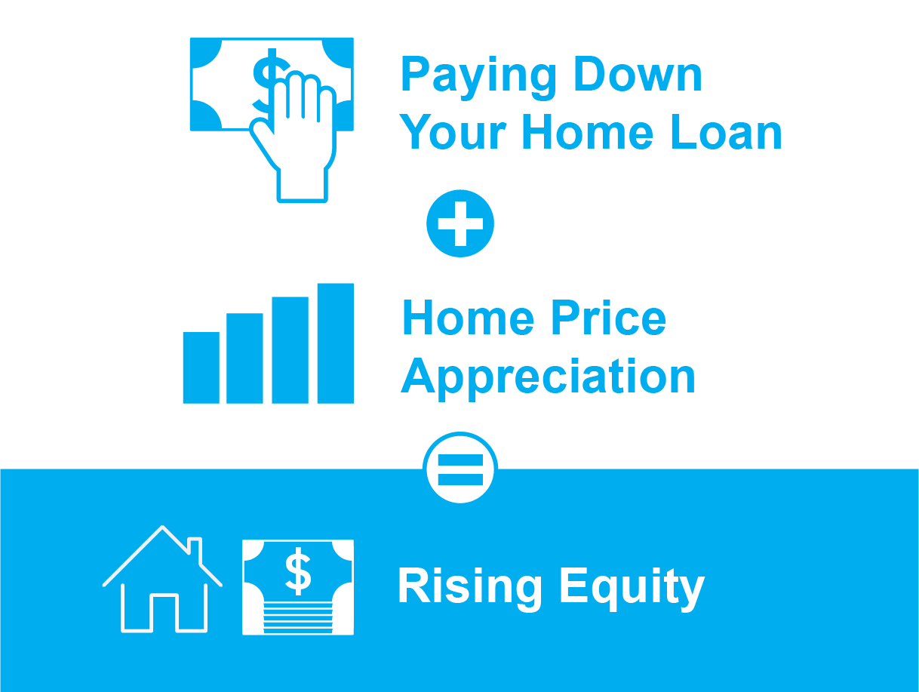
What You Need To Know About Home Equity
If you’re a current homeowner, your net worth got a big boost over the past few years thanks to rising home prices. That increase in your wealth came in the form of home equity. Here’s what you need to know about how equity works and how it can help you address your changing needs if you want to make a move.
Why Your Equity Has Grown in Recent Years
Because there was a significant imbalance between the number of homes available for sale and the number of buyers looking to make a purchase over the past few years, home prices appreciated substantially. And while inventory has grown in 2022, housing supply is still low compared to more normal years for the market.
That’s why, according to the latest Homeowner Equity Insights from CoreLogic, the average homeowner equity has grown by $60,000 over the last 12 months.
What Is Home Equity?
Equity is the current value of your home minus what you owe on the loan.
Over time, you build equity as you make your monthly mortgage payments and as home prices appreciate. It works like this:
Notes:
https://www.corelogic.com/intelligence/homeowner-equity-insights/

Slide 11
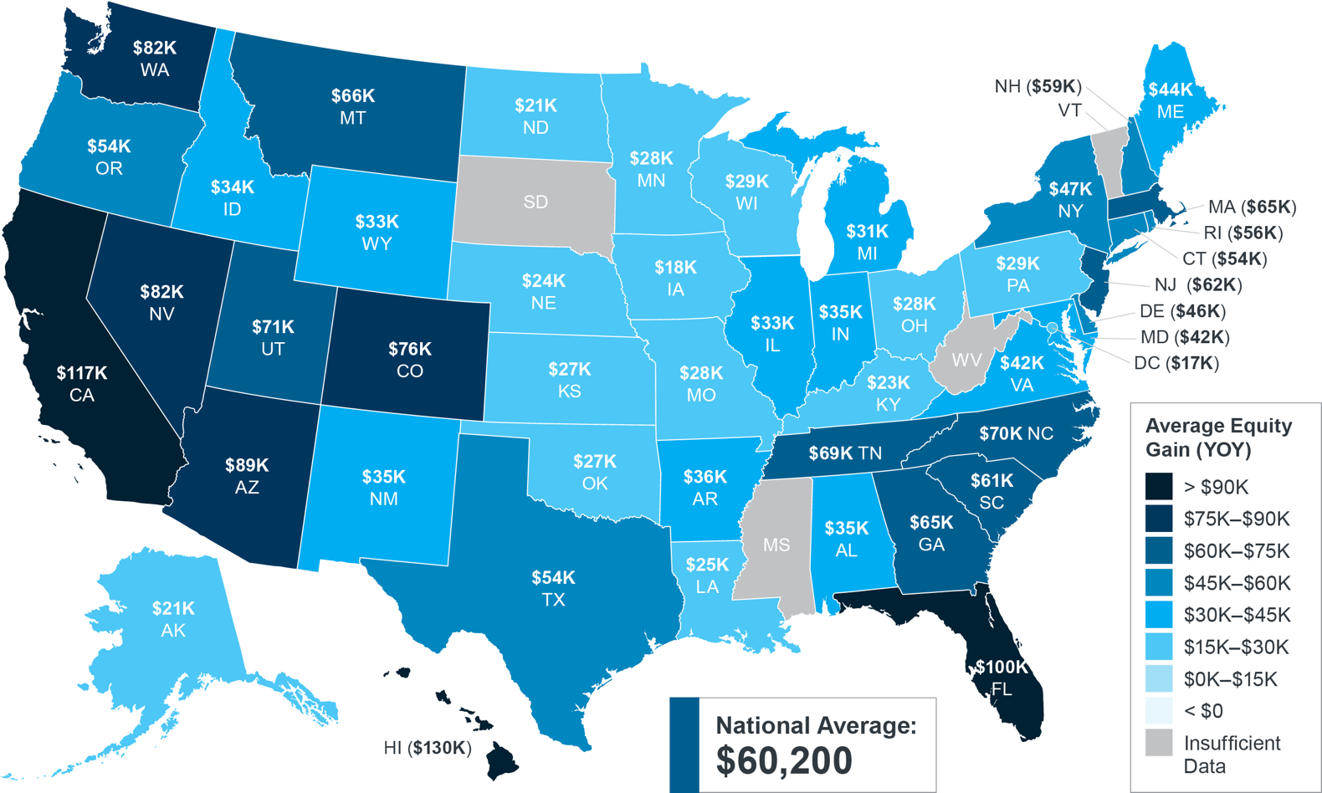
While $60,000 is the national number, if you want to know what happened, on average, over the past year in our area, look at the map below:
Homeowner Equity Gains Over the Past Year
Source: CoreLogic
The Opportunity Your Rising Home Equity Provides
In addition to building your overall net worth, equity can also help you achieve other goals, like buying your next home. When you sell your current house, the equity you’ve built up comes back to you in the sale, and it may be just what you need to cover a large portion – if not all – of the down payment on your next home.
So, if you’ve been holding off on selling or you’re worried about being priced out of your next home, rest assured your equity can help fuel your move.
Bottom Line Let’s connect to determine how much equity you have in your current home and how you can use it to help you make your next move today.
Notes:
https://www.corelogic.com/intelligence/homeowner-equity-insights/

Slide 12
“. . . record equity continues to provide fuel for housing demand, particularly if households are relocating to more affordable areas.”
- Selma Hepp, Interim Lead of the Office of the Chief Economist, CoreLogic
Notes:
https://www.corelogic.com/intelligence/homeowner-equity-insights/

Slide 13
What Increased Housing Supply Means for Current Homeowners
At first glance, the increase in housing supply may not sound like good news for sellers, but it does gives you two distinct opportunities in today’s housing market.
An article from Calculated Risk helps put the inventory gains the market saw in 2022 into perspective by comparing it to recent years (see graph below). It shows supply has surpassed 2021 levels by over 50%. But the further back you look, the more you’ll understand the bigger picture. And if you go all the way back to 2019, the last normal year in real estate, we’re roughly 30% below the housing supply we had at that time.
While It’s Grown, Housing Supply Is Still Low
Inventory the Week Ending November 25th, Compared To Last 3 Years
Source: Calculated Risk
Notes:
https://www.calculatedriskblog.com/2022/11/housing-november-28th-weekly-update.html

Slide 14
Opportunity #1: Take Advantage of More Options for Your Move
If your current house no longer meets your needs or lacks the space and features you want, this inventory growth gives you even more opportunity to sell and move into the home of your dreams. With more houses on the market, you’ll have more to choose from when you search for your next home.
Partnering with a local real estate professional can help you make sure you’re up-to-date on the homes available in our area. And when you do find the one, a professional can advise you on how to write a winning offer to seal the deal.
Opportunity #2: Sell While Inventory Is Still Low Overall
But again, despite the growth, inventory is still low compared to historical norms, and that isn’t going to change overnight. For you, that means your house should still be in demand, if you price it right.
As an article from realtor.com, says:
“Today’s shoppers generally have more homes to consider than last year’s shoppers did, but the market is still not back to pre-pandemic inventory levels.”
Bottom Line If you’re a homeowner looking to sell, you have more homes to choose from and can still sell your house while inventory is low overall. Let’s connect to get started, so you can have the best of both worlds.
Notes:
https://www.realtor.com/research/weekly-housing-trends-view-data-week-sep-17-2022-2/

Slide 15
Your Home’s Asking Price Matters More Now Than Ever
There’s no doubt the housing market is slowing from the frenzy we saw over the past two years. But what does that mean for your asking price if you’re thinking of selling your house?
Today’s Market Is Different Than Recent Years
Higher mortgage rates have impacted the housing market in 2022. As the cost of financing a home purchase rose, buyer demand moderated and that led to more homes to choose from, a decline in bidding wars, and buyers regaining some negotiation power.
While all of that is true, it doesn’t mean it’s suddenly a buyers’ market, just that it’s a more moderate sellers’ market than we’ve seen over the past two years. And, in today's market, the way you price your home matters more than ever.
Why Pricing Your House at Market Value Matters
The price you set for your house sends a message to potential buyers. If you price it too high, you run the risk of deterring buyers.
When that happens, you may have to lower the price to try to reignite interest in your house when it sits on the market for a while. But be aware that a price drop can be seen as a red flag for some buyers who will wonder what that means about the home or if it’s still overpriced.

Slide 16
To avoid the headache of having to lower your price, you’ll want to price it right from the onset.
A real estate advisor knows how to determine that perfect asking price. To find the right price, we balance the value of homes in your neighborhood, current market trends and buyer demand, the condition of your house, and more.
Why You Still Have an Opportunity When You Sell Today
Rest assured, since inventory is still low overall, it’s still a sellers’ market. That means, you’ll still get great benefits if you plan accordingly.
As Logan Mohtashami, Lead Analyst at HousingWire, says:
“Homes that are priced right, especially in areas below 2019 inventory levels, are selling quickly, and those homes that aren’t priced right to the marketplace are taking longer to sell.”
Bottom Line Homes priced appropriately are still selling in today’s real estate market. Let’s connect to make sure you price your house based on current market conditions so you can maximize your potential and minimize your hassle.
Notes:
https://www.housingwire.com/articles/the-standoff-between-homebuyers-and-sellers/

Slide 17
“For sellers, it is clear that today’s housing market is changing rapidly, and striking the right price from the start could be key to a timely and successful transaction.”
- George Ratiu, Senior Economist & Manager, Economic Research, realtor.com
Notes:
https://www.realtor.com/research/case-shiller-home-prices-june-2022/

Slide 18
How an Agent Helps Sell Your House
Today’s market is at a turning point, making it more essential than ever to work with a real estate professional so you can stay up to date and make the best decision possible. Here are five key reasons why working with a real estate professional makes sense right now.
1. We Follow the Latest Market Trends
With higher mortgage rates and moderating buyer demand, conditions are changing and staying on top of the latest market information is crucial when you sell.
Working with an expert real estate advisor helps ensure you can stay updated on what’s happening in both the local area and nationally too. More importantly, we'll know what this data means for you, and we'll be able to help you make your best decision based upon the facts.
2. We Help Maximize Your Pool of Buyers
Your agent’s role in bringing in buyers is important. We have a large variety of tools at our disposal, such as social media followers, agency resources, and the Multiple Listing Service (MLS) to ensure your house is viewed by the most buyers. Investopedia explains why it’s risky to sell on your own without the network an agent provides:
“You don’t have relationships with clients, other agents, or a real estate agency to bring the largest pool of potential buyers to your home. A smaller pool of potential buyers means less demand for your property, which can translate into waiting longer to sell your home and possibly not getting as much money as your house is worth.”
Notes:
https://www.investopedia.com/articles/personal-finance/071514/8-reasons-not-sell-your-home-without-agent.asp#toc-4-agents-access-large-networks

Slide 19
3. We Understand the Fine Print
Today, more disclosures and regulations are mandatory when selling a house. The National Association of Realtors (NAR) explains it best, saying:
“Selling a home typically requires a variety of forms, reports, disclosures, and other legal and financial documents. . . . there’s a lot of jargon involved in a real estate transaction; you want to work with a professional who can speak the language.”
A real estate professional knows exactly what needs to happen, what all the paperwork means, and how to work through it efficiently. We'll help you review the documents and avoid any costly missteps that could occur if you try to handle them on your own.
4. We're Trained Negotiators
If you sell without a professional, you’ll also be solely responsible for the negotiations. That means you’ll have to coordinate with:
The buyer, who wants the best deal possible
The buyer’s agent, who will use their expertise to advocate for the buyer
The inspection company, which works for the buyer and will almost always find concerns with the house
The appraiser, who assesses the property’s value to protect the lender
In today’s changing market, buyers are regaining some negotiation power as bidding wars ease. Instead of going toe-to-toe with all the above parties alone, lean on an expert who knows what levers to pull, how to address everyone’s concerns, and when to get a second opinion.
5. We Know How To Set the Right Price for Your House
Real estate professionals also know how to price your house accurately and competitively, so you don’t overprice or underprice your home for today's market. NAR explains it like this:
“A great real estate agent will look at your home with an unbiased eye, providing you with the information you need to enhance marketability and maximize price.”
Bottom Line A real estate agent has essential insights you’ll want to rely on throughout the transaction. Don’t go at it alone. If you plan to sell, let’s connect so you have an expert on your side.
Notes:
https://magazine.realtor/sales-and-marketing/handouts-for-customers/for-sellers/8-reasons-to-work-with-a-realtor

Slide 20
“Today’s market is different than it was just six months ago. . . . Sellers that want the contract to move forward should be willing to work with the buyer. . . . Consider helping with the closing costs or addressing many of the items on the home inspection list.”
- Ali Wolf, Chief Economist at Zonda
Notes:
https://www.realtor.com/advice/sell/reasons-home-sales-fall-through/

Slide 22
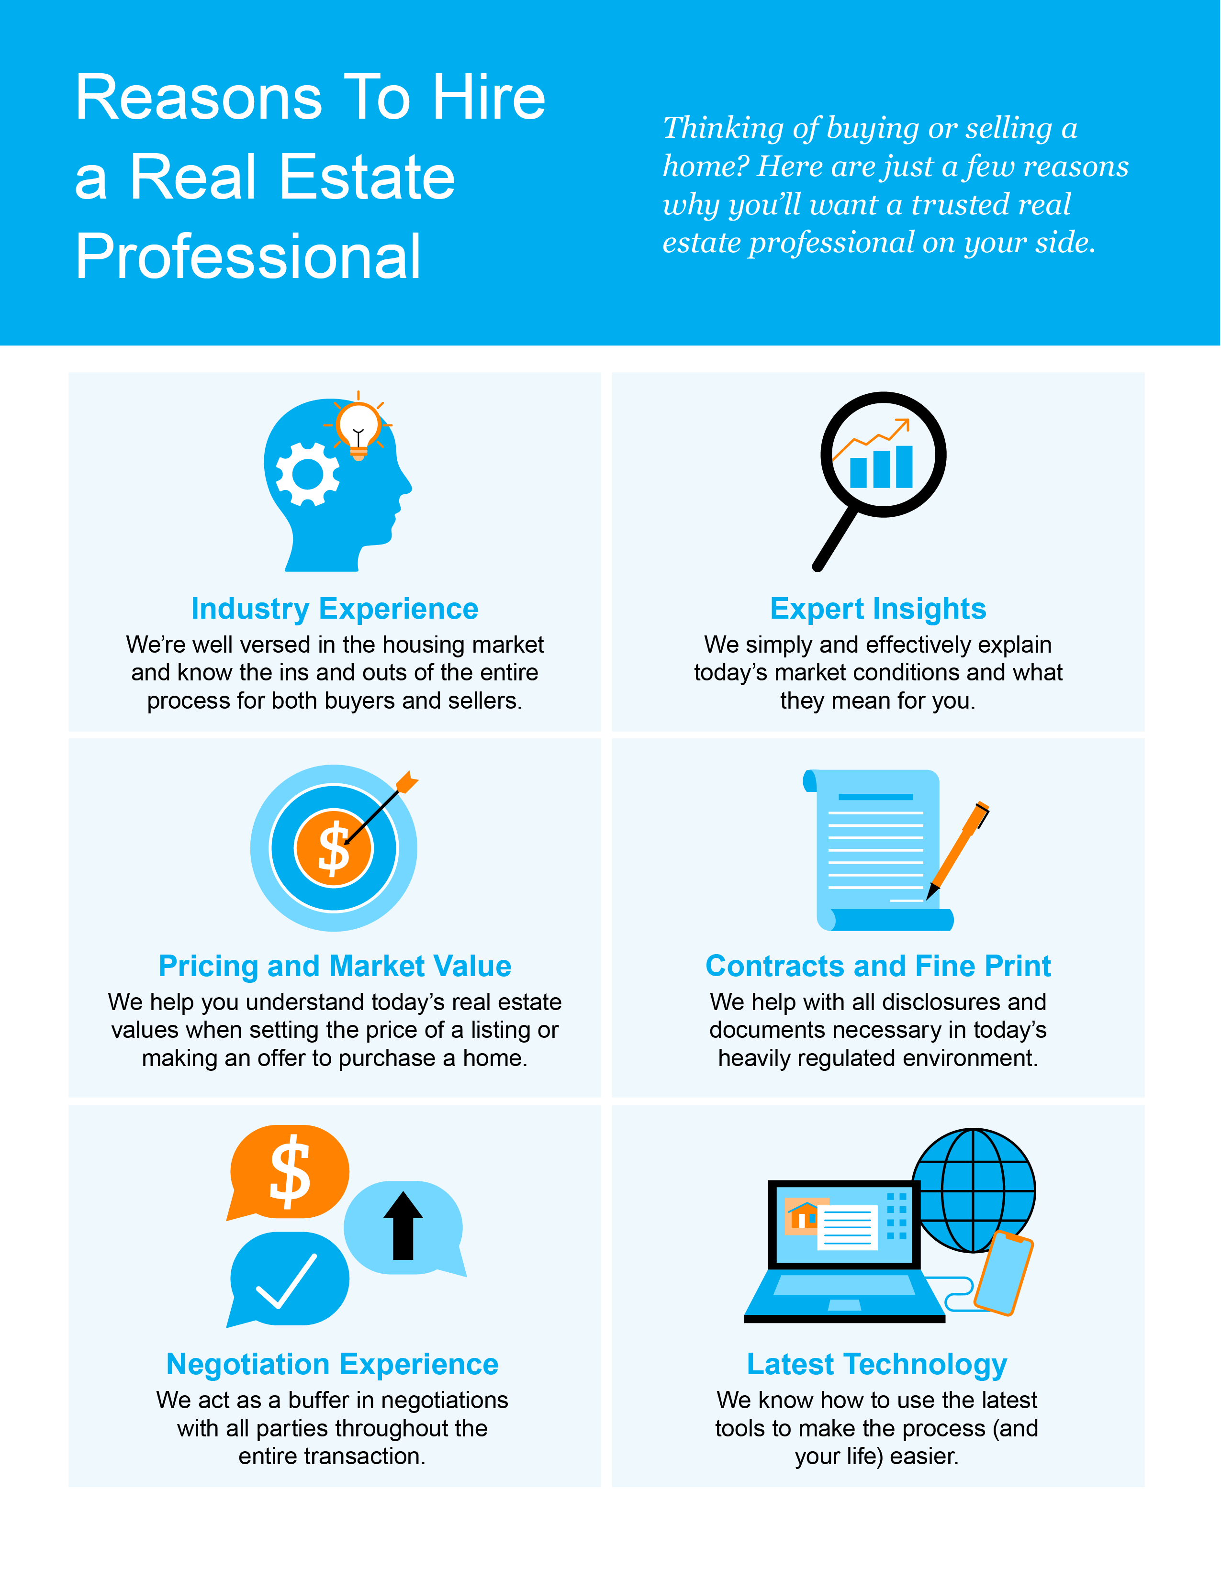

Slide 23
“Buying or selling a home involves a series of requirements and variables, and it's important to have someone in your corner from start to finish to make the process as smooth as possible . . .”
- Leslie Rouda Smith, 2022 President, National Association of Realtors
Notes:
https://www.nar.realtor/newsroom/existing-home-sales-decreased-1-5-in-september

Slide 24
Let’s Chat.
I’m sure you have questions and thoughts about the real estate process.
I’d love to talk with you about what you’ve read here and help you on the path to selling your house. My contact information is below, and I look forward to working with you.
WINTER 2023 EDITION

