Slide 1
Things To Consider When
Buying a Home
WINTER 2023
EDITION

Slide 2
Table of Contents
3 What’s Happening in the Housing Market?
5 Expert Insights for Today’s Homebuyers
6 3 Trends That Are Good News for Homebuyers
9 Top Reasons To Own Your Home
10 The Non-Financial Benefits of Homeownership
13 Why Buying a Home May Make More Sense Than Renting
14 The Long-Term Benefit of Homeownership
17 Tips for Buyers in Today’s Housing Market
19 A Crucial First Step: Mortgage Pre-Approval
20 Things To Avoid After Applying for a Mortgage
21 A Trusted Real Estate Advisor Provides Expert Advise

Slide 3
What’s Happening in the Housing Market?
With everything going on in the housing market right now, you may have a number of questions about what that means for you and your plans to buy a home. Here are three things that are likely top of mind for you.
1. Why Did Mortgage Rates Rise So Much In 2022?
In 2022, inflation reached a high not seen in 40 years. As it did, you probably felt the pinch at the gas pump and in the grocery store. But inflation did more than increase the cost of goods and services, it also led to the rapid rise in mortgage rates. CNET explains:
“As a general rule, when inflation is low, mortgage rates tend to be lower. When inflation is high, rates tend to be higher.”
As mortgage rates rose, they impacted your purchasing power by increasing the cost of buying a home. And moving forward, experts agree rates will continue to respond to inflation. If inflation eases, rates may decline as a result.
2. What’s Happening with Home Prices?
Headlines about home prices can be confusing. While home price appreciation has cooled, where home prices will go from here will vary based on supply and demand in our local market.
That may be why some experts say prices will decline slightly and others say they’ll continue to climb, just more moderately than they have been.
Notes:
https://www.bloomberg.com/news/articles/2022-10-13/core-us-inflation-rises-to-40-year-high-securing-big-fed-hike?sref=BRvilyBN
https://www.cnet.com/personal-finance/mortgages/mortgage-rates-on-sep-26-2022-rates-tick-up/

Slide 4
3. Should I Buy a Home Today?
Even with higher mortgage rates and today’s home prices, it can still make sense to buy a home today. That’s because buying a home is so much more than just a financial decision. It’s a lifestyle choice as well. As Freddie Mac, says:
"Deciding whether to rent or buy depends on your financial situation, future plans and lifestyle. Both options have benefits that you need to carefully consider before making your decision.”
If your needs have changed or if you are looking for a space that’s truly your own, there are still many compelling reasons to buy a home today. The sense of accomplishment, the wealth building opportunity, and the chance to stabilize your monthly payments can make it all worthwhile.
Bottom Line Don’t let the uncertainty in the market put your dreams on hold. Let’s connect so you have an expert on your side to answer all your housing market questions. Together, we’ll review your goals and what’s happening in our market so you have the information you need to make a powerful and confident decision.
Notes:
https://myhome.freddiemac.com/blog/rental-housing/rent-or-buy-which-option-right-you

Slide 5
Expert Insights for Today’s Homebuyers
If you want to buy a home today, here are a few things experts say you should know about what to expect and why homeownership is so important.
“ | Buyers will continue to see less competition for homes and have more time to tour homes they like and consider their options. - Michael Lane, VP and General Manager, ShowingTime
“ | While mortgage rates are expected to continue to drift higher over the coming months, much of the rapid increase in rates is likely behind us. Mark Fleming, Chief Economist, First American
“ | The key to making a good decision in this challenging housing market is to be laser focused on what you need now and in the years ahead, so that you can stay in your home long enough that buying is a sound financial decision. - Danielle Hale, Chief Economist, realtor.com
“ | Homeownership is still considered one of the most reliable ways to build wealth. When you make monthly mortgage payments, you're building equity in your home. . . . When you rent, you aren't investing in your financial future the same way you are when you're paying off a mortgage. - CNET
Notes:
https://www.showingtime.com/blog/august-2022-showing-index-results/
https://www.firstam.com/news/2022/overvalued-markets-increasing-20220927.html
https://twitter.com/RDC_Economics/status/1590722818639269889
https://www.cnet.com/personal-finance/mortgages/should-you-buy-a-home-in-2022-3-factors-to-consider/

Slide 6
3 Trends That Are Good News for Homebuyers
As the market has cooled, some of the intensity buyers faced during the peak frenzy of the pandemic has cooled too. Here are just a few trends that may be beneficial when you go to buy a home today.
1. More Homes To Choose From
During the pandemic, housing supply hit a record low at the same time buyer demand skyrocketed. This combination made it difficult to find a home because there just weren’t enough homes available for sale to meet buyer demand.
According to realtor.com, the supply of homes for sale has increased by 46.8% compared to 2021. While supply is still lower than more normal years, you do have more to choose from in your home search today. That makes finding your dream home a bit less difficult.
2. Bidding Wars Have Eased
One of the top stories in real estate headlines over the past two years was the intensity and frequency of bidding wars. But today, things are different. With more options, you’ll also likely see less competition from other buyers looking for homes. According to the National Association of Realtors (NAR), the average number of offers on recently sold homes has declined. In October 2022, the average was 2.4 offers per sale. In contrast, in October 2021, the average was 3.7 offers per sale.
Notes:
https://www.realtor.com/research/november-2022-data/
https://cdn.nar.realtor/sites/default/files/documents/2022-10-realtors-confidence-index-11-18-2022.pdf

Slide 7
If you tried to buy a house over the past two years, you probably experienced the bidding war frenzy firsthand, and may have been outbid on several homes along the way. Now, you have a chance to jump back into the market and enjoy searching for a home with less competition.
3. More Negotiation Power
When you have less competition, you also have more negotiating power as a buyer. During the frenzy of the past few years, more buyers were willing to skip important steps in the homebuying process, like the appraisal or inspection, to try to win a bidding war. But NAR shows the percentage of buyers waiving those contingencies is down year over year.
As a buyer, this is good news. The appraisal and the inspection give you important information about the value and condition of the home you’re buying. And, if something turns up in the inspection, you have more power today to re-negotiate with the seller.
A survey from realtor.com confirms more sellers are accepting offers that include contingencies. According to that report, 95% of sellers said buyers requested a home inspection, and 67% negotiated with buyers on repairs as a result of the inspection findings.
Bottom Line While buyers still face challenges today, they’re not necessarily the same ones you may have been up against just a year or so ago. If you’ve been outbid or had trouble finding a home in the past, now may be the moment you’ve been waiting for. Let’s connect to start the homebuying process today.
Notes:
https://cdn.nar.realtor/sites/default/files/documents/2022-10-realtors-confidence-index-11-18-2022.pdf
https://www.realtor.com/research/2022-summer-sellers-survey/

Slide 8
“. . . winter shoppers will see lower prices than we saw this summer. . . . On top of that, shoppers in some markets may find sellers who are more willing to negotiate on price or other contract terms than they have been in recent years, especially for a home that has been on the market for a longer period of time.”
- Danielle Hale, Chief Economist, realtor.com
Notes:
https://www.realtor.com/news/trends/where-are-budget-minded-americans-moving-these-10-surprising-up-and-coming-real-estate-markets/

Slide 10
The Non-Financial Benefits of Homeownership
While you could see less competition and more room for negotiation, you may be wondering if now’s the best time to buy a home given mortgage rates are higher than they were last year. While the financial aspects are important to consider, there are also powerful non-financial reasons it may make sense to become a homeowner.
Homeowners Can Make Their Home Truly Their Own
Owning your home gives you a significant sense of freedom because it’s a space you can customize to your heart’s desire. That can bring you added happiness.
In fact, a report from the National Association of Realtors (NAR) shows making updates or remodeling your home can help you feel more at ease and comfortable in your living space. NAR measures this with a Joy Score that indicates how much happiness specific home upgrades bring:
“There were numerous interior projects that received a perfect Joy Score of 10: paint entire interior of home, paint one room of home, add a new home office, hardwood flooring refinish, new wood flooring, closet renovation, insulation upgrade, and attic conversion to living area.”
And as a homeowner, unless there are specific homeowner’s association requirements, you typically won’t have to worry about the changes you can and can’t make.
If you rent, you may not have the same freedom. And if you do make changes as a renter, there’s a good chance you’ll need to revert them back at the end of your lease based on your rental agreement. That can add additional costs when you move out.
Notes:
https://cdn.nar.realtor/sites/default/files/documents/2022-remodeling-impact-report-04-19-2022.pdf

Slide 11
Owning a Home Can Give You a Greater Sense of Achievement
There’s no denying taking care of your home is a large responsibility, but it’s one you’ll take pride in as a homeowner. Freddie Mac explains:
“As the homeowner, you have the freedom to adopt a pet, paint the walls any color you choose, renovate your kitchen, and more. . . . Of course, along with the freedoms of homeownership come responsibilities, such as making your monthly mortgage payments on time and maintaining your home. But as the property owner, you’ll be caring for your own investment.”
You’re not taking care of a living space that belongs to someone else. The space is yours. As an added benefit, you may get a return on investment for any upgrades or repairs you make.
Homeownership Can Lead to Greater Community Engagement
That sense of ownership and your feelings of responsibility can even extend beyond the walls of your home. Your home also gives you a stake in your community. Because the average homeowner stays in their home for longer than just a few years, that can lead to having a stronger connection to our local area. NAR notes:
“Living in one place for a longer amount of time creates an obvious sense of community pride, which may lead to more investment in said community.”
If you’re looking to put down roots, homeownership can help fuel a sense of connection to the area and those around you.
Bottom Line If you’re planning to buy a home, know that homeownership has the power to change your life. Let’s connect to discuss everything homeownership has to offer.
Notes:
https://myhome.freddiemac.com/blog/homeownership/4-benefits-owning-home
https://cdn.nar.realtor/sites/default/files/documents/2022-home-buyers-and-sellers-generational-trends-03-23-2022.pdf
https://www.nar.realtor/promoting-home-ownership

Slide 12
“The personal satisfaction and sense of accomplishment achieved through homeownership can enhance psychological health, happiness and well-being for homeowners and those around them.”
- The National Association of Realtors
Notes:
https://www.nar.realtor/sites/default/files/documents/white-paper-homeownership-incentivized-by-federal-system-02-06-2020.pdf

Slide 13
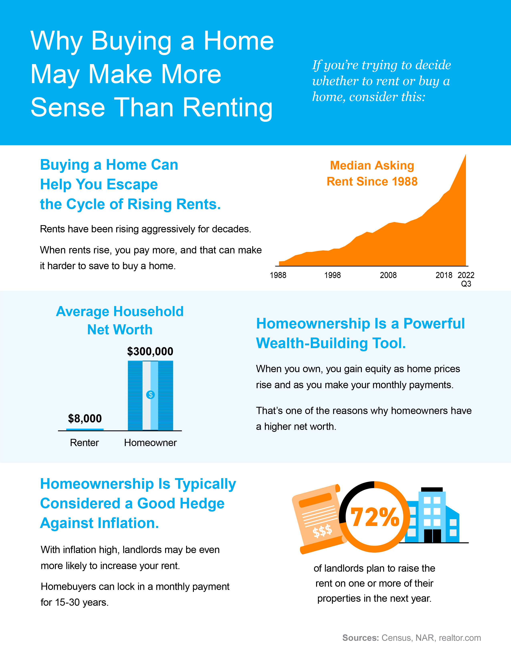
Notes:
http://www.census.gov/housing/hvs/files/currenthvspress.pdf
https://cdn.nar.realtor/sites/default/files/documents/2022-snapshot-of-race-and-home-buying-in-the-us-report-02-23-2022_0.pdf
https://www.realtor.com/research/july-2022-rent/

Slide 14
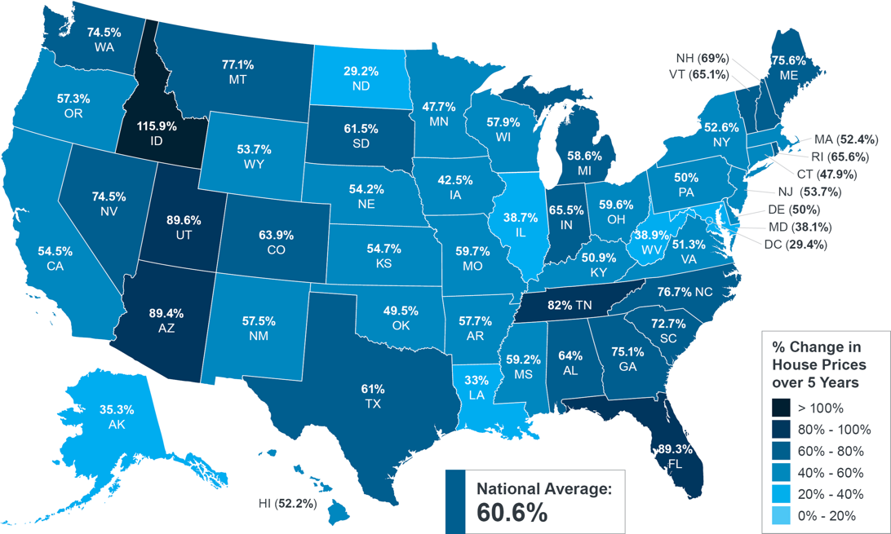
The Long-Term Benefit of Homeownership
Consider this: if you know people who bought a home 5, 10, or even 30 years ago, you’re probably going to have a hard time finding someone who regrets their decision. Why is that? The reason is tied to how you gain equity and wealth as home values grow with time.
Home Price Growth over Time
Even though home price appreciation has moderated in 2022, home values have still increased significantly in recent years. The map below uses data from the Federal Housing Finance Agency (FHFA) to show just how noteworthy those gains have been over the last five years:
Percent Change in Home Prices
Over 5 Years
Source: FHFA
If you look at the percent change in home prices, you can see prices grew on average by around 60% nationwide over the last five years. That means a home’s value can increase substantially, even in a short period of time.
Notes:
https://www.fhfa.gov/DataTools/Tools/Pages/House-Price-Index-(HPI).aspx

Slide 15
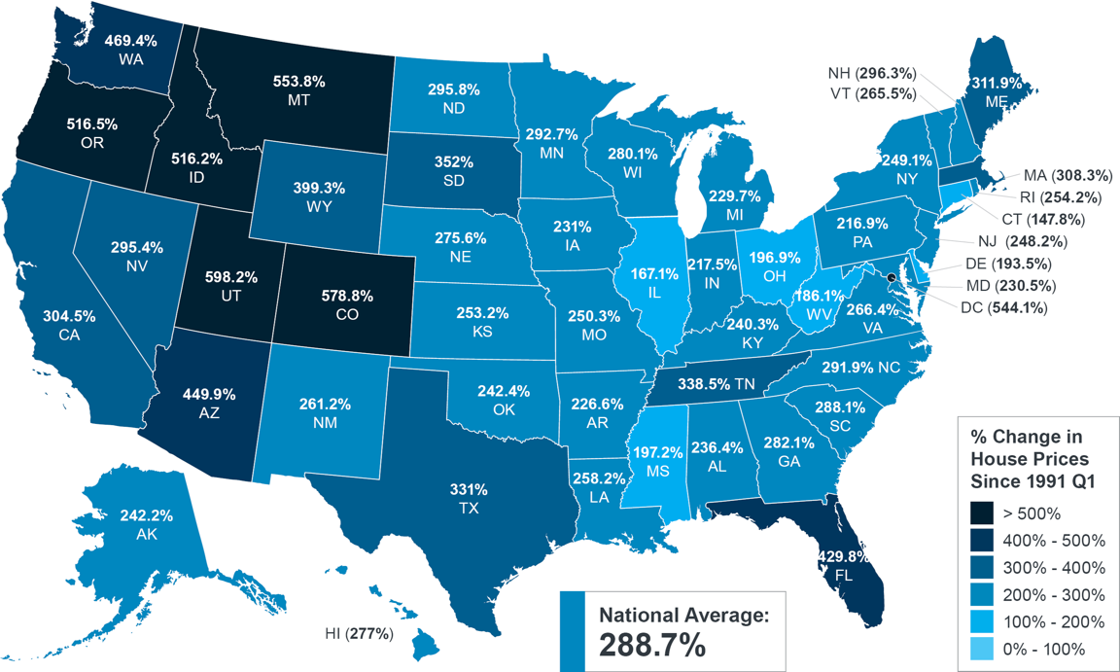
And if you expand that time frame even more, the benefit of homeownership and the drastic gains you stand to make become even clearer (see map below):
Percent Change in Home Prices
Since 1991
Source: FHFA
The second map shows, nationwide, home prices appreciated by an average of nearly 290% in roughly a 30-year span.
While home price growth varies by state and local area, the nationwide average tells you the typical homeowner who bought a house 30 years ago saw their home increase significantly in value over that time. This is why homeowners who bought their homes years ago are still happy with their decision.
The alternative to buying a home is renting, and rental prices have been climbing for decades. So why rent and deal with annual lease hikes for no long-term financial benefit? Instead, if you’re ready, consider buying a home. It’s an investment in your future that could set you up for long-term gains.
Bottom Line Data shows home values typically appreciate over time, and that gives your net worth a nice boost. If you’re ready to buy a home, let’s connect today.
Notes:
https://www.fhfa.gov/DataTools/Tools/Pages/House-Price-Index-(HPI).aspx

Slide 16
“Buying or selling a home involves a series of requirements and variables, and it's important to have someone in your corner from start to finish to make the process as smooth as possible.”
- Leslie Rouda Smith, 2022 President, National Association of Realtors
Notes:
https://www.nar.realtor/newsroom/existing-home-sales-decreased-1-5-in-september

Slide 17
Tips for Buyers in Today’s Housing Market
It’s clear the 2022 housing market has been defined by higher mortgage rates. If you’re thinking of buying a home, here are a few things you can do to help prepare for your purchase with that in mind.
1. Get Pre-Approved
If you’re planning to buy a home this year, one of the first steps is getting pre-approved for a mortgage. As part of the pre-approval process, a lender will look at your finances to determine what they’d be willing to loan you. From there, your lender will help you understand your true price range and how much money you can borrow. In a higher mortgage rate environment, that can make it easier when you set out to search for homes because you’ll know your overall numbers.
2. Expand Your Search Area and Criteria
If you’ve been looking for a home in the city center or a specific area that’s starting to feel out of your price range, you may want to try looking a little further out in a location that could be more affordable. Expanding your search or re-prioritizing the items on your wish list can open up opportunities you haven’t considered, and that could help you afford more of what you need (and want) in a home. As CNET notes:
“Area growth is likely to keep pace with the market, which means that the outskirts of town might be hopping within five years. Consider stepping out of your ideal location by searching in the nearby cities. You may find better prices and more square footage.”
Notes:
https://www.cnet.com/personal-finance/mortgages/6-tips-for-buyers-in-competitive-real-estate-markets/

Slide 18
3. Explore Alternate Financing Options
Working with a trusted lender to learn about the different loan types and options is essential too. According to NerdWallet:
“A variety of mortgages are available with varying down payment and eligibility requirements.”
Experts know how to point you in the right direction when it comes to exploring ways to find the best home loan for your situation. There may be an ideal option out there your loan officer can introduce you to. This could make a home purchase more affordable and within your financial reach over the life of your loan.
4. Look for Grants, Gift Funds, and Down Payment Assistance
There are also many options available when it comes to securing the funding you need to purchase a home. One site to explore is downpaymentresource.com. Searching for specific down payment assistance options available in your local community could be a game changer when it comes to taking your first step toward homeownership. As the National Association of Realtors (NAR) indicates:
“Many local governments and non-profit organizations offer down-payment assistance grants and loans, targeted to area borrowers and often with specific borrower requirements.”
Plus, there are programs and special benefits for individuals working in certain professions or with unique statuses, including teachers, doctors, nurses, and veterans.
Ultimately, there are many federal, state, and local programs available for you to explore. The best way to do that is to connect with professionals to learn more about what’s available in our area.
Bottom Line If you’re concerned about the rising costs of buying a home, know you have options that can still help you achieve your dreams today. For an expert guide, let’s connect.
Notes:
https://www.nerdwallet.com/article/mortgages/tips-for-first-time-home-buyers
https://downpaymentresource.com/
https://www.nar.realtor/first-time-homebuyers/first-time-homebuyer-loans-grants

Slide 19
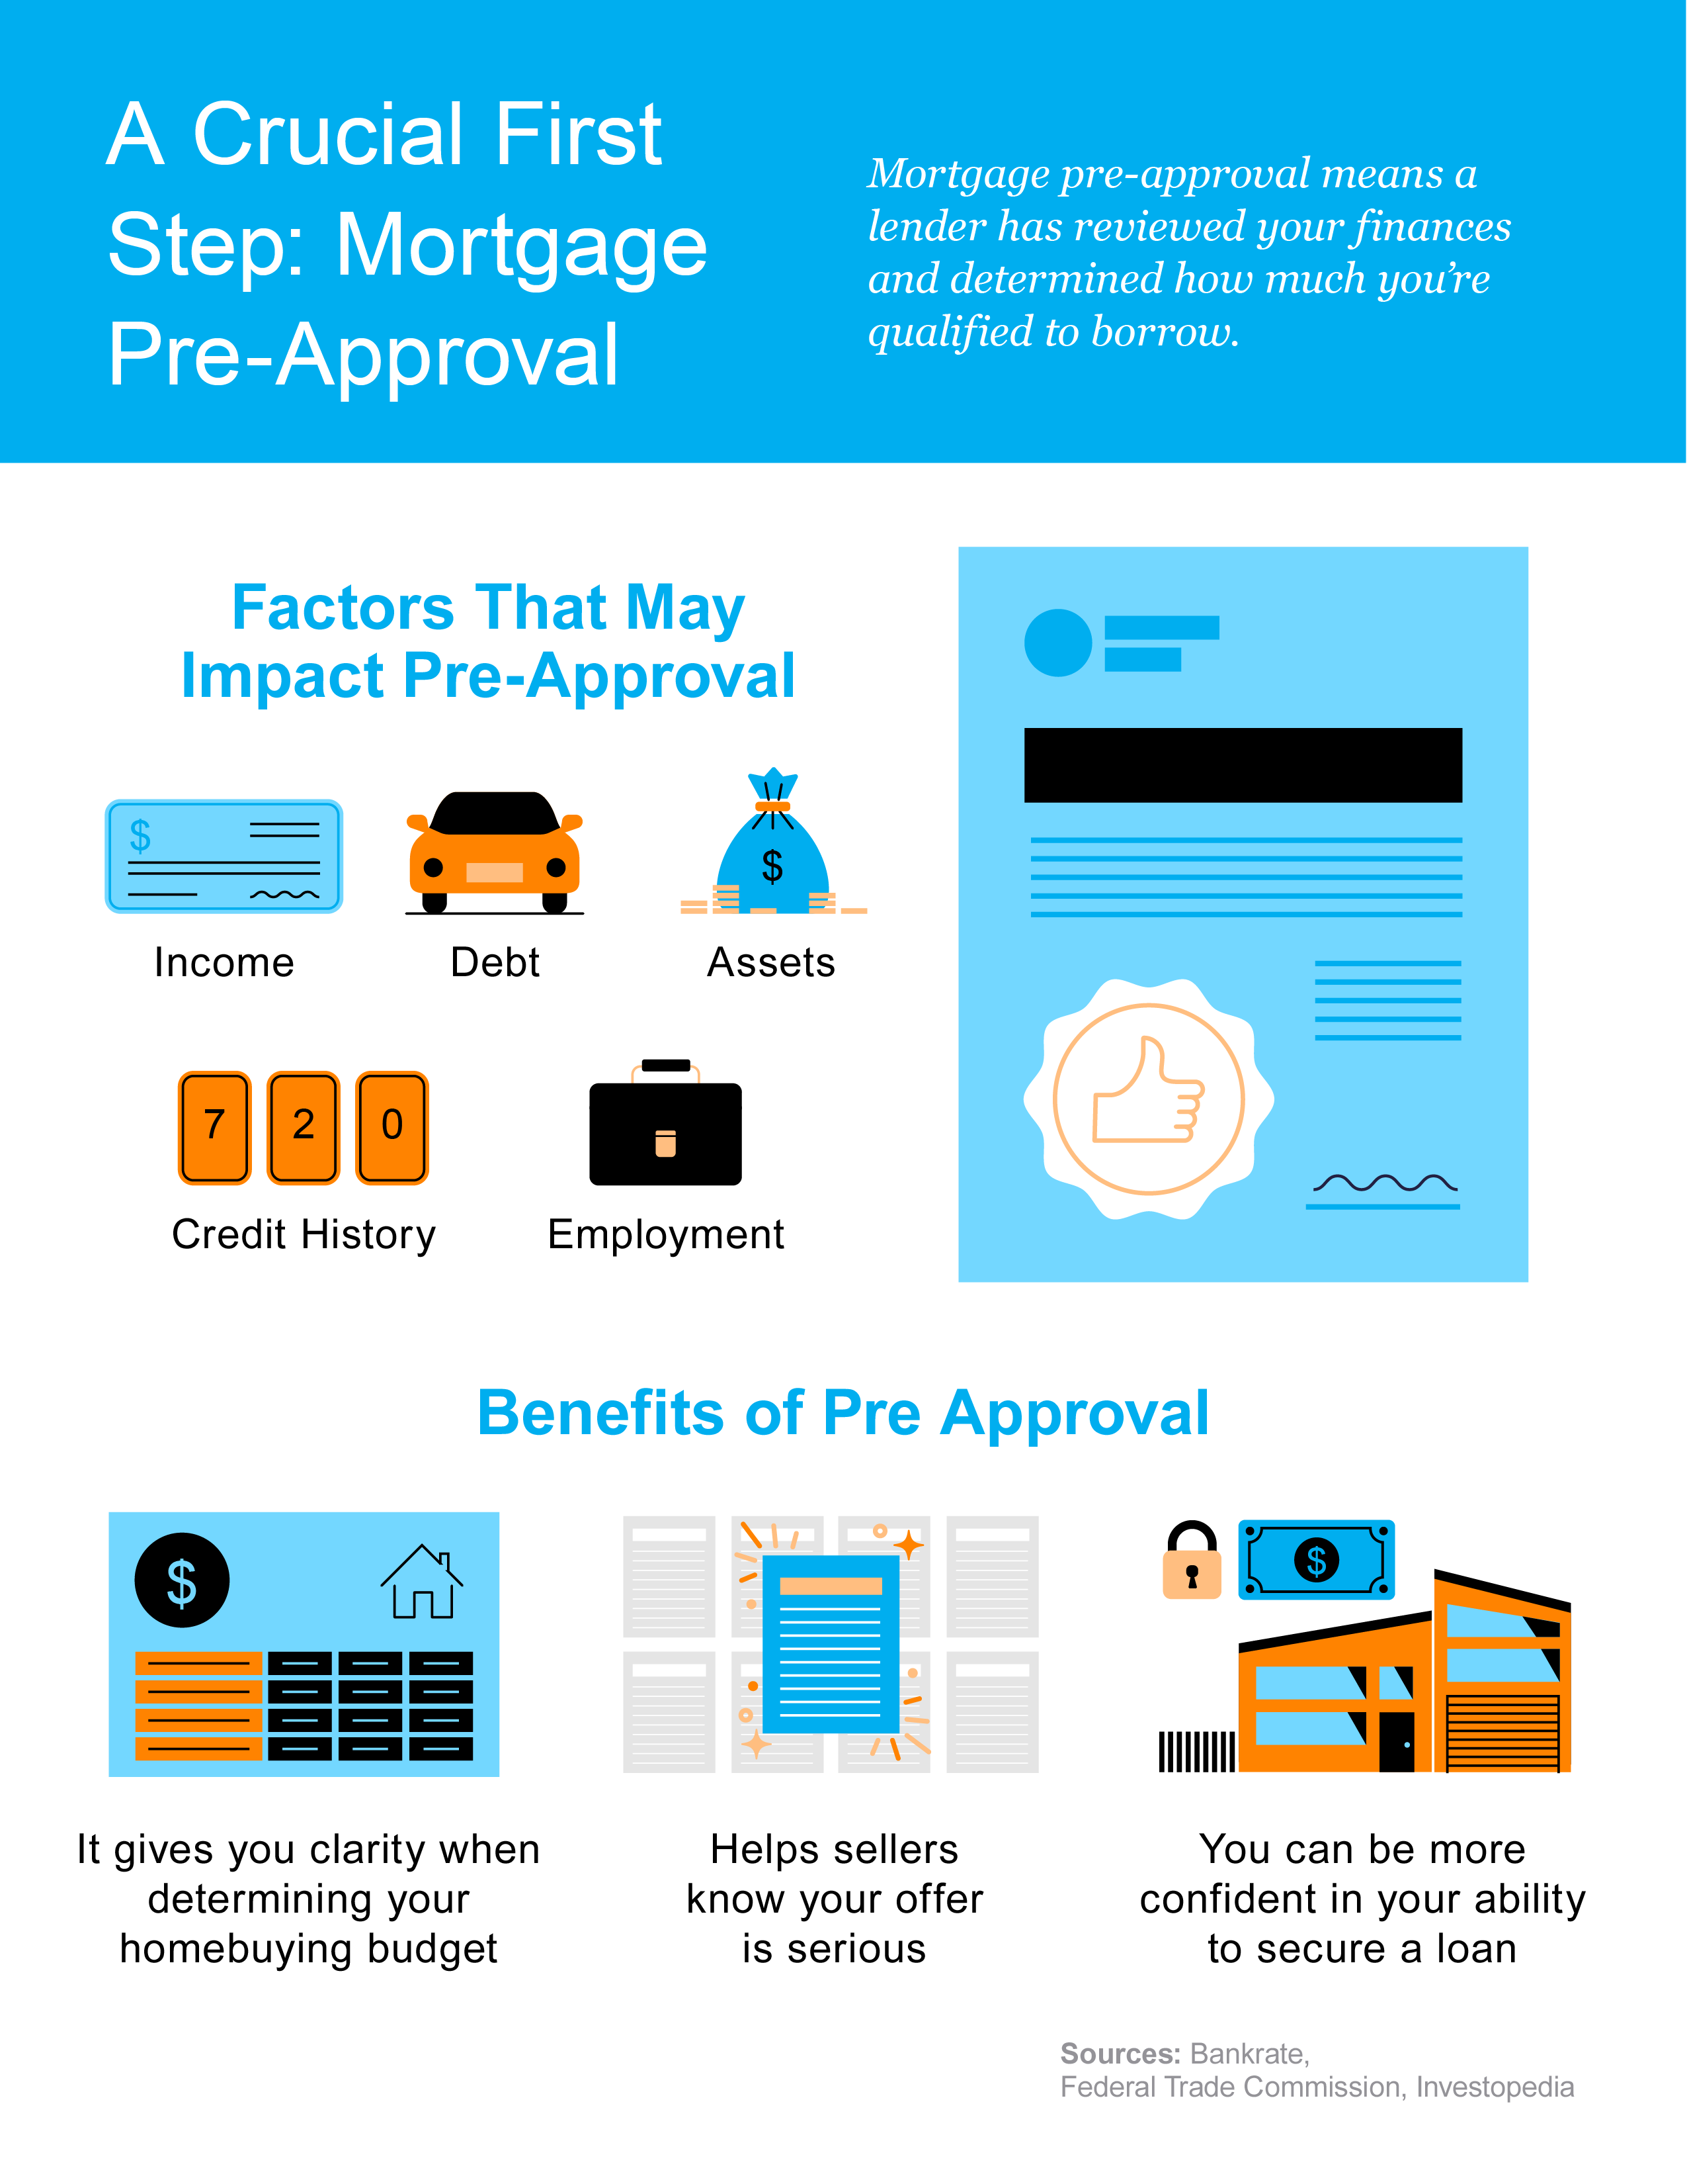
Notes:
https://www.bankrate.com/mortgages/pre-approval/
https://www.ftc.gov/sites/default/files/documents/one-stops/real-estate-competition/realestateglossary.pdf
https://www.investopedia.com/financial-edge/0411/5-things-you-need-to-be-pre-approved-for-a-mortgage.aspx

Slide 20
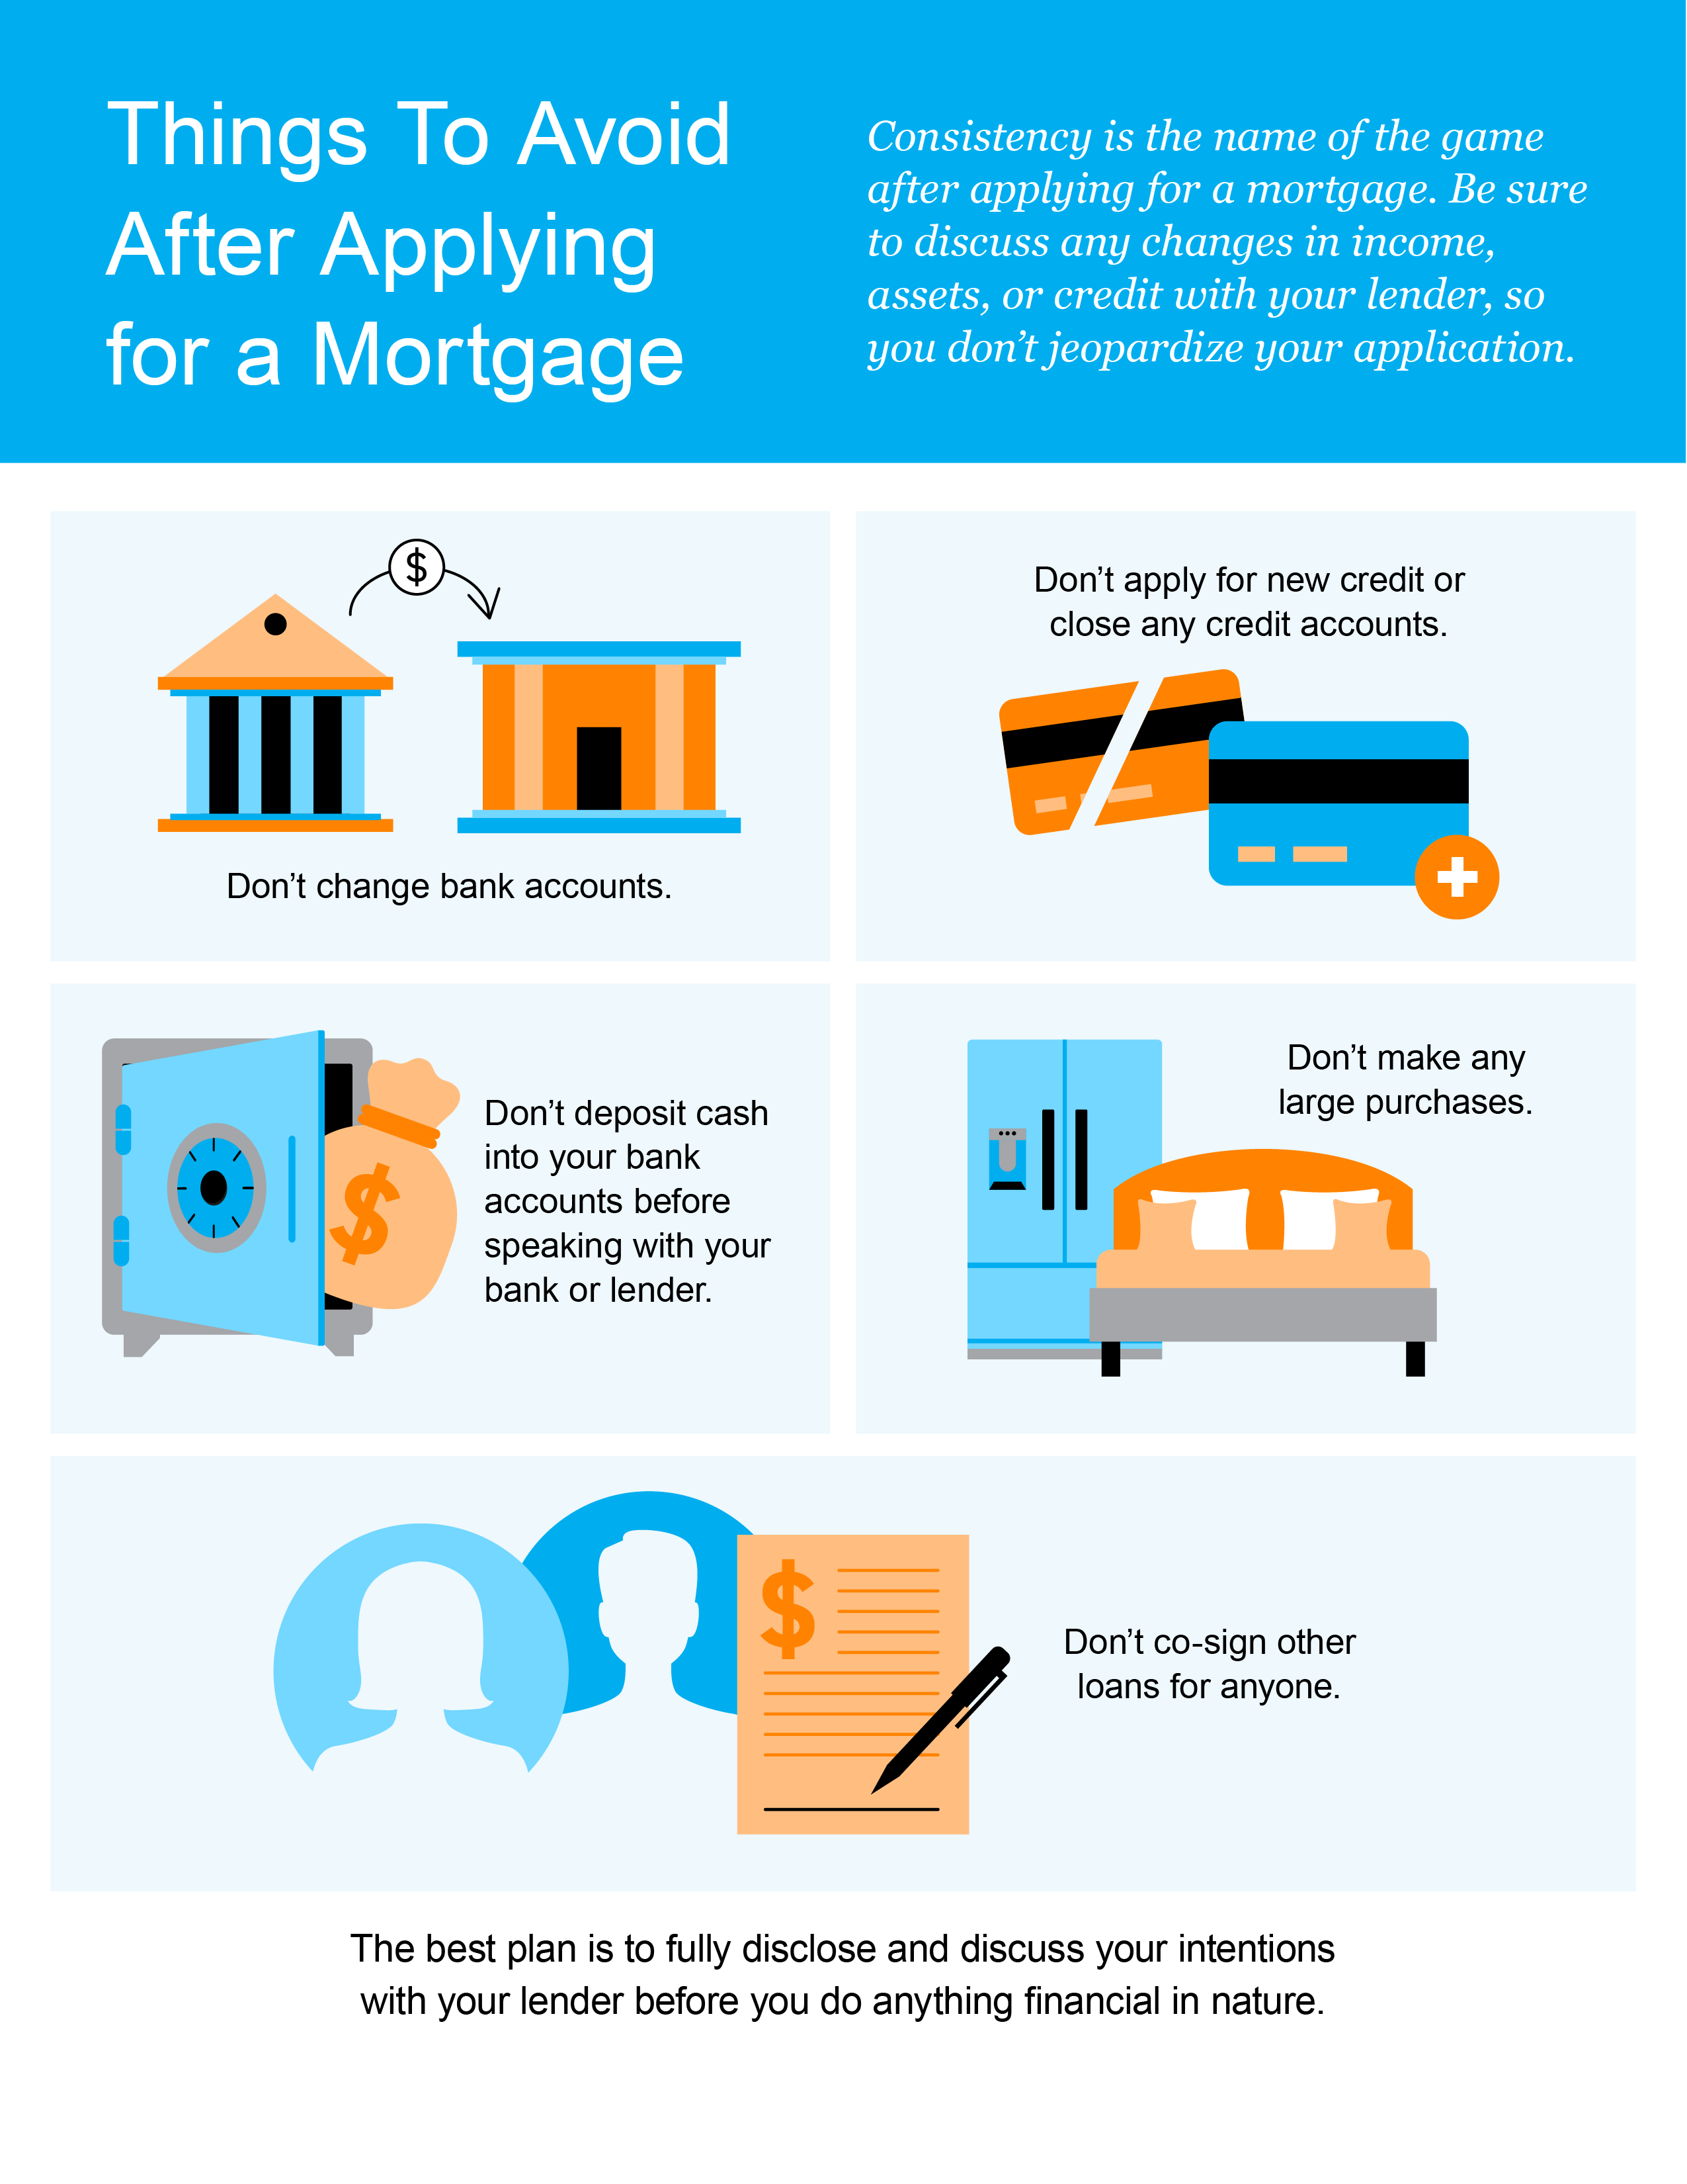

Slide 21
A Trusted Real Estate Advisor Provides Expert Advice
If you’re a homeowner or are planning to become one soon, you’re probably looking for clear information about today’s housing market. And if you’ve turned to the news or even just read headlines recently, you might feel like you’re left with more questions than answers. The best way to make sure you get what you need is to work with an expert.
Why You Want To Lean on a Trusted Professional
With any big milestone in life, it’s wise to seek advice from people who are experts in their field. While you likely want that advice to be perfect, perfect simply isn’t possible. But professionals have the knowledge and experience to be able to provide you with the best advice for your situation.
For example, let’s say you need an attorney, so you seek out an expert in the type of law required for your case. They won’t immediately tell you how the case is going to end or how the judge or jury will rule. But what a good attorney can do is discuss the most effective strategies based on their experience and help you put a plan together. They’ll even use their knowledge to work with you to adjust as new information becomes available.

Slide 22
Similarly, the job of a trusted real estate professional is to give you the best advice possible.
We use our knowledge of the homebuying process to explain both the national headlines and what’s happening in our local area. That way, you have the best of both worlds and can feel confident in your decision to buy a home.
With our expertise, we can anticipate what could happen next and work with you to put together a solid plan. Then, we'll guide you through the process, helping you make decisions along the way. That’s the very definition of getting the best – not perfect – advice. And that’s the power of working with a real estate advisor.
Bottom Line For expert advice and the latest housing market insights, let’s connect.

Slide 23
“The success of your homebuying journey largely depends on the company you keep. . . . be sure to select experienced, trusted professionals who will help you make informed decisions and avoid any pitfalls. . . . It's important to choose the right team members for you — professionals you can trust and provide the knowledge and services you need.”
- Freddie Mac
Notes:
https://myhome.freddiemac.com/buying/finding-your-team

Slide 24
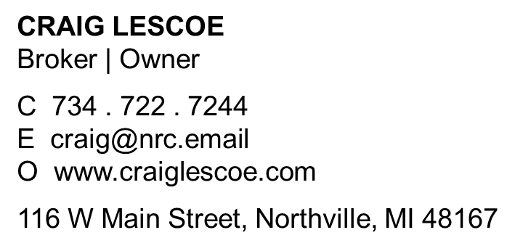
Let’s Chat.
I’m sure you have questions and thoughts about the real estate process.
I’d love to talk with you about what you’ve read here and help you on the path to buying your new home. My contact information is below, and I look forward to working with you.
WINTER 2023 EDITION

