Slide 1
Things To Consider When
Selling Your House
FALL 2022
EDITION

Slide 2
Table of Contents
3 Should I Sell My House This Year?
6 Expert Insights for Today’s Sellers
7 What Growing Housing Supply Means for Current Homeowners
9 Home Price Deceleration Doesn’t Mean Depreciation
11 Why an Agent Is Essential When Pricing Your House
12 Record Equity Gains Can Power Your Next Move
14 The One Thing Every Homeowner Needs To Know About a Recession
16 Why the Housing Market Won’t Crash
19 How an Agent Helps Sell Your House
21 A Checklist for Selling Your House
22 Reasons To Hire a Real Estate Professional

Slide 3
Should I Sell My House This Year?
There’s no denying the housing market is undergoing a shift this season, but that shift actually gives you some unique benefits when you sell. Here’s a look at the key opportunities you have if you list your house this fall. ​
1. More Options for Your Move
One of the biggest stories today is the growing supply of homes for sale. Housing inventory has been growing since the start of the year.
If you’re selling your house to make a move, this is great news for you. It means you’ll have more options for your own home search. That gives you an even better chance to find a home that checks all your boxes.
2. The Number of Homes on the Market Is Still Low
Just remember, while the latest data shows the number of homes for sale has increased, housing supply is still firmly in sellers’ market territory. To be in a balanced market, there would normally be a six months’ supply of homes. According to the National Association of Realtors (NAR), in July, there was only a 3.3 months’ supply.
While you’ll have more options for your own home search, inventory is still low, and that means your home will still be in demand if you price it right.
Notes:
https://www.nar.realtor/research-and-statistics/housing-statistics/existing-home-sales
https://www.nar.realtor/newsroom/existing-home-sales-retreated-5-9-in-july

Slide 4
3. Home Prices Are Appreciating
Since inventory is still low overall, experts say that, nationally, home price appreciation will continue, just at a more moderate pace.
What does that mean for you? Whether you’re selling so you can move into the home of your dreams or looking to downsize into something that better suits your current needs, you can find peace of mind in knowing any further home price appreciation will help grow the value of your next investment once you move.
4. Your Equity Is Growing by Record Amounts
Due to the rapid home price appreciation the market has seen over the past few years, your home’s value has likely grown substantially. That gives your equity (and your net worth) a considerable boost. Danielle Hale, Chief Economist at realtor.com, explains:
“Homeowners trying to decide if now is the time to list their home for sale are still in a good position . . . as a decade of rising home prices gives them a substantial equity cushion . . .”
If you’ve been holding off on selling because you’re worried about how rising prices will impact your next home search, rest assured your equity can help. It may be just what you need to cover a large portion (if not all) of the down payment on your next home.
Bottom Line If you’re thinking about selling your house this season, let’s connect so you have the expert insights you need to make the best possible move today.
Notes:
https://www.realtor.com/research/weekly-housing-trends-view-data-week-july-2-2022/

Slide 5
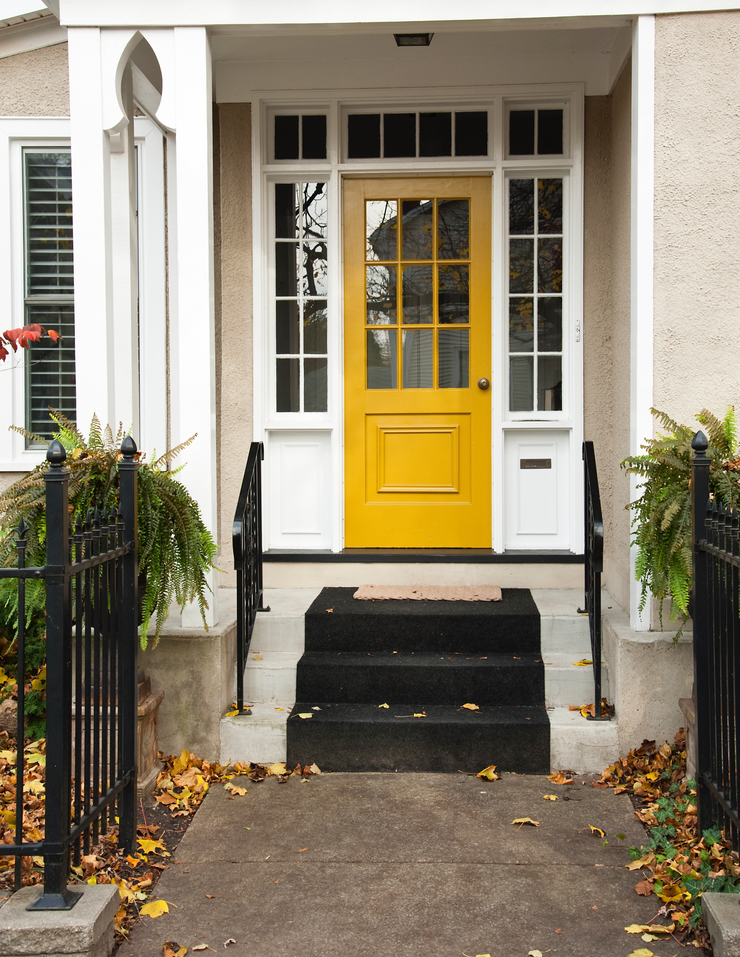
“Home equity gains are built up through price appreciation and by paying off the mortgage through principal payments. . . . A homeowner who purchased a typical home five years ago would have gained $125,300 from just price appreciation alone.”
- National Association of Realtors
Notes:
https://www.nar.realtor/research-and-statistics/research-reports/metro-area-housing-wealth-gains

Slide 6
Expert Insights for Today’s Sellers
Thinking of making a move this fall? Here’s what experts have to say about the market and where it’s headed so you can make a confident decision.
“ | Home sellers in many markets across the country continue to benefit from rising home prices and fast-selling homes. - Danielle Hale, Chief Economist, realtor.com
“ | Overall, the best summary is that we’ll move from a gangbusters sellers’ market to a modest sellers’ market. - Ed Pinto, Director of the American Enterprise Institute’s Housing Center
“ | . . . we’re still well below normal levels of inventory and that’s why even with the pullback in demand, we still see house prices appreciating. While there is more inventory, it’s still not enough. - Mark Fleming, Chief Economist, First American
“ | . . . experts don’t believe the market is in a bubble or a crash is in the cards, like during the Great Recession. The nation is still suffering from a housing shortage that has reached crisis proportions at a time when many millennials are reaching the age when they start to consider homeownership. That’s likely to keep prices high. - realtor.com
Notes:
https://www.realtor.com/research/weekly-housing-trends-view-data-week-june-18-2022/
https://fortune.com/2022/06/26/housing-market-outlook-prices-appreciation/
https://twitter.com/YahooFinance/status/1545073046393802757
https://www.realtor.com/news/trends/housing-market-showing-signs-of-correction-what-buyers-sellers-need-to-know/

Slide 7
What Growing Housing Supply Means for Current Homeowners
While growing inventory has clear benefits for buyers who are craving more options for their home search, what does that mean for current homeowners like you? It gives you two distinct opportunities in today’s housing market.
According to the latest data from the National Association of Realtors (NAR), the supply of homes for sale has increased consistently this year as homeowners list their homes for sale and the pace of sales is moderating in response to higher mortgage rates (see graph below):
Supply of Homes for Sale Is Increasing This Year
Months’ Supply of Homes for Sale
Source: NAR
Notes:
https://www.nar.realtor/topics/existing-home-sales
https://www.nar.realtor/newsroom/existing-home-sales-retreated-5-9-in-july

Slide 8
Opportunity #1: Take Advantage of More Options for Your Move Up
If your current house no longer meets your needs or lacks the space and features you want, this gives you even more opportunity to sell and move into the home of your dreams. With more houses on the market, you’ll have more to choose from when you search for your next home.
Partnering with a local real estate professional can help make sure you are up-to-date on the homes available in your area. And when you do find the one, that professional can advise you on how to write a winning offer to seal the deal.
Opportunity #2: Sell While Inventory Is Still Low Overall
Despite the growth, inventory is still low compared to historical norms, and that isn’t going to change overnight. For you, that means your house should still be in demand if you price it right and could be exactly what buyers are looking for.
As Mike Simonsen, Founder and CEO of Altos Research, says:
“Supply is at its best in a few years, which is good for buyers, but it’s still going to be relatively tight for quite a while.”
Bottom Line If you’re a homeowner looking to sell, you have a unique opportunity to benefit from the additional homes being listed today and still sell your house while inventory is low overall. Let’s connect to get started so you can have the best of both worlds.
Notes:
https://news.move.com/2022-06-13-Realtor-com-R-2022-Forecast-Update-Real-Estate-Gets-a-Refresh-from-the-Frenzy
https://www.housingwire.com/articles/mike-simonsen-inventory-is-climbing-is-the-supply-crisis-over/

Slide 9
Home Price Deceleration Doesn’t Mean Depreciation
Experts in the real estate industry use a number of terms when they talk about the latest home price trends. To help clarify what’s happening and where experts say prices are going, here’s a look at a few terms you may hear:
Appreciation is when home prices increase.
Depreciation is when home prices decrease.
Deceleration is when home prices continue to appreciate, just at a slower or more moderate pace.
Where Home Prices Have Been in Recent Years
For starters, you’ve probably heard home prices have skyrocketed over the past two years. During the pandemic, prices rose so dramatically because inventory was historically low at the same time buyer demand reached a frenzy. That imbalance put record-breaking upward pressure on home prices.
But homes were appreciating long before that. You might be surprised to learn that home prices have climbed for 126 consecutive months according to the Federal Housing Finance Agency (FHFA). Historically, 3.8% appreciation is the norm, so the 15% appreciation the market saw in 2021 was an anomaly.
Where Experts Say Home Prices Are Going
While this is helpful context, if you’re a homeowner in today’s market, you probably want to know what’s going to happen with home prices moving forward. Will they continue that same growth path or will home prices fall?
Notes:
https://www.fhfa.gov/DataTools/Downloads/Pages/House-Price-Index-Datasets.aspx#mpo
https://www.corelogic.com/intelligence/corelogic-hpi-posted-record-year-over-year-growth-in-2021/

Slide 10
Experts agree that, nationally, what we’re seeing today is deceleration. That means home prices are appreciating, just not at the record-breaking pace they have over the past year. The graph below shows home price forecasts from seven industry leaders. This year, experts project home prices will appreciate at a decelerated pace of around 11%, on average (see graph below):
2022 Home Price Forecasts
Based on Expert Projections
Average of All Forecasts: 11.3%
While moderating, home prices are still far above the norm. In fact, we’d have to see a lot more deceleration to even fall in line with the more typical rates of home price growth that we’ve seen historically (3.8%). As Black Knight explains:
“Annual home price growth dropped by nearly two percentage points . . . – the greatest single-month slowdown on record since at least the early 1970s . . . While June’s slowdown was record-breaking, home price growth would need to decelerate at this pace for six more months to drive annual appreciation back to 5%, a rate more in line with long-run averages.”
The big takeaway is home prices haven’t fallen or depreciated nationwide, they’re just decelerating. While some unique and overheated markets may see declines, nationally, home prices are forecast to appreciate. And when we look at the country as a whole, none of the experts project home prices will net depreciate or fall.
Bottom Line Experts forecast price deceleration, not depreciation. If you’re ready to sell, let’s connect so you have a full picture of what’s happening with home prices in our local market and what that means for you.
Notes:
https://www.fanniemae.com/media/44466/display
https://www.freddiemac.com/research/forecast/20220720-quarterly-forecast-market-slowdown-will-continue-high-rates-and-prices-exacerbate
https://cdn.nar.realtor/sites/default/files/documents/forecast-q3-2022-us-economic-outlook-07-27-2022.pdf
https://www.zelmanassociates.com/ (by subscription)
https://www.mba.org/docs/default-source/research-and-forecasts/forecasts/mortgage-finance-forecast-aug-2022.pdf
https://pulsenomics.com/surveys/#home-price-expectations
https://www.forbes.com/sites/brendarichardson/2022/06/07/rising-rates-and-buyer-urgency-keep-home-price-gains-above-20-in-april/?sh=4dd5b3c229ec
https://www.blackknightinc.com/black-knights-june-2022-mortgage-monitor/?

Slide 11
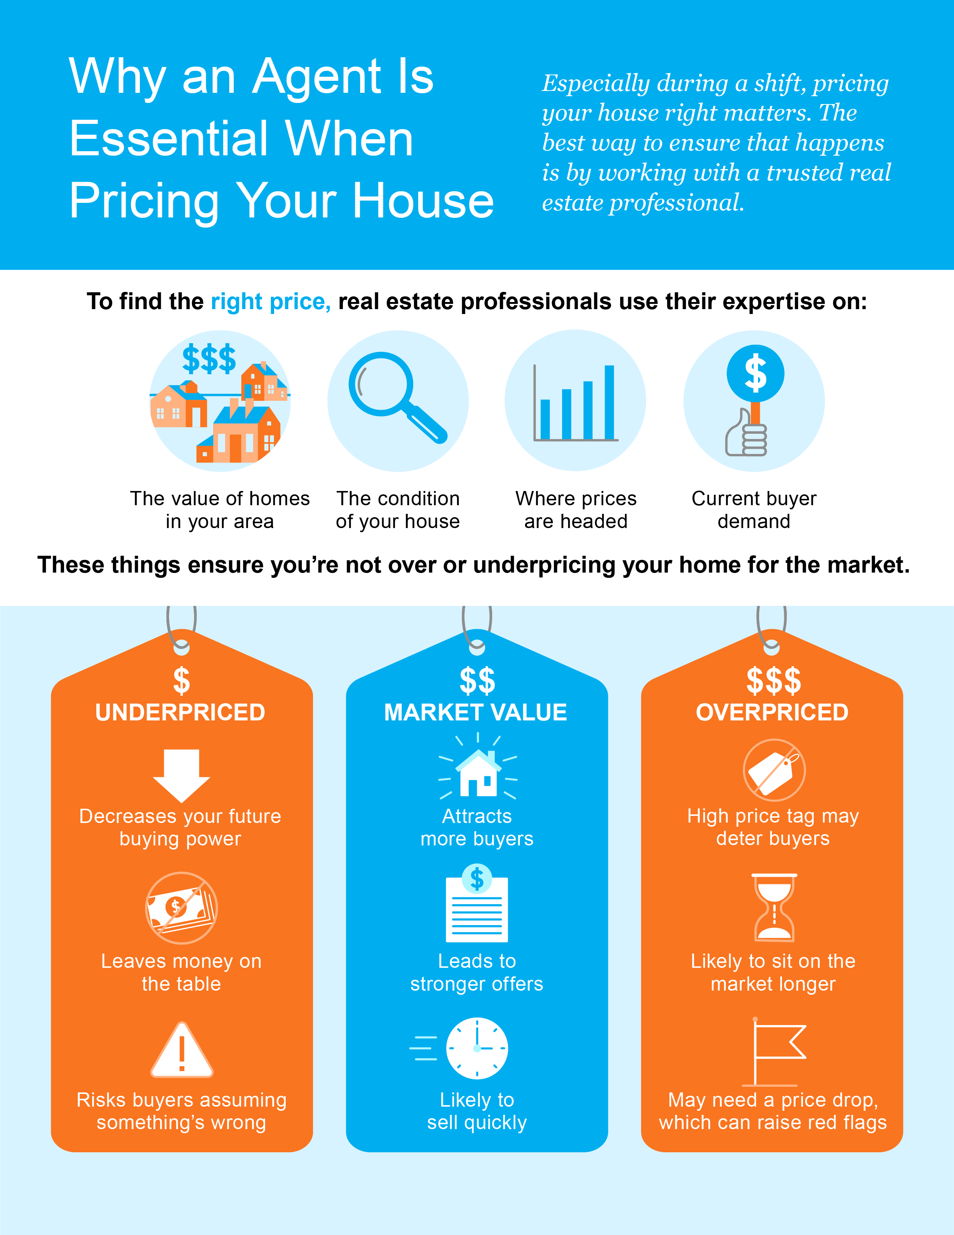
Notes:
https://www.nar.realtor/determining-asking-price

Slide 12
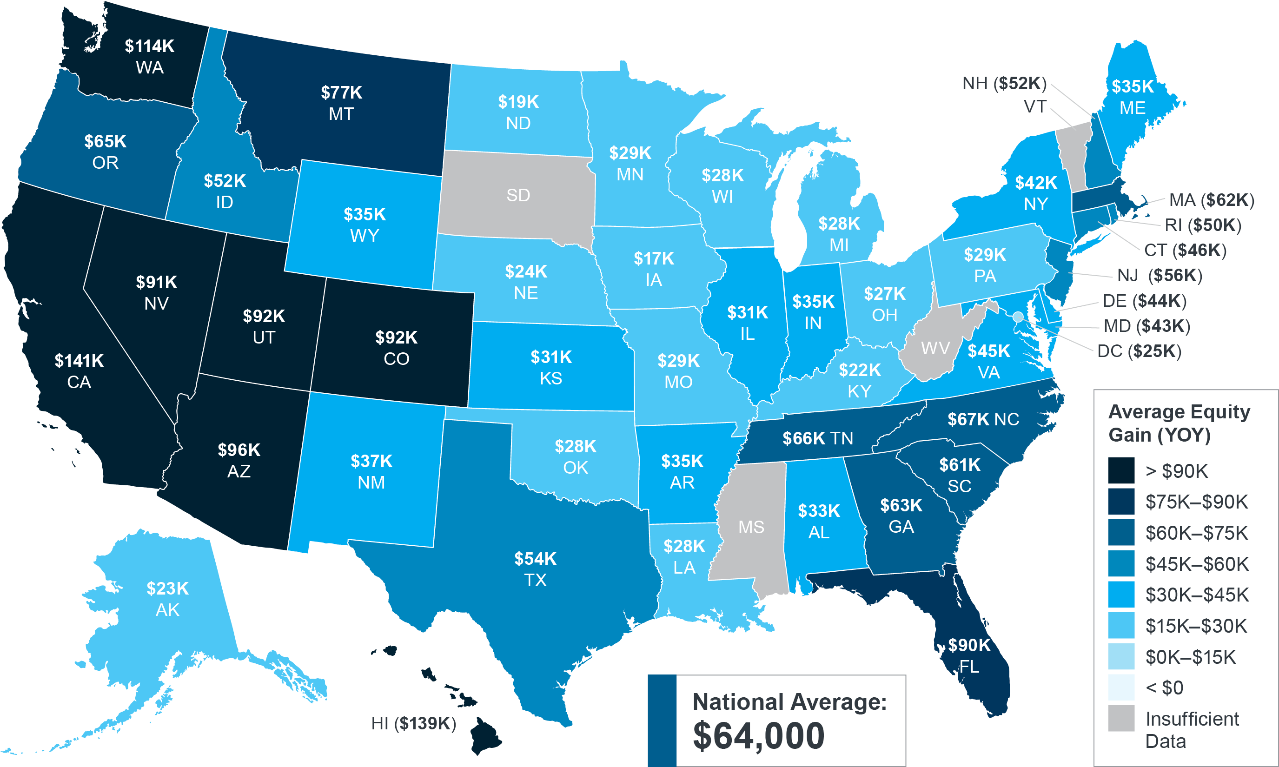
Record Equity Gains Can Power Your Next Move
Equity can be a real game-changer if you’re planning to make a move. According to the latest data from CoreLogic, the average homeowner gained $64,000 in equity over the past year, a number that grew substantially as home values appreciated.
Homeowner Equity Gains Over the Past Year
Source: CoreLogic
Notes:
https://www.corelogic.com/intelligence/homeowner-equity-insights/

Slide 13
Why Equity Is Growing Today
For a homeowner, your equity is the current value of your home minus what you owe on the loan. While experts say price growth will moderate due to the shifting market, ongoing appreciation is expected nationally and that should continue to give your equity a boost.
The graph below uses projections from the Home Price Expectation Survey (HPES) by Pulsenomics to show that if someone purchased a median priced home in January 2022 how their home value is expected to grow over the next five years.
Potential Home Price Growth Over the Next 5 Years Based on Projections from the Home Price Expectation Survey
$102,787
Potential growth in household wealth over the next five years based solely on increased home equity if you purchased a $390K home in January of 2022.
Source: HPES 2022 2Q
The Opportunity Your Rising Home Equity Provides
In addition to building your overall net worth, equity can also help you achieve other goals like buying your next home. When you sell your current house, the equity you’ve built up comes back to you in the sale, and it may be just what you need to cover a large portion – if not all – of the down payment on your next home.
So, if you’ve been holding off on selling or you’re worried about being priced out of your next home because of home price appreciation, rest assured your equity can help fuel your move.
Bottom Line Let’s connect to determine how much equity you have in your current home and how you can use it to help you make your next move today.
Notes:
https://pulsenomics.com/surveys/#home-price-expectations

Slide 14
The One Thing Every Homeowner Needs To Know About a Recession
The one thing you need to know as you watch the news and read the headlines today is that a recession does not mean falling prices.
Most people remember the housing crisis in 2008 and some worry a recession now would lead to a similar situation. But this housing market isn’t a bubble that’s about to burst. Today, conditions in the housing market are very different. One big difference is there’s far less available inventory this time. In 2008, we had a surplus of inventory and that’s why prices fell.
To help show that home prices don’t fall every time there’s a recession, take a look at the historical data (see graph below):
Recession Does Not Mean Falling Prices
Home Price Change During the Last 6 Recessions
1991
2008
Sources: CoreLogic, The Balance
Notes:
https://www.corelogic.com/blog/2019/03/housing-recessions-and-recoveries.aspx
https://www.thebalance.com/the-history-of-recessions-in-the-united-states-3306011
https://www.corelogic.com/intelligence/find-stories/corelogic-hpi-posted-record-year-over-year-growth-in-2021/

Slide 15
There have been six recessions in this country over the past four decades.
As the graph on the previous page shows, looking at the recessions going all the way back to the 1980s, home prices appreciated four times and depreciated only two times.
So, historically, there’s proof that when there’s a recession, it doesn’t mean home values will fall or depreciate.
Bottom Line If you're wondering what a recession would mean for the housing market, you should know history can help give us important context for what could happen next. Looking back at the past six recessions, the data proves a recession doesn’t mean home prices will fall.

Slide 16
Why the Housing Market Won’t Crash
With all the buzz in the media, you may start to worry the housing market is in a bubble. While it’s only natural for concerns to creep in that there could be a repeat of what took place in 2008, the good news is, there’s concrete data to show why this is nothing like the last time.
There’s a Shortage of Homes on the Market Today, Not a Surplus
The supply of inventory needed to sustain a normal real estate market is approximately six months. Anything more than that is an overabundance and will cause prices to fall. Anything less than that is a shortage and will lead to continued price appreciation.
For historical context, there were too many homes for sale during the housing crisis, and that caused prices to tumble. Today, supply has grown, but there’s still a shortage of inventory available (see graph below):
Supply of Homes Is Nothing Like Last Time
Annual Average of Months’ Supply for 1999-2021
Source: NAR
Notes:
https://www.nar.realtor/research-and-statistics/housing-statistics/existing-home-sales
https://www.nar.realtor/newsroom/existing-home-sales-retreated-5-9-in-july

Slide 17
One of the reasons inventory is still low is because of sustained underbuilding. When you couple that with ongoing buyer demand as millennials age into their peak homebuying years, it continues to put upward pressure on home prices. That limited supply compared to buyer demand is one of the reasons why experts forecast, nationally, home prices won’t fall this time.
Mortgage Standards Were Much More Relaxed During the Crash
During the lead-up to the housing crisis, it was much easier to get a home loan than it is today. The graph below shows data on the Mortgage Credit Availability Index (MCAI) from the Mortgage Bankers Association (MBA). The higher the number, the easier it is to get a mortgage.
Lending Standards Today Are Under Control
Historic Data for the Mortgage Credit Availability Index (MCAI)
Housing Bubble: 868.7
Source: MBA
Leading up to 2006, banks were creating artificial demand by lowering lending standards and making it easy for just about anyone to qualify for a home loan or refinance their current home. That led to mass defaults, foreclosures, and falling prices.
Today, things are different. Purchasers face much higher standards from mortgage companies and buyers are more qualified. Mark Fleming, Chief Economist at First American, says:
“Credit standards tightened in recent months due to increasing economic uncertainty and monetary policy tightening.”
Those stricter standards help prevent a wave of foreclosures like last time.
Notes:
https://www.mba.org/news-and-research/newsroom/news/2022/08/09/mortgage-credit-availability-decreased-in-july
https://blog.firstam.com/economics/how-the-fundamentals-influencing-housing-market-potential-have-changed

Slide 18
The Foreclosure Volume Is Nothing Like It Was During the Crash
The most obvious difference is the number of homeowners that were facing foreclosure after the housing bubble burst. Foreclosure activity has been on the way down since the crash because buyers today are more qualified and less likely to default on their loans. The graph below helps tell the story:
Foreclosure Activity Then and Now
U.S. Properties with Foreclosure Filings: ATTOM 2021 Year-End Report
Over 1 Million
Source: ATTOM Data Solutions
Not to mention, homeowners today have options they just didn’t have in the housing crisis when so many people owed more on their mortgages than their homes were worth. With the pandemic and the forbearance program, many people were able to stay in their homes and work out alternative options.
And for those homeowners who still need to make a change due to financial hardship or other challenges, today’s record-level of equity is giving them the opportunity to sell their houses and avoid foreclosure altogether. That’s why there won’t be a wave of foreclosures coming to the market.
Bottom Line If you’re worried we’re making the same mistakes that led to the housing crash, these graphs should help alleviate your concerns. Concrete data and expert insights clearly show why this is nothing like the last time.
Notes:
https://www.attomdata.com/news/market-trends/foreclosures/attom-year-end-2021-u-s-foreclosure-market-report/

Slide 19
How an Agent Helps Sell Your House
It can be tempting to consider selling your home on your own. But today’s market is at a turning point, making it more essential than ever to work with a real estate advisor. Here are five key ways a professional can help you.
1. A Professional Follows the Latest Market Trends
With higher mortgage rates and a growing number of homes for sale, today’s housing market is showing signs of a shift back toward more pre-pandemic levels. When conditions change, following the trends and staying on top of new information is crucial when you sell.
That makes working with an expert real estate advisor critical today. They know your local area and follow national trends too. More importantly, they’ll know what this data means for you, and as the market shifts, they’ll be able to help you navigate it and make your best decision.
2. A Professional Helps Maximize Your Pool of Buyers
Real estate professionals have a large variety of tools at their disposal, such as social media followers, agency resources, and the Multiple Listing Service (MLS) to ensure your house is viewed by the most buyers. Investopedia explains why it’s risky to sell on your own without the network an agent provides:
“You don’t have relationships with clients, other agents, or a real estate agency to bring the largest pool of potential buyers to your home. A smaller pool of potential buyers means less demand for your property, which can translate into waiting longer to sell your home and possibly not getting as much money as your house is worth.”
Notes:
https://www.investopedia.com/articles/personal-finance/071514/8-reasons-not-sell-your-home-without-agent.asp#toc-4-agents-access-large-networks

Slide 20
3. A Professional Understands the Fine Print
Today, more disclosures and regulations are mandatory when selling a house. The National Association of Realtors (NAR) explains it best, saying:
“Selling a home typically requires a variety of forms, reports, disclosures, and other legal and financial documents. . . . there’s a lot of jargon involved in a real estate transaction; you want to work with a professional who can speak the language.”
A real estate professional knows exactly what needs to happen, what all the paperwork means, and how to work through it efficiently. They’ll help you review the documents and avoid any costly missteps that could occur if you try to handle them on your own.
4. A Professional Is a Trained Negotiator
If you sell without a professional, you’ll also be solely responsible for the negotiations. That means you’ll have to coordinate with:
The buyer, who wants the best deal possible
The buyer’s agent, who will use their expertise to advocate for the buyer
The inspection company, which works for the buyer and will almost always find concerns with the house
The appraiser, who assesses the property’s value to protect the lender
Instead of going toe-to-toe with these parties alone, lean on an expert. They’ll know what levers to pull, how to address all concerns, and when to get a second opinion.
5. They Know How To Set the Right Price for Your House
Real estate professionals know the ins and outs of how to price your house accurately and competitively, so you don’t overprice or underprice your home for the shifting market. NAR explains it like this:
“A great real estate agent will look at your home with an unbiased eye, providing you with the information you need to enhance marketability and maximize price.”
Bottom Line A real estate agent has essential insights you’ll want to rely on throughout the transaction. Don’t go at it alone. If you plan to sell, let’s connect so you have an expert on your side.
Notes:
https://magazine.realtor/sales-and-marketing/handouts-for-customers/for-sellers/8-reasons-to-work-with-a-realtor

Slide 23
“The housing market is at a turning point. . . . We’re starting to see signs of a new direction, but the ball is still in sellers’ courts in most housing markets.”
- Danielle Hale, Chief Economist, realtor.com
Notes:
https://www.realtor.com/news/trends/housing-market-showing-signs-of-correction-what-buyers-sellers-need-to-know/

Slide 24
Let’s Chat.
I’m sure you have questions and thoughts about the real estate process.
I’d love to talk with you about what you’ve read here and help you on the path to selling your house. My contact information is below, and I look forward to working with you.
FALL 2022 EDITION

