Slide 1
Things To Consider When
Buying a Home
FALL 2022
EDITION

Slide 2
Table of Contents
3 Should I Buy a Home This Fall?
5 Expert Insights for Today’s Homebuyers
6 More Options for Your Home Search
8 Housing Market Forecast
10 Americans Choose Real Estate as the Best Investment
11 The Benefit of Buying a Home Now
13 The One Thing You Need To Know About a Recession
15 Why the Housing Market Won’t Crash
18 What You Need To Know About Down Payment Assistance Programs
20 Things To Avoid After Applying for a Mortgage
21 Tips for Making Your Best Offer
23 Top Reasons To Own Your Home

Slide 3
Should I Buy a Home This Fall?
If you’re wondering if it’s the right time to buy a home, you should know you have an opportunity to grow your wealth, stabilize your expenses, and benefit from more options for your home search this fall.
1. The Number of Homes for Sale Is Increasing
While the number of homes for sale is still low compared to pre-pandemic norms, there is good news for your home search. The number of homes for sale has grown considerably this year. As the National Association of Realtors (NAR) says:
“It’s very promising that housing inventory is improving. There are nearly 30% more homes available for sale compared to January.”
If you begin your search now and work with a trusted real estate advisor, you’ll be in a great spot to benefit from those additional options to help you find your dream home.
2. Home Prices Are Appreciating More Moderately
If you’re waiting to buy because you think home prices will fall, you should know experts say that’s not projected to happen. According to the latest forecasts, experts project home prices will keep appreciating nationally, just at a more moderate pace than they did over the past year.
The good news is, once you do buy a home, any ongoing appreciation will help grow the value of your investment.
Notes:
https://www.nar.realtor/blogs/economists-outlook/measuring-affordability-and-availability-of-homes-as-mortgage-rates-continue-to-rise

Slide 4
3. Homeownership Can Grow Your Wealth
Once you own a home, you’ll own a tangible asset that typically grows in value over time. As home prices appreciate, and as you pay your monthly mortgage payment, you’ll build equity in your home. This gives your own net worth and stability a boost. As Freddie Mac says:
“Building equity through your monthly principal payments and appreciation is a critical part of homeownership that can help you create financial stability.”
4. Buying a Home Helps Shield You from Rising Costs
Census data shows the median monthly rent is consistently going up (see chart below) and has been since the late 1980s. To escape rising rents, consider purchasing a home so you can stabilize your monthly housing payment. Homeownership allows you to lock in what’s typically your largest monthly expense: your housing payment.
Median Asking Rent Since 1988
Source: Census
Bottom Line Let’s connect if you’re ready to learn more about the benefits and rewards of homeownership. Having a local expert on your side is the best way to make your dream a reality this season.
Notes:
https://myhome.freddiemac.com/owning/equity-and-appreciation
http://www.census.gov/housing/hvs/files/currenthvspress.pdf

Slide 5
Expert Insights for Today’s Homebuyers
If you want to buy a home today, here are a few things experts say you should know about what to expect and why homeownership is so important.
“ | Active inventory continued to grow, . . . . the improvement for buyers essentially means they have four choices today for every three they had one year ago. - Danielle Hale, Chief Economist, realtor.com
“ | Homeownership builds financial security. . . . the net worth of a typical homeowner is nearly 40 times the net worth of a non-owner. - National Association of Realtors (NAR)
“ | Homeownership is still considered one of the most reliable ways to build wealth. When you make monthly mortgage payments, you're building equity in your home. . . . When you rent, you aren't investing in your financial future the same way you are when you're paying off a mortgage. - CNET
“ | This is an opportunity for people with a secure job to jump into the market, when other people are a little hesitant because of a possible recession. They’ll have fewer buyers to compete with. - Lawrence Yun, Chief Economist, NAR
Notes:
https://www.realtor.com/research/weekly-housing-trends-view-data-week-july-23-2022/
https://www.nar.realtor/june-is-national-homeownership-month
https://www.cnet.com/personal-finance/mortgages/should-you-buy-a-home-in-2022-3-factors-to-consider/
https://www.bloomberg.com/news/articles/2022-07-08/should-i-buy-a-house-with-rates-lower-experts-say-prices-may-fall-more

Slide 6
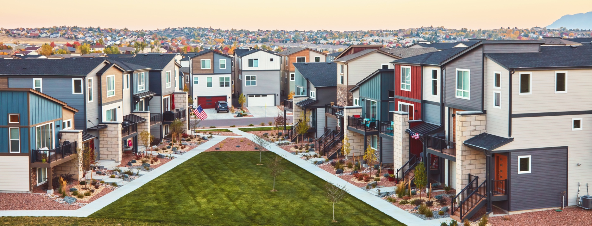
More Options for Your Home Search
There’s no denying the housing market has delivered a fair share of challenges to homebuyers over the past two years. Two of the biggest hurdles were the limited number of homes for sale and the intensity and frequency of bidding wars. But those two things have reached a turning point.
The Number of Homes for Sale Is Growing
According to data from the National Association of Realtors (NAR), the supply of homes for sale has increased consistently this year (see graph below). For you, that means you’ll have more options to choose from, so it shouldn’t be as difficult to find your next home as it has been previously.
Supply of Homes for Sale Is Increasing This Year
Months’ Supply of Homes for Sale
Source: NAR
Notes:
https://www.nar.realtor/topics/existing-home-sales
https://www.nar.realtor/newsroom/existing-home-sales-retreated-5-9-in-july

Slide 7
The Intensity of Bidding Wars Is Easing
The good news is having more options may also lead to less intense bidding wars. Data from the Confidence Index from NAR shows this trend has already begun. Their report shows bidding wars are easing month-over-month (see graph below):
Bidding Wars Ease in Recent Months
Average Number of Offers on Sold Homes (April – July 2022)
Source: NAR
If you’ve been outbid before or struggled to find a home that meets your needs, breathe a welcome sigh of relief. The big takeaway here is you have more options and less competition today. George Ratiu, Manager of Economic Research at realtor.com, confirms this is positive for buyers:
“. . . more available properties and less competition, . . . point toward a welcome change for buyers who are still in the market. The upcoming fall season may offer an even better window of opportunity, as long as the inventory landscape continues improving, as we’ve seen in recent months."
Bottom Line With more options to choose from and less intense bidding wars, you could have a unique opportunity in front of you. Let’s connect today to discuss your options in our local market.
Notes:
https://cdn.nar.realtor/sites/default/files/documents/2022-05-realtors-confidence-index-06-21-2022.pdf
https://cdn.nar.realtor/sites/default/files/documents/2022-06-realtors-confidence-index-report-07-20-2022.pdf
https://cdn.nar.realtor/sites/default/files/documents/2022-07-realtors-confidence-index-08-18-2022.pdf
https://twitter.com/RDC_Economics/status/1557730589989429248

Slide 8
Housing Market Forecast
The housing market is at a turning point, and if you’re thinking of buying a home, that may leave you wondering: is it the right time to make a move? Let’s turn to the experts for what the future is projected to hold.
Experts Project Mortgage Rates Will Stabilize
This year, mortgage rates have climbed over 2% due to the Federal Reserve’s response to inflation. While mortgage rates continue to fluctuate, experts project they’ll start to stabilize in the months ahead, hovering in the low 5% range initially, and then possibly dipping into the high 4% range later next year. That could bring some welcome relief if you’re ready to buy a home (see chart below):
Mortgage Rate Projections
Quarter | Freddie Mac | Fannie Mae | MBA | NAR | Average of All Four
2022 4Q | 5.4 | 4.8 | 5.2 | 6.0 | 5.4%
2023 1Q | 5.2 | 4.7 | 5.1 | 6.0 | 5.3%
2023 2Q | 5.2 | 4.5 | 5.0 | 6.0 | 5.2%
2023 3Q | 5.0 | 4.4 | 4.9 | - | 4.8%
Notes:
https://www.freddiemac.com/research/forecast/20220720-quarterly-forecast-market-slowdown-will-continue-high-rates-and-prices-exacerbate
https://www.fanniemae.com/media/44466/display https://www.mba.org/docs/default-source/research-and-forecasts/forecasts/mortgage-finance-forecast-aug-2022.pdf
https://cdn.nar.realtor/sites/default/files/documents/forecast-q3-2022-us-economic-outlook-07-27-2022.pdf

Slide 9
Home Price Forecasts Call for Ongoing Appreciation
In 2021, home prices appreciated rapidly because there were far more people looking to make a purchase than there were homes available for sale. CoreLogic helps explain how unusual last year’s price gains were:
“Price appreciation averaged 15% for the full year of 2021, up from the 2020 full year average of 6%.”
This year, home price appreciation is slowing (or decelerating) from the feverish pace the market saw during the pandemic. According to the latest forecasts, experts say nationwide, prices will still appreciate by roughly 11.3% in 2022 (see graph below):
2022 Home Price Forecasts
Based on Expert Projections
Average of All Forecasts: 11.3%
Even though housing supply has grown this year, it’s still low overall due to a long period of underbuilding homes. And experts say that’s going to help keep upward pressure on home prices. If you’re thinking of making a move, you shouldn’t wait for prices to fall.
Bottom Line As a buyer, you need to know what’s happening in the housing market so you can make the most informed decision possible. Let’s connect to discuss your goals so you can determine the best plan for your move.
Notes:
https://www.corelogic.com/intelligence/corelogic-hpi-posted-record-year-over-year-growth-in-2021/
https://www.fanniemae.com/media/44466/display
https://www.freddiemac.com/research/forecast/20220720-quarterly-forecast-market-slowdown-will-continue-high-rates-and-prices-exacerbate
https://cdn.nar.realtor/sites/default/files/documents/forecast-q3-2022-us-economic-outlook-07-27-2022.pdf
https://www.zelmanassociates.com/ (by subscription)
https://www.mba.org/docs/default-source/research-and-forecasts/forecasts/mortgage-finance-forecast-aug-2022.pdf
https://pulsenomics.com/surveys/#home-price-expectations

Slide 10
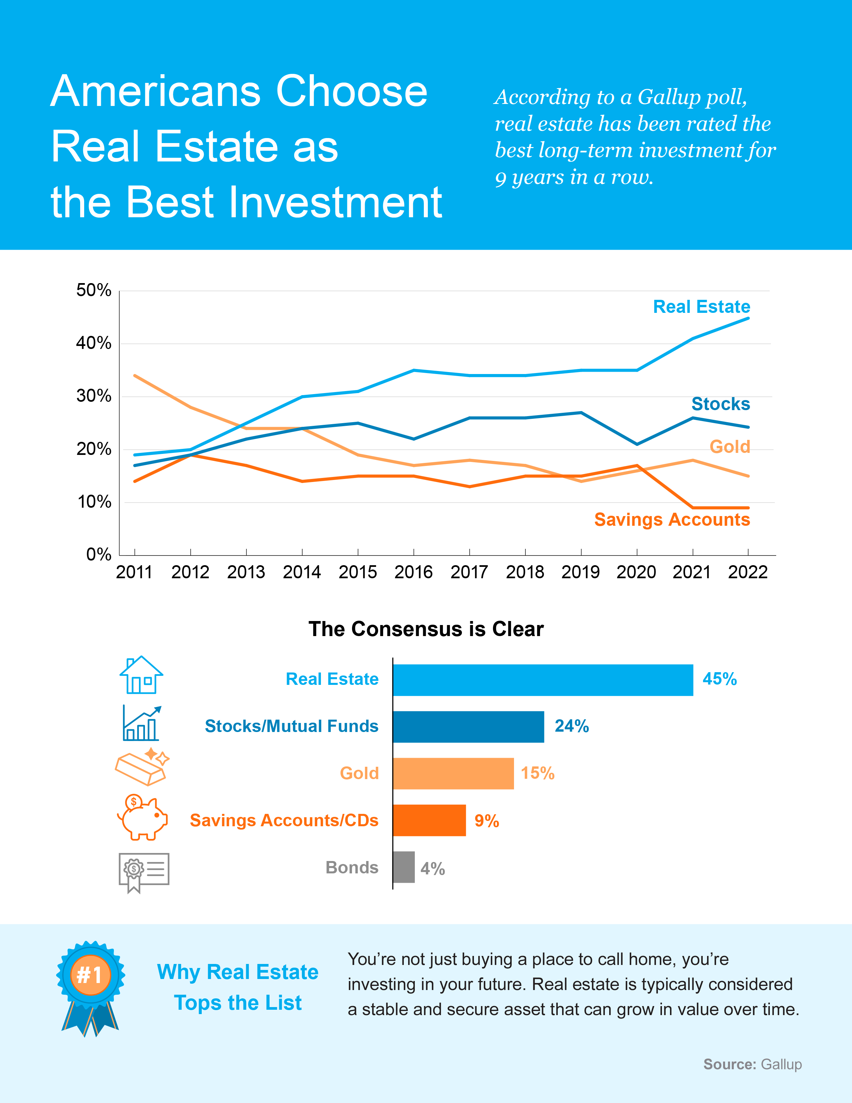
Notes:
https://news.gallup.com/poll/392330/record-low-say-good-time-buy-house.aspx

Slide 11
The Benefit of Buying a Home Now
You may be asking yourself: should I buy right now, or should I wait? While no one can answer that question for you, here’s some information that could help you make your decision.
The Future of Home Price Appreciation
Each quarter, Pulsenomics surveys a national panel of over 100 economists, real estate experts, and investment and market strategists to compile projections for the future of home price appreciation. Their survey forecasts home prices will continue appreciating over the next five years (see graph below):
Estimated Home Price Performance
December to December, as Forecast in Q2 2022
Source: HPES, Q2 2022
As the graph shows, the rate of appreciation will moderate over the next few years as the market shifts away from the feverish pace it saw during the pandemic. After this year, experts project home price appreciation will continue, but at levels that are more typical for the market.
Notes:
https://pulsenomics.com/surveys/#home-price-expectations

Slide 12
What Does That Mean for You?
Ongoing appreciation should give you peace of mind that your investment in homeownership is worthwhile because you’re buying an asset that’s projected to grow in value in the years ahead.
To give you an idea of how this could impact your net worth, here’s how a typical home could grow in value over the next five years using the expert price appreciation projections from the Pulsenomics survey (see graph below):
Potential Home Price Growth Over the Next 5 Years
Based on Projections from the Home Price Expectation Survey
$102,787
Potential growth in household wealth over the next five years based solely on increased home equity if you purchased a $390K home in January of 2022.
Source: HPES 2022 2Q
Even at a more typical pace of appreciation, you still stand to gain significant equity. That’s what’s at stake if you delay your plans.
Bottom Line Buying today can set you up for long-term success because your asset’s value (and your own net worth) is projected to grow with ongoing home price appreciation. Let’s connect to begin your homebuying journey today.
Notes:
https://pulsenomics.com/surveys/#home-price-expectations

Slide 13
The One Thing You Need To Know About a Recession
The one thing you need to know as you watch the news and read the headlines today is that a recession does not mean falling home prices.
Most people remember the housing crisis in 2008 and some worry a recession now would lead to a similar situation. But this housing market isn’t a bubble that’s about to burst. Today, conditions in the housing market are very different. One big difference is there’s far less available inventory this time. In 2008, we had a surplus of inventory, and that’s why prices fell.
To help show that home prices don’t fall every time there’s a recession, take a look at the historical data (see graph below):
Recession Does Not Mean Falling Prices
Home Price Change During the Last 6 Recessions
1991
2008
Sources: CoreLogic, The Balance
Notes:
https://www.corelogic.com/blog/2019/03/housing-recessions-and-recoveries.aspx
https://www.thebalance.com/the-history-of-recessions-in-the-united-states-3306011
https://www.corelogic.com/intelligence/find-stories/corelogic-hpi-posted-record-year-over-year-growth-in-2021/

Slide 14
There have been six recessions in this country over the past four decades.
As the graph on the previous page shows, looking at the recessions going all the way back to the 1980s, home prices appreciated four times and depreciated only two times.
So, historically, there’s proof that when there’s a recession, it doesn’t mean home values will fall or depreciate.
Bottom Line If you're wondering what a recession would mean for the housing market, you should know history can help give us important context for what could happen next. Looking back at the past six recessions, the data proves a recession doesn’t mean home prices will fall.

Slide 15
Why the Housing Market Won’t Crash
With all the buzz in the media, you may start to worry the housing market is in a bubble. While it’s only natural for concerns to creep in that there could be a repeat of what took place in 2008, the good news is there’s concrete data to show why this is nothing like the last time.
There’s a Shortage of Homes on the Market Today, Not a Surplus
The supply of inventory needed to sustain a normal real estate market is approximately six months. Anything more than that is an overabundance and will cause prices to fall. Anything less than that is a shortage and will lead to continued price appreciation.
For historical context, there were too many homes for sale during the housing crisis, and that caused prices to tumble. Today, supply has grown, but there’s still a shortage of inventory available (see graph below):
Supply of Homes Is Nothing Like Last Time
Annual Average of Months’ Supply for 1999-2021
Source: NAR
Notes:
https://www.nar.realtor/research-and-statistics/housing-statistics/existing-home-sales
https://www.nar.realtor/newsroom/existing-home-sales-retreated-5-9-in-july

Slide 16
One of the reasons inventory is still low is because of sustained underbuilding. When you couple that with ongoing buyer demand as millennials age into their peak homebuying years, it continues to put upward pressure on home prices. That limited supply compared to buyer demand is one of the reasons why experts forecast, nationally, home prices won’t fall this time.
Mortgage Standards Were Much More Relaxed During the Crash
During the lead-up to the housing crisis, it was much easier to get a home loan than it is today. The graph below shows data on the Mortgage Credit Availability Index (MCAI) from the Mortgage Bankers Association (MBA). The higher the number, the easier it is to get a mortgage.
Lending Standards Today Are Under Control
Historic Data for the Mortgage Credit Availability Index (MCAI)
Housing Bubble: 868.7
Source: MBA
Leading up to 2006, banks were creating artificial demand by lowering lending standards and making it easy for just about anyone to qualify for a home loan or refinance their current home. That led to mass defaults, foreclosures, and falling prices.
Today, things are different. Purchasers face much higher standards from mortgage companies, and buyers are more qualified. Mark Fleming, Chief Economist at First American, says:
“Credit standards tightened in recent months due to increasing economic uncertainty and monetary policy tightening.”
Those stricter standards help prevent a wave of foreclosures like we saw last time.
Notes:
https://www.mba.org/news-and-research/newsroom/news/2022/08/09/mortgage-credit-availability-decreased-in-july
https://blog.firstam.com/economics/how-the-fundamentals-influencing-housing-market-potential-have-changed

Slide 17
The Foreclosure Volume Is Nothing Like It Was During the Crash
The most obvious difference is the number of homeowners that were facing foreclosure after the housing bubble burst. Foreclosure activity has been on the way down since the crash because buyers today are more qualified and less likely to default on their loans. The graph below helps tell the story:
Foreclosure Activity Then and Now
U.S. Properties with Foreclosure Filings: ATTOM 2001 Year-End Report
Over 1 Million
Source: ATTOM Data Solutions
Not to mention, homeowners today have options they just didn’t have in the housing crisis when so many people owed more on their mortgages than their homes were worth. With the pandemic and the forbearance program, many people were able to stay in their homes and work out alternative options.
And for those homeowners who still need to make a change due to financial hardship or other challenges, today’s record level of equity is giving them the opportunity to sell their houses and avoid foreclosure altogether. That’s why there won’t be a wave of foreclosures coming to the market.
Bottom Line If you’re worried we’re making the same mistakes that led to the housing crash, these graphs should help alleviate your concerns. Concrete data and expert insights clearly show why this is nothing like the last time.
Notes:
https://www.attomdata.com/news/market-trends/foreclosures/attom-year-end-2021-u-s-foreclosure-market-report/

Slide 18
What You Need To Know About Down Payment Assistance Programs
When it comes to buying a home, it can feel a bit intimidating to know how much you need to save. Here’s some information you’ll want to know about programs that could help you reach your down payment goals.
You Can Qualify Even if You’ve Purchased a Home Before
There are several misconceptions about down payment assistance programs. For starters, many people believe there’s only assistance available for first-time homebuyers. While first-time buyers have many options to explore, repeat buyers have some, too. According to the latest Homeownership Program Index from downpaymentresource.com:
“It is a common misconception that homebuyer assistance is only available to first-time homebuyers, however, 38% of homebuyer assistance programs in Q1 2022 did not have a first-time homebuyer requirement.”
That means repeat buyers could qualify for over one-third of the assistance programs available. And if you’re a repeat buyer, you may still be able to take advantage of some first-time homebuyer programs, depending on your personal situation. That’s because many of the first-time homebuyer programs use the U.S. Department of Housing and Urban Development’s definition of a first-time homebuyer.
Notes:
https://downpaymentresource.com/professional-resource/more-homebuyer-assistance-programs-introduced-as-affordability-declines-in-most-u-s-counties/
https://downpaymentresource.com/homebuyer-resource/4-common-down-payment-assistance-program-myths-debunked/
https://archives.hud.gov/offices/hsg/sfh/ref/sfhp3-02.cfm

Slide 19
Under their definition, you could qualify as a first-time buyer if you’re:
Someone who hasn’t owned a primary residence in 3 years.
A single parent who’s only ever owned a home with a former spouse.
That means no matter where you are in your homeownership journey, there could be an option available for you.
You May Be Eligible Based on Your Location or Profession
Additionally, there are other types of down payment assistance programs that you could qualify for based on your location. According to the National Association of Realtors (NAR):
“Many local governments and non-profit organizations offer down-payment assistance grants and loans, targeted to area borrowers and often with specific borrower requirements.”
There are also programs and special benefits for individuals working in certain professions or with unique statuses, including teachers, doctors and nurses, and veterans. Ultimately, there are many federal, state, and local programs available for you to explore. The best way to do that is to connect with a local real estate professional and your lender to learn more about what’s available.
Bottom Line Down payment assistance programs have helped many homebuyers achieve their dreams, and if you qualify, they could help you too. Let’s connect today to discuss your homebuying goals and options.
Notes:
https://archives.hud.gov/offices/hsg/sfh/ref/sfhp3-02.cfm
https://www.nar.realtor/first-time-homebuyers/first-time-homebuyer-loans-grants

Slide 20
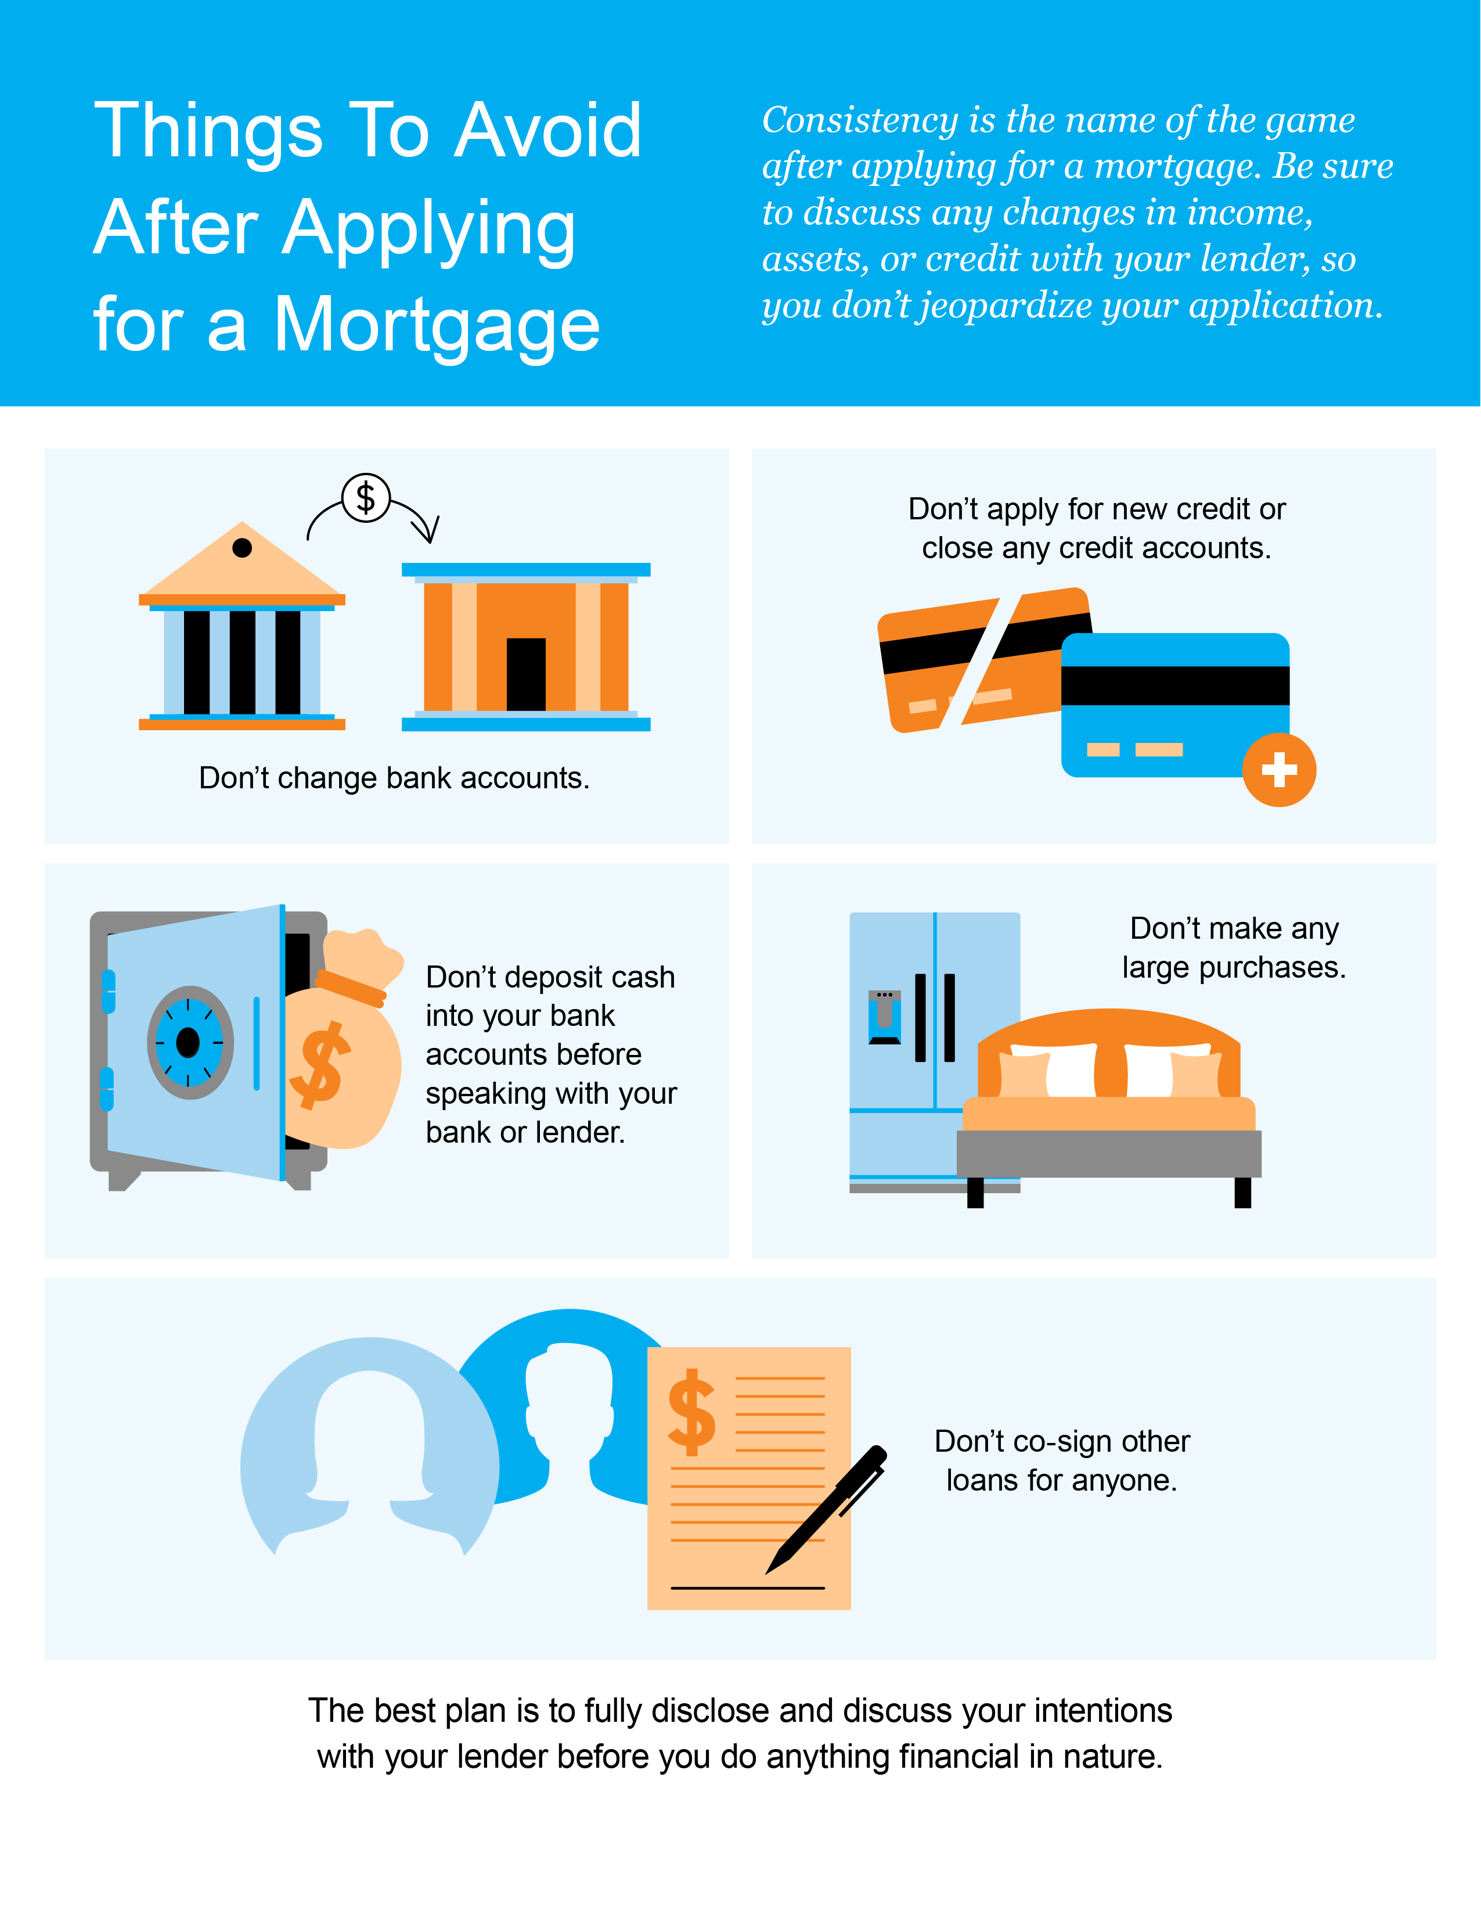

Slide 21
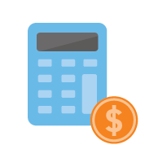
Tips for Making Your Best Offer
While the housing market is going through a shift, it’s still competitive for buyers because the overall inventory of homes for sale is low. Enjoy having more options as supply continues to grow this year, but keep these tips in mind to help you put in a strong offer once you find the one.
1. Know Your Budget
Knowing your budget and what you can afford is critical to your success as a homebuyer. The best first step is working with a lender and getting pre-approved for a loan. Your pre-approval indicates how much you’re able to borrow for your mortgage and shows sellers you’re serious. As the Mortgage Reports explains:
“. . . most sellers won’t even consider an offer unless the buyer is pre-approved at the right price point. Sellers and their agents want to know you’re ready and able to finance your offer amount.”
2. Lean on a Real Estate Professional
As conditions in the housing market moderate today, it’s especially important to rely on a trusted real estate advisor. As Freddie Mac says:
“The success of your homebuying journey largely depends on the company you keep. . . . be sure to select experienced, trusted professionals who will help you make informed decisions and avoid any pitfalls.”
Agents are experts in what’s happening in the housing market and in your area. They’ll have insight into the latest trends, what they mean for you, and what’s worked for other buyers.
Notes:
https://themortgagereports.com/92875/first-time-buyer-expert-financial-tips-podcast
https://myhome.freddiemac.com/buying/finding-your-team

Slide 22
3. Make a Strong, but Fair Offer
As the peak intensity of demand is cooling this year, the number of homes sold over asking price is decreasing and so is the typical number of offers on a recently sold home. But you still need to be prepared to come in with your best offer up front because inventory is still low overall and that makes it a sellers' market.
Lean on your agent to help you understand the current market value of the home you're interested in and recent sales trends in the area so you can craft your best offer.
4. Be a Flexible Negotiator
When putting together an offer, your trusted real estate advisor will help you consider which levers you can pull, including contract contingencies (conditions you set that the seller must meet for the purchase to be finalized). Of course, there are certain contingencies you don’t want to give up, like the home inspection. Freddie Mac explains:
“A home inspection contingency gives you the opportunity to have the entire home you'd like to purchase examined by a professional before you close on your contract. Without this contingency, you could be contracted on a house you can't afford to fix.”
Bottom Line It’s still a sellers’ market today, just a more moderate one. Let’s connect so you have expert advice on how to make your strongest offer when you find your dream home.
Notes:
https://myhome.freddiemac.com/blog/homeownership/20201019-5-rules-for-making-an-offer-on-a-home

Slide 24
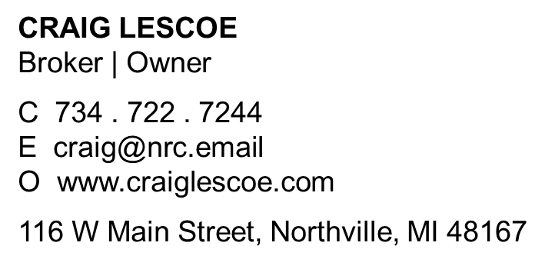
Let’s Chat.
I’m sure you have questions and thoughts about the real estate process.
I’d love to talk with you about what you’ve read here and help you on the path to buying your new home. My contact information is below, and I look forward to working with you.
FALL 2022 EDITION

