Slide 1
A Guide To Buying Your
FIRST HOME

Slide 2
Table of Contents
3 Top Reasons To Own Your Home
4 How To Kick Off the Homebuying Process
6 Myth 1: My Student Loan Debt Means I Won’t Qualify
8 Myth 2: I Need To Have a 20% Down Payment
10 Myth 3: Renting Makes More Financial Sense
13 Key Terms To Know When Buying a Home
14 Your Journey to Homeownership
15 Why Pre-Approval Matters
17 Things to Avoid After Applying for a Mortgage
19 Be Realistic About Your Desired Features
20 Checklist To Determine Your Must-Haves
21 Three Things To Know About Today’s Housing Market
22 How a Professional Supports Your Homeownership Goals

Slide 3
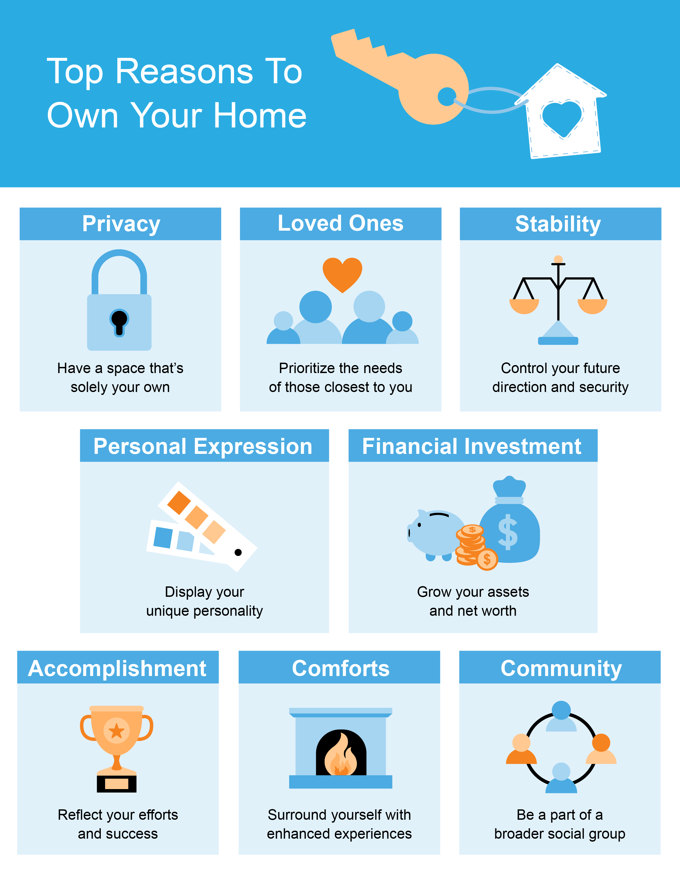

Slide 4
How To Kick Off the Homebuying Process
Buying a house can feel like a daunting task. It involves a lot of different factors, including everything from loan qualification and credit checks to appraisals, legal contracts, and more. It can all feel a little unapproachable, especially if you’ve never done it before. But it doesn’t have to be that way.
Acknowledge This Once-in-a-Lifetime Achievement
As you take the first steps on this journey, focus on the excitement you feel. Homeownership changes lives – it’s that simple. It gives you more stability, more stake in the community, and a greater sense of pride and accomplishment.
Don’t worry – no one expects you to know everything about the process up front. Instead, focus on your homebuying goal and how achieving it will change your life. Let the experts help you along the way with the finer details. Your job is to think about what you want, what you need, and who’s going to help you achieve your goal.
Build Your Knowledge and Your Team
When it comes to buying your first home, seeking out information about homeownership and the homebuying process is the first step. Before you can make one of the biggest and most impactful purchases of your life, you need to understand what it takes to become a homeowner and why homeownership is so worthwhile. That’s where the experts come in.
In this guide, you’ll find expert insights and research to help you learn how to get started, what you need to know, and what you can expect from the process. That way, you’ll have confidence as you take this important step forward.

Slide 5
Understand the Key Pieces of the Puzzle
Another thing to remember is that you may also need to overcome some of the hurdles that you feel are holding you back.
Any time you make a big life decision, it’s human nature to have concerns or look for reasons you’re not ready. In the rest of this guide, you’ll explore some of the main things that could be holding you back, including:
Student Loan Debt
Down Payments
Beliefs on Renting vs. Buying
You’ll find out what’s true and what’s not. That way, if you’re on the fence about whether or not you want to buy, or you’re just kicking off your journey into homeownership, you’ll have the information you need to make an informed decision.
After all, you know friends who are buying houses, so why can’t you?
Bottom Line If you’re thinking about homeownership, make sure you have the information you need to make your decision. Let’s start by breaking down the top three myths that could be holding you back.

Slide 6
Myth 1: My Student Debt Means I Won’t Qualify
If you have student loans and are looking to buy a home, you may be wondering how that debt could impact your plans. Do you have to wait until you’ve paid off your loans? Or could you qualify for a home loan with that debt? To give you the answers you’re searching for, let’s take a look at what recent data shows.
Do You Have To Delay Your Plans Because of Student Loans?
If you’re worried your student loans mean you have to put your homeownership goals on hold, you’re not alone. In fact, many first-time buyers in this situation believe they have to delay their plans. According to data from the National Association of Realtors (NAR):
“When asked specifically about purchasing a home, half of nonhomeowners say student loan debt is delaying them from purchasing a home (51%).”
When asked why their student loans are putting their plans on the back burner, three key themes emerge:
47% say their student loans make it harder to save for a down payment
45% say they think they can’t qualify for a home loan because of existing debt
43% say they believe the delay is necessary even though they’ve never applied for a mortgage
No matter which reason resonates most with you, you should know a delay may not be necessary. While everyone’s situation is unique, your goal may be more within your reach than you realize.
Notes:
https://cdn.nar.realtor/sites/default/files/documents/2021-the-impact-of-student-loan-debt-report-executive-summary-09-14-2021.pdf

Slide 7
Can You Qualify for a Home Loan if You Have Student Loans?
In the same report from NAR, data shows many current homeowners have student loan debt themselves:
“Nearly one-quarter of all home buyers, and 37% of first-time buyers, had student debt, with a typical amount of $30,000.”
That means other people in a similar situation were able to qualify for and buy a home even though they also had student loan debt. You may be able to do the same, especially if you have a steady source of income. Apartment Therapy drives this point home:
“. . . buying a home with student loans is possible, experts say. The proof is in the numbers, too: Some 40 percent of first-time homebuyers have student loan debt, according to the NAR study.”
The key takeaway is, for many people, homeownership is achievable even with student loans.
The best way to make a decision about your goals and next steps is to talk to the professionals. A real estate advisor can walk you through your specific situation, your options, and what has worked for other buyers like you.
They can also connect you with other professionals, such as a trusted lender, who can help. You don’t have to figure this out on your own – lean on the experts so you have the information you need to make the right decision for you.
Bottom Line Many other buyers with student loan debt are already achieving their homeownership dreams. Maybe it’s time to take the next step toward making yours a reality too. Let’s connect to discuss your options and find out how close you are to achieving your goal.
Notes:
https://cdn.nar.realtor/sites/default/files/documents/2021-the-impact-of-student-loan-debt-report-executive-summary-09-14-2021.pdf
https://www.apartmenttherapy.com/how-to-buy-a-house-with-student-loans-36755886

Slide 8
Myth 2: I Need To Have a 20% Down Payment
As you set out on your homebuying journey, you're likely working on saving for your purchase. But do you actually need to save 20% for your down payment?
A Common and Costly Misconception
If you’ve asked anyone for advice on how much to save, chances are at least one them suggested you should save 20% of the purchase price for your down payment. While that’s great if you’re able to do so, saving that much can be especially challenging for first-time buyers.
But there's good news. While well-intended, that advice is likely based on a common misconception.
The National Association of Realtors (NAR) says:
“One of the biggest misconceptions among housing consumers is what the typical down payment is and what amount is needed to enter homeownership.”
The truth is, you may not need to save as much as you think. Unless specified by your loan type or lender, it’s typically not required to put 20% down.
The Benefits of 20% Down
While you usually don’t need to put 20% down, doing so can have some great perks, if you’re able. Those may include:
Your interest rate may be lower.
You’ll end up paying less over the life of your loan.
Your offer will stand out.
You won’t need Private Mortgage Insurance (PMI).
Notes:
https://www.nar.realtor/blogs/economists-outlook/tackling-home-financing-and-down-payment-misconceptions
https://myhome.freddiemac.com/buying/breaking-down-pmi

Slide 9
According to the Profile of Home Buyers and Sellers from NAR, the median down payment hasn’t been over 20% since 2005. Today, the median down payment for all homebuyers is only 13%. And it’s even lower for first-time homebuyers. Typically, they've put down just 7%. Better yet, there are also loan options that require as little as 3.5% (or even 0%) down for buyers who qualify (see chart below):
Median Down Payments
Today’s median down payment is far less than 20%
13%
7%
3.5%
All Homebuyers
First-Time Homebuyers
With Some Loan Options
Sources: NAR, FHA
What Does This Mean for You?
While a down payment of 20% or more does have benefits, the typical buyer is putting far less than that down. That’s good news for you because it means you could be closer to your homebuying dream than you realize.
If you’re interested in learning more about low down payment options, there are several places to go. There are programs for qualified buyers with down payments as low as 3.5%. There are also options like VA and USDA loans with no down payment requirements for qualified applicants.
To understand the programs that are out there, you need to do your homework. Information is available through sites like downpaymentresource.com. But it also helps to turn to the experts for insights and advice. Be sure to work with a real estate advisor from the start to learn what you may qualify for in the homebuying process.
Bottom Line Don’t let down payment myths keep you from hitting your homeownership goals. If you’re looking to buy this year, let’s review your options together.
Notes:
https://www.nar.realtor/research-and-statistics/research-reports/highlights-from-the-profile-of-home-buyers-and-sellers
https://www.fhaloans.com/
https://www.hud.gov/buying/loans
https://www.benefits.va.gov/homeloans/index.asp
https://www.rd.usda.gov/newsroom/news-release/usda-rural-home-loans-offer-100-financing-and-no-down-payment
https://downpaymentresource.com/

Slide 10
Myth 3: Renting Makes More Financial Sense
Think renting is a better bet from a financial perspective? You may want to think again. History shows rental prices are on their way up and that means your monthly housing costs will likely rise each time you sign or renew a lease. Homeownership can provide longer-term stability.
Rents Are Going Up Again
According to Census data, rents have risen consistently for decades. And that trend is continuing this year. Data from realtor.com shows just how much rental prices are surging throughout the country. The graph below highlights rental unit price increases over the past year:
Rental Prices Are Skyrocketing
Increase in Rents from February 2021 to February 2022
Source: realtor.com
If you’re a renter and plan on signing a new lease, your monthly costs are likely to go up when you do. Those rising costs can have a big impact on your financial goals, including any plans you’re making to save for a home purchase.
Notes:
https://www.census.gov/housing/hvs/files/currenthvspress.pdf
https://news.move.com/2022-03-23-Realtor-com-R-February-Rental-Report-Affordability-Issues-Rise-as-National-Rents-Reach-30-of-Americans-Incomes

Slide 11
Homeownership Offers Stable Monthly Costs
Of course, one of the key benefits of owning your home is that you’re able to lock in and stabilize your payments for the duration of your loan. That’s not the case when you rent.
While rents are already on the rise, there’s a good chance many people will see their rental costs increase even more this year. As Danielle Hale, Chief Economist at realtor.com, says:
“With rents already at a high and expected to keep going up, rental affordability will increasingly challenge many Americans in 2022. For those thinking about making the transition from renting to buying their first home, rising rents will remain a motivating factor. . . .”
So, if you're ready to become a homeowner, waiting any longer may not make financial sense. Instead, escape the cycle of rising rents and enjoy the many benefits that come with homeownership today.
Bottom Line Don’t let the convenience of renting fool you. While it may be nice to avoid the routine maintenance on your apartment, the trade off that comes with it is steep. By renting, you’re paying more for that convenience than you may know. Let’s connect to explore your options and the many benefits of homeownership.
Notes:
https://www.prnewswire.com/news-releases/realtorcom-december-rental-report-rental-market-wraps-up-2021-with-price-growth-thats-5-3-times-faster-than-in-2020--301468347.html

Slide 12
ESSENTIAL INFORMATION
Now that you’re excited about homeownership and we’ve cleared the hurdles that could be holding you back, let’s get tactical. Here’s a look at several key terms you’ll need to know and some essential information on what to expect from the homebuying process.

Slide 13
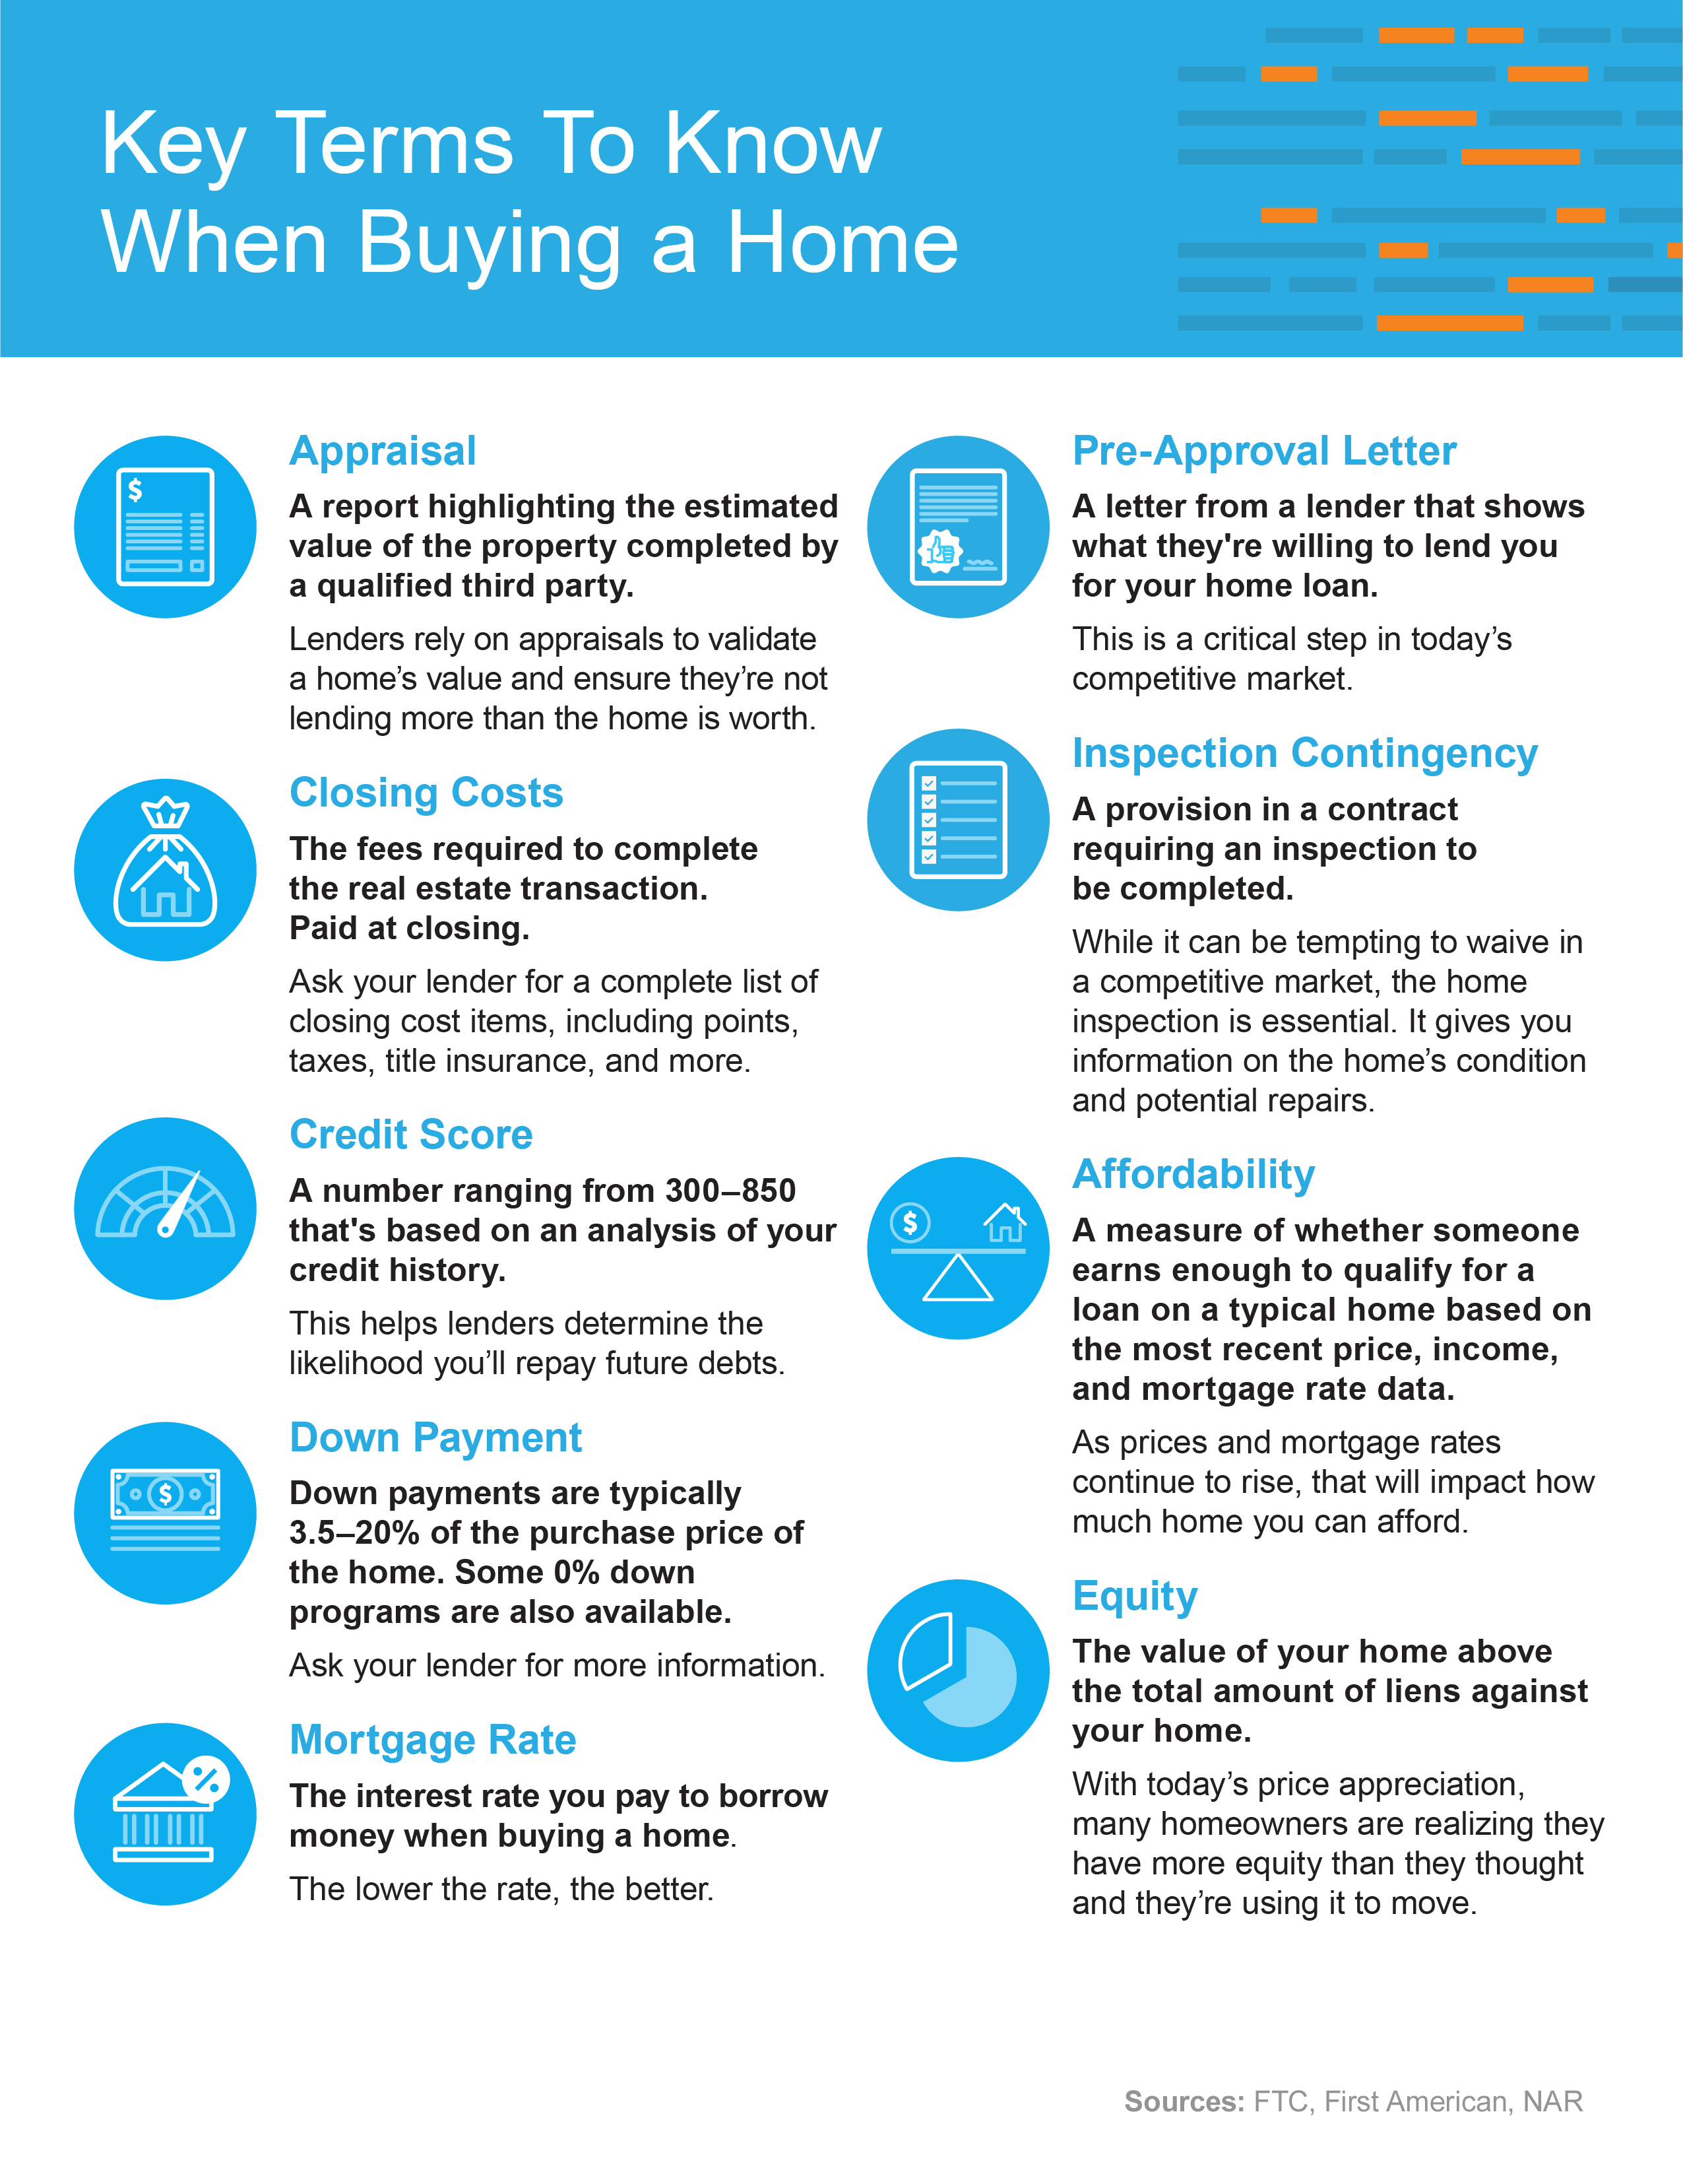
Notes:
https://www.ftc.gov/sites/default/files/documents/one-stops/real-estate-competition/realestateglossary.pdf
https://blog.firstam.com/15-real-estate-terms-you-should-know
https://magazine.realtor/tool-kit/rookie/article/2020/02/real-estate-glossary

Slide 14
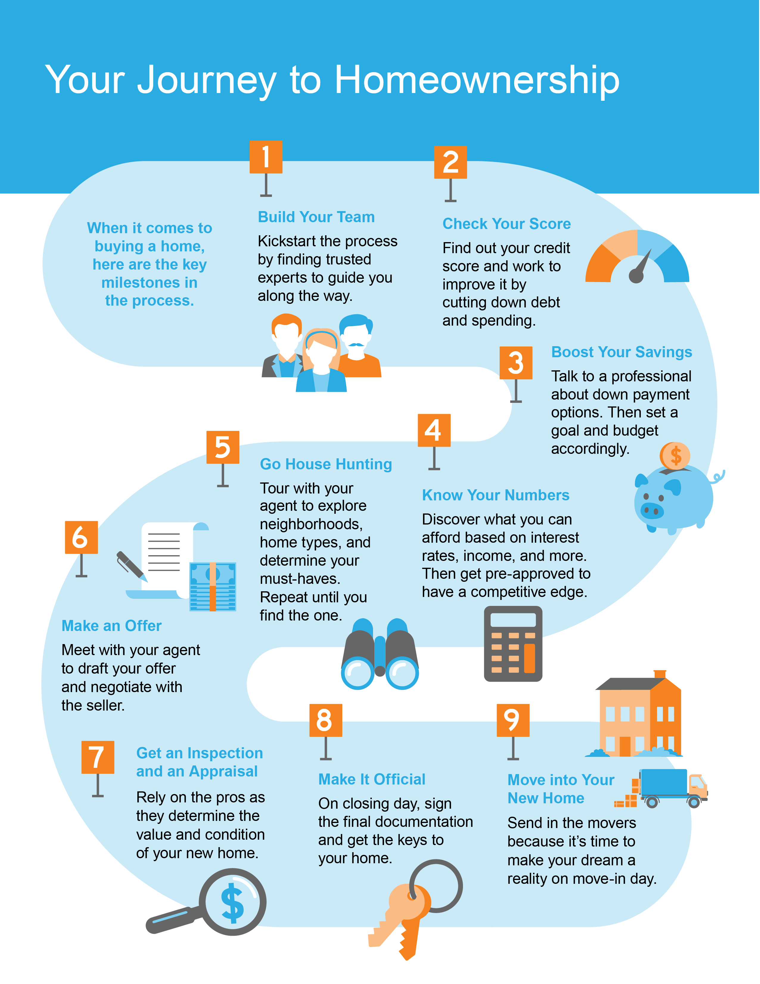

Slide 15
Why Pre-Approval Matters
You may have heard it’s important to get pre-approved for a mortgage at the beginning of the homebuying process, but what does that really mean, and why is it so important?
Why Pre-Approval Is Key
When looking for a home, the temptation to fall in love with a house that’s outside your budget is very real. So, before you start shopping around, it’s helpful to know your price range and how much money you can borrow for your loan. Pre-approval from a lender is the best way to do this.
Here’s how it works. According to NerdWallet, pre-approval is a letter that:
“. . . states the amount and type of mortgage the lender is willing to offer, along with the terms."
To get this written confirmation, you’ll need to provide information about your financials, including your income, employment information, your credit history, and more. NerdWallet explains:
“Preapproval requires you to provide proof of your financial history and stability. The lender will verify your income, employment, assets and debts, and will check your credit report.
You'll provide information in the form of W-2s, a current pay stub, a summary of your assets and your total monthly expenses. . . .”
While it may sound like a lot of documentation, the right professionals will make the process easy for you. Your pre-approval will help you know not just what you can borrow, but it’s also a great tool to help you set a budget and really understand your financial options. This way, you can begin your home search with a clear picture of what you want to look for.
Notes:
https://www.nerdwallet.com/article/mortgages/pre-qualified-vs-preapproved

Slide 16
Today’s Market Is Competitive, So Being Ready as a Buyer Is Key
The pre-approval process is more important than ever in today’s competitive market. With limited inventory, there are many more buyers than sellers right now, and that’s fueling competition for homes.
According to the National Association of Realtors (NAR), the average home is receiving multiple offers, so bidding wars are the norm as buyers compete with each other for their dream home. Pre-approval can help you stand out from the crowd.
It shows a seller that you’re a serious buyer. When a seller knows you’re qualified to purchase the home, you’re in a better position to be the winning offer. That’s because the seller will know you’re ready to move quickly.
Freddie Mac explains:
“By having a pre-approval letter from your lender, you’re telling the seller that you’re a serious buyer, and you’ve been pre-approved for a mortgage by your lender for a specific dollar amount. In a true bidding war, your offer will likely get dropped if you don’t already have one.”
Today’s housing market is changing day to day. So, you’re going to need guidance to navigate these waters. It’s important to have a team of professionals (a loan officer and a real estate agent) to help make your dreams a reality.
Bottom Line A pre-approval letter is an essential part of the homebuying process. Not only does being pre-approved bring clarity to your homebuying budget, it also shows sellers how serious you are about purchasing a home. Let’s connect so you have the expertise you need to tackle this step.
Notes:
https://www.nar.realtor/research-and-statistics/research-reports/realtors-confidence-index
https://myhome.freddiemac.com/blog/homeownership/20180926-strategies-for-winning-the-bidding-war

Slide 17
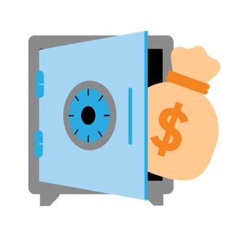
Things To Avoid After Applying for a Mortgage
Once you’ve applied for a mortgage, there are some key things to keep in mind. While it’s exciting to start thinking about moving in and decorating, be careful when it comes to making any big purchases. Here’s a list of things you may not realize you need to avoid after applying for your home loan.
1. Don’t Deposit Large Sums of Cash
Lenders need to source your money, and cash isn’t easily traceable. Before you deposit any amount of cash into your accounts, discuss the proper way to document your transactions with your loan officer.
2. Don’t Make Any Large Purchases
It’s not just home-related purchases that could disqualify you from your loan. Any large purchases can be red flags for lenders. People with new debt have higher debt-to-income ratios (how much debt you have compared to your monthly income). Since higher ratios make for riskier loans, borrowers may end up no longer qualifying for their mortgage. Resist the temptation to make any large purchases, even for furniture or appliances.
3. Don’t Co-Sign Loans for Anyone
When you co-sign for a loan, you’re making yourself accountable for that loan’s success and repayment. With that obligation comes higher debt-to-income ratios as well. Even if you promise you won’t be the one making the payments, your lender will have to count the payments against you.

Slide 18
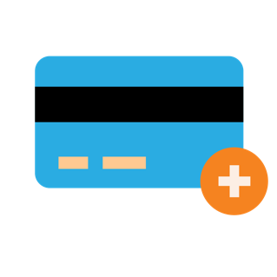
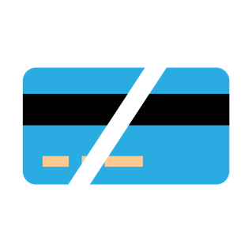
4. Don’t Change Bank Accounts
Remember, lenders need to source and track your assets. That task is much easier when there’s consistency among your accounts. Before you transfer any money, speak with your loan officer.
5. Don’t Apply for New Credit
It doesn’t matter whether it’s a new credit card or a new car. When you have your credit report run by organizations in multiple financial channels (mortgage, credit card, auto, etc.), your FICO® score will be impacted. Lower credit scores can determine your interest rate and possibly even your eligibility for approval.
6. Don’t Close Any Accounts
Many buyers believe having less available credit makes them less risky and more likely to be approved. This isn’t true. A major component of your score is your length and depth of credit history (as opposed to just your payment history) and your total usage of credit as a percentage of available credit. Closing accounts has a negative impact on both of those aspects of your score.
Any blip in income, assets, or credit should be reviewed and executed in a way that ensures your home loan can still be approved. If your job or employment status has changed recently, share that with your lender as well. The best plan is to fully disclose and discuss your intentions with your loan officer before you do anything financial in nature.
Bottom Line You want your purchase to go as smoothly as possible. Remember, before you make any large purchases, move your money around, or make any major life changes, be sure to consult your lender – someone who’s qualified to explain how your financial decisions may impact your home loan.

Slide 19
Be Realistic About Your Desired Features
It's important to go into your home search with clear priorities. This includes knowing which features and amenities you need your home to have versus the ones that are nice perks.
Bucketing features into different categories and priority levels can help you as you review available listings and decide which homes to tour and in what order. Here’s a great way to help you think about it:
Must-Haves – If a house doesn’t have these features, it won’t work for you and your lifestyle.
Nice-To-Haves – These are features you’d love to have but can live without. Nice-to-haves aren’t dealbreakers, but if the home hits all the must-haves and some of these items too, it’s a contender.
Dream State – This is where you can dream bigger. Again, these aren’t features you’ll need, but if you find a home in your budget that has all the must-haves, most of the nice-to-haves, and any of these, it’s a clear winner.
As you kick off your homebuying process, share these things with your real estate professional so you're aligned from the start and know how to focus your home search.
Danielle Hale, Chief Economist for realtor.com, explains it like this:
“Focus on the goal you set out for yourself, like your list of must-haves and nice-to-haves and your budget, . . . Stick to that. Be persistent.”
Bottom Line As a first-time buyer, it’s especially important to carefully consider what’s truly essential to your lifestyle. Your first home doesn't have to be your forever home. The most important thing is taking the first step toward building a brighter, more stable financial future. Let’s connect so you can achieve that dream.
Notes:
https://www-cnbc-com.cdn.ampproject.org/c/s/www.cnbc.com/amp/2022/02/26/what-to-do-before-you-buy-a-home.html

Slide 20
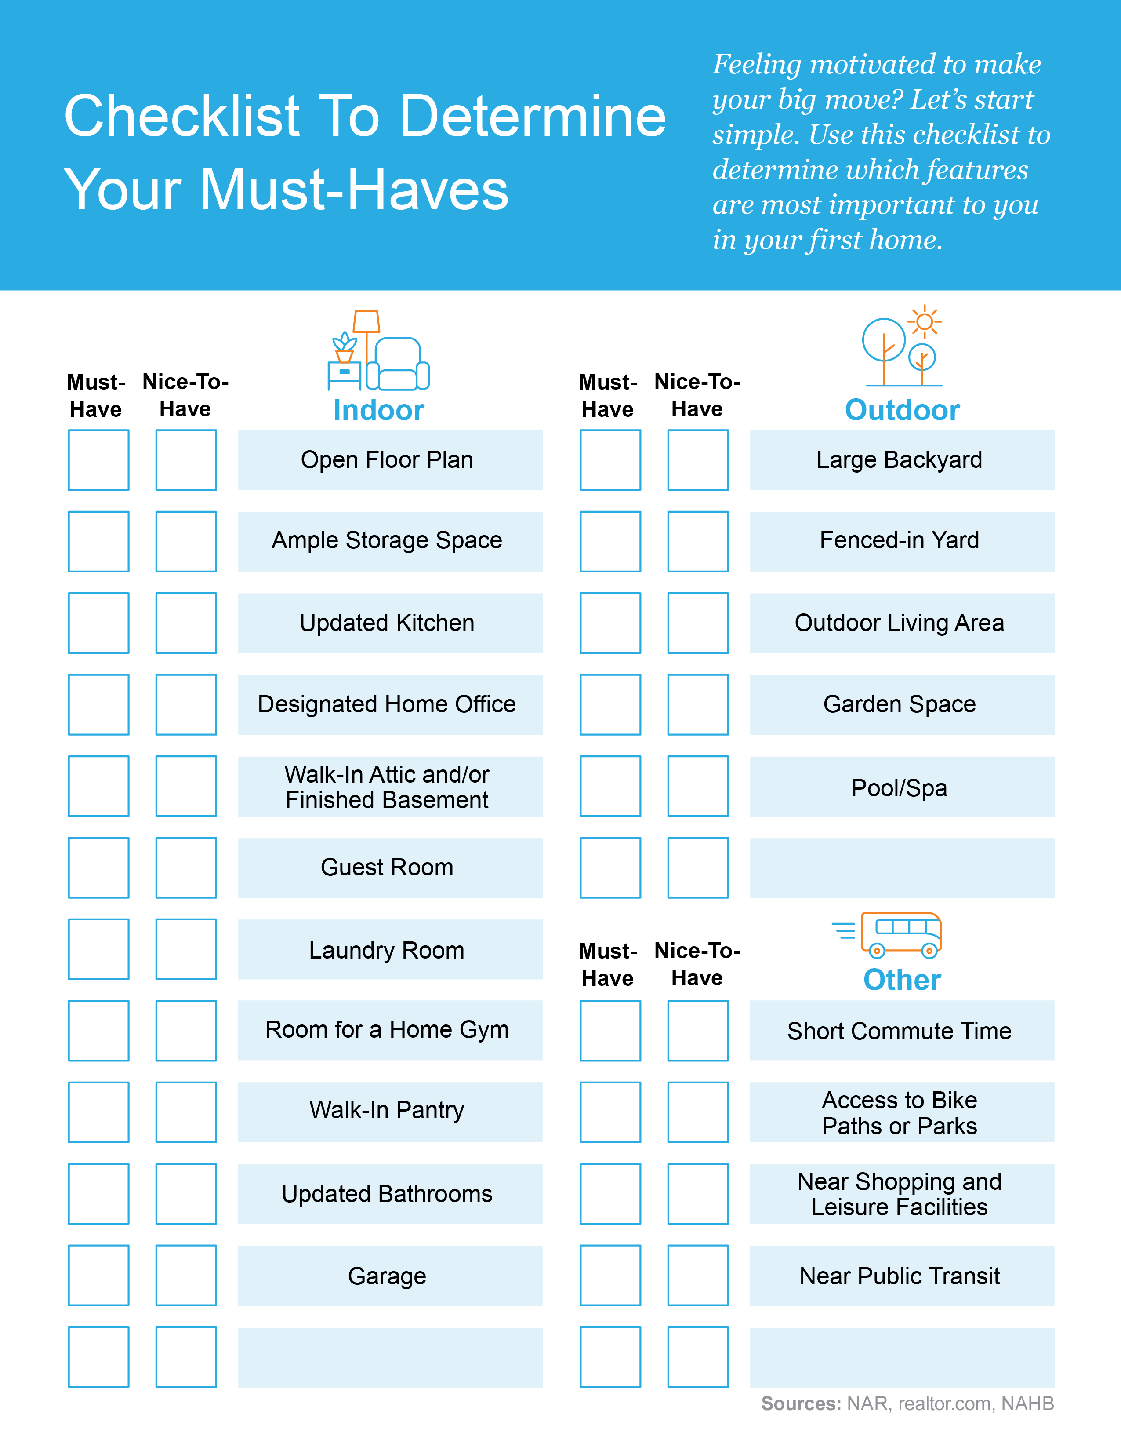
Notes:
https://cdn.nar.realtor/sites/default/files/documents/2022-home-buyers-and-sellers-generational-trends-03-23-2022.pdf
https://www.realtor.com/research/first-time-home-buyers-housing-2021/
https://eyeonhousing.org/2022/03/what-first-time-home-buyers-really-want/

Slide 21
Three Things To Know About Today’s Housing Market
Based on what we’ve seen over the past two years, one thing is clear: the current housing market is one for the record books. As a first-time buyer, here are three key components that are shaping this unprecedented market.
The Shortage of Homes for Sale
The number of homes available for sale hit an all-time low in January 2022. As Danielle Hale, Chief Economist for realtor.com, says:
“We expect that we’ll start to see a turnaround and inventory will stabilize and start to go up a little bit in 2022. . . . But that means we’re looking at inventory levels of roughly half of what we saw before the pandemic. For buyers, the market is likely to continue to move fast. If you see a home you like, you want to jump on it right away.”
Buyer Competition and Bidding Wars
The ongoing low supply, coupled with high demand, creates significant buyer competition and bidding wars. Some buyers are offering over the asking price, all cash, or waiving some contingencies. Just remember, you don’t want to waive the inspection, as it’s necessary to determine the condition of the home you’re buying.
Home Price Appreciation
That competition among buyers is driving prices up. Over the past year, home price appreciation has reached record levels throughout the country. According to CoreLogic:
“Home prices rose 18% during 2021 in the CoreLogic Home Price Index, the largest annual gain recorded in its 45-year history…”
The good news is, rising prices helps you know you’re making a good long-term investment. That’s because once you move in, that ongoing price appreciation will help grow your home’s value with time.
Bottom Line To help you find and buy your first home, you need the support of a real estate professional that you can lean on for insights on today’s housing market, what’s happening in your area, and expert advice for how to submit a strong offer at a fair price.
Notes:
https://www.realtor.com/news/trends/today-housing-market-compared-with-before-covid-19-pandemic/
https://www.corelogic.com/intelligence/homeowner-equity-insights/

Slide 22
How a Professional Supports Your Homeownership Goals
While it may be tempting to turn to the internet for advice, nothing can replace the expertise of a true professional. Buying a home is likely one of the biggest financial decisions of your life, so it’s crucial to have the right team in place.
A good agent will:
Explain the ins and outs of contracts. When it comes to buying a home, you’ll sign various disclosures and contracts as part of the process. Before you give any of these legally binding documents your autograph, your agent will help explain the terms and conditions.
Keep you up-to-date on today’s market conditions. The real estate industry is complex and dynamic. Pricing, mortgage interest rates, and demand can change often. You need someone by your side who will keep you informed on the latest trends and what they mean for you.
Serve as your advisor in the negotiation process. Even after the contract is signed by the seller, there’s a lot of room left for negotiating terms after the home inspection and the appraisal. Your agent will handle all the back-and-forth communication that comes with it.
Give advice and share their experience. Let’s be honest, buying a home is emotional. When your offer isn’t accepted, your must-haves aren’t realistic, or they suspect something is wrong, you want someone who will be honest with you. Your agent’s expert advice and know-how will bring you peace of mind.

Slide 23
“Buying a home is not just a financial decision. It’s also a lifestyle decision.”
- Mark Fleming, Chief Economist, First American
Notes:
https://blog.firstam.com/economics/the-reconomy-podcast-what-is-the-fed-signaling-on-interest-rates

Slide 24
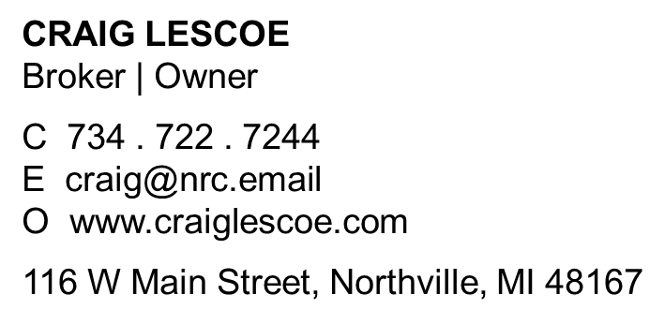
Let’s Chat.
I’m sure you have questions about the real estate process, what to expect as a first-time buyer, and what’s happening in the market too. I can help with all of those.
I’d love to talk with you about what you’ve read here and help you on the path to buying your first home. My contact information is below, and I look forward to working with you.

