Slide 1
Things To Consider When
Selling Your House
SUMMER 2022
EDITION

Slide 2
Table of Contents
3 Reasons To Sell This Summer
5 Expert Insights for Today’s Sellers
7 Why Sellers Are Winning Big Today
9 Should I Update My House Before I Sell It?
10 What’s Going To Happen with Home Prices This Year?
12 Your Agent Is Key When Pricing Your House
13 Record Equity Gains Can Power Your Next Move
16 Homeownership as a Hedge Against Inflation
19 How an Agent Helps Sell Your House
21 A Checklist for Selling Your House
22 Reasons To Hire a Real Estate Professional

Slide 3
Reasons To Sell This Summer
When you sell your house, you want to balance getting the most out of your sale with knowing you’re making a good investment on your next home. Here are a few reasons why you may want to make a move this summer and prioritize your homeownership goals sooner rather than later.
1. The Number of Homes on the Market Is Still Low
While data from realtor.com shows the number of listings coming to market (known in the industry as new listings) has grown since the start of the year, housing supply is still firmly in sellers’ market territory. This means there are still more buyers in the market than there are homes available. That puts you in the driver’s seat.
Purchasers are eagerly waiting for your house, so if you work with a real estate professional to price it correctly, it could sell quickly and get multiple strong offers this season. Just know that listing sooner rather than later can help your house stand out before more sellers add their homes to the market.
2. Your Equity Is Growing in Record Amounts
Odeta Kushi, Deputy Chief Economist at First American, reports:
“. . . homeowners in Q4 2021 had an average of $307,000 in equity – a historic high.”
That much equity can open doors for you to make a move. If you’ve been holding off on selling because you’re worried about how rising prices will impact your next home search, rest assured your equity can help fuel your move. It may be just what you need to cover a large portion (if not all) of the down payment on your next home.
Notes:
https://www.realtor.com/research/data/
https://twitter.com/odetakushi/status/1508926031381553164

Slide 4
3. Mortgage Rates Have Increased This Year
While it’s true the 30-year fixed mortgage rate from Freddie Mac has climbed over two percentage points this year, current rates are still below what they’ve been in past decades. Mark Fleming, Chief Economist at First American, explains:
“Rising mortgage rates impact affordability, but historical context is important. An average 30-year, fixed mortgage rate of 5.5 percent is still well below the historical average of nearly 8 percent.”
That means you still have an opportunity to lock in a rate that’s comparatively lower than decades past. Work with a trusted advisor to kickstart the process so you can make your next purchase today.
4. Home Prices Are Appreciating
Home prices have been skyrocketing in recent years, thanks to the imbalance of supply and demand. And as long as that imbalance continues, so will the rise in home values.
What does that mean for you? If you’re selling so you can move into the home of your dreams or downsize into something that better suits your current needs, you have an opportunity to get ahead of the curve by leveraging your growing equity and purchasing your next home before prices appreciate further.
And, once you make your purchase, you can find peace of mind in knowing any further home price appreciation is growing the value of your new investment.
Bottom Line Just like anything else in life, timing is a big part of any decision. If you’re thinking about selling your house, let’s connect so you have the expert insights you need to make the best possible move today.
Notes:
http://www.freddiemac.com/pmms/pmms_archives.html
https://blog.firstam.com/economics/how-do-rapidly-rising-mortgage-rates-impact-affordability

Slide 5
Expert Insights for Today’s Sellers
Real estate experts agree: sellers have a great opportunity in front of them this season thanks to low housing supply, home price appreciation, and growing home equity. These are some of the main reasons industry leaders say you should consider selling your house this summer.
“ | There is an ongoing housing shortage, and properly listed homes are still selling swiftly – generally seeing a contract signed within a month. - Lawrence Yun, Chief Economist, National Association of Realtors
“ | The process of getting a home ready for sale traditionally involved cleaning, repairing any items needing maintenance, decluttering, and even staging. With many homeowners expecting a quick sale, . . . the preparation process took less than a month for over 50% of home sellers . . . with 20% completing it in less than two weeks. - George Ratiu, Senior Economist & Manager of Economic Research, realtor.com
“ | This imbalance between an insufficient number of owners looking to sell relative to buyers searching for a home has led to the record appreciation of the past 12 months. - Dr. Frank Nothaft, Chief Economist, CoreLogic
“ | Strong house price appreciation typically encourages more existing homeowners to move. As homeowners gain equity in their homes, they may be more likely to consider using the equity to purchase a larger or more attractive home. - Mark Fleming, Chief Economist, First American
Notes:
https://www.realtrends.com/articles/pending-home-sales-reach-slowest-pace-in-a-decade/
https://www.realtor.com/research/2022-spring-home-sellers/
https://www.corelogic.com/intelligence/u-s-home-price-insights/
https://blog.firstam.com/economics/why-the-2022-housing-market-is-very-2019

Slide 6
“While house price growth is expected to moderate from the rapid pace of 2021, strong home buyer demand against a backdrop of historically tight inventory of homes for sale will likely keep appreciation positive in the coming year.”
- First American
Notes:
https://blog.firstam.com/economics/it-doesnt-take-much-house-price-appreciation-to-make-owning-a-better-choice-than-renting

Slide 7
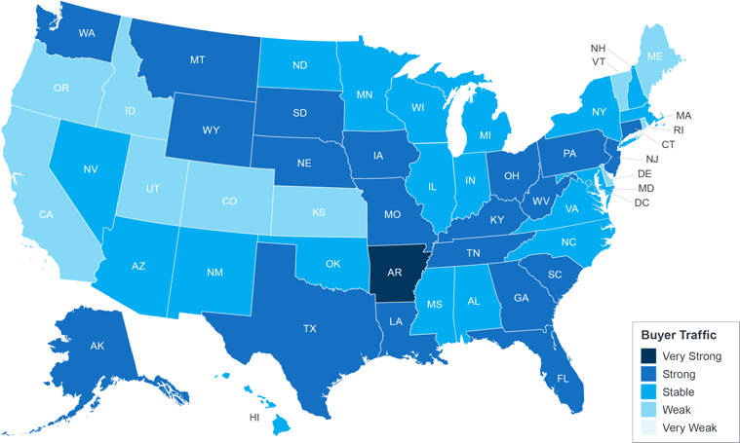
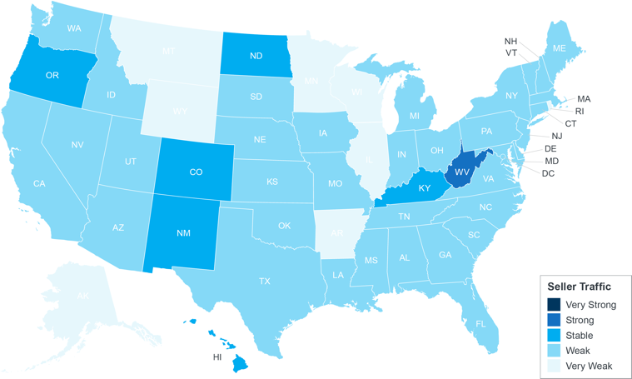
Why Sellers Are Winning Big Today
When selling anything, you always hope for strong demand for the item coupled with limited supply. In essence, when demand is high and supply is low, prices naturally rise. That’s exactly what’s happening in the housing market today.
Here’s a look at the current imbalance in supply and demand according to the National Association of Realtors (NAR):
Buyer Traffic
Seller Traffic
Very Strong
Strong
Stable
Weak
Very Weak
Source: NAR
Notice there's more dark blue on the left. This shows buyer traffic (demand) is strong or stable. In contrast, the lighter blues on the right indicate weak or very weak seller traffic (supply). In a nutshell, the demand for homes is greater than what’s available to purchase.
Notes:
https://cdn.nar.realtor/sites/default/files/documents/2022-04-realtors-confidence-index-05-19-2022.pdf

Slide 8
As the maps on the previous page show, seller traffic is weak. That directly impacts housing supply. While signs indicate housing supply is starting to rise as more sellers list their homes, inventory is still low. The graph below gives you an idea of how today’s low inventory compares to pre-pandemic years using data from NAR on the months’ supply of homes for sale.
Months Inventory of Homes for Sale
In Millions (2011-2022)
Source: NAR
What That Means For You
When there’s strong demand for an item and a limited supply of it available, the seller has maximum leverage. You might already realize this advantage enables you to sell at the best possible price, but it also means you’re in a better position to get the ideal contract terms to suit your needs.
That’s because there’s a chance you’ll get offers from multiple buyers who are willing to compete for your house. They’ll do everything they can to make their offer stand out. This could mean you’ll see things like waived contingencies, offers over asking price, earnest money deposits, and more. As the offers come in, work with your agent to look closely at each one before you decide which works best for you.
Bottom Line The current imbalance of supply and demand puts sellers in the driver’s seat. Let’s connect today to discuss how much leverage you have, and why it may make sense to sell now before your house has more competition.
Notes:
https://www.nar.realtor/topics/existing-home-sales

Slide 9
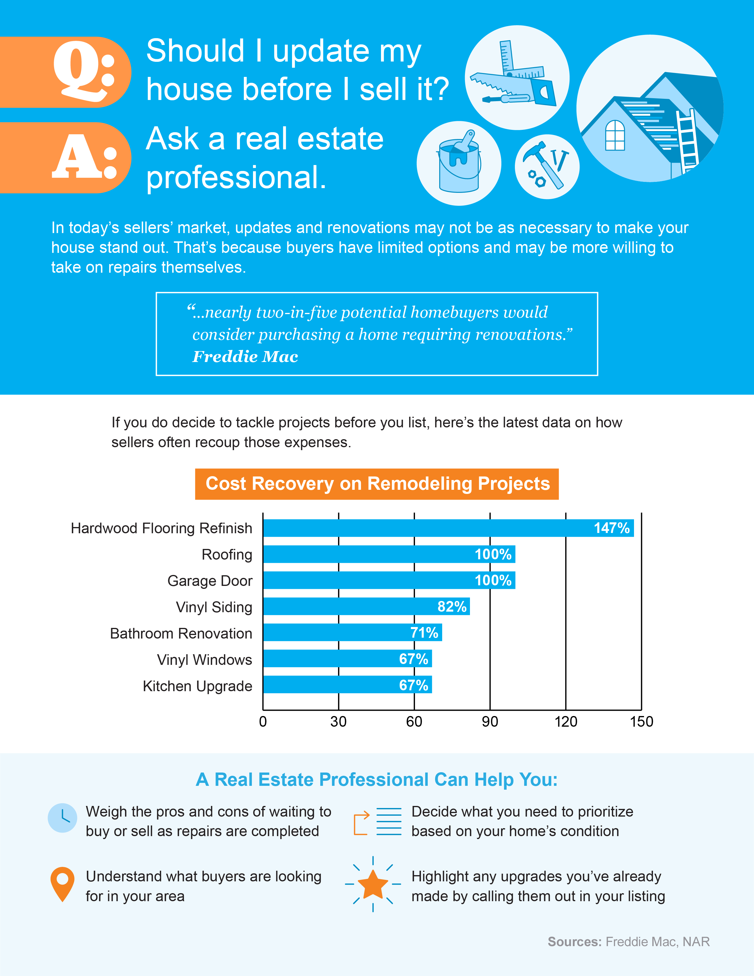
Notes:
https://cdn.nar.realtor/sites/default/files/documents/2022-remodeling-impact-04-06-2022.pdf
https://myhome.freddiemac.com/blog/homeownership/breathing-new-life-old-buying-fixer-upper-and-distressed-homes

Slide 10
What’s Going To Happen
with Home Prices This Year?
You may be thinking of selling because you’ve heard your home’s value has increased. But will that trend continue? Or will prices fall since mortgage rates have risen?
History Shows Home Prices Don’t Fall When Mortgage Rates Rise
While some people may worry the rise in mortgage rates this year will impact demand so much that home prices will depreciate, experts say otherwise. Doug Duncan, Senior Vice President and Chief Economist at Fannie Mae, notes:
“What I will caution against is making the inference that interest rates have a direct impact on house prices. That is not true.”
To give you historical context, here’s a look at the impact on home prices over the past 30 years when mortgage rates rose by a percentage point or more. As the chart below shows, rates jumped by at least 1% six times in that time frame. In each case, home values increased. So, if you’re planning to sell, history shows rising mortgage rates have not had a negative impact on home prices.
The Impact of Rising Mortgage Rates on Home Prices
Start Date | End Date | Months | Increase | Home Prices
Oct 1993 | Dec 1994 | 14 | 2.38% | +3%
Jan 1996 | Sept 1996 | 8 | 1.20% | +2%
Oct 1998 | May 2000 | 19 | 1.81% | +13%
June 2003 | June 2004 | 12 | 1.06% | +13%
June 2005 | July 2006 | 13 | 1.18% | +7%
Nov 2012 | Dec 2013 | 13 | 1.11% | +11%
Average |  | 13 | 1.46% | +8%
Source: Freddie Mac
Notes:
https://themreport.com/daily-dose/03-09-2022/expert-insights-inventory-levels-fed-rates-more
https://www.freddiemac.com/research/insight/20180223-increasing-mortgage-rates

Slide 11
What’s Driving the Continued Price Growth Today?
According to the U.S. Home Price Insights Report from CoreLogic, home values increased by an average of 15% in 2021. That dramatic rise in home prices is a direct result of more buyers in the market (demand) than houses available for sale (supply). When demand is high and supply is low like it is right now, prices naturally rise.
The graph below shows 2022 home price forecasts from several industry experts. The average of these projections indicates an expected 8.9% home price appreciation in 2022. While this isn’t quite the dramatic 15% the market experienced last year, it shows experts are calling for ongoing appreciation. Basically, experts are all indicating home values will continue to climb, just at a more moderate pace.
2022 Home Price Forecasts
Based on Expert Projections
Average of All Forecasts: 8.9%
Bottom Line Selling now is a great way to take advantage of today’s home price appreciation. And when you buy your next home, projections for ongoing appreciation indicate it’ll be a worthwhile investment that should grow in value with time.
Notes:
https://www.mba.org/docs/default-source/research-and-forecasts/forecasts/mortgage-finance-forecast-may-2022.pdf?
https://cdn.nar.realtor/sites/default/files/documents/forecast-q2-2022-us-economic-outlook-04-27-2022.pdf
https://www.fanniemae.com/media/43571/display
http://www.freddiemac.com/research/forecast/20220121_quarterly_economic_forecast.page
https://pulsenomics.com/surveys/#home-price-expectations
https://www.corelogic.com/intelligence/find-stories/corelogic-hpi-posted-record-year-over-year-growth-in-2021/
https://www.zelmanassociates.com/ (by subscription)

Slide 12
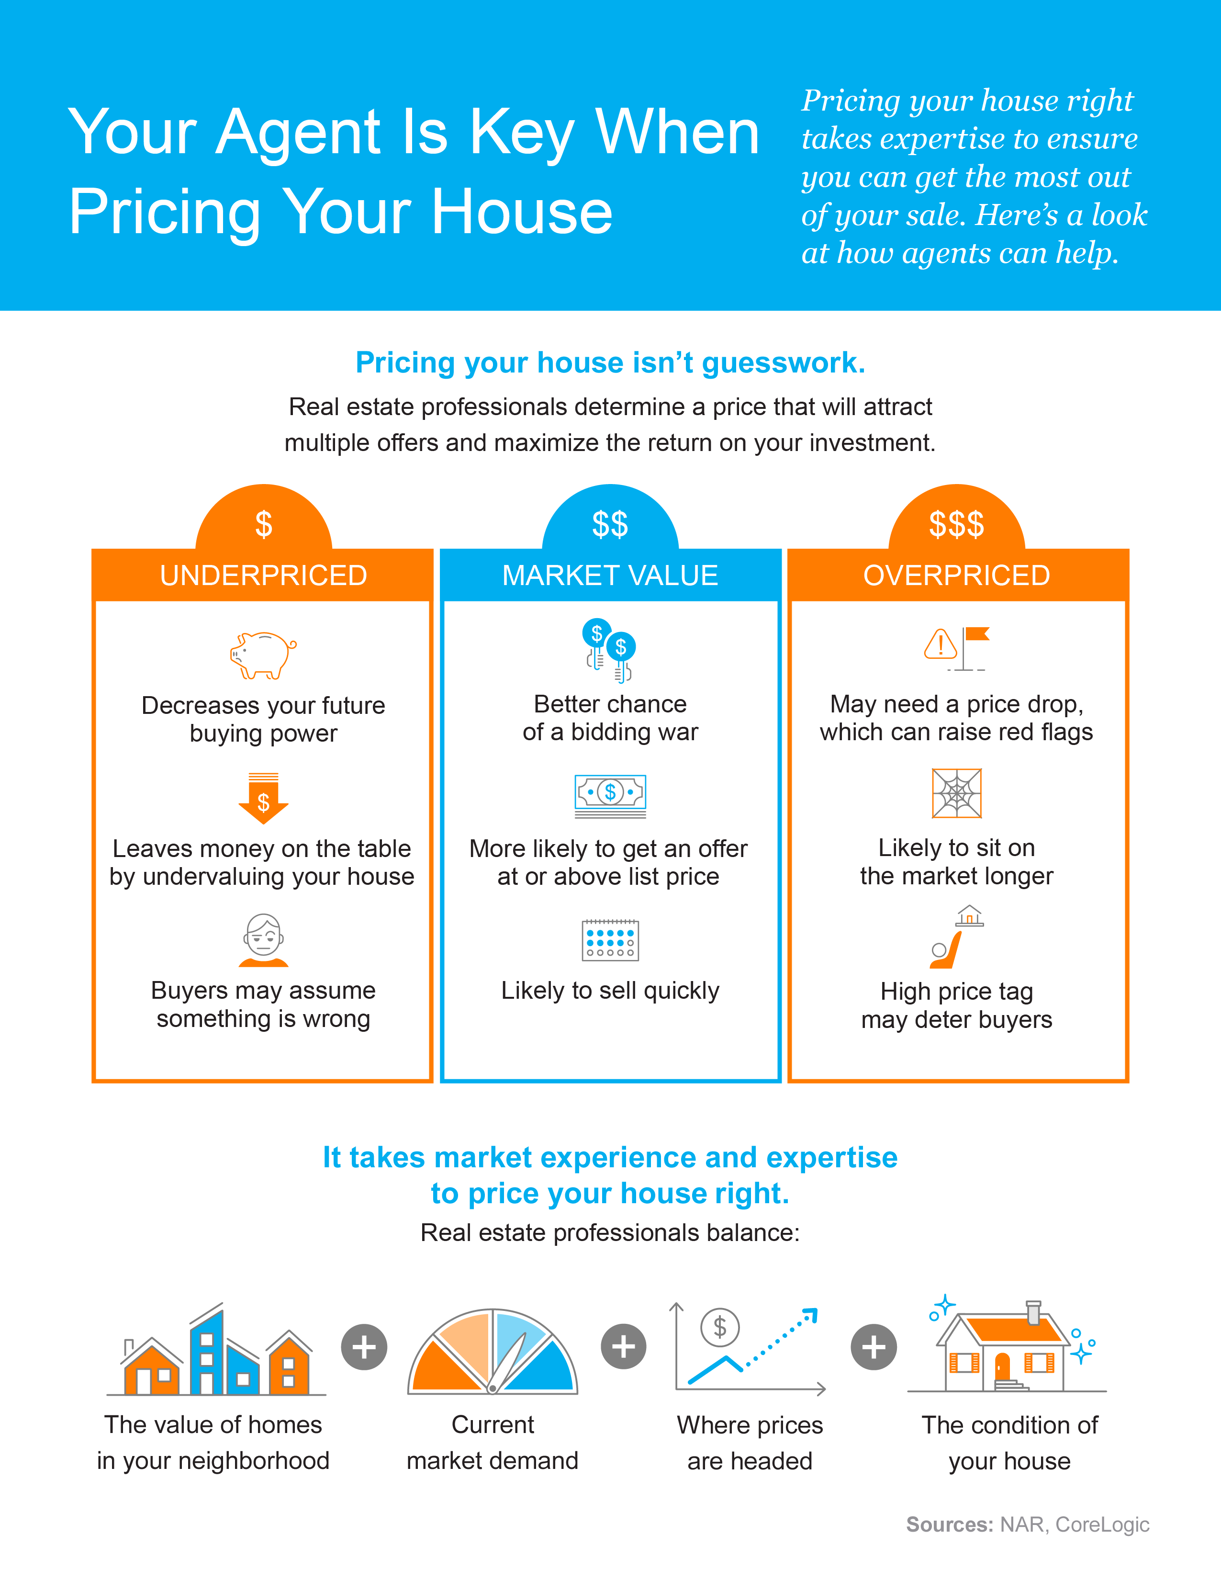
Notes:
https://www.nar.realtor/determining-asking-price
https://www.corelogic.com/intelligence/find-stories/us-sp-corelogic-case-shiller-rockets-to-16-6-reaches-new-records/

Slide 13
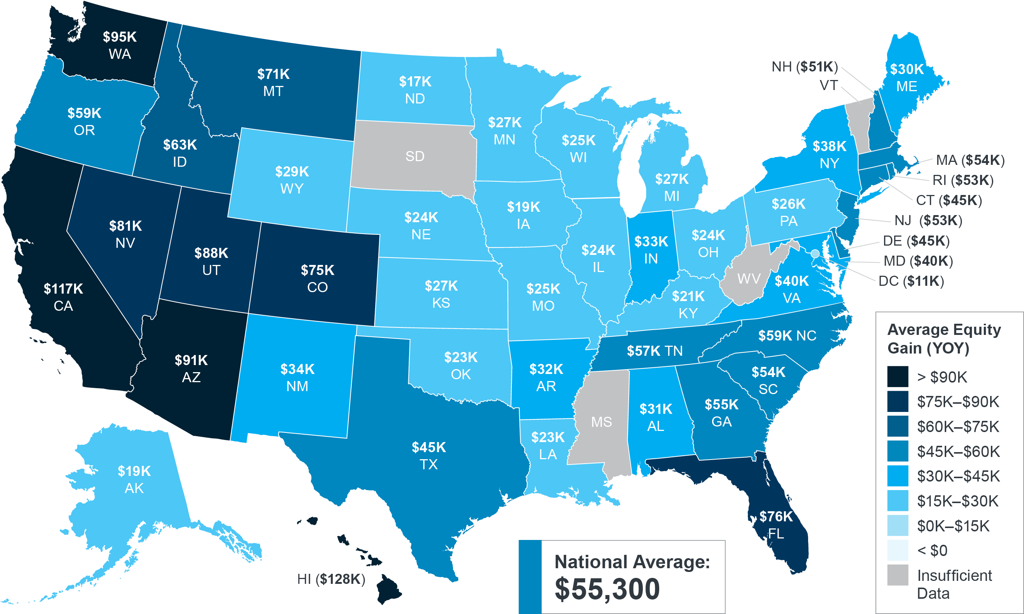
Record Equity Gains Can
Power Your Next Move
Equity can be a real game-changer if you’re planning to make a move. According to the latest data from CoreLogic, the average homeowner gained $55,300 in equity over the past year, a number that grew substantially as home values appreciated.
Homeowner Equity Gains Over the Past Year
Source: CoreLogic
Notes:
https://www.corelogic.com/intelligence/homeowner-equity-insights/

Slide 14
Why Equity Is Growing Today
For a homeowner, your equity is the current value of your home minus what you owe on the loan. Today, there aren’t enough homes on the market to meet buyer demand, so bidding wars and multiple offers are driving home values up, giving current homeowners a significant equity boost.
The graph below uses the most recent projections from the Home Price Expectation Survey (HPES) by Pulsenomics to show how your household wealth is expected to continue building as home values rise.
Potential Home Price Growth Over the Next 5 Years
Based on Projections from the Home Price Expectation Survey
$96,342
Potential growth in household wealth over the next five years based solely on increased home equity if you purchased a $360K home in January of 2022.
Source: HPES 2022 1Q
How Rising Equity Impacts You
If you’re a homeowner, equity not only builds your wealth, it also opens doors for you to achieve your financial goals.
It works like this: when you sell your house, the equity you built up comes back to you in the sale. You can use those proceeds to fuel your next move, especially if you’ve decided your needs have changed and you’re looking for something new.
Bottom Line Let’s connect to determine how much equity you have in your current home and how you can use it to help you make your next move sooner than you may have thought possible.
Notes:
https://www.corelogic.com/intelligence/homeowner-equity-insights/
https://pulsenomics.com/surveys/#home-price-expectations

Slide 15
“Home prices rose . . . generating a big increase in home equity. . . . Home equity has historically been a major source of wealth.”
- Dr. Frank Nothaft, Chief Economist, CoreLogic
Notes:
https://www.corelogic.com/press-releases/number-of-u-s-homeowners-in-negative-equity-dropped-to-lowest-level-in-over-12-years-corelogic-reports/

Slide 16
Homeownership as a Hedge
Against Inflation
If you’re thinking about selling to make a move this summer, you may be wondering if the recent news about rising inflation should impact your plans. The good news is, history shows homeownership is usually a strong hedge against inflation.
Your Next Home Will Give You Lasting Stability
With inflation reaching its highest level in 40 years, it’s more important than ever to think about stabilizing your expenses wherever you can.
If you want to move up into your next home, know that doing so sooner rather than later may be the key to get what you want. When you move, you can lock in your largest monthly expense - your mortgage payment - before prices climb higher. This protects you from increasing housing costs for the foreseeable future.
So, while prices for other goods and services like groceries, gas, and more could put a pinch on your wallet, you can secure a stable housing payment even as those other items rise in cost around you.
A fixed-rate mortgage allows you to maintain the biggest portion of housing expenses at the same payment. Sure, property taxes will rise and other expenses may creep up, but your monthly housing payment remains the same.
- James Royal, Senior Investing and Wealth Management Reporter, Bankrate
Notes:
https://www.cbsnews.com/news/consumer-prices-inflation-highest-rate-in-40-years/
https://www.bankrate.com/investing/inflation-hedges-to-protect-against-rising-prices/

Slide 17
History Shows During Inflationary Periods, Home Prices Rise Too
As an added plus, history indicates your next home will likely grow in value with time. Mark P. Cussen, Financial Writer at Investopedia, explains:
“Real estate is one of the time-honored inflation hedges. It's a tangible asset, and those tend to hold their value when inflation reigns, unlike paper assets. More specifically, as prices rise, so do property values.”
To help give you more context, here’s a look at how home prices have performed compared to inflation since the 1970s. When prices rise, the value of your home does too. And when you’re looking to protect yourself from rising costs, you want to be in a fixed asset that typically outperforms the rate of inflation. As history shows, that makes buying your next home a great hedge during periods of high inflation.
Homeownership: a Hedge Against Inflation
Home Price Appreciation vs. Consumer Price Increases Over the Decades
Source: NAR, CoreLogic, Consumer Price Index
Bottom Line If you’re ready, moving sooner rather than later will put you in the best position to gain from your next investment. Let’s connect if you want to better understand how moving into your dream home could be a great long-term decision.
Notes:
https://www.investopedia.com/articles/investing/060916/top-5-ways-hedge-against-inflation.asp
https://cdn.nar.realtor/sites/default/files/documents/2021-11-12-residential-economic-issues-and-trends-lawrence-yun-presentation-slides-11-12-2021.pdf
https://www.bls.gov/news.release/archives/cpi_01132021.pdf
https://www.bls.gov/opub/ted/2022/consumer-price-index-2021-in-review.htm
https://www.corelogic.com/intelligence/find-stories/home-prices-topple-expectations-surging-at-the-end-of-2020/
https://www.corelogic.com/intelligence/corelogic-hpi-posted-record-year-over-year-growth-in-2021/

Slide 18
“There are many advantages to investing in real estate. . . . It often acts as a good inflation hedge since there will always be a demand for homes, regardless of the economic climate, and because as inflation rises, so do property values, . . .”
- Investopedia
Notes:
https://www.investopedia.com/articles/investing/060916/top-5-ways-hedge-against-inflation.asp

Slide 19
How an Agent Helps Sell Your House
With today’s housing market moving as fast as it is, working with a professional is more essential than ever. Here are five reasons you’ll want to use a real estate advisor when you sell your home this season.
1. They Know What Buyers Want To See
Before you decide which projects and repairs to take on, connect with a real estate professional. They have first-hand experience with today’s buyers, what they expect, and what you need to do to make sure your house shows well. A survey from Freddie Mac finds:
“. . . nearly two-in-five potential homebuyers would consider purchasing a home requiring renovations.”
A professional can use their expertise to help you make the best decisions possible for your local market.
2. They Help Maximize Your Buyer Pool
While it’s true the average home for sale is receiving multiple offers, it’s important to understand your agent’s role in bringing buyers in. Real estate professionals have an assortment of tools at their disposal, such as social media followers, agency resources, and the multiple listing service (MLS) to ensure your house is viewed by the most buyers. According to realtor.com:
“Only licensed real estate agents can list homes on the MLS, which is a one-stop online shop of sorts for getting a house seen by thousands of agents and home buyers.”
Without access to these tools, your buyer pool is limited.
Notes:
https://myhome.freddiemac.com/blog/homeownership/breathing-new-life-old-buying-fixer-upper-and-distressed-homes
https://www.realtor.com/advice/buy/what-is-fsbo-for-sale-by-owner/

Slide 20
3. They Understand the Fine Print
Today, more disclosures and regulations are mandatory when selling a house. That’s why Investopedia says:
“One of the biggest risks of FSBO [For Sale By Owner] is not having the experience or expertise to navigate all of the legal and regulatory requirements that come with selling a home.”
A real estate professional knows exactly what needs to happen, what all the paperwork means, and how to work through it efficiently. They’ll help you review the documents and avoid any costly missteps that could occur if you try to handle them on your own.
4. They’re Trained Negotiators
If you sell without a professional, you’ll also be solely responsible for the negotiations. That means you’ll have to coordinate with:
The buyer, who wants the best deal possible
The buyer’s agent, who will use their expertise to advocate for the buyer
The inspection company, which works for the buyer and will almost always find concerns with the house
The appraiser, who assesses the property’s value to protect the lender
Instead of going toe-to-toe with these parties alone, lean on an expert. They’ll know what levers to pull, how to address all concerns, and when to get a second opinion.
5. They Know How To Set the Right Price for Your House
Real estate professionals know the ins and outs of how to price your house accurately and competitively. They compare your house to recently sold homes in your area and assess the current condition of your house. These factors are key to making sure it’s priced to move quickly while still getting you the highest possible final sale price.
Bottom Line There’s a lot that goes into selling your house, and it takes time, effort, and expertise to truly do it right. Before you decide to sell your house on your own, let's discuss how having a professional at your side can help.
Notes:
https://www.investopedia.com/articles/personal-finance/071514/8-reasons-not-sell-your-home-without-agent.asp

Slide 21
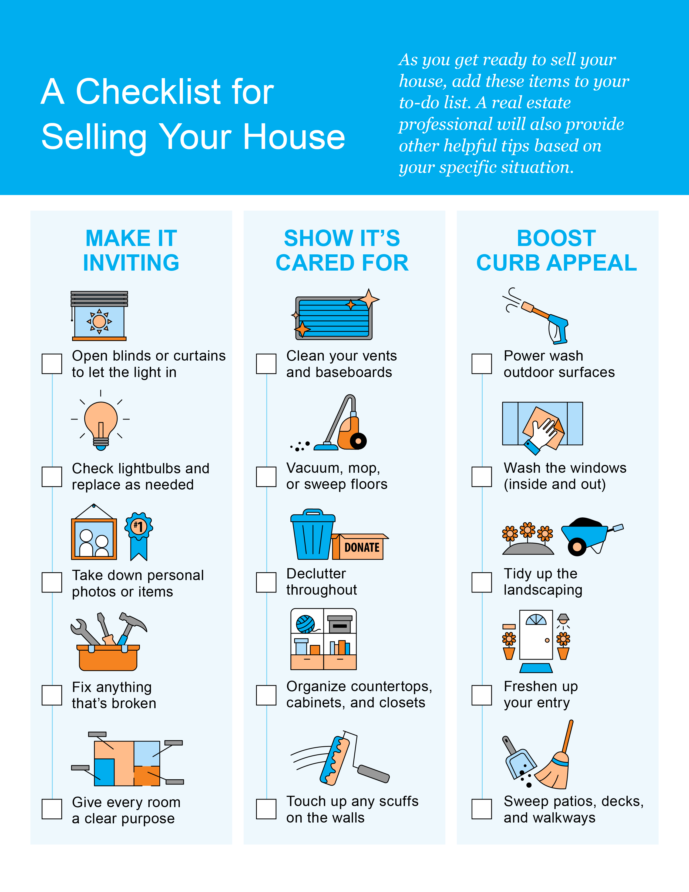

Slide 22
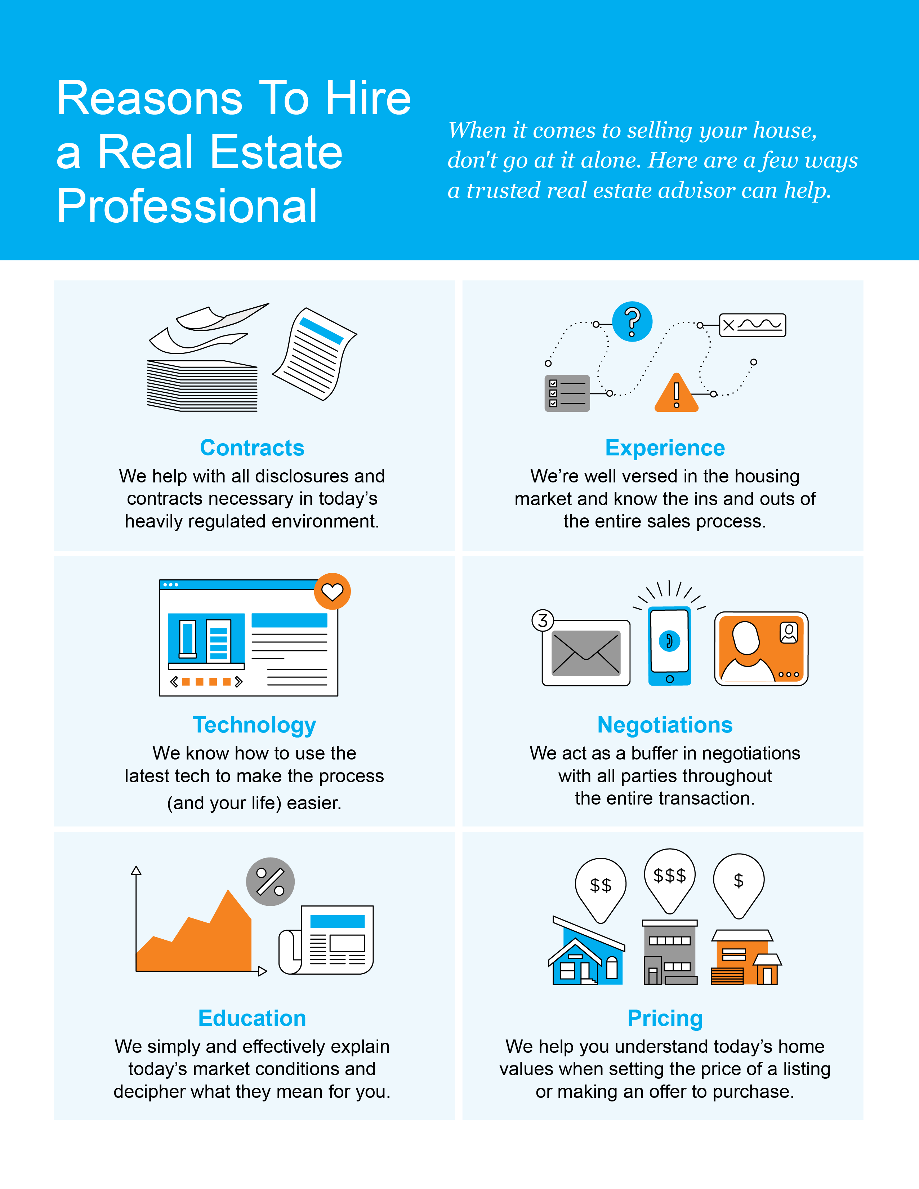

Slide 23
“. . . homes are moving quickly and a lot of times with all-cash offers. That means sellers can get top dollar for their property if they decide to list.”
- realtor.com
Notes:
https://www.realtor.com/news/trends/where-were-seeing-the-most-new-listings/

Slide 24
Let’s Chat.
I’m sure you have questions and thoughts about the real estate process.
I’d love to talk with you about what you’ve read here and help you on the path to selling your house. My contact information is below, and I look forward to working with you.
SUMMER 2022 EDITION

