Slide 1
Things To Consider When
Selling Your House
SPRING 2022
EDITION

Slide 2
Table of Contents
3 Why You Should Sell This Spring
5 Expert Insights for Today’s Sellers
7 Why Sellers Are Winning Big Today
9 What’s Going To Happen with Home Prices This Year?
11 Record Equity Gains Can Power Your Next Move
13 Real Estate Voted the Best Investment
16 Save Time and Effort by Selling with an Agent
18 Your Agent Is Key When Pricing Your House
19 Should I Update My House Before I Sell It?
21 A Checklist for Selling Your House
22 Reasons To Hire a Real Estate Professional

Slide 3
Why You Should Sell This Spring
Trying to decide when to sell? If so, you likely want to time it just right so you can get the most out of the sale of your current house and know you’re making a good investment when you buy your next home. You may not realize that the opportunity to get the best of both worlds is already here. Here’s why.
The Number of Homes on the Market Is Still Low
Today’s limited supply of houses for sale is putting sellers in the driver’s seat. There are far more buyers in the market than there are homes available, and that means purchasers are eagerly waiting for your house.
Listing your house now makes it the center of attention. And if you work with a real estate professional to price your house correctly, you can expect it to sell quickly and likely get multiple strong offers this season.
Your Equity Is Growing in Record Amounts
According to CoreLogic, current homeowners are sitting on record amounts of equity thanks to recent home price appreciation.
That much equity can open doors for you to make a move. If you’ve been holding off on selling because you’re worried about how rising prices will impact your next home search, rest assured your equity can help fuel your move. It may be just what you need to cover a large portion – if not all – of the down payment on your next home.
Notes:
https://www.corelogic.com/intelligence/homeowner-equity-insights/

Slide 4
Mortgage Rates Are Increasing
While it’s true mortgage rates have been climbing this year, current rates are still below what they’ve been in recent decades. In the 2000s, the average mortgage rate was 6.27%. In the 1990s, the average rate was 8.12%.
Even though mortgage rates are rising, they’re still worth taking advantage of today. You just want to do so sooner rather than later because experts are projecting rates will continue to increase throughout this year. Doug Duncan, Senior Vice President and Chief Economist at Fannie Mae, says:
“For homebuyers, we believe that borrowing costs will likely rise with the increase in mortgage rates....”
When that happens, it’ll cost you more to purchase your next home. That’s why it’s important to act now if you’re ready to sell. Work with a trusted advisor to kickstart the process so you can make your next purchase before rates climb further.
Home Prices Are Climbing Too
Home prices have been skyrocketing in recent years thanks to the imbalance of supply and demand. And as long as that imbalance continues, so will the rise in home values.
What does that mean for you? If you’re selling so you can move into the home of your dreams or downsize into something that better suits your current needs, you have an opportunity to get ahead of the curve by leveraging your growing equity and purchasing your next home before prices climb higher.
And, once you make your purchase, you can find peace of mind in knowing ongoing home price appreciation is growing the value of your new investment.
Bottom Line As a homeowner, you have a great opportunity to get the best of both worlds this season. You can truly win when you sell and when you buy. If you’re thinking about making a move, let’s connect so you have the insights you need to make the best possible decision in today’s sellers’ market.
Notes:
http://www.freddiemac.com/pmms/pmms_archives.html
https://www.fanniemae.com/newsroom/fannie-mae-news/economic-growth-expected-slow-fed-wrangles-inflation

Slide 5
Expert Insights for Today’s Sellers
Real estate experts agree: sellers have a great opportunity in front of them this season thanks to low housing supply, high buyer demand, and growing home equity. These are some of the main reasons industry leaders say you should consider selling your house this spring.
“ | The inventory of homes on the market remains woefully depleted, and in fact, is currently at an all-time low. - Lawrence Yun, Chief Economist, NAR
“ | . . . history demonstrates that potential homebuyers who are on the fence will often enter the market at the start of rate increase cycles. . . . We do expect rates to continue to increase but at a more gradual pace. - Freddie Mac
“ | The current supply-demand imbalance is expected to remain in 2022. . . . Homebuilders are working very hard to bridge the housing supply gap created by a decade of under building, but it will take some time to reduce the housing stock debt in the face of growing millennial demand. - Odeta Kushi, Deputy Chief Economist, First American
“ | As home prices kept rising, so did the equity built up in residential properties, to the point where close to half of all mortgage payers around the country found themselves in equity-rich territory. - Todd Teta, Chief Product Officer, ATTOM Data
Notes:
https://www.nar.realtor/newsroom/existing-home-sales-surge-6-7-in-January
https://freddiemac.gcs-web.com/node/24721/pdf
https://blog.firstam.com/economics/the-reconomy-podcast-what-to-expect-from-the-housing-market-in-2022
https://www.attomdata.com/news/market-trends/home-sales-prices/attom-q4-2021-u-s-home-equity-and-underwater-report/

Slide 6
KEY TAKEAWAY
Homeowners who want to to take advantage of today’s market shouldn’t wait to sell. Let’s connect today so you can make a confident and informed decision if you’re thinking of moving into your dream home.

Slide 7
Why Sellers Are Winning Big Today
When selling anything, you always hope for strong demand for the item coupled with a limited supply. That maximizes your leverage when negotiating the sale. Home sellers are in that exact situation right now. Here’s why.
Demand Is Very Strong
According to the Existing Home Sales Report from the National Association of Realtors (NAR), 6.18 million homes were sold in 2021 – the highest home sales in 15 years. Lawrence Yun, Chief Economist for NAR, explains:
“Sales for the entire year finished strong, reaching the highest annual level since 2006. . . .”
The good news is, demand is expected to remain strong this year as buyers rush to stay ahead of rising mortgage rates and increasing prices. As a seller, that means you can expect there will be plenty of buyers eager to purchase your house.
Supply Is Very Limited
The same report from NAR also reveals the year began with the supply of available homes at an all-time low. NAR notes:
“Total housing inventory at the end of January amounted to 860,000 units, down 2.3% from December and down 16.5% from one year ago (1.03 million). Unsold inventory sits at a 1.6-month supply at the current sales pace, down from 1.7 months in December and from 1.9 months in January 2021.”
Notes:
https://www.globenewswire.com/news-release/2022/01/20/2370344/0/en/Annual-Existing-Home-Sales-Hit-Highest-Mark-Since-2006.html
https://www.nar.realtor/newsroom/existing-home-sales-surge-6-7-in-january

Slide 8
Right now, housing supply isn’t just low, it’s very low, and that won't change overnight. That means you may have an incredible opportunity to cash in on the demand for our house. To give you an idea of just how low supply is today, look at the graph below.
Months Inventory of Homes for Sale
In Millions (2011-2022)
Source: NAR
High Demand and Low Supply Gives You Maximum Leverage
When there’s strong demand for an item and a limited supply of it available, the seller has maximum leverage in the negotiation. You might already realize this advantage enables you to sell at the best possible price, but it also means you can negotiate the ideal contract terms to suit your needs.
And since demand is so high, there’s a good chance you’ll get offers from multiple buyers who are willing to compete for your house. When you do, work with your agent to look closely at each offer. Make sure you understand all the unique terms and conditions before you make your decision.
Bottom Line The current imbalance of supply and demand is good news for you. Let’s connect today to discuss how much leverage you have, and why it’s best to sell now instead of later, if you’re ready.
Notes:
https://www.nar.realtor/topics/existing-home-sales

Slide 9
What’s Going To Happen
with Home Prices This Year?
You may be thinking of selling because you’ve heard about how you can benefit from today’s rising home prices. But will that trend continue?
Where Will Home Values Go From Here?​
According to the U.S. Home Price Insights Report from CoreLogic, home values increased by an average of 15% in 2021. That dramatic rise in home prices is a direct result of more buyers in the market (demand) than houses available for sale (supply). When demand is high and supply is low like it is right now, prices naturally rise. And while this is great news for what your house is worth today, you may be wondering what the future holds.
A Look at Expert Projections ​
The graph below shows 2022 home price forecasts from several key industry experts. The average of these projections indicates an expected 6.1% home price appreciation in 2022. While this isn’t the dramatic 15% the market experienced last year, it is a continued increase. Basically, experts are indicating home values will continue to climb – not decline.
2022 Home Price Forecasts
Based on Expert Projections
Average of All Forecasts: 6.1%
Notes:
https://www.corelogic.com/intelligence/find-stories/corelogic-hpi-posted-record-year-over-year-growth-in-2021/
https://www.fanniemae.com/media/42901/display
https://pulsenomics.com/surveys/#home-price-expectations
http://www.freddiemac.com/research/forecast/20220121_quarterly_economic_forecast.page?
https://www.mba.org/news-research-and-resources/research-and-economics/forecasts-and-commentary
https://cdn.nar.realtor/sites/default/files/documents/forecast-Q1-2022-us-economic-outlook-01-27-2022.pdf
https://www.zelmanassociates.com/ (by subscription)

Slide 10
What Does This Mean for You?
As a seller, you can rest assured the ongoing imbalance of supply and demand will continue to put upward pressure on home prices this year. That’s good news for you if you’re ready to sell your house.
Selling sooner rather than later lets you capitalize on today’s rising home prices and your growing equity to fuel your next move.
Bottom Line Selling your house now is a great way to take advantage of today’s home price appreciation. And when you buy your next home, projections for ongoing appreciation indicate it’ll be a worthwhile investment that will help you improve your financial future.

Slide 11
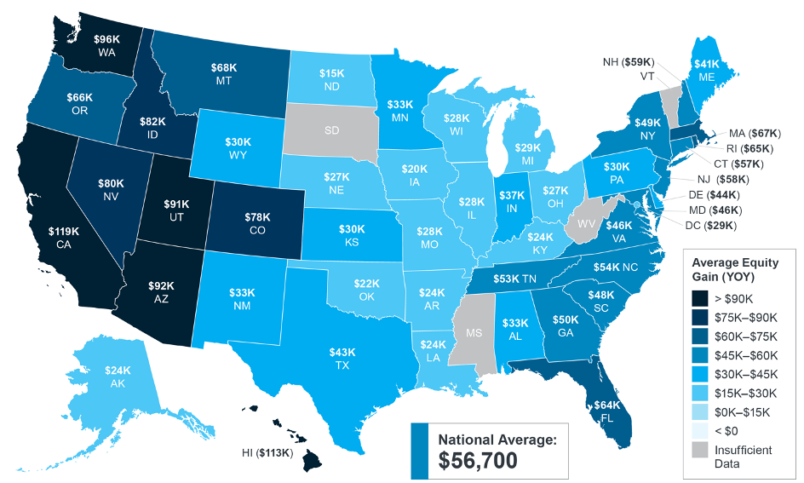
Record Equity Gains Can
Power Your Next Move
Equity can be a real game-changer for current homeowners planning to make a move. According to the latest data from CoreLogic, the average homeowner gained $56,700 in equity over the past year, a number that grew substantially as home values appreciated.
Homeowner Equity Gains Over the Past Year
Source: CoreLogic
Notes:
https://www.corelogic.com/intelligence/homeowner-equity-insights/

Slide 12
For a homeowner, your equity is the current value of your home minus what you owe on the loan. Today, there aren’t enough homes on the market to meet buyer demand, so bidding wars and multiple offers are driving home values up, giving current homeowners a significant equity boost. Selma Hepp, Deputy Chief Economist at CoreLogic, explains it like this:
“Building equity through your monthly principal payments and appreciation is a critical part of homeownership that can help you create financial stability.”
Other experts agree. The graph below shows potential growth in household wealth based on the most recent projections from the Home Price Expectation Survey (HPES) by Pulsenomics. This data helps visualize how your household wealth is expected to continue building as home values rise.
Potential Home Price Growth Over the Next Five Years
Based on Projections from the Home Price Expectation Survey
$89,441
Potential growth in household wealth over the next five years based solely on increased home equity if you purchased a $350K home in January of 2022
Source: HPES 2021 4Q
How Rising Equity Impacts You
If you’re a homeowner, equity not only builds your wealth, but it also opens doors for you to achieve your financial goals.
It works like this: when you sell your house, the equity you built up comes back to you in the sale. You can use those proceeds to fuel your next move, especially if you’ve decided your needs have changed and you’re looking for something new.
Bottom Line Let’s connect to determine if your current home equity can help you make your next move sooner than you may have thought possible.
Notes:
https://myhome.freddiemac.com/owning/equity-and-appreciation
https://www.corelogic.com/intelligence/homeowner-equity-insights/
https://pulsenomics.com/surveys/#home-price-expectations

Slide 13
Real Estate Voted the Best Investment
If you’re thinking about making a move this spring, Americans agree that real estate is one of the best investments you can make. Even when inflation is rising like it is today, real estate truly shines.
In an annual Gallup poll, Americans chose real estate as the best long-term investment. And it’s not the first time it’s topped the list, either. Real estate has been on a winning streak for the past eight years, consistently gaining traction as the best long-term investment (see graph below). This is reassuring news if you’re thinking about making a move this year.
Real Estate Voted Best Long-Term Investment
Compared to Stocks, Gold, and Savings
Real Estate 41%
Stocks 26%
Gold 18%
Savings Accounts 9%
Source: Gallup
Notes:
https://news.gallup.com/poll/349607/americans-expect-home-prices-rise-divided-buying.aspx

Slide 14
Why Is Real Estate a Great Investment During Times of High Inflation?
With inflation reaching its highest level in 40 years, it’s more important than ever to understand the benefits of leveraging your current investment if you want to move into the home of your dreams.
Rising inflation means prices are increasing across the board – that includes goods, services, housing costs, and more. But if you want to move and aren’t sure if now is the right time, know that doing so sooner rather than later means you can lock in your monthly housing payments on your next home, protecting you from increasing housing costs for the foreseeable future. James Royal, Senior Wealth Management Reporter at Bankrate, explains it like this:
“A fixed-rate mortgage allows you to maintain the biggest portion of housing expenses at the same payment. Sure, property taxes will rise and other expenses may creep up, but your monthly housing payment remains the same.”
This way, the bulk of your housing costs are shielded from inflation for the duration of your loan on your next home. And you can make this happen before prices, rates, and inflationary expenses climb higher.
History Shows During Inflationary Periods, Home Prices Rise Too
As an added plus, history indicates your next home will likely grow in value with time. That‘s because, as prices rise, the value of your home does, too. And that makes buying your next home a great hedge during periods of high inflation. Mark P. Cussen, Financial Writer at Investopedia, notes:
“Real estate is one of the time-honored inflation hedges. It's a tangible asset, and those tend to hold their value when inflation reigns, unlike paper assets. More specifically, as prices rise, so do property values.”
Clearly, housing is a strong investment, especially when inflation is high.
When you make a move and lock in your next mortgage payment, you’re shielded from housing cost increases. You’ll also benefit from rising home prices over time, which increases the value of your home (and by extension, your net worth).
Bottom Line If you’re ready, moving sooner rather than later will put you in the best position to gain from your next investment. Let’s connect if you want to better understand how moving into your dream home could be a great investment.
Notes:
https://www.cbsnews.com/news/consumer-prices-inflation-highest-rate-in-40-years/
https://www.bankrate.com/investing/inflation-hedges-to-protect-against-rising-prices/
https://www.investopedia.com/articles/investing/060916/top-5-ways-hedge-against-inflation.asp

Slide 15
Tangible assets like real estate get more valuable over time, which makes buying a home a good way to spend your money during inflationary times.
- Natalie Campisi, Advisor Staff, Forbes
Notes:
https://www.forbes.com/advisor/mortgages/homebuying-can-hedge-against-inflation/

Slide 16
Save Time and Effort by Selling with an Agent
Selling a house is no simple task – especially if you decide to do it on your own and list it as For Sale By Owner, also known as a FSBO. Working with an agent is the best way to ensure you have an expert on your side, guiding you at every turn as you navigate pricing, paperwork, and more. Here are a few things you should consider before putting that For Sale sign up in your yard.
1. Make the Best First Impression
Selling a house requires a significant amount of time and effort, even though it may seem simple at first glance. Doing it right takes expertise and an understanding of what buyers are looking for. A professional considers things like:
Do you need to take down your personal art?
What’s the right amount of landscaping to boost your curb appeal?
What wall colors are most appealing to buyers?
Your time and money are important, and you don’t want to waste either one focusing on the wrong things. A real estate advisor relies on experience to answer these questions and more, allowing you to make the right investments to prep your house before you list.
2. Maximize Your Buyer Pool – and Your Sale
Today, the average home is getting 3.9 offers, according to recent data from the National Association of Realtors (NAR).
That’s great news if you’re planning to sell, since the more offers you receive, the more likely you are to sell your house in a bidding war, and for a higher price.
Real estate agents have an assortment of tools at their disposal, like social media followers and agency resources, that will ensure your house is viewed by the most buyers. Without access to these tools and your agent’s marketing expertise, your buyer pool – and your home’s selling potential – is limited.
Notes:
https://cdn.nar.realtor/sites/default/files/documents/2022-01-realtors-confidence-index-02-18-2022.pdf

Slide 17
3. Understand the Documentation, Including the Fine Print
Today, when a house sells, more disclosures and regulations are mandatory, meaning the number of legal documents to juggle is growing. It’s hard to understand all the requirements and fine print (especially if you’re not an expert). That’s why your advisor is an invaluable guide.
Your agent knows exactly what needs to happen, what all the paperwork means, and can work through it efficiently. We’ll help you review the documentation and avoid any costly missteps that could happen if you tackle it on your own.
4. Act as Your Expert Negotiator
If you sell without a real estate professional, you’ll also be solely responsible for all negotiations. That means you have to coordinate with:
The buyer, who wants the best deal possible
The buyer’s agent, who will use their expertise to advocate for the buyer
The inspection company, which works for the buyer and will almost always find concerns with the house
The appraiser, who assesses the property’s value to protect the lender
Instead of going toe-to-toe with all these parties alone, lean on an expert. Your agent relies on experience and training to make the right moves throughout the negotiation. We’ll know what levers to pull, how to address each individual concern, and when you may want to get a second opinion.
5. Price It Right
Real estate professionals have the expertise to price your house accurately and competitively. To do so, we compare your house to recently sold homes in your area and factor in its current condition. When you sell as a FSBO, you’re operating without this advantage. That could cost you in the long run if you price your house too high or too low.
Bottom Line There’s a lot that goes into selling your house, and it takes time, effort, and expertise to truly do it right. Before you decide to sell your house yourself, let's discuss your options to make sure you get the most out of your sale.

Slide 18
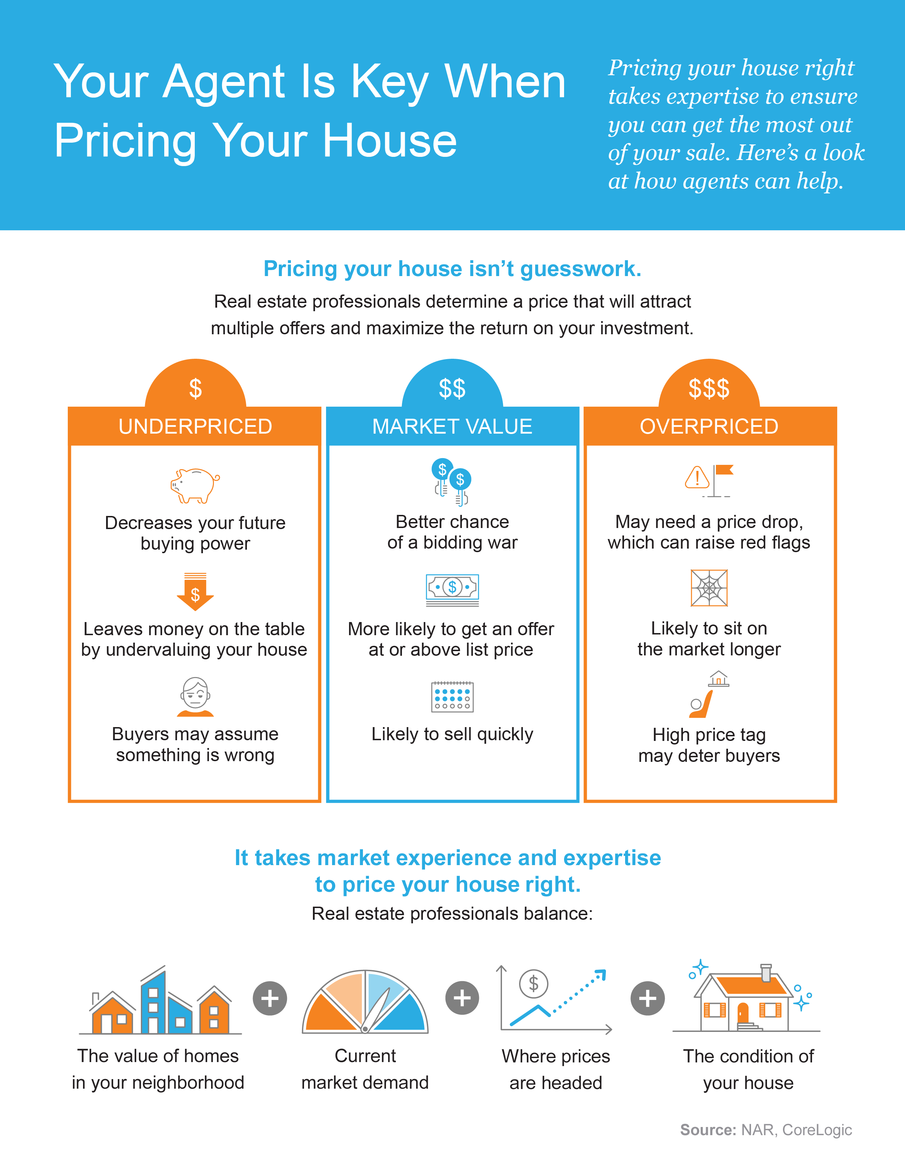
Notes:
https://www.nar.realtor/determining-asking-price
https://www.corelogic.com/intelligence/find-stories/us-sp-corelogic-case-shiller-rockets-to-16-6-reaches-new-records/

Slide 19
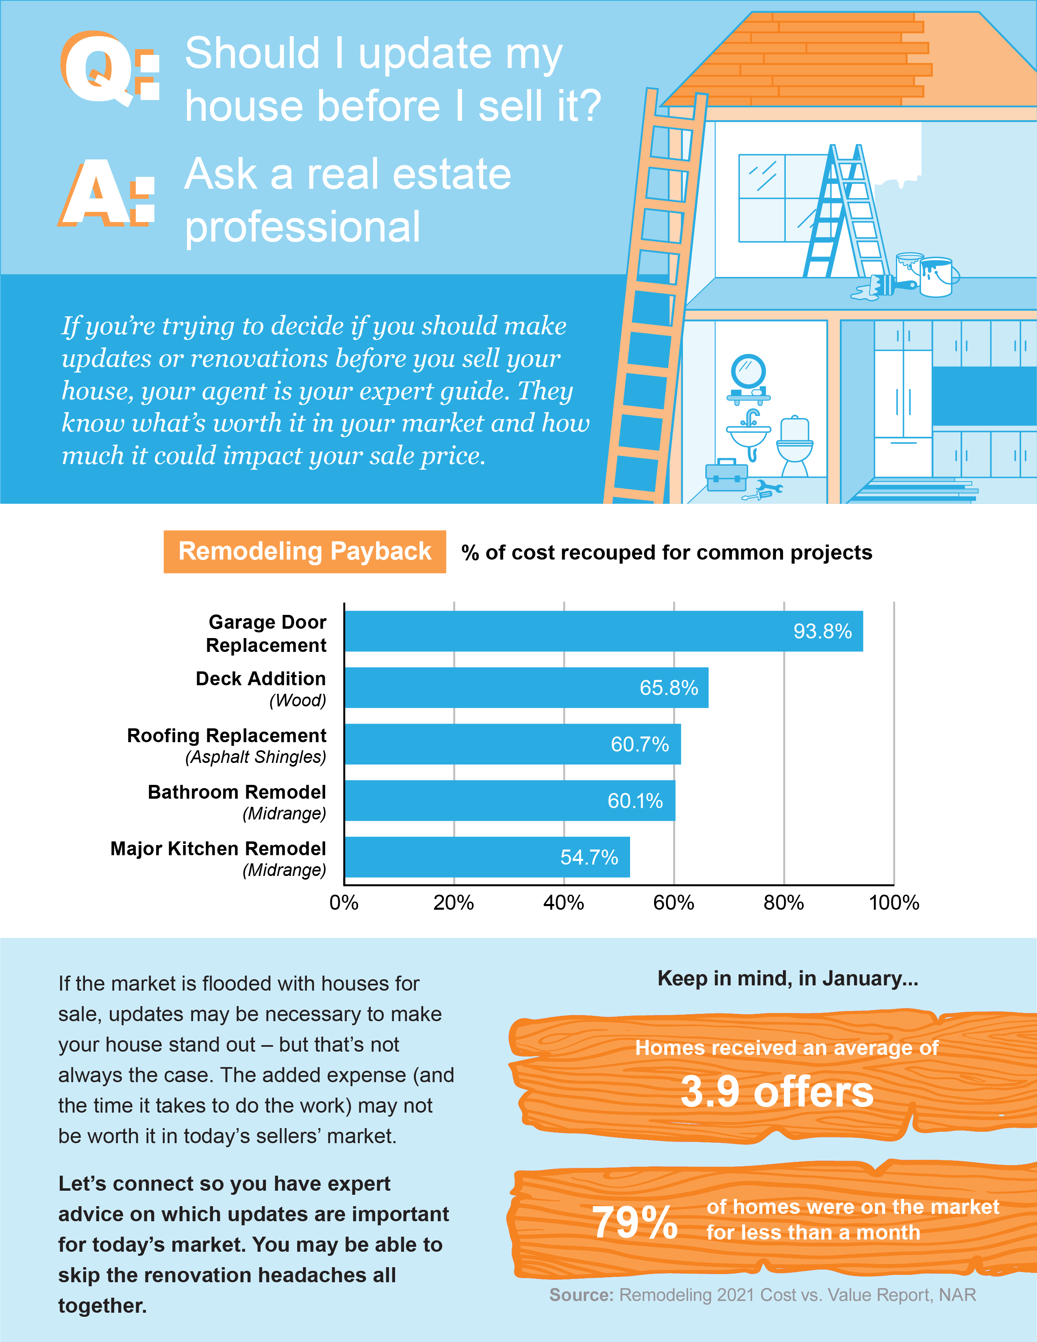
Notes:
https://www.remodeling.hw.net/benchmarks/cost-vs-value/key-trends-in-the-2021-cost-vs-value-report_o
https://cdn.nar.realtor/sites/default/files/documents/2022-01-realtors-confidence-index-02-18-2022.pdf
https://www.nar.realtor/newsroom/existing-home-sales-surge-6-7-in-january

Slide 20
Thanks to today’s low inventory, many buyers are more willing to take on home improvement projects themselves to get the house they’re after, even if it means putting in a little extra work. A survey from Freddie Mac finds that:
“. . . nearly two-in-five potential homebuyers would consider purchasing a home requiring renovations.”
Notes:
https://myhome.freddiemac.com/blog/homeownership/breathing-new-life-old-buying-fixer-upper-and-distressed-homes

Slide 21
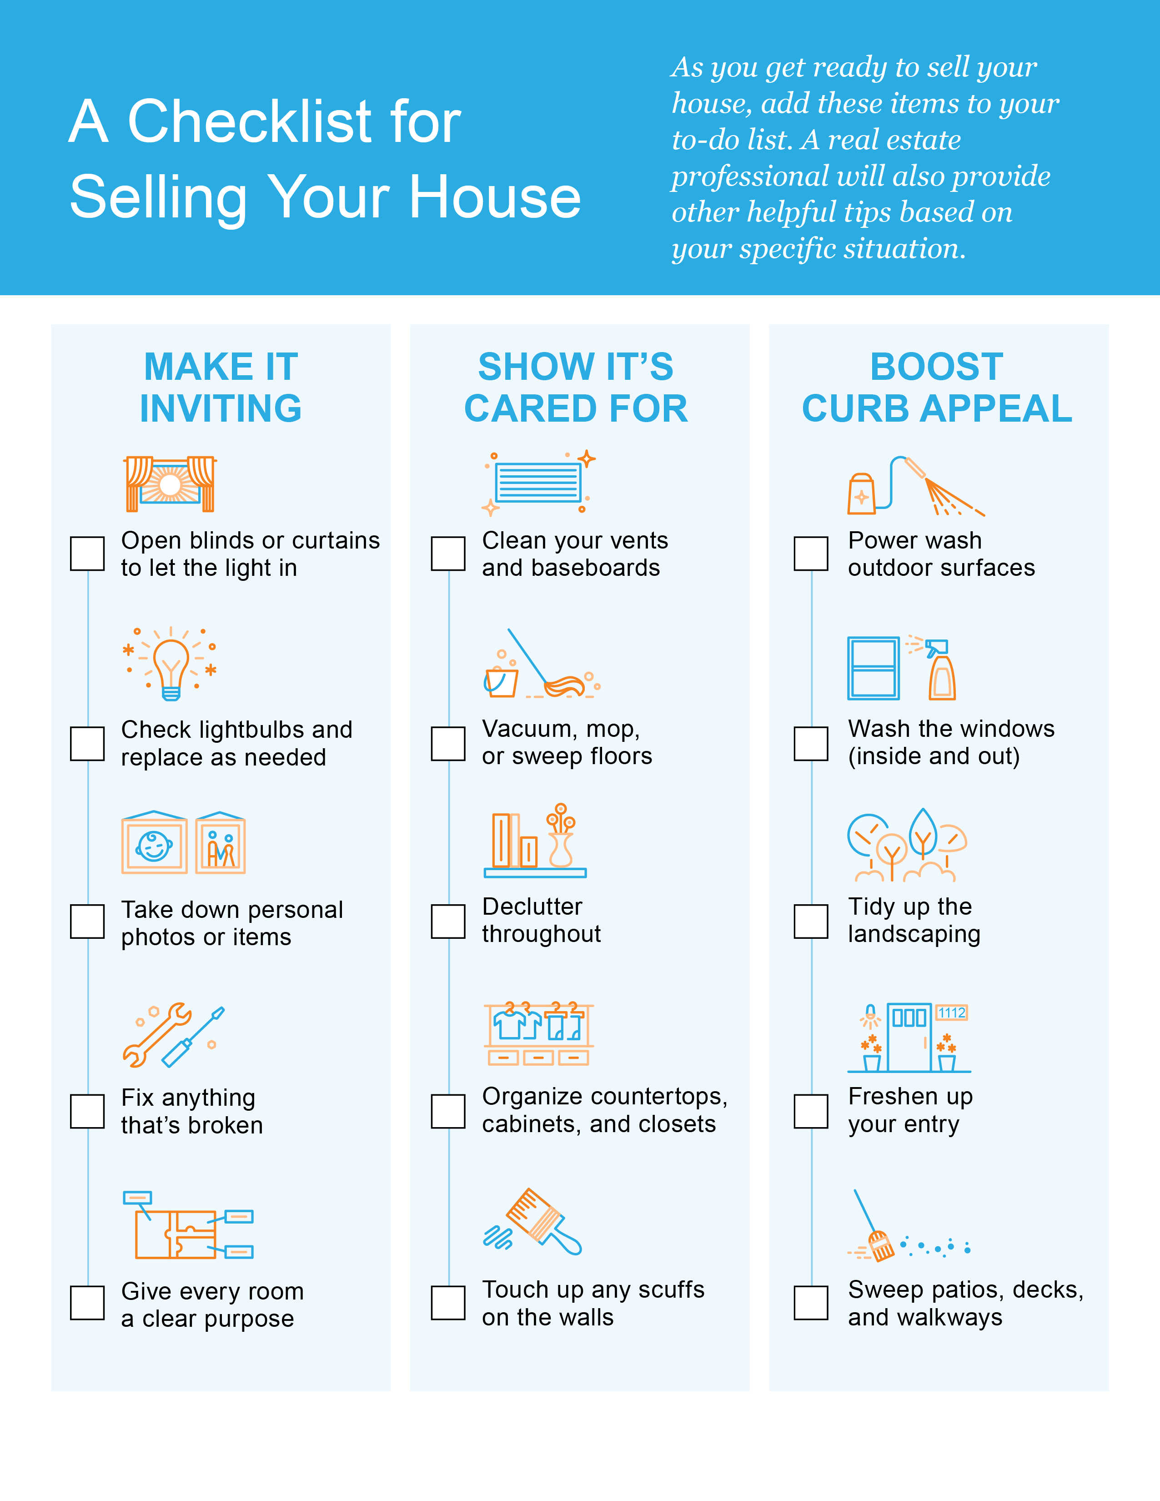

Slide 22
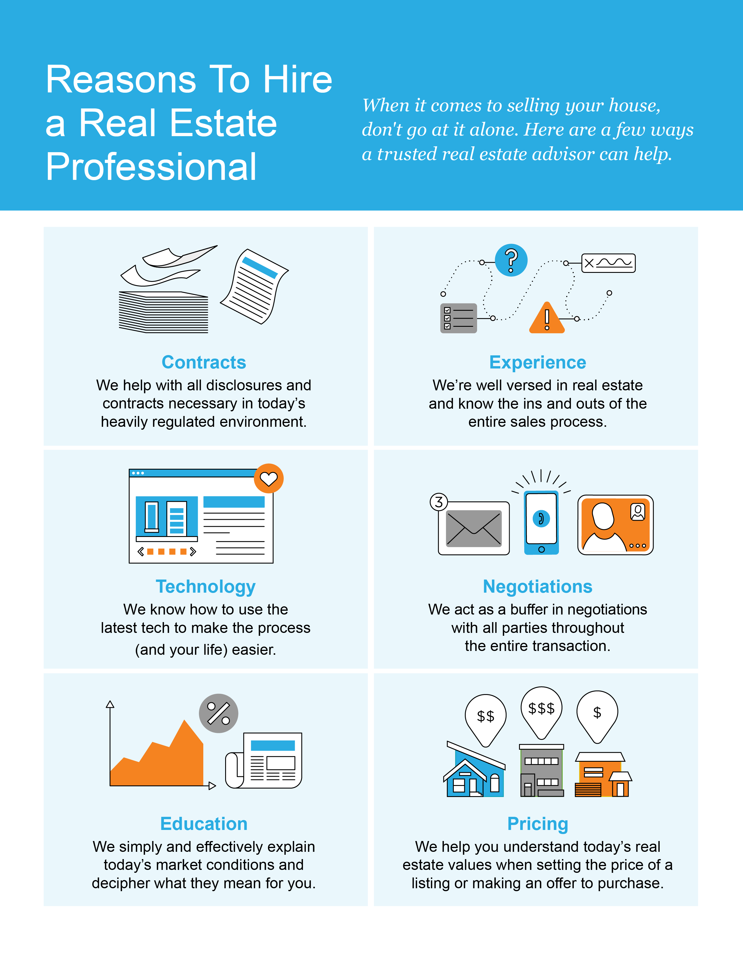

Slide 23
“Homes are selling faster than they did at the fastest time of the year before the pandemic.”
- Danielle Hale, Chief Economist, realtor.com
Notes:
https://www.realtor.com/news/trends/today-housing-market-compared-with-before-covid-19-pandemic/

Slide 24
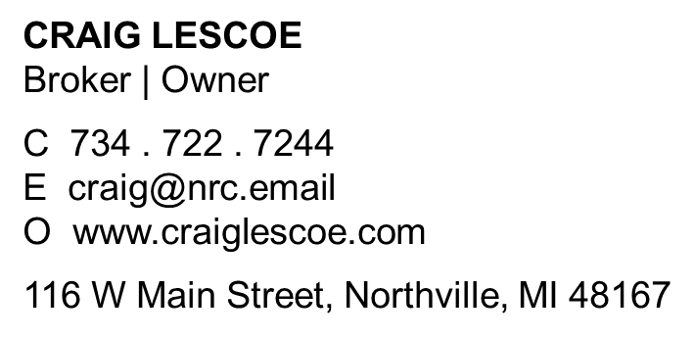
Let’s Chat.
I’m sure you have questions and thoughts about the real estate process.
I’d love to talk with you about what you’ve read here and help you on the path to selling your house. My contact information is below, and I look forward to working with you.
SPRING 2022 EDITION

