Slide 1
Things To Consider When
Buying a Home
SPRING 2022
EDITION

Slide 2
Table of Contents
3 Why This Spring Is the Time To Buy
5 Expert Insights for Today’s Homebuyers
6 Owning Is More Affordable than Renting in Much of the Country
8 The Non-Financial Benefits of Homeownership
9 The Biggest Opportunity for Homebuyers This Spring
12 Why Inflation Shouldn’t Stop You from Buying a Home
14 What Buyers Need To Know About Today’s Housing Supply
16 Key Terms To Know When Buying a Home
17 Your Journey to Homeownership
18 How Much Do You Need for a Down Payment?
20 Things To Avoid After Applying for a Mortgage
21 5 Tips for Making Your Best Offer

Slide 3
Why This Spring Is the Time To Buy
Are you thinking of buying a home? If so, this spring is a great time to make your purchase. Here are the top motivators this season that should encourage you to start the homebuying process sooner rather than later.
1. Homeownership Has Many Perks
Homeownership is the American dream – not just because it has tangible financial benefits, but because it also has the power to change lives.
The security, stability, and success homeowners feel have far-reaching impacts, especially in a time like this. Over the past two years, the health crisis has made having a safe space to call home more important than ever before. If the pandemic has changed what you’re looking for, homeownership may be able to deliver the perks you want, financially and emotionally.
2. More Homes Are Expected To Enter the Market This Spring
With more active buyers in the market than there are houses for sale, the homebuying process may take more time and effort than usual. But the good news is, spring is typically a highly active season in the real estate market when more sellers list their houses.
If you begin your search now and work with a trusted real estate advisor, you’ll be in a great spot to benefit from those additional options when your dream home hits the market.

Slide 4
3. Home Prices and Mortgage Rates Are Climbing
Last year, the housing market saw a sharp increase in home price appreciation due to the imbalance of supply and demand. While competitive buyers are expected to keep home prices climbing, industry leaders say the pace of appreciation should be milder in 2022. And as this year kicked off, so did a rise in both inflation and mortgage rates. With expert projections indicating prices and mortgage rates will keep rising this year, this means it will cost more to buy a home if you wait.
While everyone moves through the homebuying process at a different pace, it’s more important than ever to put your plans in place and begin working with a real estate advisor. If you’re thinking about buying a home over the next year or two, purchasing sooner rather than later may be your most affordable option.
4. Rents Are Rising
Mortgage rates and home prices aren’t the only things on the rise either. Census data also shows the median monthly rent continues to go up year after year (see chart below). To escape rising rents, consider purchasing a home so you can lock in your monthly mortgage payment and avoid future increases. Even though the number of homes available for sale is low, homeownership is a much more stable long-term investment. The search is worthwhile, and the purchase will help grow your net worth as home values appreciate.
Median Asking Rent Since 1988
Source: Census
Bottom Line Let’s connect if you’re ready to learn more about the benefits and rewards of homeownership. Having a local expert on your side is the best way to make your dream a reality this year.
Notes:
http://www.census.gov/housing/hvs/files/currenthvspress.pdf

Slide 5
Expert Insights for Today’s Homebuyers
Experts agree, it’s a great time to explore the benefits of homeownership, even in a competitive market. Here's what several industry leaders have to say about why homeownership is a wise long-term investment.
“ | For those thinking about making the transition from renting to buying their first home, rising rents will remain a motivating factor even as for-sale home prices and mortgage rates continue to climb. - Danielle Hale, Chief Economist, realtor.com
“ | If you wait on the expectation that prices will fall in a year or two, you might be disappointed. - Holden Lewis, Home and Mortgage Expert, NerdWallet
“ | Homeownership is the largest source of wealth among families. . . . Housing wealth (home equity or net worth) gains are built up through price appreciation and by paying off the mortgage. - Scholastica Gay Cororaton, Research Economist, NAR
“ | Homeowners are shielded from mounting rental prices because their cost is fixed, regardless of what’s happening in the market. . . . Tangible assets like real estate get more valuable over time, which makes buying a home a good way to spend your money during inflationary times. - Natalie Campisi, Advisor Staff, Forbes
Notes:
https://news.move.com/2022-01-26-Realtor-com-R-December-Rental-Report-Rental-Market-Wraps-Up-2021-with-Price-Growth-Thats-5-3-Times-Faster-than-in-2020
https://www.marketwatch.com/picks/here-are-todays-mortgage-rates-is-it-a-good-time-to-buy-a-home-experts-weigh-in-01643823941?siteid=yhoof2
https://www.nar.realtor/blogs/economists-outlook/single-family-homeowners-typically-accumulated-225K-in-housing-wealth-over-10-years
https://www.forbes.com/advisor/mortgages/homebuying-can-hedge-against-inflation/

Slide 6
Owning Is More Affordable than Renting in Much of the Country
According to a recent report from ATTOM Data, owning a home is more affordable than renting in the majority of the country. This makes considering homeownership even more worthwhile.
The 2022 Rental Affordability Report from ATTOM Data says:
“. . . owning a median-priced home is more affordable than the average rent on a three-bedroom property in 666, or 58 percent, of the 1,154 U.S. counties analyzed for the report. That means major home ownership expenses consume a smaller portion of average local wages than renting.”
In the Single-Family Rent Index from CoreLogic, rent saw the fastest year-over-year growth in over 16 years when comparing data for December of each year (see graph below):
Rents Continue To Skyrocket
Y-O-Y % Single-Family Rent Growth in December of Each Year
12.1%
11.4%
Source: CoreLogic
Notes:
https://www.attomdata.com/news/market-trends/home-sales-prices/attom-2022-rental-affordability-report/
https://www.corelogic.com/intelligence/find-stories/rental-property/single-family-annual-rent-growth-finishes-2021-at-a-new-record/

Slide 7
What Does This Mean for You?
As the data shows, rents are skyrocketing. The big difference between renting and owning a home is, when you rent, that rising cost benefits your landlord’s investment strategy, but it doesn’t deliver any sort of return for you.
In contrast, when you buy a home, your monthly mortgage payment works like a forced savings account. Over time, as you pay down your loan and as home values rise, you build equity (and by extension, your own net worth). According to the latest data from CoreLogic, the average homeowner gained $56,700 in equity over the past year, a number that continues to grow as home values appreciate.
This should give you peace of mind that your investment is worthwhile. Not to mention, when you buy, you lock in your monthly mortgage for the duration of your loan, creating a stable and predictable monthly payment, even in today’s inflationary times.
When asking yourself if you should continue renting or if it’s time to buy, think about what Todd Teta, Chief Product Officer at ATTOM Data, says:
“. . . Home ownership still remains the more affordable option for average workers in a majority of the country because it still takes up a smaller portion of their pay.”
If buying takes up a smaller portion of your pay and has financial benefits renting can’t provide, the question becomes: is renting really worth it?
Bottom Line If you’re renting today, but thinking about buying a home, it’s important to look at the full picture. While buying can feel like a big decision, having a trusted advisor on your side is key. Let’s connect to explore your options so you can learn more about the benefits of homeownership.
Notes:
https://www.corelogic.com/intelligence/homeowner-equity-insights/
https://www.attomdata.com/news/market-trends/home-sales-prices/attom-2022-rental-affordability-report/

Slide 8
The Non-Financial Benefits of Homeownership
While there are many financial benefits of homeownership, what’s often overlooked are the feelings of gratitude, security, pride, and comfort we get from owning a home.
Today, those emotions are stronger than ever. We’ve lived through a time that has truly changed our needs and who we are, and as a result, homeownership has a whole new meaning for many of us. According to The State of the American Homeowner report from Unison:
“Last year, staying home became a necessity and that caused many homeowners to have renewed gratitude for the roof over their head.”
Since the health crisis began, we’ve spent more time than ever at home: working, eating, schooling, exercising, and more. The world around us changed almost overnight, our needs shifted, and our shelters became a place that protected us on a whole new level. The same study from Unison notes:
91% of homeowners say they feel secure, stable, or successful owning a home
64% of American homeowners say living through a pandemic has made their home more important to them than ever
83% of homeowners say their home has kept them safe during the COVID-19 pandemic
As we’ve learned throughout this pandemic, homeownership can provide the safety and security we crave in a time of uncertainty. That sense of connection and emotional stability genuinely reaches beyond just the financial aspect of owning a home.
Bottom Line If you’re considering buying a home, it’s not just about the dollars and cents. Don’t forget to weigh the non-financial benefits that may truly change your life just when you need it most.
Notes:
https://contentimages.o-prod.unison.com/images/press/2021-Unison-SOTAH-Report.pdf

Slide 9
The Biggest Opportunity for Homebuyers This Spring
If you’re thinking of buying a home this season, the biggest opportunity you have right now is to get ahead of rising mortgage rates and increasing prices. Here’s what you need to know about where both are headed.
What’s Going To Happen With Mortgage Rates?
Mortgage interest rates are already climbing this year, and experts agree they’ll continue rising as we move through 2022.
Nadia Evangelou, Senior Economist and Director of Forecasting at the National Association of Realtors (NAR), discusses how rising rates are motivating today’s buyers to move quickly. She also stresses that, even despite rising rates, buying a home today is still a great investment:
“…buyers are rushing to lock in lower rates as the outlook is for even higher mortgage rates in the following months....even with this increase in rates, purchasing a home is a great investment. In addition to the other benefits of homeownership, the equity that homebuyers will build in 2022 due to price appreciation will be higher than their mortgage payment.”
So, what does that mean for you? The big takeaway is that rates are expected to continue to rise. That means it’s going to cost more to buy a home if you wait. If you’re planning a home purchase sometime this year or next, but you’re waiting to see if rates will drop, it’s time to start working with your trusted advisor. This way, you’ll have an expert to help you plan for your purchase sooner rather than later.
And, as Evangelou notes, once you do buy a home, you’ll start building equity as home values rise. That should give you confidence your investment is a sound one.
Notes:
http://www.freddiemac.com/pmms/
https://www.nar.realtor/blogs/economists-outlook/instant-reaction-mortgage-rates-february-17-2022

Slide 10
What Will Happen With Home Prices This Year?
In addition, home prices are expected to continue climbing. The graph below shows the 2022 home price forecasts from six industry leaders. As the bars indicate, they’re all projecting an increase in prices this year as buyers competing for a limited number of houses continue to put upward pressure on prices. The dotted line represents the average of all the forecasts together, showing the rate of appreciation is expected to be about 6.1%.
While that’s not the record-breaking increase we saw over the past year, its still continued price growth – not a decline. Why is that important to you? If you’re waiting for prices to drop because you think homes will be more affordable in a few years, the data from leading experts simply doesn’t support it.
2022 Home Price Forecasts
Based on Expert Projections
Average of All Forecasts: 6.1%
Bottom Line If you’re ready to buy a home, you have a great opportunity to get ahead of the curve by purchasing before rates and prices climb higher. If you can, buying sooner rather than later may make the most financial sense.
Notes:
https://www.corelogic.com/intelligence/find-stories/corelogic-hpi-posted-record-year-over-year-growth-in-2021/
https://www.fanniemae.com/media/42901/display
https://pulsenomics.com/surveys/#home-price-expectations
http://www.freddiemac.com/research/forecast/20220121_quarterly_economic_forecast.page?
https://www.mba.org/news-research-and-resources/research-and-economics/forecasts-and-commentary
https://cdn.nar.realtor/sites/default/files/documents/forecast-Q1-2022-us-economic-outlook-01-27-2022.pdf
https://www.zelmanassociates.com/ (by subscription)

Slide 11
KEY TAKEAWAY
While it’s still a sellers’ market, buyers have a great opportunity to find a home before mortgage rates and prices rise further. Doing so is not only a smart move today, it’s also a great way to secure a stable monthly housing payment that will grow your wealth as home values appreciate over time.

Slide 12
Why Inflation Shouldn’t Stop You from Buying a Home
If you’re following along with the news today, you’re probably hearing about increasing home prices, rising consumer costs, supply chain constraints, and more. These inflationary concerns might make you wonder if you should wait to buy. Here’s why inflation shouldn’t stop you from buying a home this year.
Homeownership Offers Stability and Security
Home prices have been increasing for quite some time, and experts say they’re going to continue to climb throughout the year ahead. So, as a buyer, how can you protect yourself from rising costs for things like food, shelter, entertainment, and other goods and services? The answer is in housing.
Buying a home allows you to lock in your monthly mortgage payment for the foreseeable future. That means as other prices rise around you, your monthly housing payment (which is likely your largest recurring expense) will be consistent thanks to your fixed-rate mortgage. This gives you the peace of mind that the bulk of your housing costs are shielded from inflation.
James Royal, Senior Wealth Management Reporter at Bankrate, says:
“A fixed-rate mortgage allows you to maintain the biggest portion of housing expenses at the same payment. Sure, property taxes will rise and other expenses may creep up, but your monthly housing payment remains the same. That’s certainly not the case if you’re renting.”
As a renter, you don’t get the same benefit, and you won’t be protected from rising housing costs.
Notes:
https://www.bankrate.com/investing/inflation-hedges-to-protect-against-rising-prices/

Slide 13
As an added incentive to buy, remember that today’s mortgage interest rates may be rising, but know they’re still incredibly competitive compared to recent decades. In the 2000s, the average mortgage rate was 6.27%. In the 1990s, the average rate was 8.12%.
While rising inflation decreases what your dollars can buy, lower mortgage rates help counteract it by boosting your purchasing power. This way, you can get more home for your money.
Lower rates also help keep your monthly payments down. This is especially important during an inflationary period because you’ll want to protect yourself from the impact of rising rates and prices as much as possible.
Ali Wolf, Chief Economist at Zonda, explains:
“If you have cash and are expecting inflation, you want to think through where you can put your money so it does not lose value. Housing is commonly looked at as a good inflation hedge, especially with interest rates so low.”
Since mortgage rates are projected to continue rising, it’s important to act sooner rather than later, if you’re ready to buy, so you can lock in your mortgage payments at the best possible rate for years to come.
Bottom Line History shows the best hedge against inflation is a fixed housing cost. That’s why you shouldn’t let it stop you from buying a home this year. Not sure where to start? Let’s connect so you have expert advice at every step of the homebuying process.
Notes:
http://www.freddiemac.com/pmms/pmms_archives.html
https://www.forbes.com/advisor/mortgages/homebuying-can-hedge-against-inflation/

Slide 14
What Buyers Need To Know About Today’s Housing Supply
If you’re searching for a home right now, it’s important to understand a little bit about the current supply of homes available for sale. Here’s a look at two reasons why today’s housing inventory is low and some promising news as you move forward with your search.
1. New Home Construction Fell Behind for Several Years
The graph below shows new home construction for single-family homes over the past five decades, including the long-term average for housing units completed. Builders exceeded that average during the housing bubble (shown in red on the graph). The result was an oversupply of homes on the market, so home values declined. That was one of the factors that led to the housing crash back in 2008 – and it’s very different than the inventory available today.
Since then, the level of new home construction has fallen off. For the last 14 years, builders haven’t been able to construct enough homes (shown in green on the graph) to meet the historical average. That underbuilding left a multi-year inventory deficit going into the pandemic.
Single-Family Housing Units Completed
In Millions (1970-2021)
4 Consecutive Years of a Record-Setting Number of Units
Long-Term Average
14 Straight Years Below the Long-Term Average
Source: Census
Notes:
www.census.gov/construction/nrc/xls/co_cust.xls

Slide 15
2. The Pandemic’s Impact on the Housing Market
Then, when the health crisis hit in 2020, it fueled a renewed appreciation and a focus on the meaning of home. Having a safe space to live, work, learn, exercise, and more became increasingly important for Americans throughout the country. So, as mortgage rates dropped below 3%, buyers eagerly entered the market looking to secure a home that would fulfill their changing needs. At the same time, sellers hesitated to put their houses on the market as concerns about the pandemic mounted. The result? The number of homes available for sale dropped even further.
What Does This Mean for You?
For a buyer, low inventory is a challenge. You want to find the home of your dreams, and you don’t want to settle. But what if there just aren’t that many homes to choose from? There is some good news. Experts project more homes will soon become available thanks to sellers re-entering the market. Danielle Hale, Chief Economist at realtor.com, offers perspective:
“We expect that we’ll start to see a turnaround and inventory will stabilize and start to go up a little bit in 2022. . . . But that means we’re looking at inventory levels of roughly half of what we saw before the pandemic. For buyers, the market is likely to continue to move fast. If you see a home you like, you want to jump on it right away.”
So, inventory is still low, even though more homes are expected to become available. But you shouldn’t put your plans on hold because you’re waiting for those additional houses to hit the market. Instead, stick with your search and persevere through today’s inventory challenges. You can find your next home if you’re patient and focused, and your agent can help.
Bottom Line The number of homes available for sale is still low. So, if you’re looking for a home but you’re having trouble finding one, hang in there. Homeownership is a worthwhile and life-changing goal. The key is sticking with your search, working with a real estate professional, and trusting the process. You will find the right one.
Notes:
https://www.realtor.com/news/trends/today-housing-market-compared-with-before-covid-19-pandemic/

Slide 16
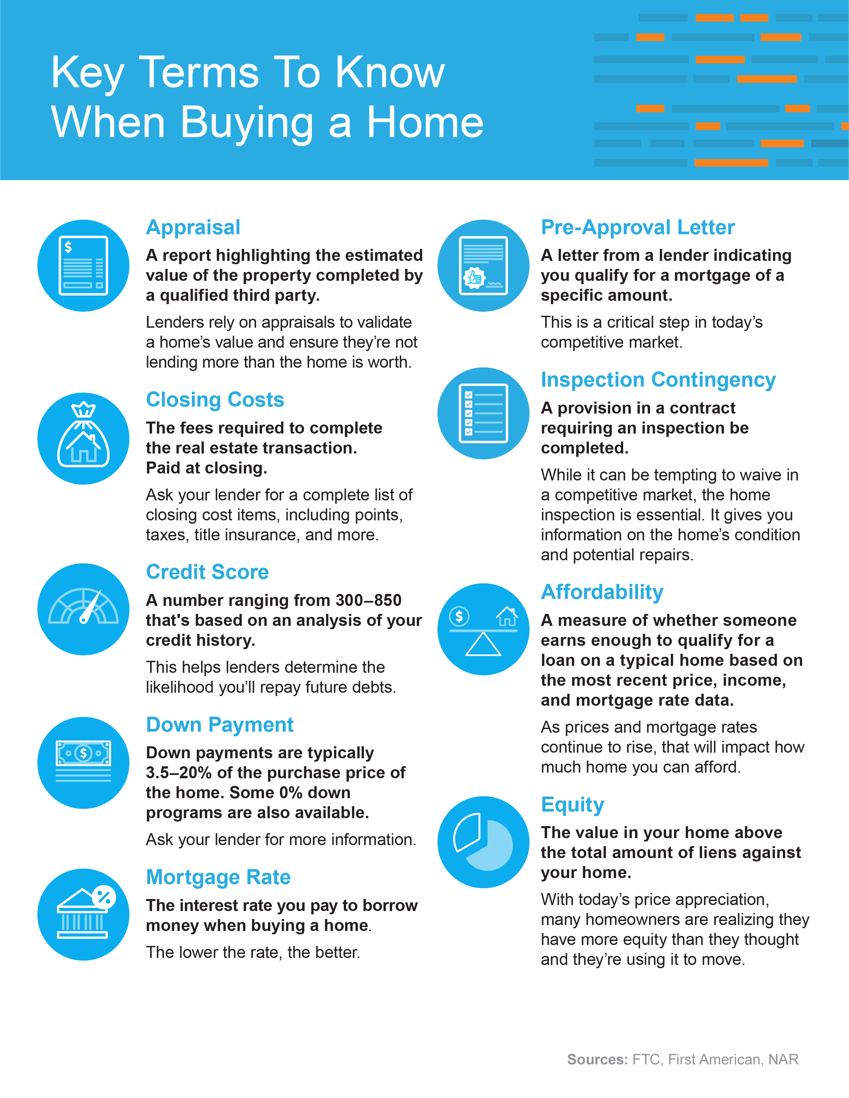
Notes:
https://www.ftc.gov/sites/default/files/documents/one-stops/real-estate-competition/realestateglossary.pdf
https://blog.firstam.com/15-real-estate-terms-you-should-know
https://magazine.realtor/tool-kit/rookie/article/2020/02/real-estate-glossary

Slide 17
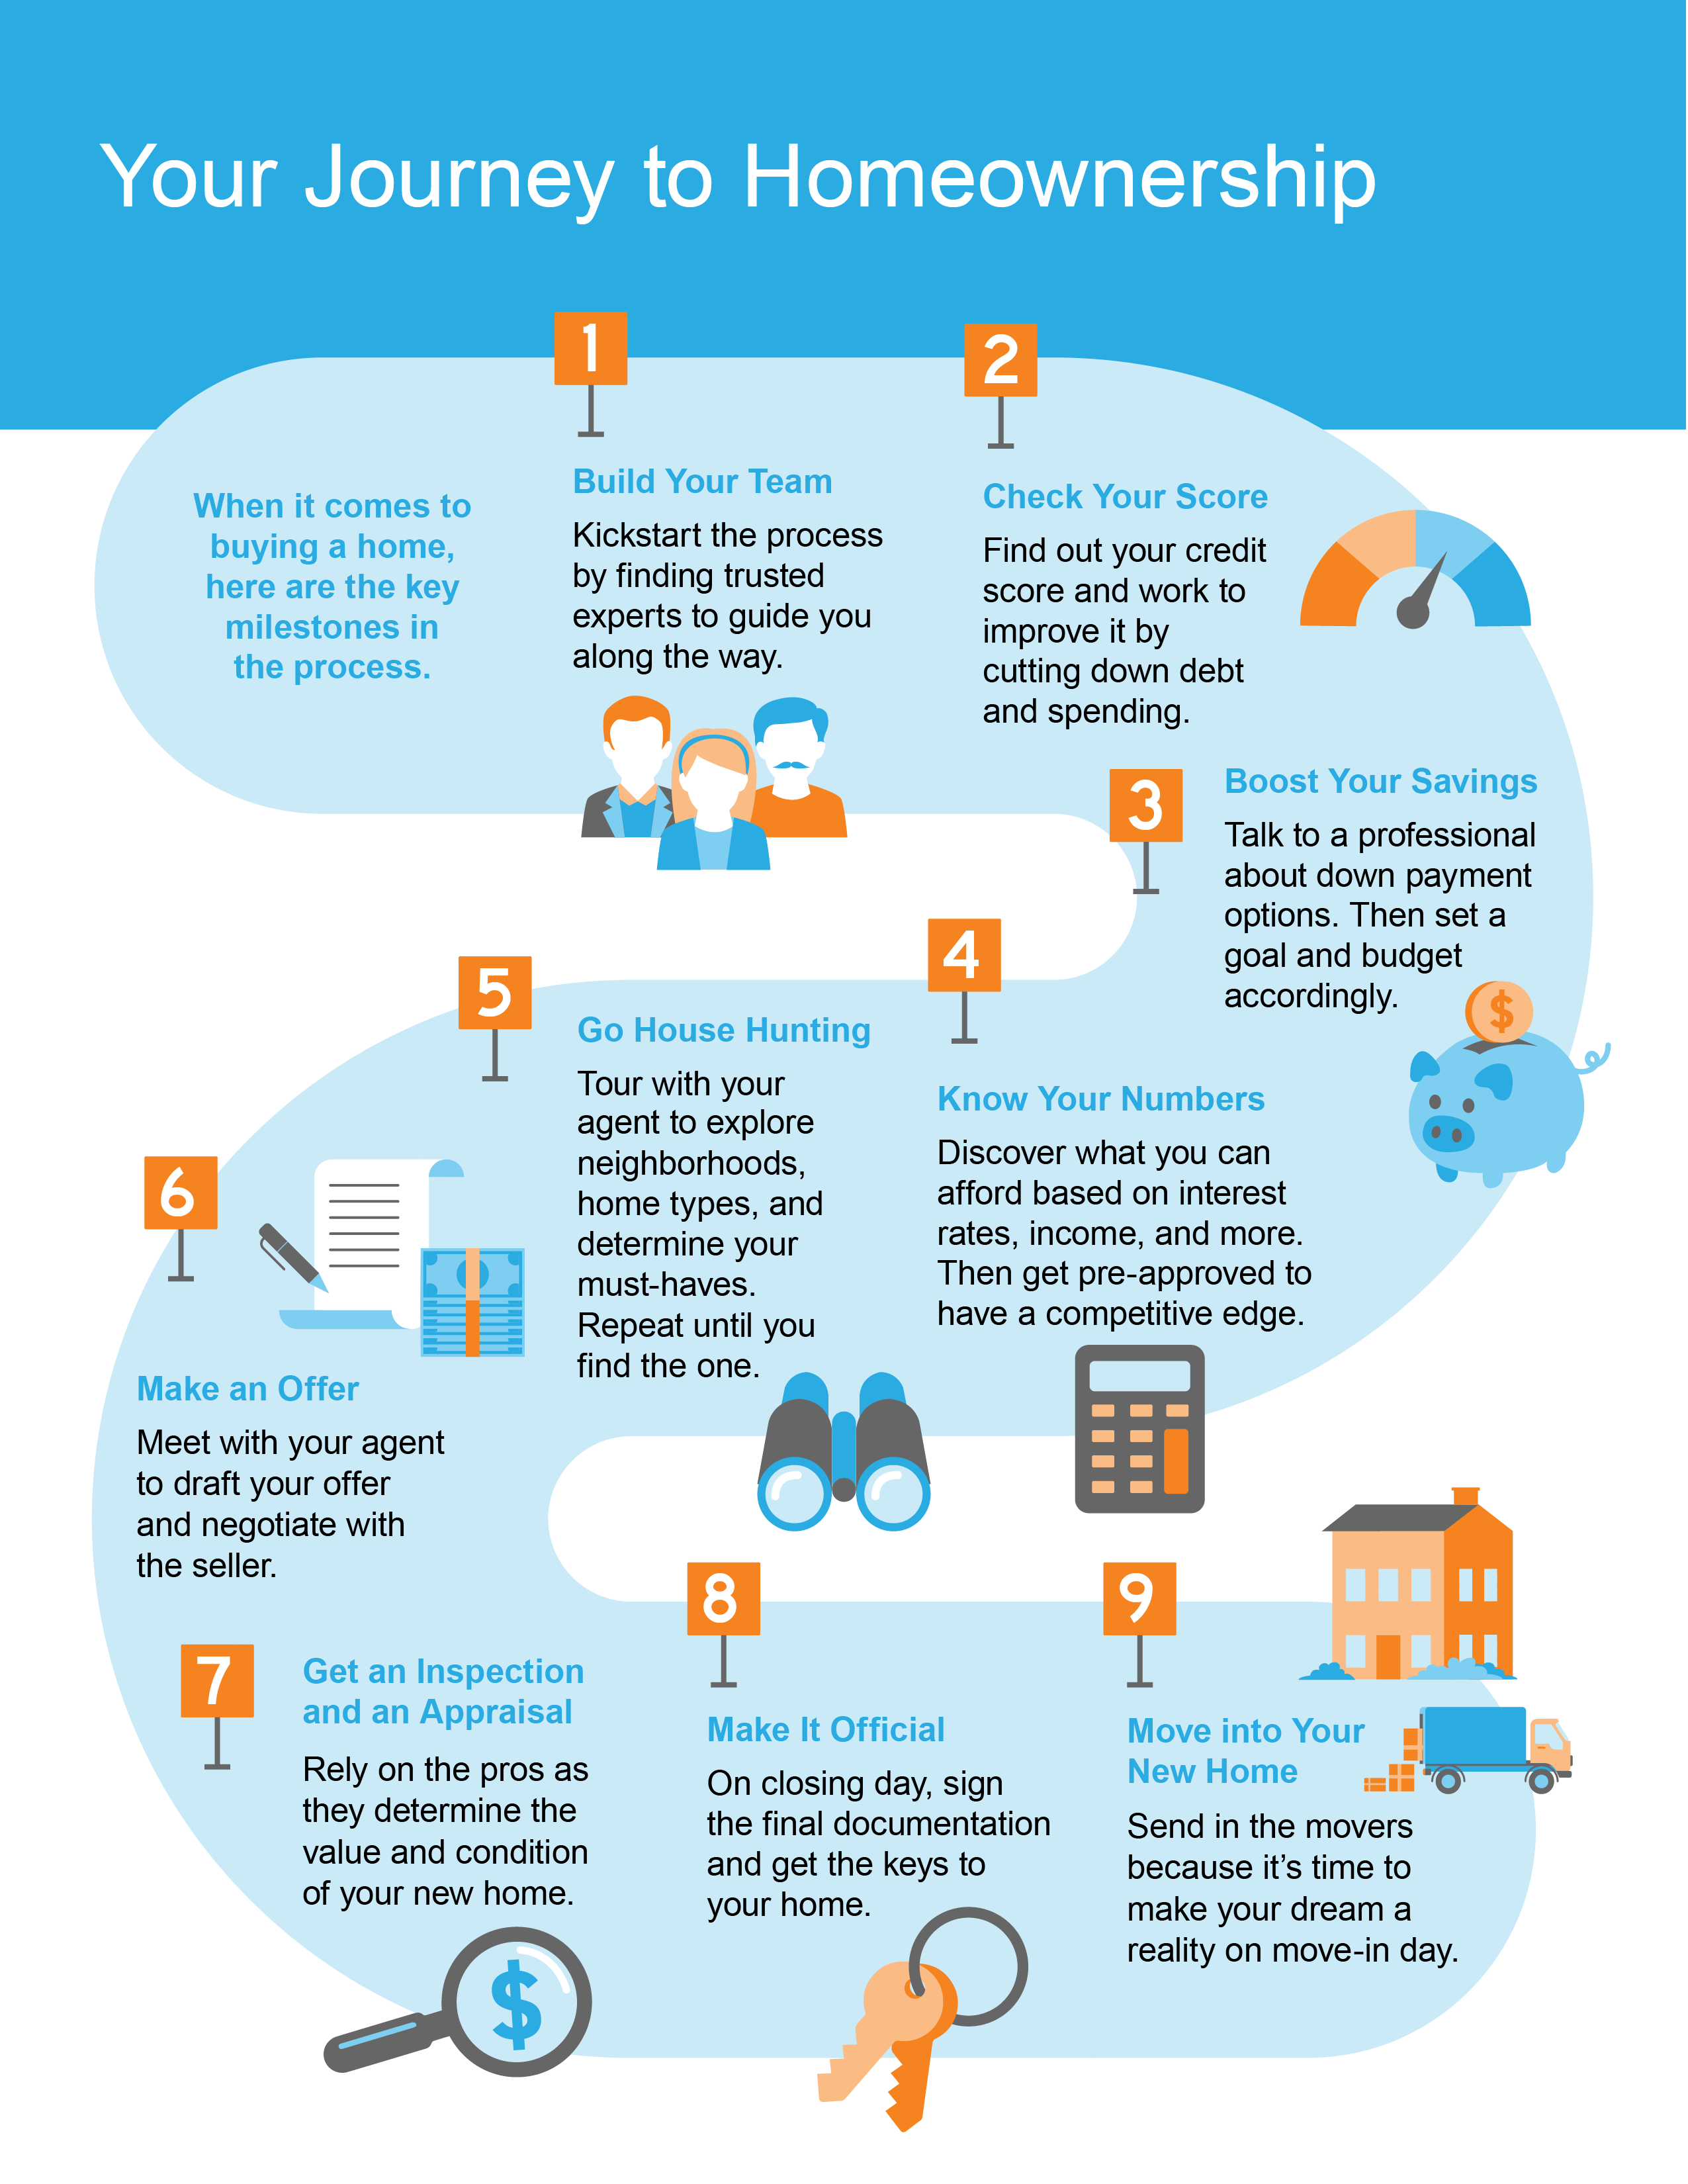

Slide 18
How Much Do You Need for a Down Payment?
There’s a common misconception that you need to come up with 20% of the total purchase price of a house for your down payment. But is that always how much you have to save to buy a home?
A survey by the National Association of Realtors (NAR) asks consumers what hurdles they’re facing when saving for a down payment. More than a quarter of those surveyed say they believe a 16% or even a 20% down payment is necessary. The truth is: unless specified by your loan type or lender, it’s typically not required to put that much down.
According to the Profile of Home Buyers and Sellers from NAR, the median down payment hasn’t been over 20% since 2005. It may sound surprising, but today’s typical down payment is only 13%. That number is even lower for first-time homebuyers (see chart below):
Median Down Payments
Today’s median down payment is less than 20%
7%
13%
20%
First-Time Homebuyers
All Homebuyers
Common Misconception
Source: NAR
Notes:
https://www.nar.realtor/blogs/economists-outlook/tackling-home-financing-and-downpayment-misconceptions
https://www.nar.realtor/research-and-statistics/research-reports/highlights-from-the-profile-of-home-buyers-and-sellers

Slide 19
What Does This Mean for You?
If you’re thinking of buying a home, it’s important to know you don’t always have to put 20% down.
And while saving for any down payment amount may feel like a challenge, keep in mind there are programs for qualified buyers that allow a down payment as low as 3.5%. There are also options like VA loans and USDA loans with no down payment requirements for qualified applicants.
To understand your options, you need to do your homework. If you’re interested in learning more about down payment assistance programs, check out the information available through sites like downpaymentresource.com.
Be sure to also work with a real estate advisor from the start to learn what you may qualify for in the homebuying process.
The Benefits of 20% Down
While you don’t need to put 20% down, doing so can have some great perks, if you’re able. Those may include:
Your interest rate may be lower.
You’ll end up paying less over the life of your loan.
Your offer will stand out.
You won’t need Private Mortgage Insurance (PMI).
Bottom Line Don’t let down payment myths keep you from hitting your homeownership goals. If you’re looking to buy this year, let’s review your options together.
Notes:
https://www.hud.gov/buying/loans
https://www.benefits.va.gov/homeloans/index.asp
https://www.rd.usda.gov/newsroom/news-release/usda-rural-home-loans-offer-100-financing-and-no-down-payment
https://downpaymentresource.com/
https://sf.freddiemac.com/articles/insights/down-payments-helping-future-borrowers-bridge-the-awareness-gap

Slide 20
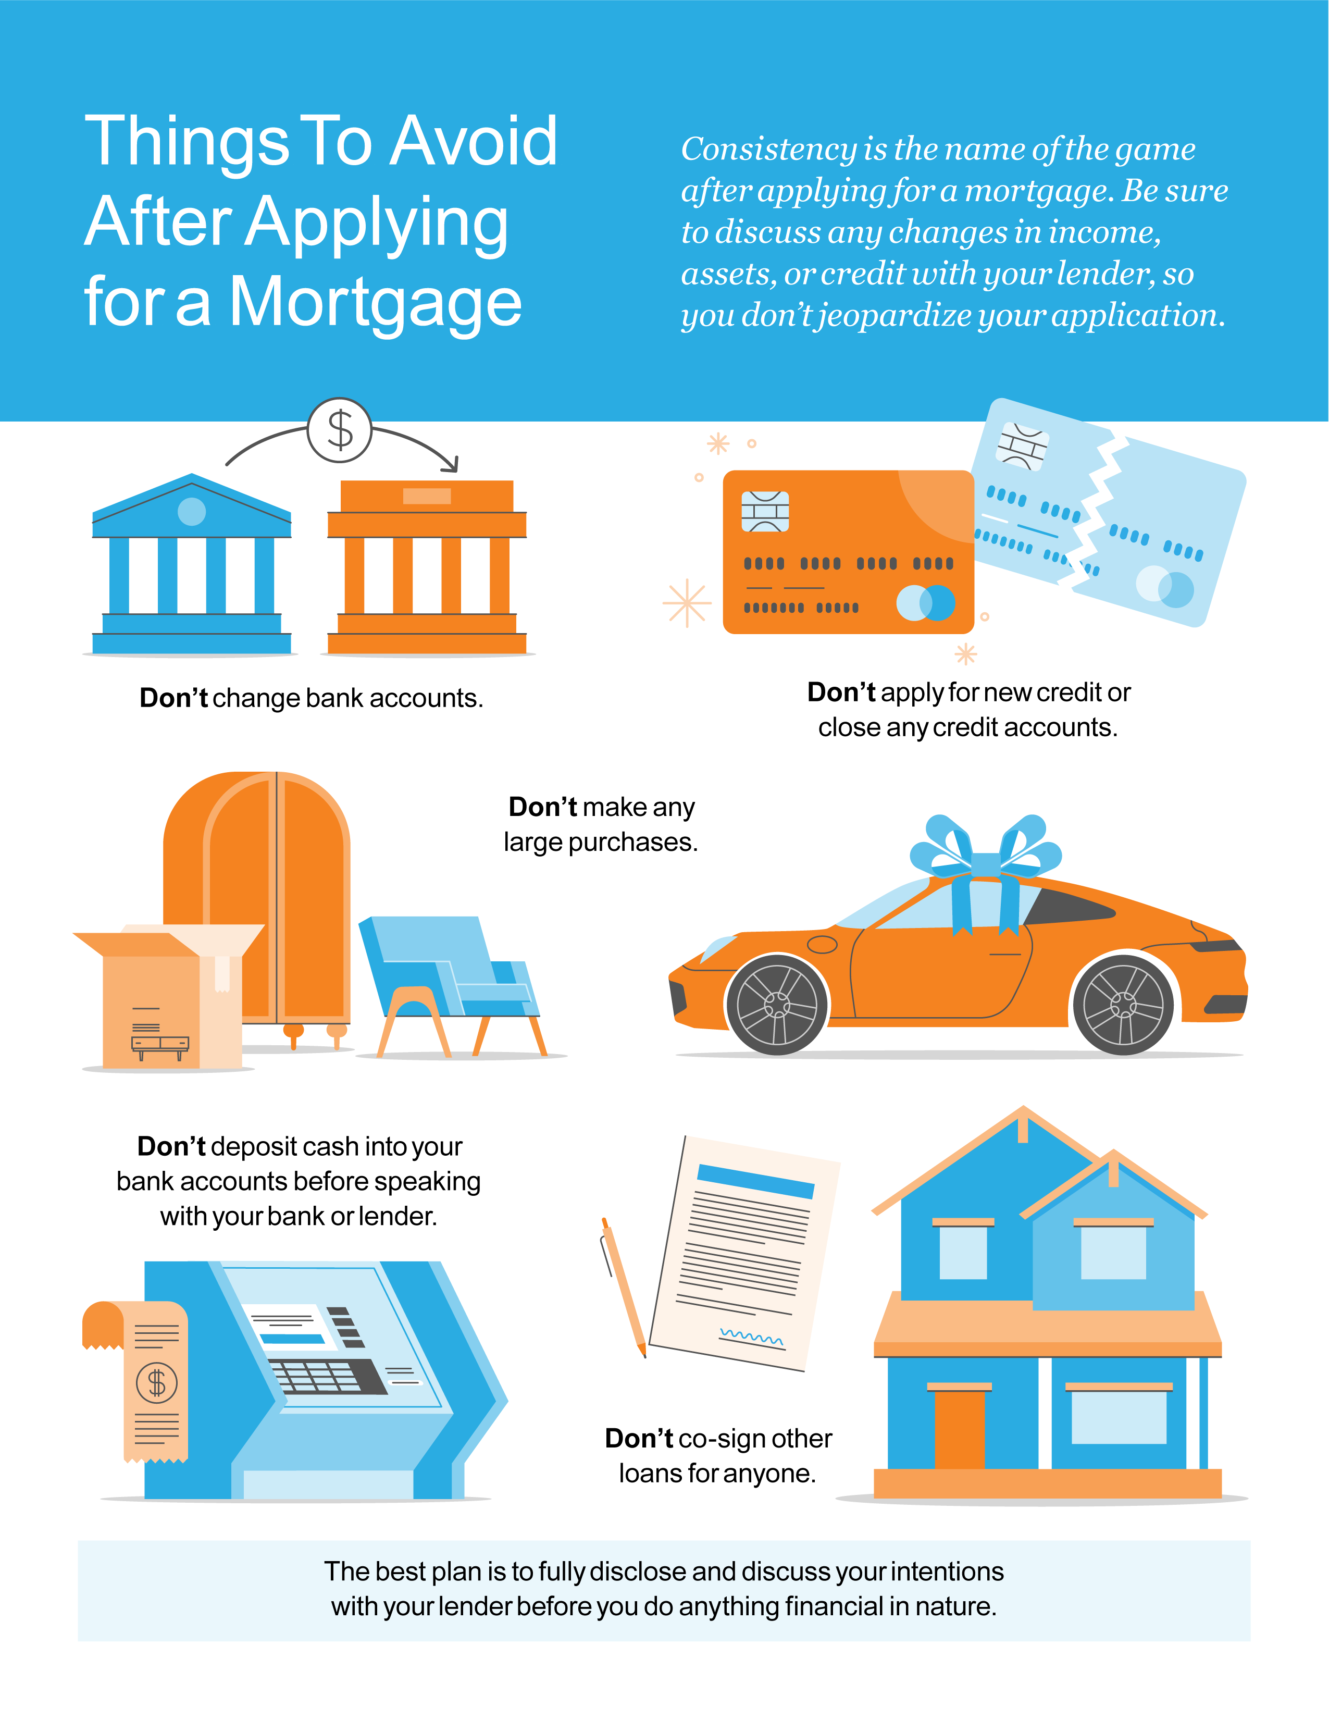

Slide 21
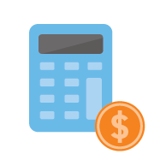
5 Tips for Making Your Best Offer
As a buyer in a sellers’ market, you may feel like you’re stuck between a rock and a hard place, especially when inventory is as low as it is today. When you do find the right home, here are five tips to keep in mind that will help you make the best offer possible.
1. Know Your Budget
Knowing your budget and what you can afford is critical to your success as a homebuyer. The best way to understand your numbers is to work with a lender so you can get pre-approved for a loan. As Freddie Mac notes:
“This pre-approval allows you to look for a home with greater confidence and demonstrates to the seller that you are a serious buyer.”
Showing sellers you’re serious can give you a competitive edge. It enables you to act quickly when you’ve found your perfect home.
2. Be Ready To Move Fast
Speed and the pace of sales are contributing factors to today’s competitive housing market. According to the Existing Home Sales Report from the National Association of Realtors (NAR):
“Seventy-nine percent of homes sold in January 2022 were on the market for less than a month.”
When homes are selling fast, it’s important to stay on top of the market and be ready to move quickly. A skilled agent will help you put together and submit your best offer as soon as you find the home you want to buy.
Notes:
https://myhome.freddiemac.com/buying/working-with-your-lender.html
https://www.nar.realtor/newsroom/existing-home-sales-surge-6-7-in-January

Slide 22
3. Lean on a Real Estate Professional
No matter what the housing market looks like, rely on a trusted real estate advisor. As Freddie Mac says:
“The success of your homebuying journey largely depends on the company you keep. . . . be sure to select experienced, trusted professionals who will help you make informed decisions and avoid any pitfalls.”
Agents are experts in the local real estate market. We have insight into what’s worked for other buyers in the area and what sellers may be looking for in an offer. Your agent will help you understand how to cater to what a seller needs, so your offer stands out.
4. Make a Strong, but Fair Offer
According to the Realtors Confidence Index from NAR, 46% of offers today are above the list price. That means when you’ve found your dream home, offering below or even at a home’s asking price may not be enough right now.
Lean on your agent to help you understand the market value of the home and recent sales trends in the area so you can craft your best offer.
5. Be a Flexible Negotiator
When putting together an offer, your trusted real estate advisor will help you consider which levers you can pull, including contract contingencies (conditions you set that the seller must meet for the purchase to be finalized). Of course, there are certain contingencies you don’t want to give up, like the home inspection. Freddie Mac explains:
“A home inspection contingency gives you the opportunity to have the entire home you'd like to purchase examined by a professional before you close on your contract. Without this contingency, you could be contracted on a house you can't afford to fix.”
Bottom Line Today’s competitive landscape makes it more important than ever to make a strong offer on a home. Let’s connect to make sure you rise to the top along the way.
Notes:
https://myhome.freddiemac.com/buying/finding-your-team
https://cdn.nar.realtor/sites/default/files/documents/2022-01-realtors-confidence-index-02-18-2022.pdf
https://myhome.freddiemac.com/blog/homeownership/20201019-5-rules-for-making-an-offer-on-a-home

Slide 23
“For most families, homeownership is a good long-term strategy that results in forced savings and the creation of intergenerational wealth.”
- Rick Sharga, Executive VP, RealtyTrac
Notes:
https://themortgagereports.com/85263/housing-market-predictions-2022

Slide 24
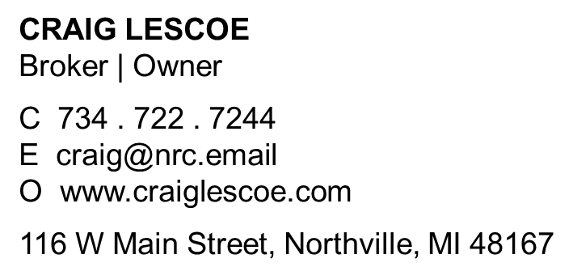
Let’s Chat.
I’m sure you have questions and thoughts about the real estate process.
I’d love to talk with you about what you’ve read here and help you on the path to buying your new home. My contact information is below, and I look forward to working with you.
SPRING 2022 EDITION

