Slide 1
Things To Consider When
Selling Your House
WINTER 2022
EDITION

Slide 2
Table of Contents
3 Why To Sell This Winter
6 Expert Insights for Today’s Sellers
8 What Does the Future Hold for Home Prices?
10 Sellers Have Incredible Leverage Today
12 Using Your Equity To Make a Move
15 If I Sell Now, Where Will I Go?
17 Should I Renovate My House Before I Sell It?
18 Save Time and Effort by Selling with an Agent
20 Why Pricing Your House Right Matters
21 A Checklist for Selling Your House
22 Reasons To Hire a Real Estate Professional

Slide 3
Why To Sell This Winter
If you’re trying to decide when to sell your house, there may not be a better time than this winter. Selling this season means you can take advantage of today’s strong sellers’ market when you make a move.
Win When You Sell
Right now, we’re still in a sellers’ market, which means conditions are very favorable for current homeowners looking for a change. If you sell now, data shows you can expect:
Your House Will Stand Out
While research from realtor.com indicates there are more sellers getting ready to list their homes this winter, there are still more buyers in the market than there are homes for sale. If you sell your house now, before more houses are listed, it will get more attention from serious buyers who are eager to find a home.
Your House Will Likely Get Multiple Offers
When supply is low and demand is high like it is now, buyers have to compete with each other for a limited number of homes for sale. The Realtors Confidence Index from the National Association of Realtors (NAR) shows sellers are getting an average of 3.6 offers in today’s market.
Your House Should Sell Quickly
According to the same report from NAR, homes are selling in a median of just 18 days. As a seller, that's great news for you if you’re looking for a quick process.
Notes:
https://news.move.com/2021-11-11-Low-Temps,-High-Expectations-Realtor-com-R-Survey-Shows-65-of-Prospective-Sellers-Plan-to-Enter-the-Market-this-Winter
https://www.nar.realtor/research-and-statistics/research-reports/realtors-confidence-index
https://cdn.nar.realtor/sites/default/files/documents/2021-10-realtors-confidence-index-11-22-2021.pdf

Slide 4
Win When You Move
In addition to these great perks, you’ll also win big on your next move if you sell now. CoreLogic reports homeowners gained an average of $51,500 in equity over the past year. This wealth boost is the result of buyer competition driving home prices up. You can leverage that equity to fuel a move, before mortgage rates and home prices climb more.
The longer you wait to make your move, the more it will cost you down the road. As mortgage rates rise, even modestly, it will impact your monthly payment when you purchase your next home. Waiting just a few months to move up could mean a long-term financial impact.
The good news is, today’s rates are still hovering in a historically low range. According to Doug Duncan, Senior VP and Chief Economist at Fannie Mae:
“Right now, we forecast mortgage rates to average 3.3 percent in 2022, which thought slightly higher than 2020 and 2021, by historical standards remains extremely low.”
Selling before rates climb higher means you can make your move and lock in a low rate on the mortgage for your next home. This helps you get more home for your money and keeps your payments down too. You have a fantastic opportunity to get ahead today.
2022 Mortgage Rate Projections
Quarter | Freddie Mac | Fannie Mae | MBA | NAR | Average of All Four
2022 1Q | 3.4 | 3.2 | 3.3 | 3.3 | 3.30%
2022 2Q | 3.5 | 3.3 | 3.5 | 3.5 | 3.45%
2022 3Q | 3.6 | 3.3 | 3.7 | 3.6 | 3.55%
2022 4Q | 3.7 | 3.4 | 4.0 | 3.7 | 3.70%
Bottom Line As a homeowner, you have a great opportunity to get the best of both worlds this season. You can truly win when you sell and when you buy. If you’re thinking about making a move, let’s connect so you have the education you need to make the best possible decision in today’s sellers’ market.
Notes:
https://www.corelogic.com/intelligence/homeowner-equity-insights/
https://www.fanniemae.com/newsroom/fannie-mae-news/economic-growth-again-revised-downward-due-supply-chain-and-inflation-concerns
http://www.freddiemac.com/research/forecast/20211015_quarterly_economic_forecast.page?
https://www.fanniemae.com/media/42011/display
https://www.mba.org/news-research-and-resources/research-and-economics/forecasts-and-commentary
https://cdn.nar.realtor/sites/default/files/documents/forecast-Q4-2021-us-economic-outlook-10-28-2021.pdf

Slide 5
As buyers race against the clock of rising mortgage rates, sellers who price their homes in line with today’s market and stick to their plans will likely see their expectations met.
- realtor.com
Notes:
https://news.move.com/2021-11-11-Low-Temps,-High-Expectations-Realtor-com-R-Survey-Shows-65-of-Prospective-Sellers-Plan-to-Enter-the-Market-this-Winter

Slide 6
Expert Insights for Today’s Sellers
Real estate experts agree: sellers have a great opportunity in front of them this season. Here are some of the main reasons experts say you should consider selling your house this winter.
“ | New housing data shows 2021’s feverish home sales pace broke a yearly record in October, . . . with last month marking the eighth straight month of buyers snatching up homes more quickly than the fastest pace in previous years. . . . - realtor.com Press Release
“ | These low mortgage rates, combined with the tailwind of first-time homebuyers entering the market, means that purchase demand will remain strong into next year. - Sam Khater, Chief Economist, Freddie Mac
“ | With strong homebuying demand, homes go under contract within days. Before the pandemic, the time from listing to pending usually took about three to five weeks, . . . - Shu Chen, Senior Professional, Office of the Chief Economist, CoreLogic
“ | Home sellers have historically moved when something in their lives changed – a new baby, a marriage, a divorce or a new job. The pandemic has impacted everyone, and for many this became an impetus to sell. . . . - Jessica Lautz, VP of Demographics and Behavioral Insights, National Association of Realtors (NAR)
Notes:
https://news.move.com/2021-11-10-Realtor-com-R-October-Housing-Report-Homes-Sell-at-Breakneck-Speed-for-the-Eighth-Month-in-a-Row
https://freddiemac.gcs-web.com/node/24066/pdf
https://www.corelogic.com/intelligence/homes-sold-quickly-and-supply-shortage-remains/
https://www.nar.realtor/newsroom/home-buyers-motivated-by-desire-to-be-closer-to-family-and-friends-sellers-collected-full-asking-price

Slide 7
KEY TAKEAWAY
Homeowners who want to to take advantage of today’s market shouldn’t wait to sell. Let’s connect today so you can make a confident and informed decision when it comes to moving into your dream home this season.

Slide 8
What Does the Future Hold for Home Prices?
You may be thinking of moving because you’ve heard about how you can benefit from today’s rising home prices. According to the Home Price Insights Report from CoreLogic, nationwide, home values increased by an impressive 18% over the last 12 months. This is great news if you’re ready to leverage your equity and make a move this season.
Where Will Home Values Go From Here?
The dramatic rise in home prices is a direct result of more buyers in the market (demand) than houses available for sale (supply). When demand is high and supply is low like it is right now, prices naturally rise. That means sellers have the perfect opportunity to close the best possible deal by selling this winter.
And while this is great news for what your house is worth today, you may be wondering what the future holds. Will prices continue to rise with time, or should you expect them to fall? To answer that question, let’s first look at a few terms you may be hearing right now.
Appreciation is an increase in the value of an asset.
Depreciation is a decrease in the value of an asset.
Deceleration is when something happens at a slower pace.
It’s important to note home prices have increased, or appreciated, for nearly 10 years now. To find out if that trend will continue, look to the experts.
Notes:
https://www.corelogic.com/intelligence/u-s-home-price-insights/
https://www.merriam-webster.com/dictionary/appreciation
https://www.merriam-webster.com/dictionary/depreciation
https://www.merriam-webster.com/dictionary/deceleration

Slide 9
A Look at Expert Projections
The chart below shows 2022 price forecasts from various industry experts. The average of these projections indicates 5.1% home price appreciation in 2022. While this isn’t the record-breaking rate of over 18% appreciation from the past year, it is a continued increase, just at a slower pace. This means experts forecast a deceleration in prices, but not depreciation. So, home prices are projected to continue increasing next year, and that’s a direct result of low supply and high demand.
2022 Home Price Forecasts
Based on Expert Projections
Average of All Forecasts: 5.1%
Bottom Line Selling your house now is a great way to take advantage of today’s home price appreciation. And when you buy your next home, you can rest assured, thanks to projections for ongoing appreciation, it’ll be a worthwhile investment that will help you improve your financial future.
Notes:
https://www.mba.org/news-research-and-resources/research-and-economics/forecasts-and-commentary
https://cdn.nar.realtor/sites/default/files/documents/forecast-Q4-2021-us-economic-outlook-10-28-2021.pdf
https://www.fanniemae.com/media/42011/display
http://www.freddiemac.com/research/forecast/index.page
https://pulsenomics.com/surveys/#home-price-expectations

Slide 10
Sellers Have Incredible Leverage Today
With mortgage rates climbing and home prices rising, serious buyers are more motivated than ever to find a home sooner rather than later – and that’s good news for you as a seller.
Lawrence Yun, Chief Economist for the National Association of Realtors (NAR), puts it best, saying:
“Housing demand remains strong as buyers likely want to secure a home before mortgage rates increase even further next year.”
But the sense of urgency they feel is complicated by the lack of homes for sale in today’s market. According to the Existing Home Sales Report from NAR:
“From one year ago, the inventory of unsold homes decreased 12%. . . .”
What Does This Mean for Sellers Today?
With buyers eager to purchase, but so few homes available, sellers who list their houses now have a tremendous advantage – also known as leverage – when negotiating with buyers. That’s because, in today’s market, buyers want three things:
To be the winning bid on their dream home
To buy before mortgage rates rise
To buy before prices go even higher
These three buyer needs give homeowners a leg up when selling their house.
Notes:
https://www.nar.realtor/newsroom/existing-home-sales-inch-up-0-8-in-october

Slide 11
Your Leverage Can Help You Negotiate Your Best Terms
You might already realize this advantage enables you to sell at a good price, but it also means you can negotiate the best contract terms to suit your needs.
And since demand is still high, there’s a good chance you’ll get offers from multiple buyers who are willing to compete for your house. When you do, look closely at each offer to make sure you understand all the unique terms and conditions before you make your decision.
An agent can help you determine which offer has the best perks for you. If you have questions about what’s ideal for your situation, lean on the experts. Real estate professionals have the right expertise, and they’re skilled negotiators in all stages of the sales process.
Take Advantage of This Opportunity and Sell Sooner Rather Than Later
This unique opportunity to capitalize on today’s low supply and high demand won’t last forever. That’s because recent data shows some initial inventory relief for buyers may be on its way. There are signs more sellers are about to enter the market. George Ratiu, Manager of Economic Research for realtor.com, says:
“Recent survey data suggests the majority of prospective sellers are actively preparing to enter the market this winter.”
For you, that means the longer you wait, the more options buyers will have to choose from, and the less leverage you’ll have when you sell.
Bottom Line Today’s buyers are motivated to purchase a home, and that’s great news if you’re thinking of selling. Let’s connect today to discuss how much leverage you have, and why it’s best to sell now instead of later.
Notes:
https://news.move.com/2021-11-11-Low-Temps,-High-Expectations-Realtor-com-R-Survey-Shows-65-of-Prospective-Sellers-Plan-to-Enter-the-Market-this-Winter

Slide 12
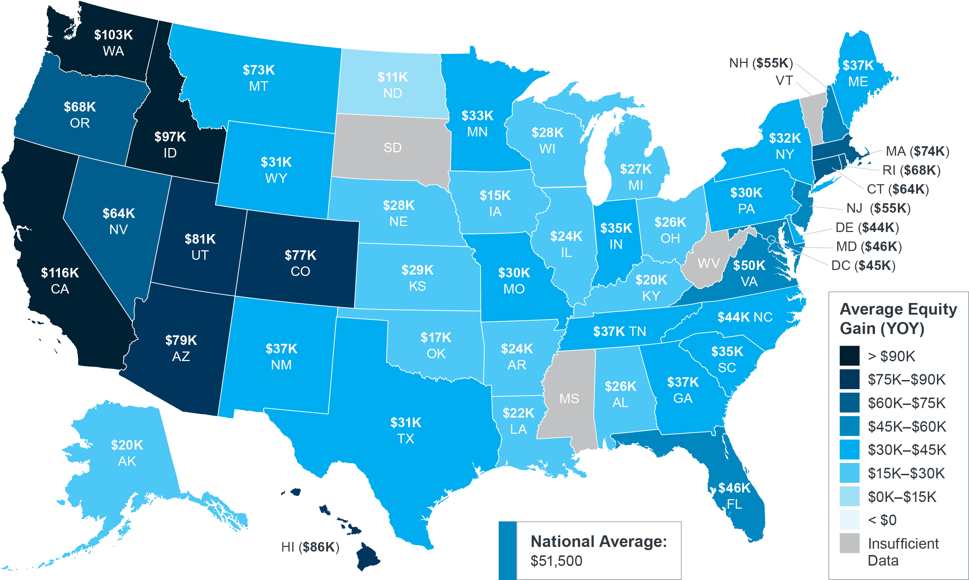
Using Your Equity To Make a Move
According to the latest data from CoreLogic, the average homeowner gained $51,500 in equity over the past year, and that number continues to grow as home values appreciate.
Homeowner Equity Gains Over the Past Year
CoreLogic
Notes:
https://www.corelogic.com/insights-download/homeowner-equity-report.aspx

Slide 13
Equity is the difference between what you owe on the home and its market value based on factors like price appreciation. The best thing about equity is that it often grows without you even realizing it, especially as home values rise like they’re doing today. As mentioned, the current combination of low housing supply and high buyer demand is driving home values up, which gives you a significant equity boost.
When you sell your house, that equity can be used to help you meet your goals. If you’re looking to move, you can use the equity from your current home to fuel a move into the home of your dreams.
Alternatively, you can use your equity to reach other big goals in your life, such as starting your own business or funding an education.
The graph below is a great example of how price appreciation converts into equity when you own a home. If you purchased a $350,000 home in January 2021, based on projected home price appreciation, you could potentially gain $111,285 in equity over the next five years – just by being a homeowner.
So, if you’re thinking of moving, don’t forget – you may have more equity in your current house than you realize, and that equity can take you places.
Potential Home Price Growth Over the Next Five Years
Based on projections from the Home Price Expectation Survey
$111,285
Potential growth in household wealth over the next five years based solely on increased home equity if you purchased a $350K home in January 2021
Home Price Expectation Survey 2021 2Q
Bottom Line Let’s connect to determine if your current home equity can help you make your next move sooner than you may have thought possible.
Notes:
https://pulsenomics.com/surveys/#home-price-expectations

Slide 14
Homeowners across most of the United States could sit back with a smile yet again in the third quarter and watch their balance sheets grow as soaring home prices pushed their equity levels ever higher. . . . there is no doubt that homeowners continue benefitting big-time from the relentless home price increases we are seeing around the country.”
-Todd Teta, Chief Product Officer, ATTOM
Notes:
https://www.attomdata.com/news/market-trends/home-sales-prices/attom-q3-2021-u-s-home-equity-and-underwater-report/

Slide 15
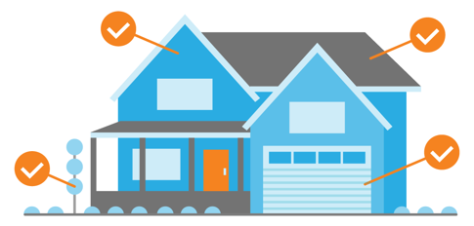
If I Sell Now, Where Will I Go?
Now is clearly a great time to sell, but when you do, you may be wondering where you’ll go. Let’s compare the benefits of buying a newly built home versus an existing one. That way, we can work together to determine what most closely aligns with your homeownership goals.
Pros for Purchasing a Newly Built Home
Create your perfect home. If you build a home from the ground up, you’ll have the option to select the custom features you want, including appliances, finishes, landscaping, layout, and more.
Cash in on energy efficiency. When building a home, you can choose energy-efficient options to help lower your utility costs, protect the environment, and reduce your carbon footprint.
Minimize the need for repairs. Many builders offer a warranty, so you’ll have peace of mind on unlikely repairs. Plus, you won’t have as many little projects to tackle, like leaky faucets or shutters to paint.
Know you have brand new everything. Another perk is that nothing in the house is used. It’s all brand new and uniquely yours from day one.
Notes:
https://www.energy.gov/eere/buildings/energy-star
https://www.investopedia.com/articles/personal-finance/062614/should-you-buy-or-build-home.asp
https://www.quickenloans.com/learn/old-house-vs-new-house

Slide 16
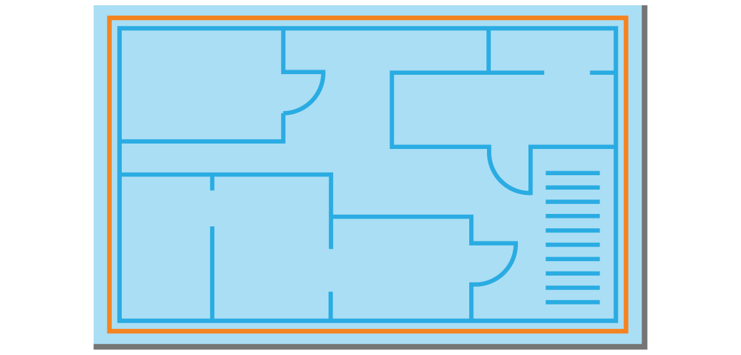
Pros for Buying an Existing Home
Explore a wider variety of home styles and floorplans. With decades of homes to choose from, you’ll have a broader range of floorplans and designs available.
Join an established neighborhood. Existing homes give you the option to get to know the neighborhood, community, or traffic patterns before you commit.
Enjoy mature trees and landscaping. Established neighborhoods also have more mature landscaping and trees, which can give you additional privacy and curb appeal.
Appreciate that lived-in charm. The character of older homes is hard to reproduce. If you value timeless craftsmanship or design elements, you may prefer an existing home.
Bottom Line If you have questions about the options in our area, let’s discuss what's available and what's right for you, so you’re ready to make your next move.
Notes:
https://www.investopedia.com/articles/personal-finance/062614/should-you-buy-or-build-home.asp
https://www.quickenloans.com/learn/old-house-vs-new-house

Slide 17
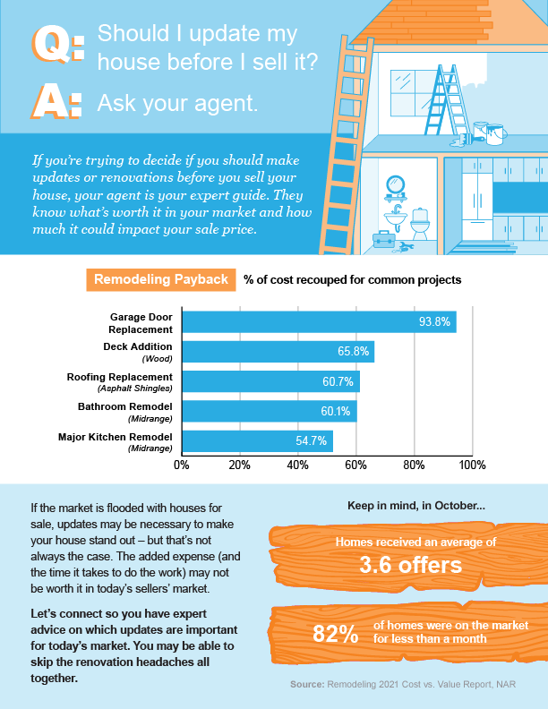
Notes:
https://www.remodeling.hw.net/benchmarks/cost-vs-value/key-trends-in-the-2021-cost-vs-value-report_o
https://www.nar.realtor/newsroom/existing-home-sales-inch-up-0-8-in-october
https://cdn.nar.realtor/sites/default/files/documents/2021-10-realtors-confidence-index-11-22-2021.pdf

Slide 18
Save Time and Effort by Selling with an Agent
Selling a house is a time-consuming journey – especially if you decide to do it on your own, known as a For Sale By Owner (FSBO). From conducting market research to reviewing legal documents, handling negotiations, and more, it’s an involved and highly-detailed process. Here are a few things you should consider before putting that For Sale sign up in your yard.
1. Make a Good First Impression
Selling a house requires a significant amount of time and effort, even though it may seem simple at first glance. Doing it right takes expertise and an understanding of what buyers are looking for. An agent considers things like:
Do you need to take down your personal art?
What’s the right amount of landscaping to boost your curb appeal?
What wall colors are most appealing to buyers?
An expert real estate advisor relies on their experience to answer these questions and more, so you don’t invest in the wrong things. Your time and money are important – and you shouldn’t waste either one.
2. Maximize Your Buyer Pool
The more buyers that view your house, the more likely you are to get a better return on your investment. Today, homes are receiving an average of 3.6 offers per sale, according to recent data from the National Association of Realtors (NAR). While that’s promising for the sale of your house, it’s important to understand your agent’s role in bringing buyers in.
Agents have multiple tools at their disposal – from social media to agency resources – to ensure your home is viewed by more prospective buyers. Leveraging the tools available to your agent and their expertise will give you the best advantage in the process.
Notes:
https://cdn.nar.realtor/sites/default/files/documents/2021-10-realtors-confidence-index-11-22-2021.pdf

Slide 19
3. Understand the Fine Print
An agent can also save you time by taking out the guesswork you’ll have when navigating the required documentation. Today, more disclosures and regulations are mandatory, meaning the number of legal documents you need to juggle is growing.
It can be hard to truly understand all the requirements and fine print. That’s where an advisor can be a valuable guide so you can avoid any costly missteps.
4. Navigate Negotiations
When it comes to selling your house as a FSBO, you’ll have to handle all the negotiations. Here are just a few of the people you’ll work with:
The buyer, who wants the best deal possible
The buyer’s agent, who will use their expertise to advocate for the buyer
The inspection company, which works for the buyer and will almost always find concerns with the house
The appraiser, who assesses the property’s value to protect the lender
An agent relies on experience and training to make the right moves during the negotiation. That’s how we know what levers to pull, how to address each individual’s concerns, and when you may want to get a second opinion. Selling your house as a FSBO means you’ll need to be prepared to have these conversations on your own.
5. Price It Right
Another way your agent maximizes the sale of your home is by making sure it’s priced right. Real estate professionals have the experience to compare your house to recently sold homes in your area and factor in any upgrades you’ve completed. Combining these factors is the key to making sure your house is priced to move quickly and competitively. When you FSBO, you’re operating without this expertise.
Bottom Line Selling your house on your own is time consuming and requires an immense amount of effort and expertise. Before you decide to sell your house yourself, let's discuss your options to make sure you get the most out of your sale.

Slide 20
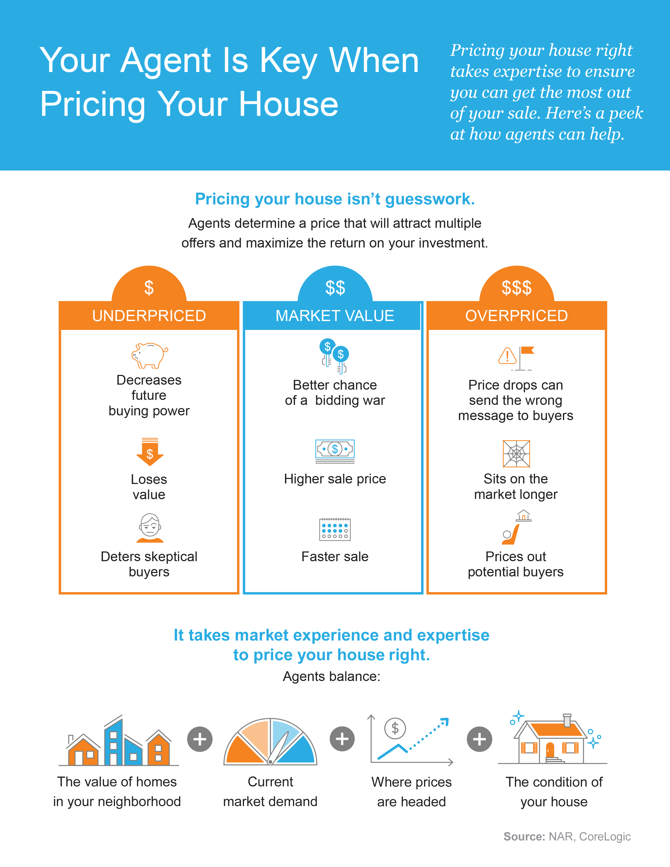
Notes:
https://www.nar.realtor/determining-asking-price
https://www.corelogic.com/intelligence/find-stories/us-sp-corelogic-case-shiller-rockets-to-16-6-reaches-new-records/

Slide 21
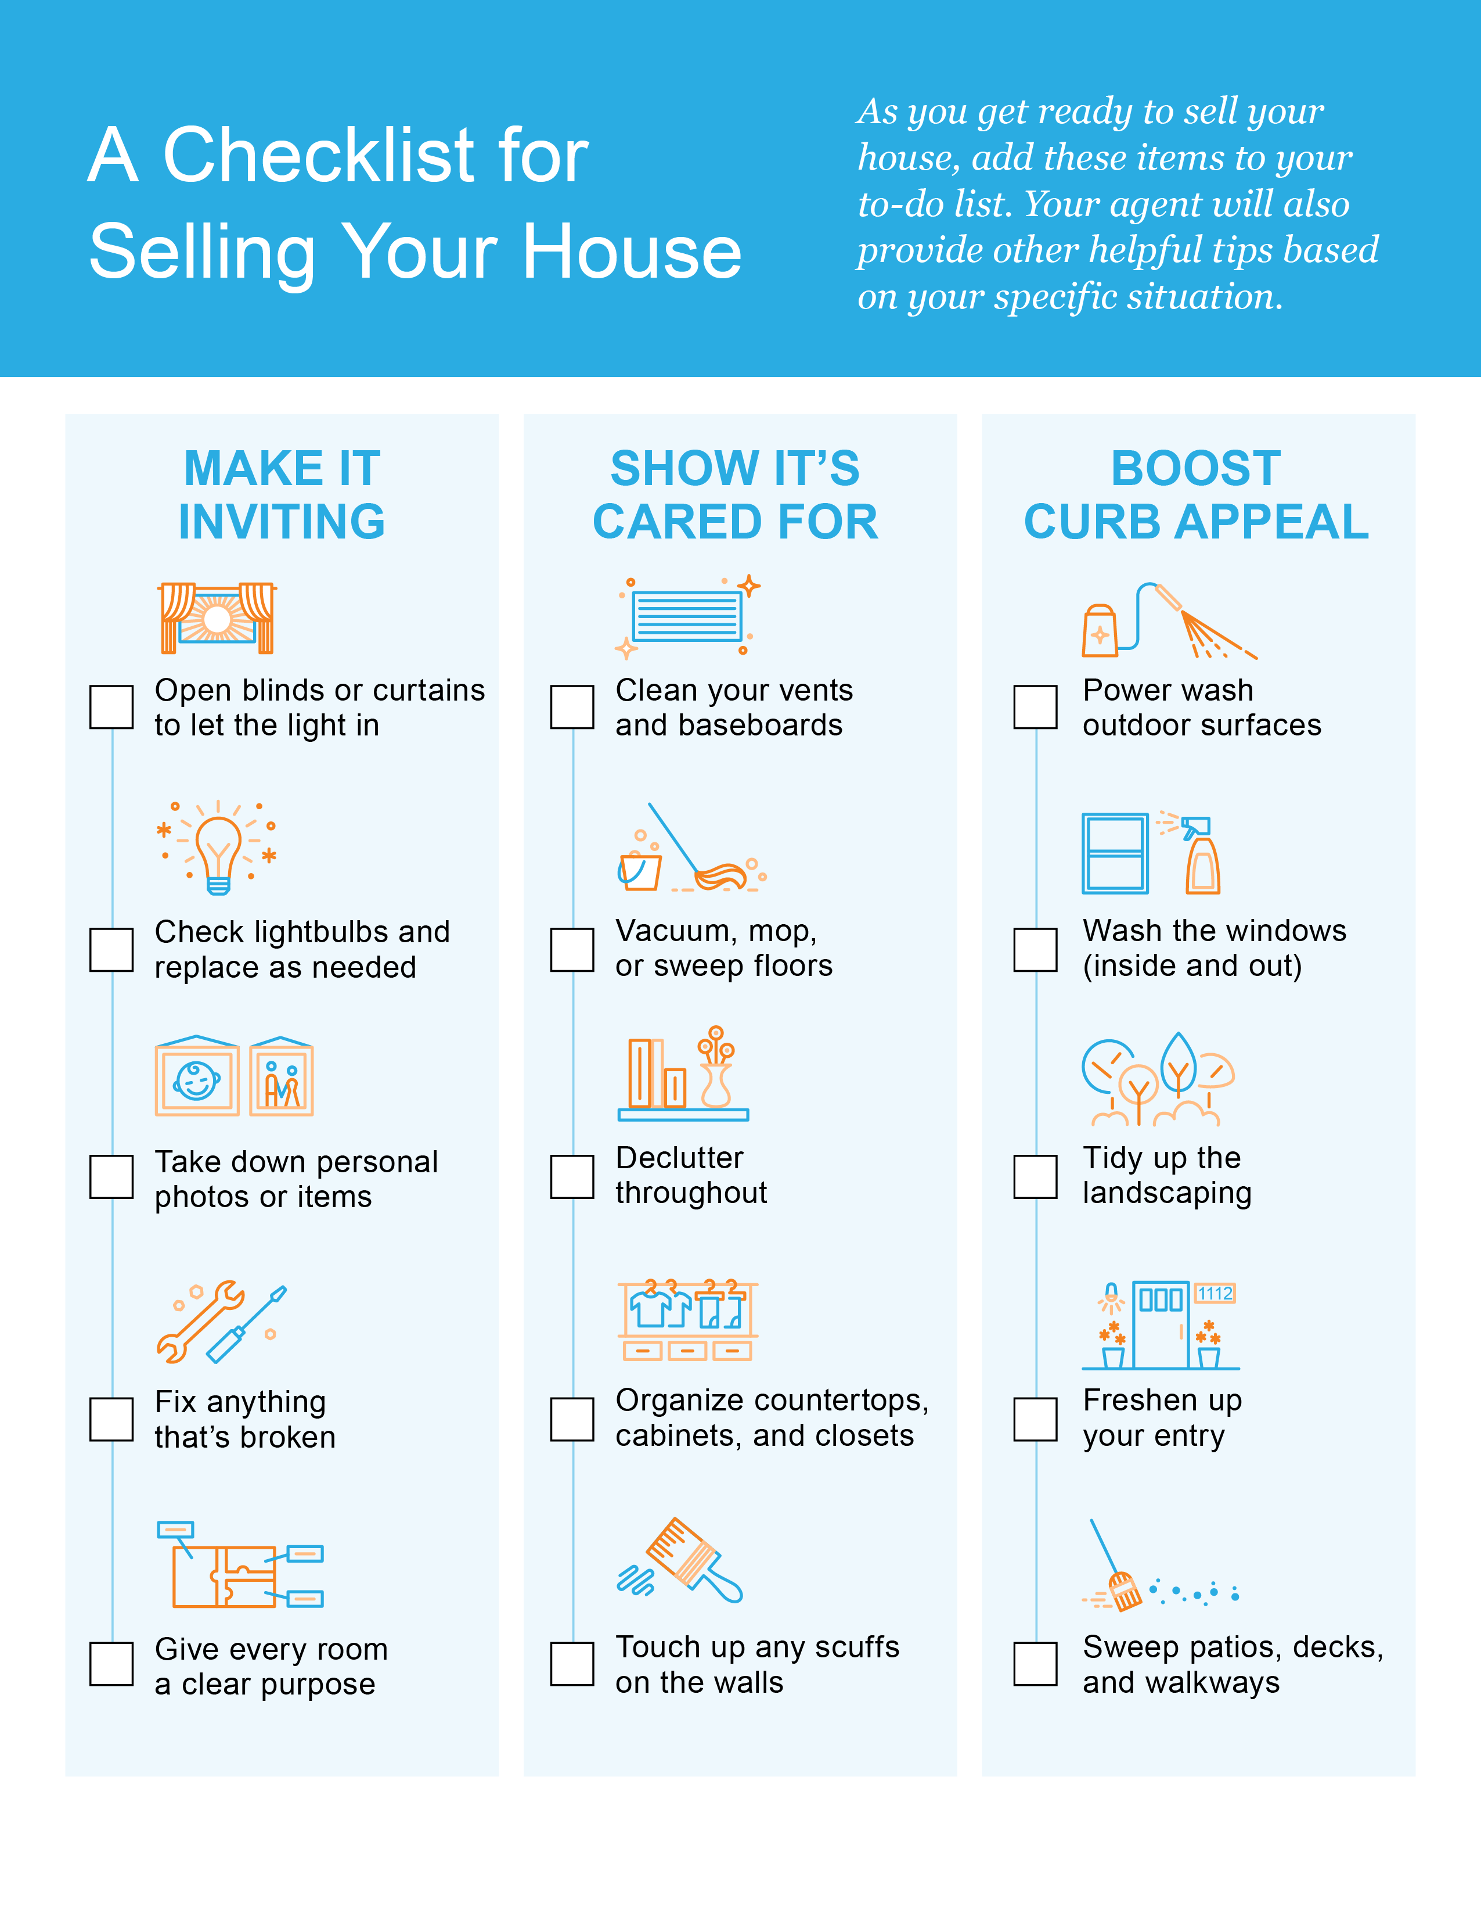

Slide 22
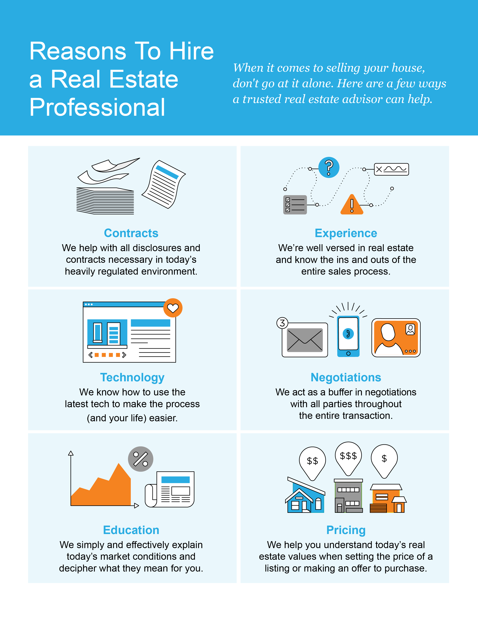

Slide 23
Buying a home is not just a financial decision. It’s also a lifestyle decision.
- Mark Fleming, Chief Economist, First American
Notes:
https://blog.firstam.com/economics/the-reconomy-podcast-what-is-the-fed-signaling-on-interest-rates

Slide 24
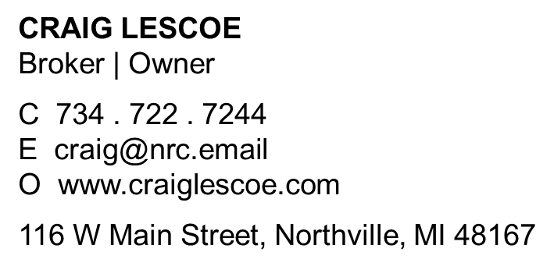
Let’s Chat.
I’m sure you have questions and thoughts about the real estate process.
I’d love to talk with you about what you’ve read here and help you on the path to selling your house. My contact information is below, and I look forward to working with you.
WINTER 2022 EDITION

