Slide 1
Things To Consider When
Buying a Home
WINTER 2022
EDITION

Slide 2
Table of Contents
3 Reasons To Buy a Home This Winter
5 Expert Insights for Today’s Homebuyers
6 What Does the Future Hold for Home Prices?
8 Why You Shouldn’t Be Upset by 3% Mortgage Rates
10 The Non-Financial Benefits of Homeownership
12 Key Terms To Know When Buying a Home
13 The Importance of the Appraisal and Inspection
15 The Path to Homeownership
16 Is a 20% Down Payment Really Necessary?
18 Things To Avoid After Applying for a Mortgage
19 Is Offering Asking Price Enough?
21 5 Tips for Making Your Best Offer

Slide 3
Reasons To Buy a Home This Winter
Are you thinking of buying a home? If so, here are the top motivators that should encourage you to learn more about the homebuying process and start your search sooner rather than later.
1. Homeownership Has Many Perks
Homeownership is the American dream – not just because it has tangible financial benefits, but because it also has the power to change lives.
The sense of security, stability, and success homeowners feel has far-reaching impacts, especially in a time like today, where the health crisis has made having a safe space to call home more important now than ever before. If the pandemic has changed what you’re looking for, homeownership can deliver the perks you want: financially, emotionally, and more.
2. Mortgage Rates Are Climbing
Early 2021 saw the lowest mortgage interest rates in recorded history. This season, however, rates are beginning to rise. When mortgage rates rise, it impacts affordability. Expert projections for 2022 indicate mortgage rates are expected to continue going up, meaning it will cost more to buy a home if you wait.
While everyone moves through the homebuying process at a different pace, it’s more important than ever to put your plans in place and begin working with a trusted advisor. If you’re thinking about buying a home sometime over the next year or two, learning what it takes to purchase sooner rather than later may be your most affordable option. And when you’re educated on the process and working with an agent at your side, you can make the most informed decision about your next steps toward homeownership.

Slide 4
3. Home Prices Are Going Up
The recent surge in home prices is the result of more active buyers in the market than there are homes for sale. And although data indicates more listings are expected to be available for buyers this winter, the shortage of homes on the market won’t be solved overnight. Experts agree, prices will keep rising while demand is greater than supply. As Danielle Hale, Chief Economist at realtor.com, puts it:
“Home prices continue to rise due to a mismatch between supply and demand... This means that housing affordability will be an increasingly important consideration for buyers, but with rents rising by 13.6%, buying may be the relatively more affordable housing option for some.”
Making the decision to buy now gives you a chance to purchase your home before prices increase further, and take advantage of today’s affordability, which won’t last forever.
4. Rents Are Rising
Census data also shows the median monthly rent is rising year after year (see chart below):
Median Asking Rent Since 1988
Census
To escape that cycle, consider purchasing a home so you can lock in your monthly mortgage payment and avoid future increases. Why pay more for less? Instead, invest in homeownership, which acts as forced savings that comes back to you in the form of equity, boosting your long-term wealth gain.
Bottom Line Let’s connect if you’re ready to learn more about the benefits and rewards of homeownership. Having an expert on your side is the best way to make your dream a reality this season.
Notes:
https://www.realtor.com/research/weekly-housing-trends-view-data-week-nov-6-2021/
http://www.census.gov/housing/hvs/files/currenthvspress.pdf

Slide 5
Expert Insights for Today’s Homebuyers
Experts throughout the industry agree, if you’re thinking about buying a home, it’s a great time to invest in homeownership, even in a competitive market. Here's what they have to say about the latest in real estate.
“ | Housing demand remains strong as buyers likely want to secure a home before mortgage rates increase even further next year. - Lawrence Yun, Chief Economist, National Association of Realtors (NAR)
“ | By some measures, house prices seem high, but the recent price increases make sense from a supply and demand perspective. - Bill McBride, Author, Calculated Risk
“ | If you find something you like, that’s within your budget, and you plan to hold onto it for a few years, then buying a house might be cheaper than renting. - Ralph McLaughlin, Chief Economist, Kukun
“ | Homeownership is regarded as causing an improvement in the quality of life of a typical family. It is the most common method for such a family to build wealth…that can be used for retirement or other needs, including helping the next generation. Such wealth creation therefore provides a major social as well as economic benefit. - Don Layton, Senior Industry Fellow, Joint Center for Housing Studies at Harvard University
Notes:
https://www.nar.realtor/newsroom/existing-home-sales-ascend-7-0-in-september
https://calculatedrisk.substack.com/p/house-price-to-median-income
https://www.forbes.com/advisor/mortgages/housing-bubble-experts/
https://www.jchs.harvard.edu/sites/default/files/research/files/harvard_jchs_homeownership_rate_layton_2021.pdf

Slide 6
What Does the Future Hold for Home Prices?
According to the Home Price Insights Report from CoreLogic, nationwide, home prices increased by 18% over the last 12 months. Those rising home prices can spark many questions for potential homebuyers, like why are they climbing so quickly and how long can this last?
Where Will Home Values Go From Here?
The dramatic rise in home prices is a direct result of more buyers in the market (demand) than houses available for sale (supply). When demand is high and supply is low like it is right now, prices naturally rise.
But today’s buyers are wondering what the future holds. Will prices continue to rise with time, or should you expect them to fall? To answer that question, let’s first look at a few terms you may be hearing right now.
Appreciation is an increase in the value of an asset.
Depreciation is a decrease in the value of an asset.
Deceleration is when something happens at a slower pace.
It’s important to note home prices have increased, or appreciated, for nearly 10 years now. According to Greg McBride, Chief Financial Analyst at Bankrate, home prices are projected to continue increasing, too:
“… Waiting in expectation that prices will fall seems unlikely to pay off.”
Notes:
https://www.corelogic.com/intelligence/u-s-home-price-insights/
https://www.merriam-webster.com/dictionary/appreciation
https://www.merriam-webster.com/dictionary/depreciation
https://www.merriam-webster.com/dictionary/deceleration
https://www.marketwatch.com/picks/more-sellers-are-cutting-their-list-price-heres-exactly-what-economists-think-will-happen-to-home-prices-in-the-next-few-months-01635260708

Slide 7
A Look at Expert Projections
The chart below shows 2022 price forecasts from various industry experts. The average of these projections indicates 5.1% home price appreciation in 2022. While this isn’t the record-breaking rate of over 18% appreciation from the past year, it’s a continued increase, just at a slower pace. This means experts forecast a deceleration in prices, but not depreciation. So, home prices are projected to continue increasing next year, and that’s a direct result of low supply and high demand.
The good news for prospective buyers is you can rest assured your investment in your home will be an asset that increases in value over time, growing your net worth.
2022 Home Price Forecasts
Based on Expert Projections
Average of All Forecasts: 5.1%
Bottom Line Don’t expect a drop in home prices next year – experts say it won’t happen. Instead, think about your homeownership goals and consider purchasing a home before prices rise further.
Notes:
https://www.mba.org/news-research-and-resources/research-and-economics/forecasts-and-commentary
https://cdn.nar.realtor/sites/default/files/documents/forecast-Q4-2021-us-economic-outlook-10-28-2021.pdf
https://www.fanniemae.com/media/42011/display
http://www.freddiemac.com/research/forecast/20211015_quarterly_economic_forecast.page?
https://pulsenomics.com/surveys/#home-price-expectations

Slide 8
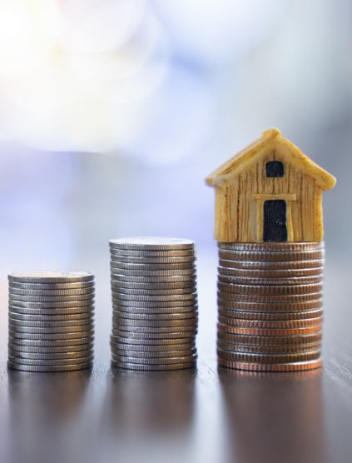
Why You Shouldn’t Be Upset
by 3% Mortgage Rates
With the average 30-year fixed mortgage rate climbing above 3%, rising rates are one of the big topics of discussion in the housing market today. But as a homebuyer, what do 3% mortgage rates really mean?
Today’s Rates Still Give Buyers Great Opportunity
Buyers don’t want mortgage rates to rise, as any upward movement increases your monthly mortgage payment when you purchase a home. But it’s important to put today’s average mortgage rate into perspective. Even though rates today are climbing back into the 3% range, they’re still incredibly competitive. To truly give you the full picture, take a look at the last 50 years (see graph below). Looking back, today’s rate is outstanding by comparison.
Today’s Rate Is Lower than the Average in Each of the Past 5 Decades
Based on historical data from Freddie Mac
TODAY
Freddie Mac
Notes:
http://www.freddiemac.com/pmms/pmms_archives.html

Slide 9
What Does This Mean for You?
Being upset that you may have missed out on sub-3% mortgage rates is understandable. But it’s important to realize, buying now still makes sense, as experts project rates will continue to rise. And when rates rise, it will cost more to purchase a home.
As Mark Fleming, Chief Economist at First American, explains:
“Rising mortgage rates, all else equal, will diminish house-buying power, meaning it will cost more per month for a borrower to buy ‘their same home.’”
In other words, the longer you wait, the more it will cost you. Being educated and informed on the homebuying process is incredibly important today, so you can make the best possible decision about when to purchase a home.
Bottom Line While it’s true today’s average mortgage rate is higher than it was a few months ago, 3% mortgage rates shouldn’t deter you from your homebuying goals. Historically, today’s rate is still low. Consider this an opportunity rather than a hurdle. Let’s connect so you can lock in a great rate now.
Notes:
https://blog.firstam.com/economics/how-will-rising-mortgage-rates-impact-house-buying-power

Slide 10
The Non-Financial Benefits of Homeownership
There’s no denying the financial benefits of homeownership, but what’s often overlooked are the feelings of gratitude, security, pride, and comfort we get from owning a home.
This year, those emotions are stronger than ever. We’ve lived through a time that has truly changed our needs and who we are, and as a result, homeownership has a whole new meaning for many of us. According to the 2021 State of the American Homeowner Report by Unison:
“Last year, staying home became a necessity and that caused many homeowners to have renewed gratitude for the roof over their head.”
That’s because, over the past year and a half, we’ve spent more time than ever at home: working, eating, schooling, exercising, and more. The world around us changed almost overnight, our needs shifted, and our shelters became a place that protected us on a whole new level. The same study from Unison notes:
91% of homeowners say they feel secure, stable, or successful owning a home
64% of American homeowners say living through a pandemic has made their home more important to them than ever
83% of homeowners say their home has kept them safe during the COVID-19 pandemic
As we’ve learned throughout this health crisis, homeownership can provide the safety and security we crave in a time of uncertainty. That sense of connection and emotional stability genuinely reaches beyond just the financial aspect of owning a home.
Bottom Line If you’re considering buying a home, it’s not entirely about the dollars and cents. Don’t forget to weigh the non-financial benefits that may truly change your life when you need it most.
Notes:
https://contentimages.o-prod.unison.com/images/press/2021-Unison-SOTAH-Report.pdf

Slide 11
KEY TAKEAWAY
If you’re looking for a home but you’re still having trouble finding one, hang in there. Homeownership is a worthwhile and life-changing goal. The key is sticking with your search, working with your agent, and trusting the process.

Slide 12
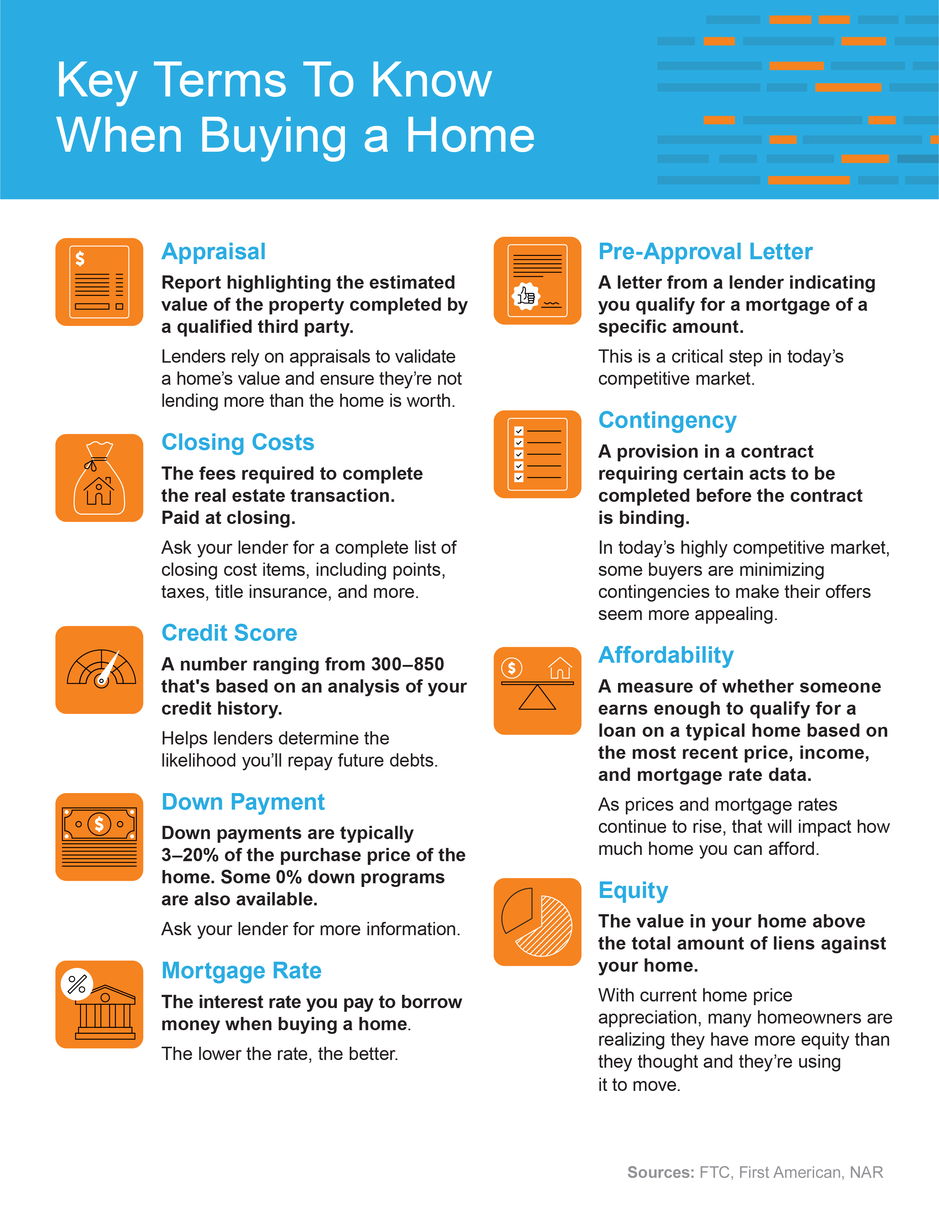
Notes:
https://www.ftc.gov/sites/default/files/documents/one-stops/real-estate-competition/realestateglossary.pdf
https://blog.firstam.com/15-real-estate-terms-you-should-know
https://magazine.realtor/tool-kit/rookie/article/2020/02/real-estate-glossary

Slide 13
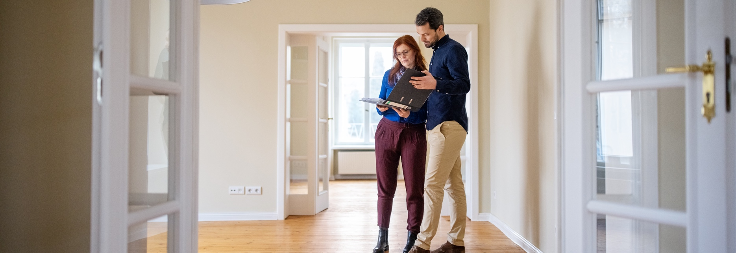
The Importance of the Appraisal and Inspection
When it comes to finding the home of your dreams, it’s easy to get emotionally attached even before your offer is accepted. In a competitive market like today’s, some buyers wonder whether they should waive the appraisal and inspection in their offer to improve their chances of getting the home. But is that the best move?
Here’s a breakdown of why getting an appraisal and an inspection can potentially save you a lot of time, money, and headaches down the road.
The Home Appraisal
The appraisal is a critical step for securing a mortgage on your home. When you apply for a mortgage, an unbiased appraisal – typically required by your lender – is the best way to verify the current value of the home. An appraisal ensures the lender doesn’t loan you more than what the home is worth. As Home Light explains:
“… lenders typically require an appraisal to ensure that your loan-to-value ratio falls within their underwriting guidelines.”
When buyers are competing like they are today, bidding wars and market conditions can put upward pressure on prices. A buyer’s contract price may end up higher than the value of the home. This is known as an appraisal gap.
In the current market, it’s common for the seller to ask the buyer to make up the difference if this occurs. That means, as a buyer, you may need to be prepared to bring extra money to the table if you really want the home.
Notes:
https://www.homelight.com/blog/what-to-expect-from-a-home-appraisal/

Slide 14
The Home Inspection
Like the appraisal, the inspection is important because it gives an impartial evaluation of the home. While the appraisal determines the current value of the home, the inspection determines the current condition of the home. As the American Society of Home Inspectors notes:
“Home inspections are the opportunity to discover major defects that were not apparent at a buyer’s showing … Your home inspection is to help you make an informed decision about the house, including its condition.”
If there are any concerns during the inspection – an aging roof, a faulty HVAC system, or any other questionable items – you have the option to discuss potential issues with the seller. Your real estate advisor can help you navigate this process and negotiate what, if any, repairs need to be made before the sale is finalized.
Keep in mind, home inspections are critical because they can shed light on challenges you may face as the new homeowner. Without an inspection, serious and sometimes costly issues could come as a surprise later on.
Bottom Line The appraisal and the inspection are both important in order to protect your best interests as a buyer. Work with your trusted real estate advisor so you have an expert guiding you throughout the entire process.
Notes:
https://www.homeinspector.org/Newsroom/Articles/Waiving-A-Home-Inspection-Good-Idea-or-Bad-Idea/15698/Article

Slide 15
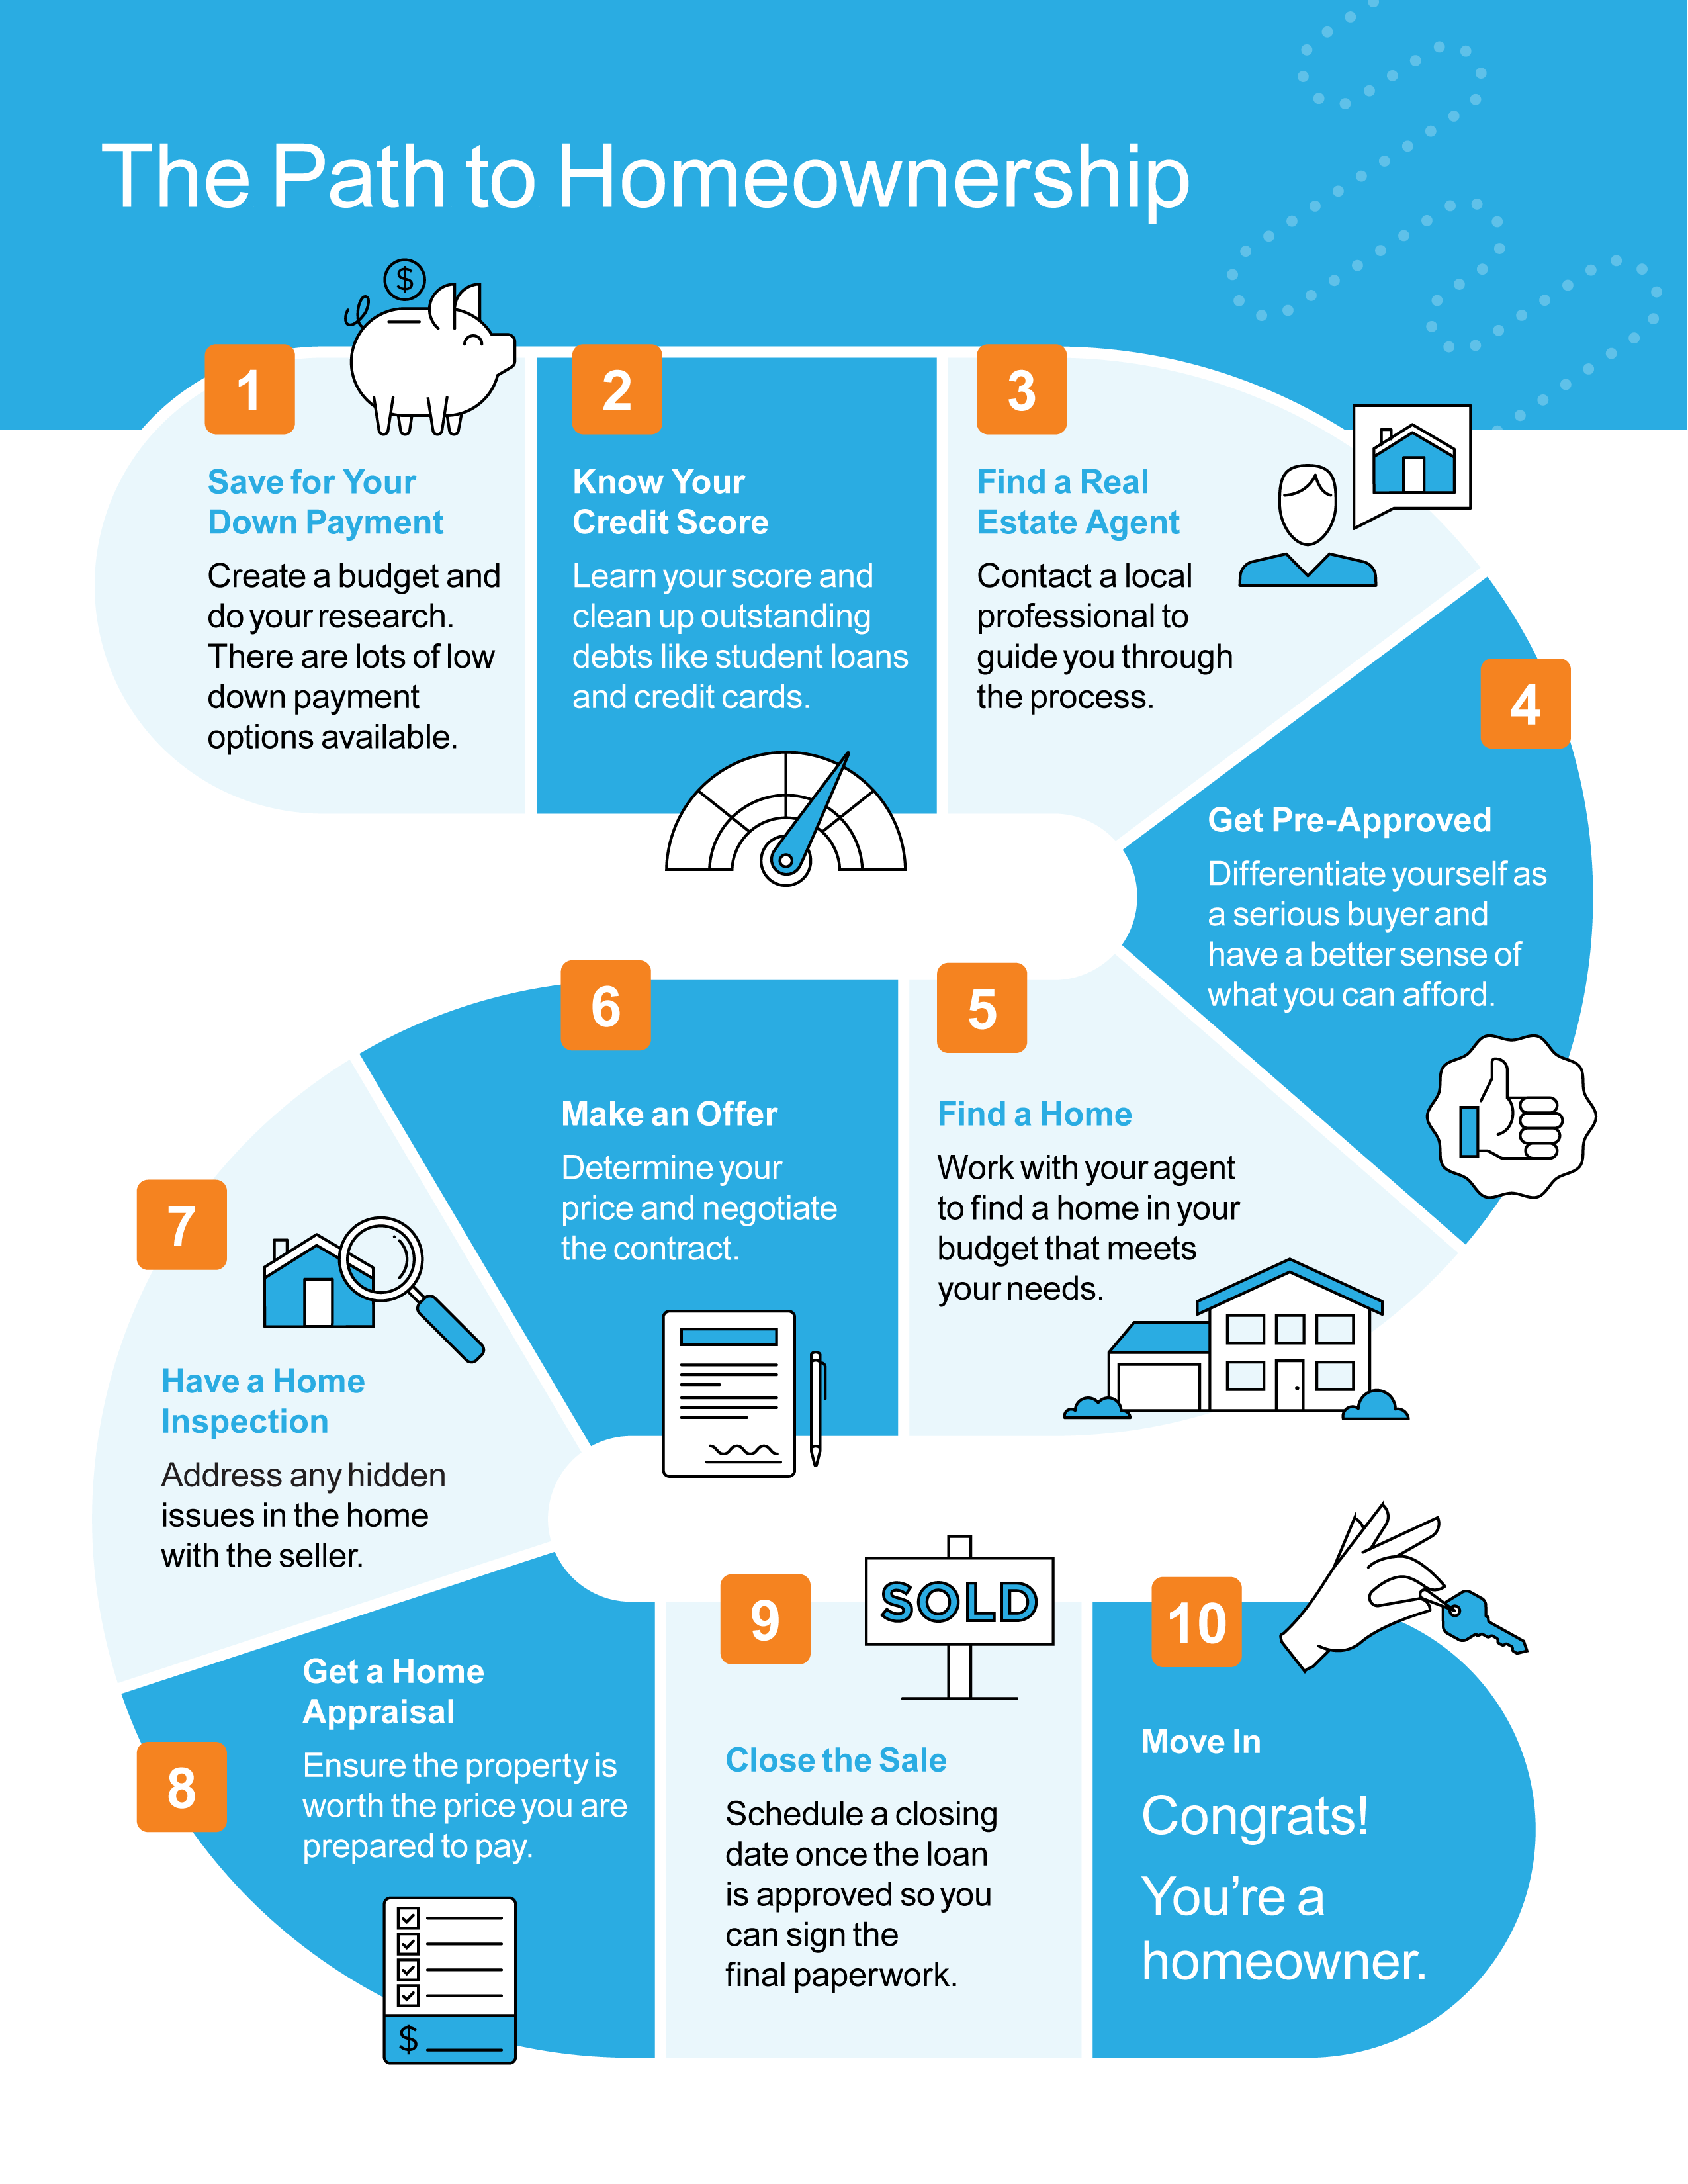

Slide 16
Is a 20% Down Payment
Really Necessary?
There’s a common misconception that, as a homebuyer, you need to come up with 20% of the total sale price for your down payment. But is that really how much you have to save?
A survey by Lending Tree asks buyers what’s keeping them from purchasing a home. Over half of those surveyed say their biggest hurdle is the ability to afford a down payment.
That may be because those individuals assume a 20% down payment is necessary. While putting more money down if you’re able can benefit you as a buyer, putting 20% down isn’t always required.
According to the latest Profile of Home Buyers and Sellers from the National Association of Realtors (NAR), the median down payment hasn’t been over 20% since 2005.
It may sound surprising, but today’s average down payment is only 13%. That number is even lower for first-time homebuyers, whose average down payment is only 7%.
The most damaging down payment myth—since it stops the homebuying process before it can start—is the belief that 20% is necessary.
- Freddie Mac
Notes:
https://www.lendingtree.com/home/mortgage/homeownership-renting-survey/
https://sf.freddiemac.com/articles/insights/down-payments-helping-future-borrowers-bridge-the-awareness-gap
https://www.nar.realtor/research-and-statistics/research-reports/highlights-from-the-profile-of-home-buyers-and-sellers

Slide 17
Median Down Payments
Today’s median down payment is less than 20%
Common Misconception: 20%
NAR
What Does This Mean for You?
If you’re thinking of buying a home, it’s important to know you don’t always have to put 20% down. And while saving for any down payment amount may feel like a challenge, keep in mind there are programs for qualified buyers that allow a down payment as low as 3.5%. There are also options like VA loans and USDA loans with no down payment requirements for qualified applicants.
To understand what’s available, do your homework. If you’re interested in learning more about down payment assistance programs, information is available through sites like downpaymentresource.com. Be sure to also work with a real estate advisor from the start to learn what you may qualify for in the homebuying process.
Bottom Line Don’t let down payment myths keep you from hitting your homeownership goals. If you’re looking to buy a home, let’s review your options together.
Notes:
https://www.nar.realtor/research-and-statistics/research-reports/highlights-from-the-profile-of-home-buyers-and-sellers
https://www.hud.gov/buying/loans
https://www.benefits.va.gov/homeloans/index.asp
https://www.rd.usda.gov/newsroom/news-release/usda-rural-home-loans-offer-100-financing-and-no-down-payment
https://downpaymentresource.com/

Slide 18
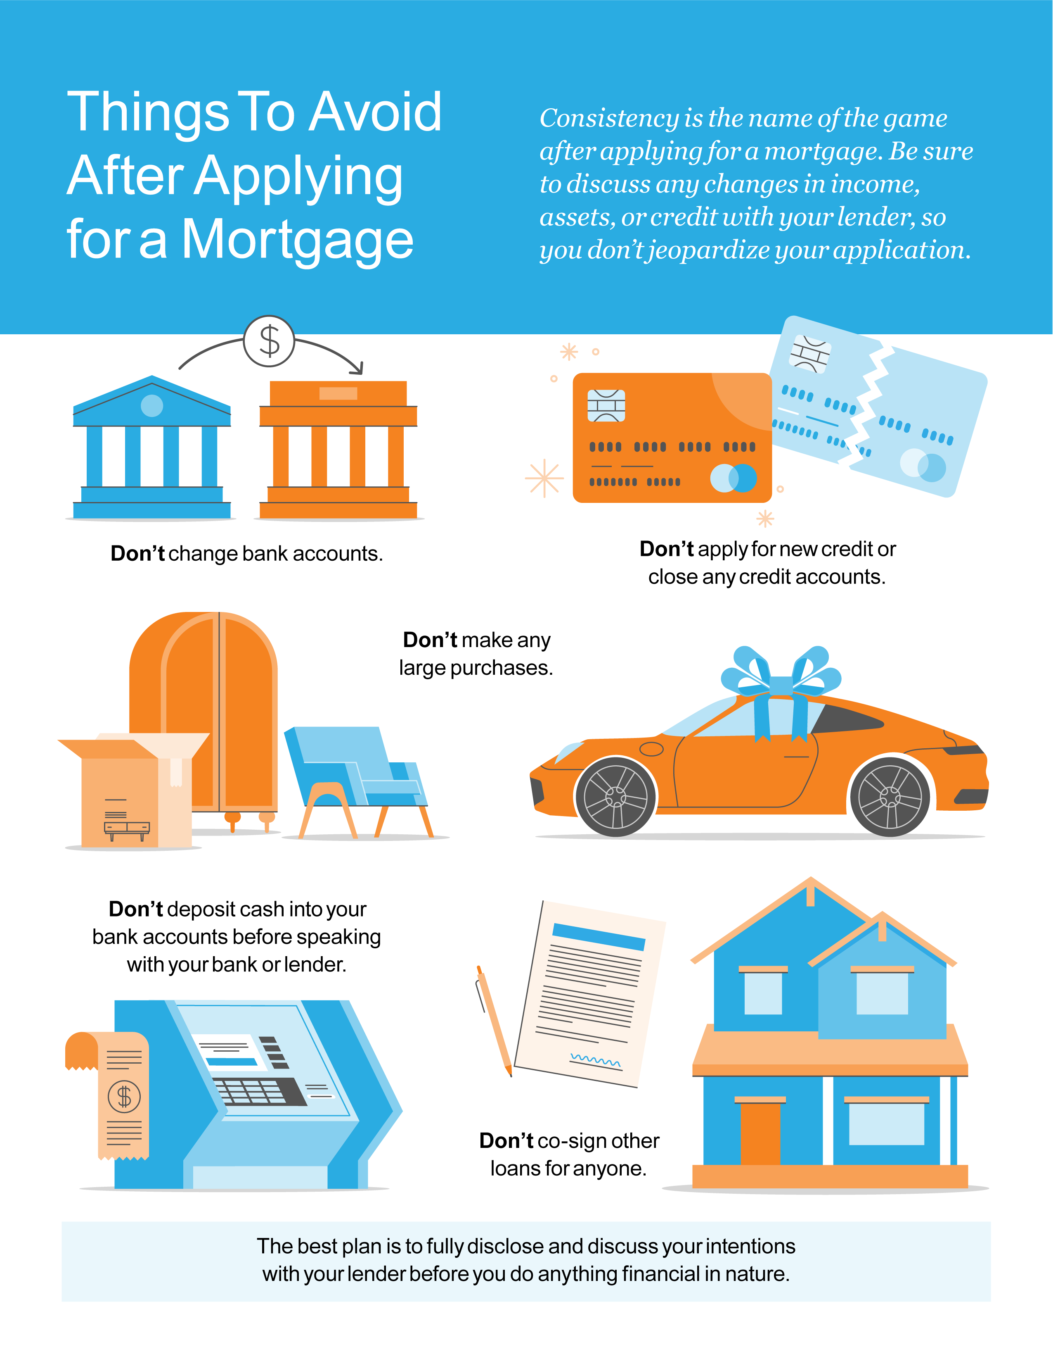

Slide 19
Is Offering Asking Price Enough?
If you’re hoping to buy a home in today’s highly competitive market, it’s important to make your offer stand out. If you’ve gotten advice from someone who’s purchased a home before, know that what’s worked in the past may not ring true anymore.
Today’s buyers shouldn’t shop for a home and expect to negotiate a lower sales price. In a typical housing market, buyers try to determine how much less than the asking price they can offer and still get the home. From there, the buyer and seller typically negotiate and agree on a revised price somewhere in the middle.
Today is different.
The current housing market is anything but normal. According to the National Association of Realtors (NAR), homes today are:
Receiving an average of 3.6 offers
Selling in a median of just 18 days
This is due, in large part, to the fact that there just aren't enough homes available for the number of buyers who are eager to purchase them. Low supply and high demand means homes often sell for more than the asking price. In some cases, they sell for a lot more.
You may need to rethink how you look at a home’s asking price.
If you’ve found your dream home, you need to be realistic about today’s housing market and how that impacts the offer you’ll make. Offering below or even at a home’s asking price may not cut it right now. Currently, the asking price is often the floor of the negotiation rather than the ceiling. That’s important to keep in mind as you work with your agent to craft an offer.
Notes:
https://www.nar.realtor/research-and-statistics/research-reports/realtors-confidence-index
https://cdn.nar.realtor/sites/default/files/documents/2021-10-realtors-confidence-index-11-22-2021.pdf

Slide 20
More homes may be on their way, giving you more options.
If you’re having trouble competing against other buyers, there is good news. There are some signs more sellers are about to enter the market. George Ratiu, Manager of Economic Research for realtor.com, says:
“Recent survey data suggests the majority of prospective sellers are actively preparing to enter the market this winter.”
As a buyer, that means more homes will likely be listed this season, which gives you hope for more options. Just remember, you still need to be prepared to make a competitive offer if you really love the home. Here’s a look at the percent of offers over asking price, so you can get a feel for what to expect.
Percent of Offers Above Asking Price
NAR
Bottom Line Even if more sellers list their homes this season, it will still be a highly competitive market. Be ready to act quickly when you find the right home for you. Then, let’s work together so you can submit a strong offer based on today’s current conditions.
Notes:
https://news.move.com/2021-11-11-Low-Temps,-High-Expectations-Realtor-com-R-Survey-Shows-65-of-Prospective-Sellers-Plan-to-Enter-the-Market-this-Winter
https://news.move.com/2021-11-10-Realtor-com-R-October-Housing-Report-Homes-Sell-at-Breakneck-Speed-for-the-Eighth-Month-in-a-Row
https://cdn.nar.realtor/sites/default/files/documents/2021-10-realtors-confidence-index-11-22-2021.pdf

Slide 21
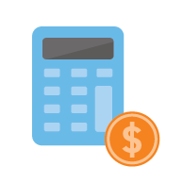
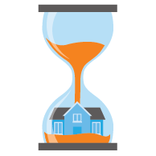
5 Tips for Making Your Best Offer
As a buyer in a sellers’ market, you may feel like you’re stuck between a rock and a hard place. When you’re ready to make an offer on a home, remember these five easy tips to rise above the competition.
1. Know Your Budget
Knowing your budget and what you can afford is critical to your success as a homebuyer. The best way to understand your numbers is to work with a lender so you can get pre-approved for a loan. As Freddie Mac puts it:
“This pre-approval allows you to look for a home with greater confidence and demonstrates to the seller that you are a serious buyer.”
Showing sellers you’re serious can give you a competitive edge. It enables you to act quickly when you’ve found your perfect home.
2. Be Ready To Move Fast
Speed and the pace of sales are contributing factors to today’s competitive housing market. According to the Existing Home Sales Report from the National Association of Realtors (NAR):
“Eighty-two percent of homes sold in October 2021 were on the market for less than a month.”
When homes are selling fast, staying on top of the market and moving quickly are key. A skilled agent will do everything possible to ensure you see the latest listings and help you submit your best offer as soon as you find the perfect place to call home.
Notes:
https://myhome.freddiemac.com/buying/working-with-your-lender.html
https://www.nar.realtor/newsroom/existing-home-sales-inch-up-0-8-in-october
https://myhome.freddiemac.com/buying/finding-your-team.html

Slide 22
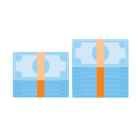
3. Lean on a Real Estate Professional
No matter what the housing market looks like, rely on a trusted real estate advisor. As Freddie Mac says:
“The success of your homebuying journey largely depends on the company you keep. . . . be sure to select experienced, trusted professionals who will help you make informed decisions and avoid any pitfalls.”
Agents are experts with unique insight into what’s worked for other buyers in your area and what sellers may be looking for in an offer. It may seem simple, but catering to what a seller may need can help your offer stand out.
4. Make a Strong, but Fair Offer
According to the Realtors Confidence Index from NAR, 42% of offers today are above the list price. In such a competitive market, emotions and prices can run high. Having an agent to help you submit a strong, yet fair offer is critical in these situations. Your agent can help you understand the market value of the home and recent sales trends in the area.
5. Be a Flexible Negotiator
When putting together an offer, your trusted real estate advisor will help you consider which levers you can pull, including contract contingencies (conditions you set that the seller must meet for the purchase to be finalized). Of course, there are certain contingencies you don’t want to give up. Freddie Mac explains:
“Resist the temptation to waive the inspection contingency, especially in a hot market or if the home is being sold ‘as-is’, which means the seller won’t pay for repairs. Without an inspection contingency, you could be stuck with a contract on a house you can’t afford to fix.”
Bottom Line Today’s competitive landscape makes it more important than ever to make a strong offer on a home. Let’s connect to make sure you rise to the top along the way.
Notes:
https://myhome.freddiemac.com/blog/homeownership/20201019_5_rules_for_making_an_offer_on_a_home.page
https://cdn.nar.realtor/sites/default/files/documents/2021-10-realtors-confidence-index-11-22-2021.pdf

Slide 23
Buying a home is not just a financial decision. It’s also a lifestyle decision.
- Mark Fleming, Chief Economist, First American
Notes:
https://blog.firstam.com/economics/the-reconomy-podcast-what-is-the-fed-signaling-on-interest-rates

Slide 24
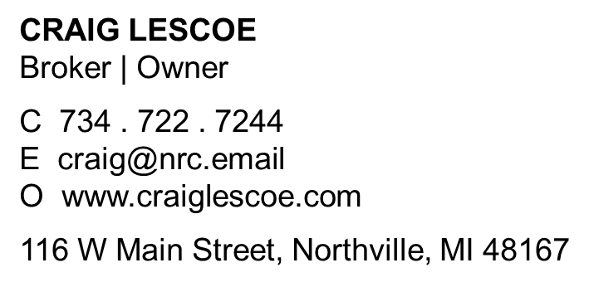
Let’s Chat.
I’m sure you have questions and thoughts about the real estate process.
I’d love to talk with you about what you’ve read here and help you on the path to buying your new home. My contact information is below, and I look forward to working with you.
WINTER 2022 EDITION

