Slide 1
Things To Consider When
Selling Your House
FALL 2021
EDITION

Slide 2
Table of Contents
3 4 Major Incentives To Sell This Fall
6 Expert Insights on the Current Housing Market
8 Will Home Prices Continue To Rise?
10 Leveraging Your Equity To Make a Move
13 Remote Work Is Changing Our Home Needs
15 If I Sell Now, Where Will I Go?
17 Should I Renovate My House Before I Sell It?
18 Save Time and Effort by Selling with an Agent
20 Why Pricing Your House Right Matters
21 How To Prepare Your House for a Winning Sale
22 Reasons To Hire a Real Estate Professional

Slide 3
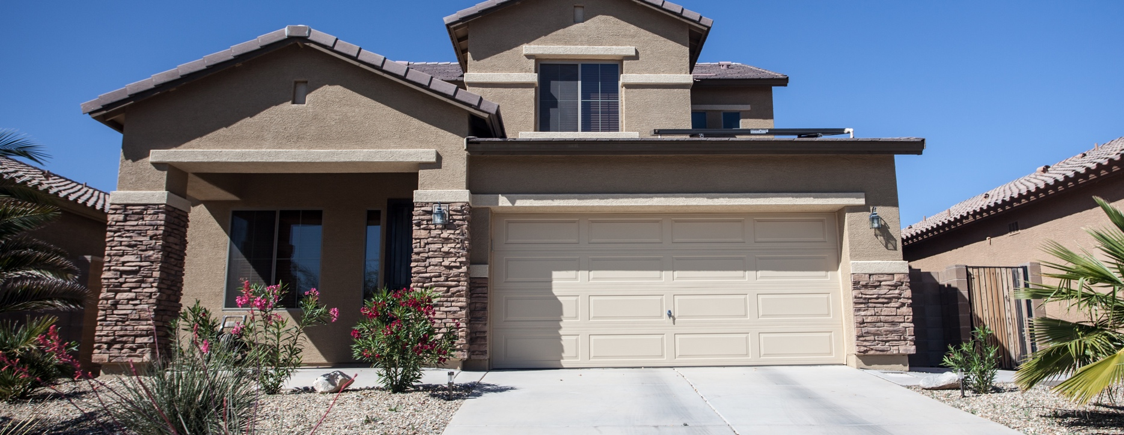
4 Major Incentives To Sell This Fall
If you're trying to decide when to sell your house, there may not be a better time to list than right now. The ultimate sellers' market we're in today won't last forever. If you’re thinking of making a move, here are four reasons to put your house up for sale sooner rather than later.
1. Your House Will Likely Sell Quickly
According to the Realtors Confidence Index released by the National Association of Realtors (NAR), homes continue to sell quickly – on average, they're selling in just 17 days.
As a seller, that's great news for you. Average days on market is a strong indicator of buyer demand. And if homes are selling quickly, buyers have to be more decisive and act fast to submit their offer before other buyers swoop in.
2. Buyers Are Willing To Compete for Your House
In addition to selling quickly, homes are receiving multiple offers. That same survey shows sellers are seeing an average of 4.5 offers, and they’re competitive ones. Realtor.com sums up the impact this can have:
“Buyers today know bidding wars are a likely outcome and they're coming prepared with their best offer in hand. Receiving several offers on your house means you can select the one that makes the most sense for your situation and financial well-being.”
Notes:
https://cdn.nar.realtor/sites/default/files/documents/2021-07-realtors-confidence-index-08-23-2021.pdf
https://www.realtor.com/advice/sell/the-new-normal-of-selling-a-home-today-explained/

Slide 4
When Supply Is Low, Your House Is in the Spotlight
One of the most significant challenges for motivated buyers is the current inventory of homes for sale. Though it’s improving, it remains at near-record lows. The chart below shows just how low today’s inventory is.
If you’re looking to take advantage of buyer demand and get the most attention for your house, selling now before more listings come to the market might be your best option.
If You’re Thinking of Moving Up, Now May Be the Time
If your current home no longer meets your needs, it may be the perfect time to make a move. Today, homeowners are gaining a significant amount of wealth through growing equity.
You can leverage that equity, plus current low mortgage rates, to power your move now. But these near-historic low rates won’t last forever.
Experts forecast mortgage rates will start to rise in the months ahead. In their forecast, Freddie Mac says:
“While we forecast rates to increase gradually later in the year, we don't expect to see a rapid increase. At the end of the year, we forecast 30-year rates will be around 3.4%, rising to 3.8% by the fourth quarter of 2022.”
When rates rise, even modestly, it’ll impact your monthly payment and by extension your purchasing power.
Months Inventory of Homes for Sale
Today’s low inventory puts us in one of the strongest sellers’ markets ever
2008
2010
Buyers’
Market
(> 7 Months)
2007
2006
Neutral Market (6-7 Months)
Sellers’
Market
(< 6 Months)
1999
Today
NAR
Bottom Line Don't delay. The combination of housing supply challenges, low mortgage rates, and extremely motivated buyers gives sellers this season a unique opportunity. If you’re thinking about making a move, let's chat about why it makes sense to list your house sooner rather than later.
Notes:
https://www.nar.realtor/research-and-statistics/housing-statistics/existing-home-sales
http://www.freddiemac.com/research/forecast/20210715_quarterly_economic_forecast.page?

Slide 5
In the past, home sellers might have waited weeks or months to get an offer that might not be as high as they’d hoped. Buyers may have lowballed, or driven a hard bargain . . .
Today . . . homes are getting snapped up fast, sometimes within days of going on the market. Buyers mired in bidding wars are pushing their offers over asking price, and often waiving inspections and other demands to sweeten their offer.
- realtor.com
Notes:
https://www.realtor.com/advice/sell/the-new-normal-of-selling-a-home-today-explained/

Slide 6
Expert Insights on the Current Housing Market
Real estate experts agree that the strength of today’s housing market isn’t going away anytime soon. Here’s what several industry leaders have to say:
“ | The improvement we saw in new listings growth . . . shows sellers are entering the market historically later in the season, which could mean we’ll see home buying continue into the fall as buyers jump at new opportunities. - George Ratiu, Senior Economist, realtor.com​
“ | Low mortgage rates likely will remain a strong pull for potential home buyers. A rush to lock in a low rate may continue to propel the housing market. NAR predicts the 30-year fixed-rate mortgage to rise, expecting it to average 3.2% from October through December. - National Association of Realtors
“ | The good news for homeowners and potential sellers is that despite slowing, home prices continue to grow. . . . We expect prices to ease as we head into fall, as they have historically, which means we may not see new all-time highs, but are likely to see the highest prices ever for the fall and winter season. - Danielle Hale, Chief Economist, realtor.com
“ | Existing-home sales have moderated in recent months, and some may believe that this is due to a demand pullback. Yet, examining market dynamics with our Potential Home Sales Model indicates the moderation in home sales is the result of a lack of supply more so than a falling demand. - Mark Fleming, Chief Economist, First American​
Notes:
https://cnb.cx/3jxN3hf
https://magazine.realtor/daily-news/2021/08/27/mortgage-rates-barely-budge-averaging-287
https://www.realtor.com/research/weekly-housing-trends-view-data-week-july-31-2021/
https://blog.firstam.com/economics/housing-supply-limiting-market-potential

Slide 7
KEY TAKEAWAY
Sellers who want to close a deal on the best possible terms shouldn’t wait to put their houses on the market. Let’s connect today so you can get in on the action and move into your dream home this year.

Slide 8
Will Home Prices Continue To Rise?
According to the latest CoreLogic Home Price Insights Report, nationwide, home values increased by an impressive 17.2% over the last 12 months. The dramatic rise happened when the inventory of houses for sale reached historic lows at the same time buyer demand skyrocketed as a result of near record-low mortgage rates.
Where Will Home Values Go from Here?
Home price appreciation will continue to be determined by an imbalance of supply and demand. If supply remains low and demand high, prices will continue to increase, making it a great time to sell your house. Frank Martell, President and CEO of CoreLogic, explains:
“Home prices have been rising in the mid-single digits for some years now. The recent surge to double-digit price jumps reflect the convergence of exceptional demand and persistent low supply . . .”
Housing Supply
Home prices are rising, but they should moderate as more housing inventory comes to market. George Ratiu, Senior Economist at realtor.com, says there are signs we may see the current inventory challenges lessen, slowing the fast-paced home price appreciation and creating more choices for buyers:
“. . . there are still fewer homes for sale than last year when we were focused on how limited supply was holding back the housing market. On the other hand, the gap continues to shrink. . . . This means that low inventory of homes for sale is still a problem, but we’re on pace to see inventories grow before the end of the year.”
Notes:
https://www.corelogic.com/press-releases/corelogic-reports-annual-home-price-growth-of-17-2-the-highest-level-since-the-late-1970s/
https://www.corelogic.com/intelligence/appraisal-gap-increases-in-hot-markets/​
https://www.realtor.com/research/weekly-housing-trends-view-data-week-july-24-2021/​

Slide 9
2021 Home Price Forecasts
Top real estate analysts’ expectations for annual price appreciation
Average of All Forecasts: 12.46%
Housing Demand
Will the high level of buyer demand last? For over a year, low mortgage rates have powered buyer demand. While rates are projected to rise, they’re still much lower than the historical norm, which creates opportunity for homebuyers. That’s why demand is expected to remain high throughout 2021.
Taking into consideration the projections on housing supply and demand, real estate analysts forecast home prices will continue to appreciate.
Bottom Line There’s still a very limited number of homes for sale compared to the demand from purchasers looking to buy them. As a result, home values will continue to appreciate, making this fall a fantastic time to sell your current house.
Notes:
https://www.fanniemae.com/media/40816/display
https://cdn.nar.realtor/sites/default/files/documents/forecast-q3-2021-us-economic-outlook-07-29-2021_1.pdf
http://www.freddiemac.com/research/forecast/20210715_quarterly_economic_forecast.page?
Zelman (subscription required)
https://www.mba.org/news-research-and-resources/research-and-economics/forecasts-and-commentary

Slide 10
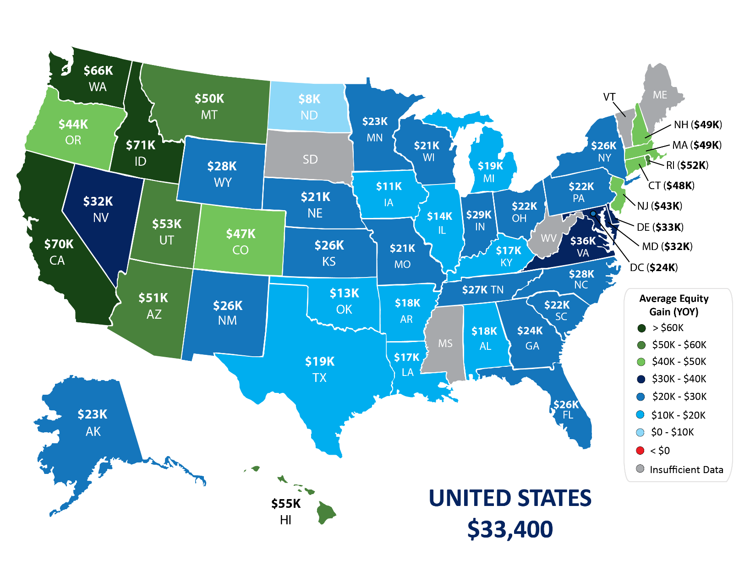
Leveraging Your Equity To Make a Move
According to the latest data from CoreLogic, the average homeowner gained $33,400 in equity over the past year, and that number continues to grow as home values appreciate.
Homeowner Equity Gains over the Past Year
CoreLogic
Notes:
https://www.corelogic.com/insights-download/homeowner-equity-report.aspx

Slide 11
Potential Home Price Growth over the Next Five Years
Based on projections from the Home Price Expectation Survey
$93,629
Potential growth in household wealth over the next five years based solely on increased home equity if you purchased a $350K home in January 2021
Home Price Expectation Survey 2021 2Q
When you sell, the equity you build up over time can be used to help you meet your goals. If you’re looking to move, you can use the equity from your current home to make a larger down payment on your next one, so you’ll need to finance less of the purchase price of that house.
Alternatively, you can use your equity to reach other big goals in your life, such as starting your own business or funding an education.
The graph above is a great example of how home price appreciation converts into equity when you own a home. If you purchased a $350,000 home in January of this year, based on projected home price appreciation, you could potentially gain $93,629 in equity over the next five years – just by being a homeowner.
So, if you’re thinking of moving, remember that as a homeowner, you may have more equity in your house than you realize.
This equity can also help homeowners who entered the forbearance program. Those homeowners who have yet to work out a plan can leverage their equity and sell their homes in order to avoid the foreclosure process.
Bottom Line No matter your situation, let’s connect to find out if your current home equity can help you make your next move sooner than you may have thought possible.
Notes:
https://pulsenomics.com/surveys/#home-price-expectations

Slide 12
Existing homeowners today are sitting on record amounts of equity. As homeowners gain equity in their homes, the temptation grows to list their current home for sale and use the equity to purchase a larger or more attractive home.
- Mark Fleming, Chief Economist, First American
Notes:
https://blog.firstam.com/economics/the-good-the-bad-and-the-maybe-ahead-of-spring-home-buying?

Slide 13
Remote Work Is Changing Our Home Needs
If you're still on the fence of whether or not to sell your house, think about if your current home still meets your needs. For many homeowners, working remotely impacts which features are most important in a home.
Before the pandemic, only 21% of individuals worked from home. However, a survey of hiring managers conducted by Statista and Upwork projects 37.5% of U.S. workers will work remotely in some capacity over the next five years.
Working from home gives you more flexibility and more options.
If you’re part of that 37.5%, working from home may provide you with opportunities you didn’t realize you had. Since you don’t need to be tied to a specific area for your job, it gives you more flexibility when it comes to where you can live.
Working from home isn’t a passing fad – for many professionals, it's here to stay.
Percentage of Workers Anticipated To Work Remotely over the Next Five Years
Based on a survey of hiring managers
Fully Remote
Not
Remote
Partially
Remote
Statista/Upwork
Notes:
https://www.statista.com/chart/23781/remote-work-teams-departments/

Slide 14
If you’re one of the nearly 23% of workers who will remain 100% remote:
You have the option to move to a lower cost-of-living area or to the location of your dreams. If you search for a home in a more affordable area, you’ll be able to get more house for your money, freeing up more options for your dedicated office space and additional breathing room.
You could also move to a location where you’ve always wanted to live – somewhere near the beach, the mountains, or simply a market that features better weather and community amenities. Without your job tying you to a specific location, you’re bound to find your ideal spot.
If you’re one of the almost 15% of individuals who will have a partially remote or hybrid schedule:
Relocating within your local area to a home that’s further away from your office could be a great choice. Since you won’t be going into work every day, a slightly longer commute from a more suburban or rural neighborhood could be a worthy trade-off for a home with more features, space, or comforts. After all, if you’ll still be at home part-time, why not find a place that better suits your needs?
According to the latest Top Ten Issues Affecting Real Estate from The Counselors of Real Estate (CRE), many homebuyers are already taking advantage of their newfound flexibility:
“. . . after years of apparent but variant trends towards urbanization, the pandemic universally caused a movement away from urban cores, particularly for those with higher incomes who could afford to move and for lower-income individuals seeking lower costs of living.”
Bottom Line If you’ve found what you’re looking for in a home is changing due to remote work, it may be time to make a move. Let’s start prioritizing your home needs today.
Notes:
https://www.statista.com/chart/23781/remote-work-teams-departments/
https://www.cre.org/external-affairs/2021-22-top-ten-issues-affecting-real-estate/

Slide 15
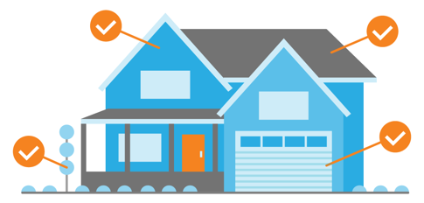
If I Sell Now, Where Will I Go?
Now is clearly a great time to sell, but when you do, where will you go? Let’s compare the benefits of buying a newly built home versus an existing one. That way, you can consider what most closely aligns with your homeownership goals.
Pros for Purchasing a Newly Built Home
Create your perfect home. If you build a home from the ground up, you’ll have the option to select the custom features you want including appliances, finishes, landscaping, layout, and more.
Cash in on energy efficiency. When building a home, you can choose energy-efficient options to help lower your energy costs, protect the environment, and reduce your carbon footprint.
Minimize the need for repairs. Many builders offer a warranty, so you’ll have peace of mind on unlikely repairs. Plus, you won’t have as many little projects to tackle, like leaky faucets or shutters to paint.
Know you have brand new everything. Another perk is that nothing in the house is used, it’s all brand new and uniquely yours from day one.
Notes:
https://www.energy.gov/eere/buildings/energy-star
https://www.investopedia.com/articles/personal-finance/062614/should-you-buy-or-build-home.asp
https://www.quickenloans.com/learn/old-house-vs-new-house

Slide 16
Pros for Buying an Existing Home
Explore a wider variety of home styles and floorplans. With decades of homes to choose from, you’ll have a broader range of floorplans and designs.
Join an established neighborhood. Existing homes give you the option to get to know the neighborhood, community, or traffic flow and patterns before you commit.
Enjoy mature trees and landscaping. Established neighborhoods also have more mature landscaping and trees, which can give you more privacy and curb appeal.
Appreciate that lived-in charm. The character of older homes is hard to reproduce. If you value old-school craftsmanship or design elements, you may prefer an existing home.
Bottom Line If you have questions about the options in your area, let's meet to explore what's available and what's right for you.
Notes:
https://www.investopedia.com/articles/personal-finance/062614/should-you-buy-or-build-home.asp
https://www.quickenloans.com/learn/old-house-vs-new-house

Slide 17
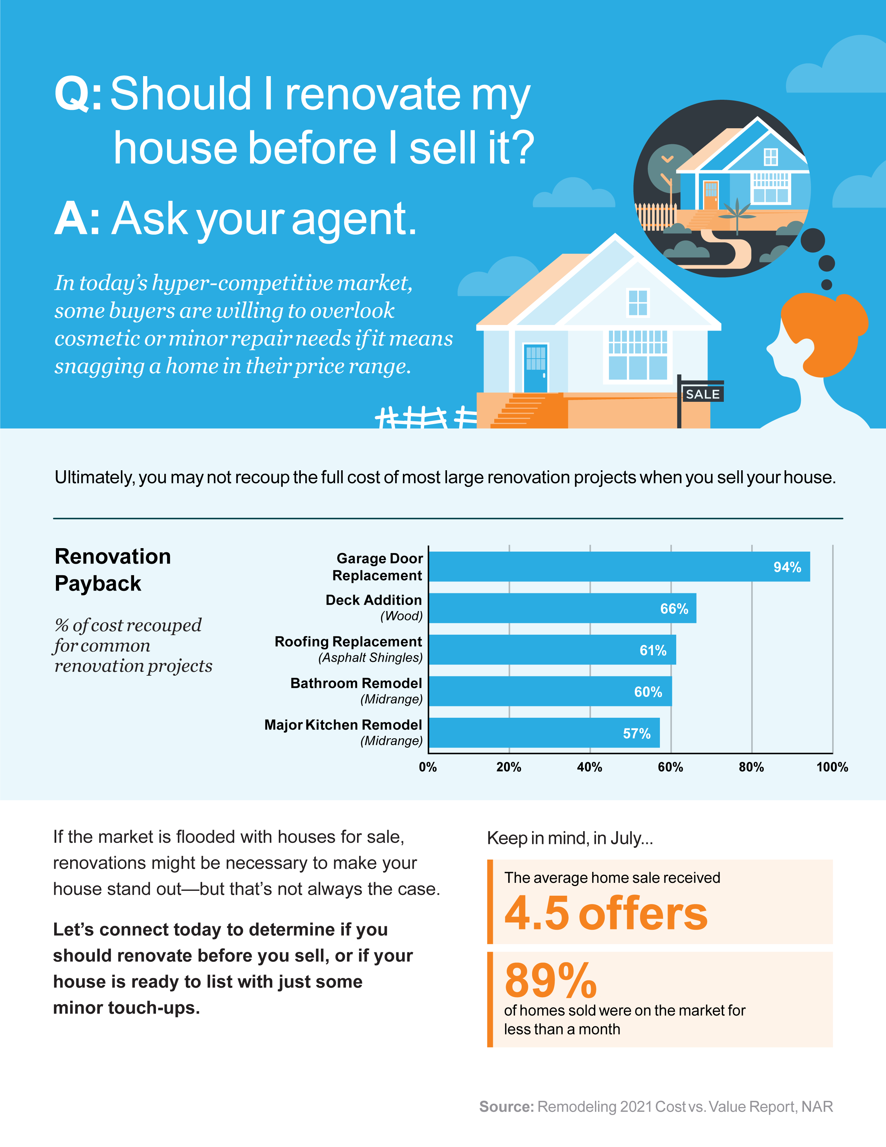
Notes:
https://www.remodeling.hw.net/benchmarks/cost-vs-value/key-trends-in-the-2021-cost-vs-value-report_o
https://cdn.nar.realtor/sites/default/files/documents/2021-07-realtors-confidence-index-08-23-2021.pdf
https://www.nar.realtor/newsroom/existing-home-sales-climb-2-0-in-july

Slide 18
Save Time and Effort by Selling with an Agent
Selling a house is a time-consuming process – especially if you decide to do it on your own, known as a For Sale By Owner (FSBO). From conducting market research to reviewing legal documents, handling negotiations, and more, it’s an involved and highly-detailed process. Here are a few things you should consider before putting that “For Sale” sign up in your yard.
1. Making a Good First Impression
While it may sound simple, there are a lot of proven best practices to think about when prepping a house for sale.
Do you need to take down your personal art?
What’s the right amount of landscaping to boost your curb appeal?
What wall colors are most appealing to buyers?
If you do this work on your own, you may invest capital and many hours into the wrong things. Your time is money – don’t waste it. An agent can help steer you in the right direction based on current market conditions to save you time and effort. Since we’re in a hot sellers’ market, you don’t want to delay listing your house by focusing on things that won’t change your bottom line.
2. Pricing It Right
Real estate professionals are experienced when it comes to looking at recent comparable homes that have sold in your area and understanding what price is right for your neighborhood. We use that data to price your house appropriately, maximizing your return.
In a FSBO, you’re operating without this expertise. Even with your own research, you may not find the most up-to-date information and could risk setting a price that’s inaccurate or unrealistic. If you price your house too high, you could turn buyers away before they’re even in the front door or run into problems when it comes time for the appraisal.

Slide 19
3. Maximizing Your Buyer Pool
Simply put, real estate professionals can get your house in front of more buyers via their social media followers, agency resources, and proven sales strategies. The more buyers that view a home, the more likely a bidding war becomes. Using an agent to boost your exposure may help boost your sale price too.
4. Navigating Negotiations
When it comes to selling your house as a FSBO, you’ll have to handle all the negotiations. Here are just a few of the people you’ll work with:
The buyer, who wants the best deal possible
The buyer’s agent, who will use their expertise to advocate for the buyer
The inspection company, which works for the buyer and will almost always find concerns with the house
The appraiser, who assesses the property’s value to protect the lender
As part of our training, agents are taught how to negotiate every aspect of the real estate transaction and how to mediate potential snags that may pop up. When appraisals come in low and in countless other situations, we know what levers to pull, how to address the buyer and seller emotions that come with it, and when to ask for second opinions. Navigating all of this on your own takes time – a lot of it.
4. Juggling Legal Documentation
Speaking of time, consider how much free time you have to review the fine print. Just in terms of documentation, more disclosures and regulations are now mandatory. That means the stack of legal documents you need to handle as the seller is growing. It can be hard to know and truly understand all the terms and requirements. Instead of going at it alone, use an agent as your shield and advisor to help you avoid potential legal missteps.
Bottom Line Selling your house on your own is time consuming and requires an immense amount of effort and expertise. Before you decide to sell your house yourself, let's discuss your options to make sure you get the most out of the sale.

Slide 20
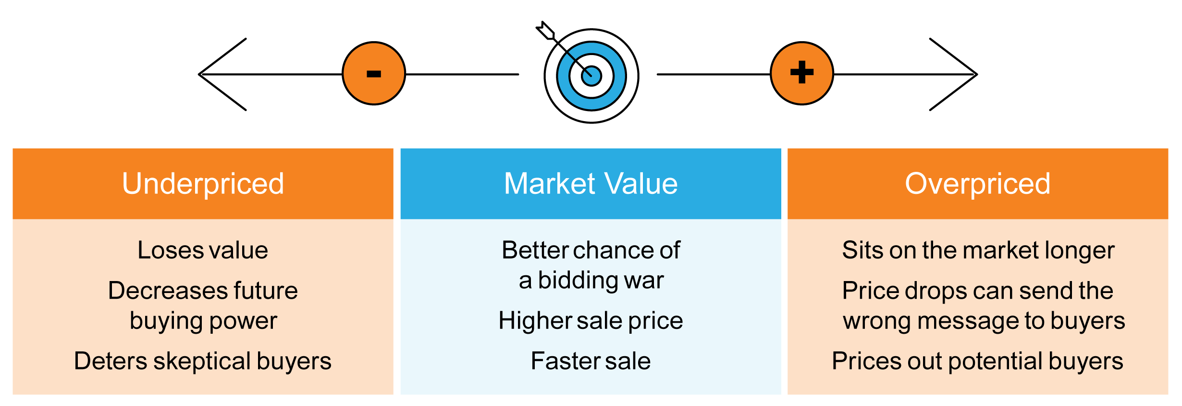
Why Pricing Your House Right Matters
There’s no denying we’re in a sellers’ market. According to the Realtors Confidence Index Survey from the National Association of Realtors (NAR), 50% of today’s offers are over the asking price.
While it may be tempting to price your house on the high side to capitalize on this trend, doing so could limit your house’s potential.
A high price tag doesn’t mean you’re going to cash in big on the sale. While you may be trying to maximize your return, the tradeoff may be steep. A high list price is more likely to deter buyers, sit on the market longer, or require a price drop that can raise questions among prospective buyers.
Instead, focus on setting a price that’s fair. Real estate professionals know the value of your home.
By pricing your house based on its current condition and similar homes that have recently sold in your area, your agent can help you set a price that’s realistic and obtainable – and that’s good news for you and for buyers.
When you price your house right, you increase your home’s visibility, which drives more buyers to your front door. The more buyers that tour your home, the more likely you’ll have a multi-offer scenario to create a bidding war. When multiple buyers compete for your house, that sets you up for a bigger win.
Bottom Line When it comes to pricing your house, working with a local real estate professional is essential. Let’s meet to discuss how you can optimize your exposure, your timeline, and the return on your investment, too.
Notes:
https://cdn.nar.realtor/sites/default/files/documents/2021-07-realtors-confidence-index-08-23-2021.pdf

Slide 22
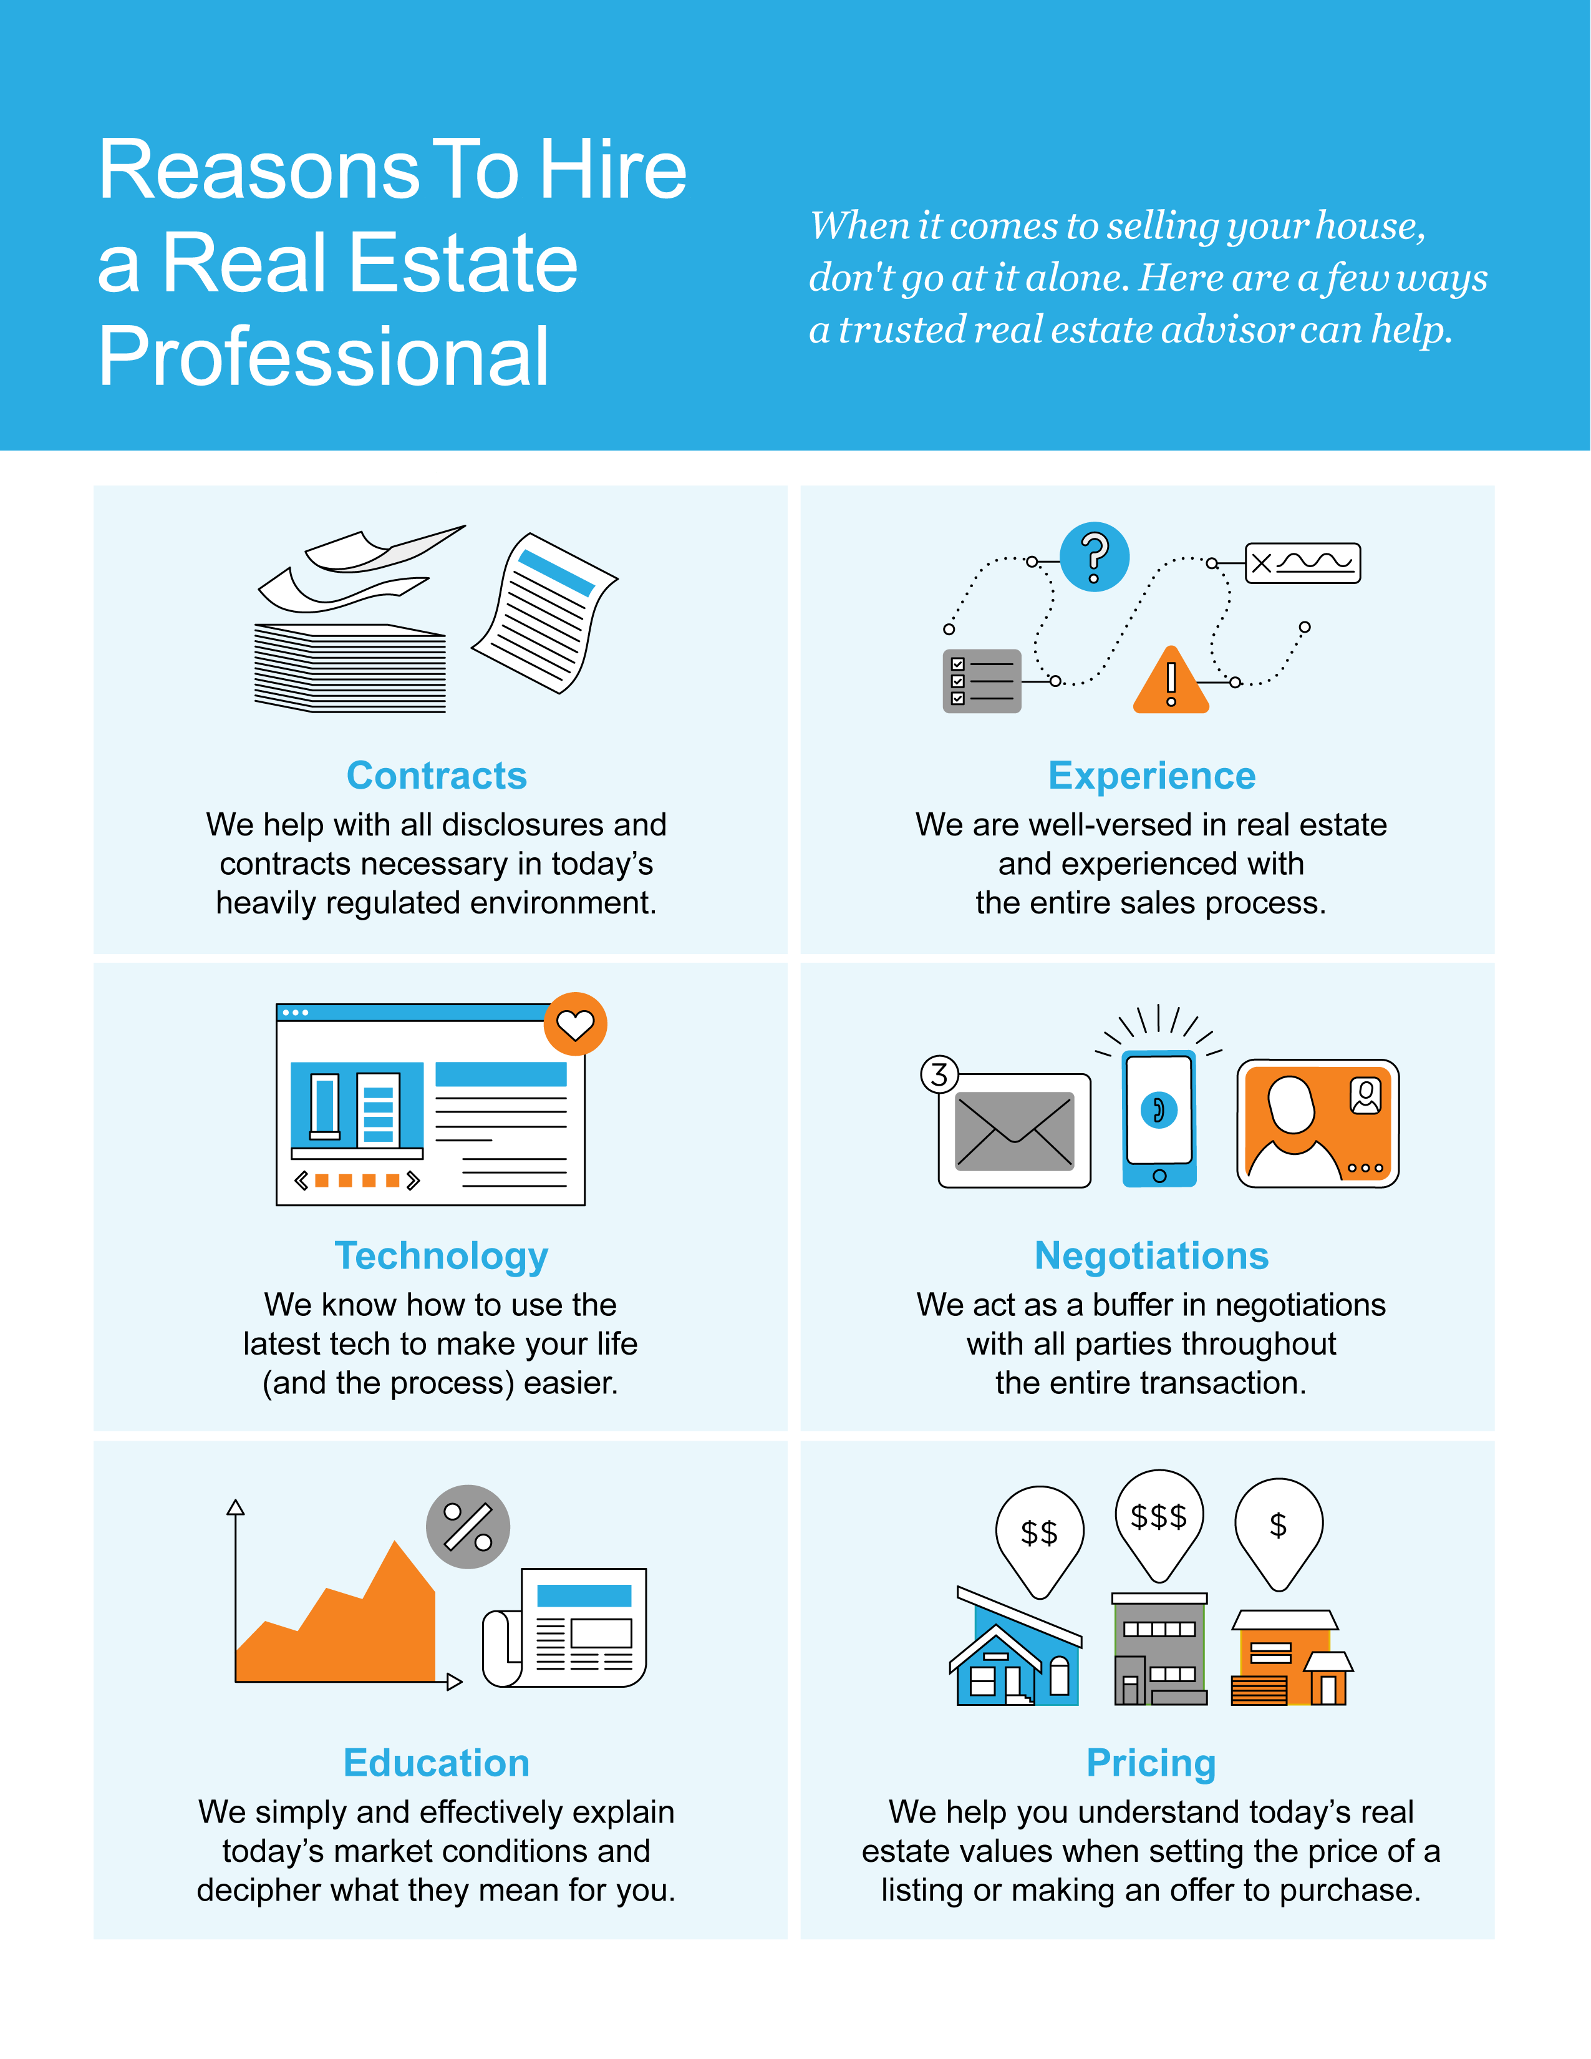

Slide 23
“A home, now more than ever, has become a top priority for American households.”
- Odeta Kushi, Deputy Chief Economist, First American
Notes:
https://blog.firstam.com/economics/pandemic-accelerated-roaring-20s-of-millennial-homeownership-demand

Slide 24
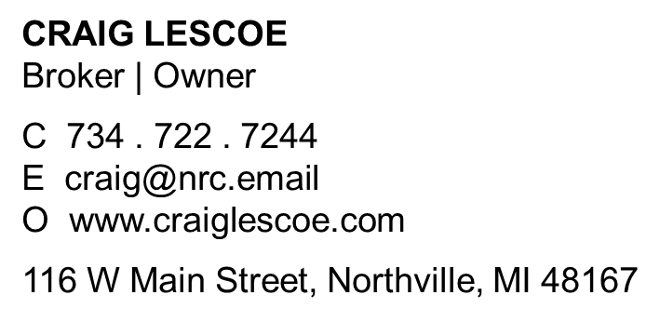
Let’s Chat.
I’m sure you have questions and thoughts about the real estate process.
I’d love to talk with you about what you’ve read here and help you on the path to selling your house. My contact information is below, and I look forward to working with you.
FALL 2021 EDITION

