Slide 1
Things To Consider When
Buying a Home
FALL 2021
EDITION

Slide 2
Table of Contents
3 Buying a Home This Fall
5 Expert Insights for Today’s Homebuyers
7 Patience Is Key in a Competitive Market
9 Why Listing Prices Are Like an Auction’s Reserve Price
11 A Deeper Look at Affordability
13 Are We in a Housing Bubble? Experts Say No.
15 Key Terms To Know in the Homebuying Process
16 The Path to Homeownership
17 Do I Really Need a 20% Down Payment?
19 Things To Avoid After Applying for a Mortgage
20 5 Tips for Making an Offer
22 Homebuyers: Hang in There

Slide 3
Buying a Home This Fall
As the weather begins to cool, the real estate market will remain red-hot. Here’s a dive into some of the biggest wins for homebuyers this fall.
More Homes Are Coming to the Market
Earlier this year, the number of homes available for sale fell to an all-time low. In recent months, however, housing supply has started to trend up. This is good news for buyers who crave more options. Odeta Kushi, Deputy Chief Economist at First American, says:
“It looks like existing inventory is starting to inch up, which is good news for a housing market parched for more supply.”
Buying Is More Affordable than Renting
According to data from realtor.com, median rental prices just reached their highest point ever recorded. Let’s compare today’s median mortgage payment to the median rent.
According to the National Association of Realtors (NAR), the latest data on homes closed shows the median monthly mortgage payment is $1,255. By contrast, the median national rent is $1,607 according to the most current data provided by realtor.com (see graph below). That’s a difference of $352 dollars each month.
If you’re a renter, it may be time to consider purchasing a home so you can lock in your housing expenses for the life of your loan and avoid future increases.
Median Monthly Rental Prices
Median Monthly Mortgage:
$1,255
realtor.com, NAR
Notes:
https://twitter.com/odetakushi/status/1407344750534041615
https://news.move.com/2021-08-26-Realtor-com-R-July-Rental-Report-Buying-a-Starter-Home-is-More-Affordable-than-Renting-in-Nearly-Half-of-the-Biggest-U-S-Metros
https://www.nar.realtor/blogs/economists-outlook/housing-affordability-weakens-in-june-as-home-prices-ascend

Slide 4
Expected Rate of Home Price Appreciation Through 2025
Based on a survey of 100 economists, investment strategists, and housing market analysts
Home Price Expectation Survey 2021, Q2
Mortgage Rates Are Still Low
Last year, we saw the lowest mortgage interest rates in recorded history as they fell below 3% for the first time ever. This season, they’re still incredibly low compared to the historic norm. According to the latest quarterly forecast from Freddie Mac:
“. . . while we forecast rates to increase gradually later in the year, we don't expect to see a rapid increase. At the end of the year, we forecast 30-year rates will be around 3.4%, rising to 3.8% by the fourth quarter of 2022.”
Today’s low mortgage rates help boost your purchasing power, but it’s unlikely they’ll last much longer. Buying sooner rather than later is the best way to get more house for your money.
Home Prices Are Appreciating
Investopedia defines appreciation like this:
“Appreciation, in general terms, is an increase in the value of an asset over time.”
Over the past year, we’ve seen home prices rise across the country. And according to expert forecasts, that appreciation will continue through 2025.
This should help you feel confident that buying a home this year is a strong long-term investment.
If you’re worried about what that means for affordability today, remember that current mortgage rates help boost your purchasing power and keep your monthly payments more affordable.
Bottom Line Let’s connect if you’re ready to buy so we can get your journey to homeownership started and you can capitalize on today's unique housing market opportunities.
Notes:
https://pulsenomics.com/surveys/#home-price-expectations
http://www.freddiemac.com/research/forecast/20210715_quarterly_economic_forecast.page?
https://www.investopedia.com/terms/a/appreciation.asp

Slide 5
Expert Insights for Today’s Homebuyers
Experts throughout the industry agree, if you’re ready to buy a home, it’s still a good time as housing supply starts to rise and mortgage rates remain low. Here's what they have to say about today's market:
“ | As the inventory is beginning to pick up ever so modestly, we are still facing a housing shortage, but we may have turned a corner. - Lawrence Yun, Chief Economist, National Association of Realtors
“ | We never saw mortgage rates like this. . . . This is unprecedented territory. . . . But, basically, by the end of the year, we don't expect rates to be below 3%. We expect them to be somewhat modestly higher in the low 3 to 3.5% range. - Mark Fleming, Chief Economist, First American
“ | . . . as Americans embrace the return to a new normal, many are ready to move on to the next chapter of life and are listing their homes for sale. With prices at record highs and mortgage rates still hovering near record lows, sellers are recognizing the favorable conditions. . . . The influx of new supply is keeping price growth in check and offering much-needed relief for buyers who have been frustrated by the very tight inventory and highly competitive market conditions . . . - George Ratiu, Senior Economist, realtor.com
Notes:
https://www.instagram.com/p/CRFC2_QHBQI/
https://blog.firstam.com/economics/reconomy-podcast-what-influences-changes-in-mortgage-rates-and-where-are-rates-headed-the-rest-of-the-year
https://www.realtor.com/research/pending-home-sales-decline-in-june-2021/

Slide 6
KEY TAKEAWAY
If you’re looking for a home but are having trouble finding one, stick with it. Today’s low mortgage rates are still in your favor, and as more houses become available, you’ll have more options to choose from. But act now before mortgage rates rise.

Slide 7
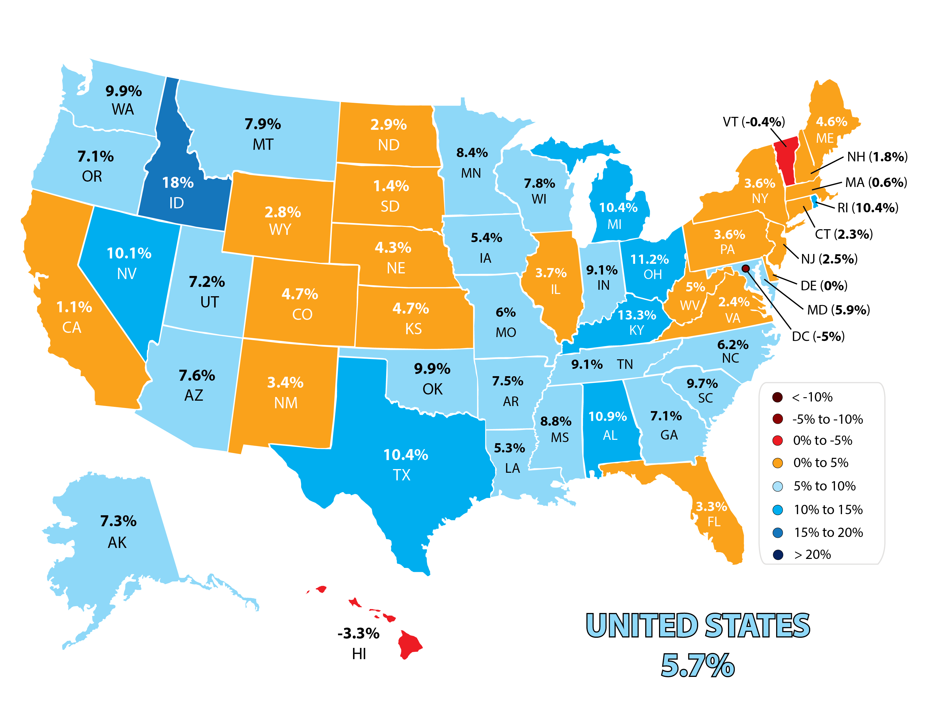
Patience Is Key in a Competitive Market
According to realtor.com, the number of sellers listing their houses for sale is on the rise. Looking at the month-over-month change in housing inventory, the number of homes available for sale increased 5.7% in the latest report.
Month-Over-Month Change in Housing Inventory
realtor.com
Notes:
https://www.realtor.com/research/data/

Slide 8
What does this mean for you?
This increase in homes available for sale is good news for buyers. If you’re ready to buy and you’re having trouble finding a home, take comfort in knowing that more options are already coming to the market. The key is sticking with your search, working with your agent, and trusting the process.
While there are more homes on the market today, NAR reports that inventory sits at a 2.6-months’ supply at the current sales pace. For there to be enough homes on the market to meet buyer demand, that number would be 6.0 months of inventory – which is significantly higher than where we are today.
Bottom Line Even with the welcome rise in supply, it’s still a highly competitive market. Be ready to act immediately once you find the right home for you. Then, let’s work together so you can craft a strong offer based on today's market conditions.
Notes:
https://www.nar.realtor/newsroom/existing-home-sales-climb-2-0-in-july

Slide 9
Why Listing Prices Are Like an Auction’s Reserve Price
The near record-low supply of homes for sale coupled with very strong buyer demand is resulting in bidding wars that are driving home prices up.
In the past, a home's asking price was generally the ceiling of the negotiation. Buyers would try to determine how much less than full price they could offer and still get the home. Usually, the outcome was the buyer and seller would agree on a revised price that met somewhere in the middle.
Today is different.
Homes today often sell for more than the list price. In some cases, they sell for a lot more. Selma Hepp, Deputy Chief Economist at CoreLogic, explains:
“The imbalance between robust demand and dismal availability of for-sale homes has led to a continual bidding over asking prices, which reached record levels in recent months. Now, almost 6 in 10 homes listed are selling over the asking price.”
You may need to change the way you look at the asking price of a home.
Instead of looking at the asking price as the ceiling of negotiations, think of the list price of the house as the reserve price at an auction. It’s the minimum the seller will accept in many cases. Therefore, if you really love a home, be prepared that it may ultimately sell for more than the sellers are asking.
Notes:
https://www.corelogic.com/intelligence/find-stories/us-sp-corelogic-case-shiller-rockets-to-16-6-reaches-new-records/

Slide 10
Be ready to close an appraisal gap.
With current home price appreciation, appraisal gaps are becoming more common. An appraisal gap occurs when the price of your contract doesn’t match up with the appraisal for the house.
According to data from CoreLogic:
“Beginning in January 2020, nationally, 7% of purchase transactions had a contract price above the appraisal, but by May 2021, the frequency had increased to 19% of purchase transactions.”
When this happens, chances are your lender won’t loan more than the home’s appraised value. That means there’s going to be a gap between the amount of loan you can secure and the contract price on the house.
In today’s competitive market, the seller may ask you to pay the difference out of pocket. Make sure you know your budget, know what you can afford, and work with a trusted advisor who can help you make all the right moves as you buy a home.
Bottom Line Bidding wars are creating an auction-like atmosphere in many real estate transactions. Let’s connect so you have a trusted real estate professional on your side to provide the best advice on how to make a competitive offer on a home and how to navigate the process.
Notes:
https://www.corelogic.com/intelligence/appraisal-gap-increases-in-hot-markets/

Slide 11
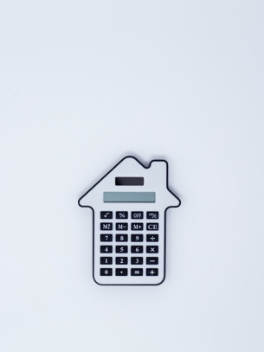
A Deeper Look at Affordability
Rising prices and bidding wars are leading some buyers to question affordability. Here’s what the data says.
The 2021 U.S. Home Affordability Report from ATTOM Data explains that the major ownership costs (on the typical home) as a percent of the average national wage increased from 22.2% in the second quarter of 2020 to 25.2% in the second quarter of this year. That means homeowners today are contributing a slightly higher percentage of their total income to their monthly mortgage payments than they did last year, but this shouldn’t be a major cause for concern:
“Still, the latest level is within the 28 percent standard lenders prefer for how much homeowners should spend on mortgage payments, home insurance and property taxes.”
It’s true that monthly mortgage payments are greater than they were a year ago (as the ATTOM data shows), but they’re not unaffordable when compared to the last 30 years. While payments have increased dramatically during that several-decade span, if we adjust for inflation, today’s mortgage payments are 10.7% lower than they were in 1990.
What does that mean for you? While you may not get the homebuying deal someone you know got last year, that doesn’t mean you shouldn’t still buy a home. Here are your alternatives to buying and the trade-offs you’ll have with each one.
Alternative 1: I'll rent instead.
Some may consider renting as the better option. However, the monthly cost of renting a home is skyrocketing. According to the latest National Rent Report from Apartment List:
“The first half of 2021 has seen the fastest growth in rent prices since the start of our estimates in 2017. Our national rent index has increased by 11.4 percent since January.”
If you continue to rent, your monthly payments will keep increasing at a very rapid pace. That means you’ll end up spending significantly more of your income on your rental as time goes on, which can make it even harder to save for a home.
Notes:
https://www.attomdata.com/news/market-trends/home-sales-prices/q2-2021-u-s-home-affordability-report/
https://www.apartmentlist.com/research/national-rent-data

Slide 12
Alternative 2: I'll wait it out.
Others may consider waiting for another year in hopes that purchasing a home will be less expensive by then. Let’s look at that possibility. A lower monthly payment will require one of those two elements to decrease over the next year. However, experts are forecasting the exact opposite:
Freddie Mac projects mortgage rates will be at 3.8% by the end of 2022.
The Home Price Expectation Survey (HPES), a survey of over 100 economists, investment strategists, and housing market analysts, calls for home prices to increase by 5.12% in 2022.
Based on these projections, let’s see the possible impact on a monthly mortgage payment:
Home Purchase Date | Cost of Home* | 10% Down Payment | Mortgage Amount | Mortgage Rate** | Monthly Payment***
Today | $350,000 | $35,000 | $315,000 | 2.86% | $1,304
Next Year | $367,920 | $36,792 | $331,128 | 3.8% | $1,543
Difference | $17,920 | $1,792 | $16,128 | 0.94% | $239
*Increase in value based on 5.12% price growth as forecast by the Home Price Expectation Survey
**Freddie Mac’s current rate and forecast for Q4 2022
***Principal and interest only
By waiting until next year, you’ll potentially pay more for the home, need a larger down payment, pay a higher mortgage rate, and pay an additional $239 a month ($2,868 a year) over the life of the loan.
Bottom Line While you may have missed the absolute best time to buy a home, waiting any longer may not make sense. Mark Fleming, Chief Economist at First American, says it best: “Affordability is likely to worsen before it improves, so try to buy it now, if you can find it.”
Notes:
http://www.freddiemac.com/research/forecast/20210715_quarterly_economic_forecast.page?
https://pulsenomics.com/surveys/#home-price-expectations
https://freddiemac.gcs-web.com/node/23431/pdf
https://blog.firstam.com/economics/is-it-a-good-time-to-buy-a-home

Slide 13
Are We in a Housing Bubble? Experts Say No.
The conversations around pricing and affordability are leading some to question whether the real estate market is a bubble ready to pop. Experts say it’s not.
When it comes down to it, the opinions that carry the most weight are the ones based on experience and expertise. Here’s what leading industry influencers have to say:
“ | . . . conditions today are quite different than in the early 2000s, particularly in terms of credit availability. The current climb in house prices instead reflects strong demand amid tight supply, helped along by record-low interest rates. - The State of the Nation’s Housing 2021 Report, Joint Center for Housing Studies
“ | The housing market is in line with fundamentals as interest rates are attractive and incomes are high due to fiscal stimulus, making debt servicing relatively affordable and allowing buyers to qualify for larger mortgages. Underwriting standards are still strong, so there is little risk of a bubble developing. - Nathaniel Karp, Chief U.S. Economist, BBVA
Notes:
https://www.jchs.harvard.edu/sites/default/files/reports/files/Harvard_JCHS_State_Nations_Housing_2021.pdf
https://www.reuters.com/business/us-home-prices-keep-racing-ahead-with-risks-upside-2021-05-24/

Slide 14
“ | Looking back at the bubble years, house prices exceeded house-buying power in 2006 nationally, but today house-buying power is nearly twice as high as the median sale price nationally. . . . Many find it hard to believe, but housing is actually undervalued in most markets and the gap between house-buying power and sale prices indicates there’s room for further house price growth in the months to come. - Mark Fleming, Chief Economist, First American
“ | It’s not clear at all to me that things are going to slow down significantly in the near future. In 2005, I had a strong sense that the hot market would turn and that, when it turned, things would get very ugly. Today, I don’t have that sense at all, because all of the fundamentals are there. Demand will be high for a while, because Millennials need houses. Prices will keep rising for a while, because inventory is so low. - Bill McBride, Calculated Risk
Bottom Line All four strongly believe we’re not in a bubble and won’t see crashing home values like we did in 2008. This is good news for homebuyers as you can rest assured it isn't like the last time.
Notes:
https://blog.firstam.com/economics/house-prices-are-hot-but-is-housing-overvalued
https://www.theatlantic.com/ideas/archive/2021/05/us-housing-market-records/619029/

Slide 15
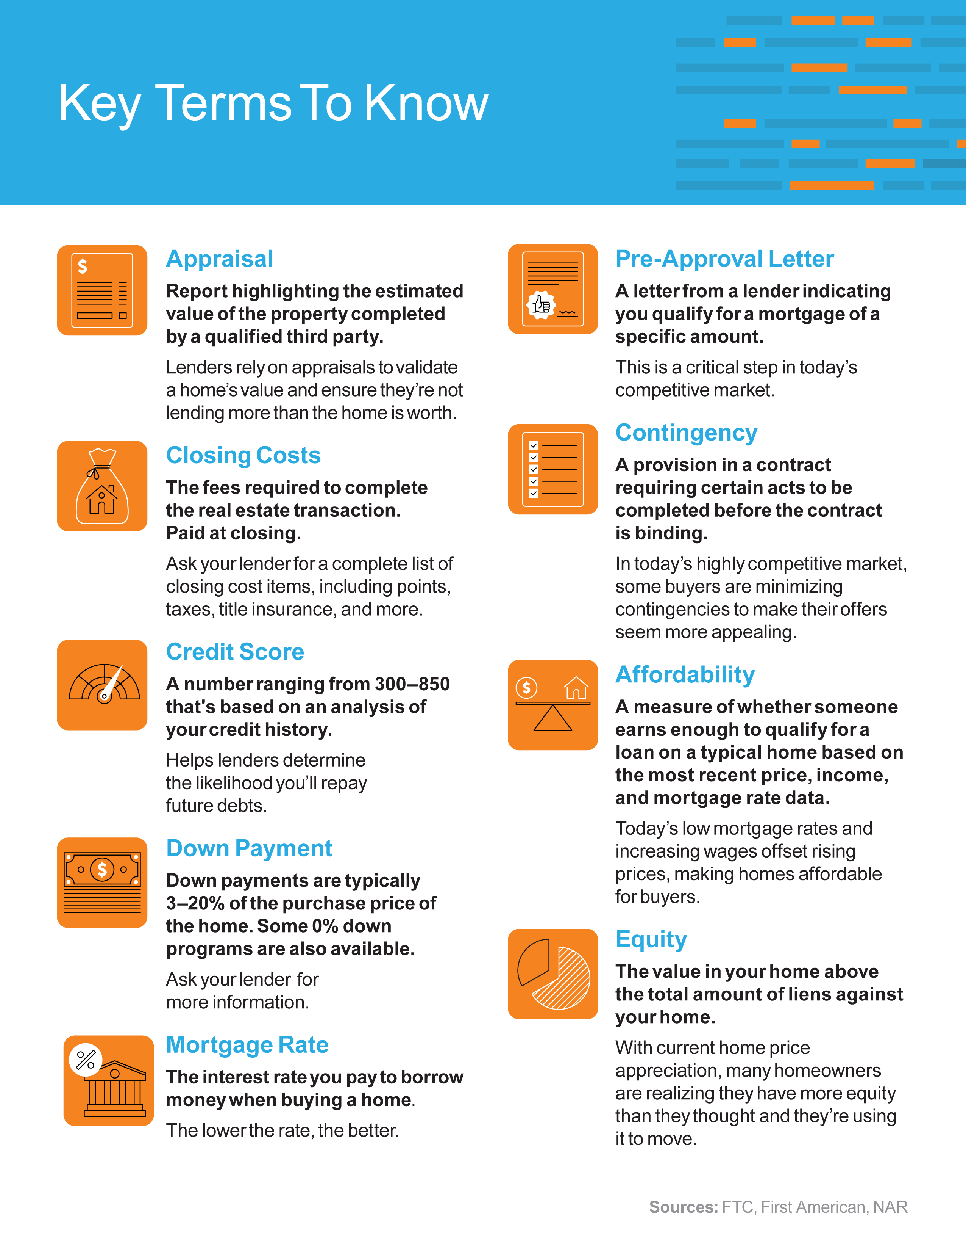
Notes:
https://www.ftc.gov/sites/default/files/documents/one-stops/real-estate-competition/realestateglossary.pdf
https://blog.firstam.com/15-real-estate-terms-you-should-know
https://magazine.realtor/tool-kit/rookie/article/2020/02/real-estate-glossary

Slide 16
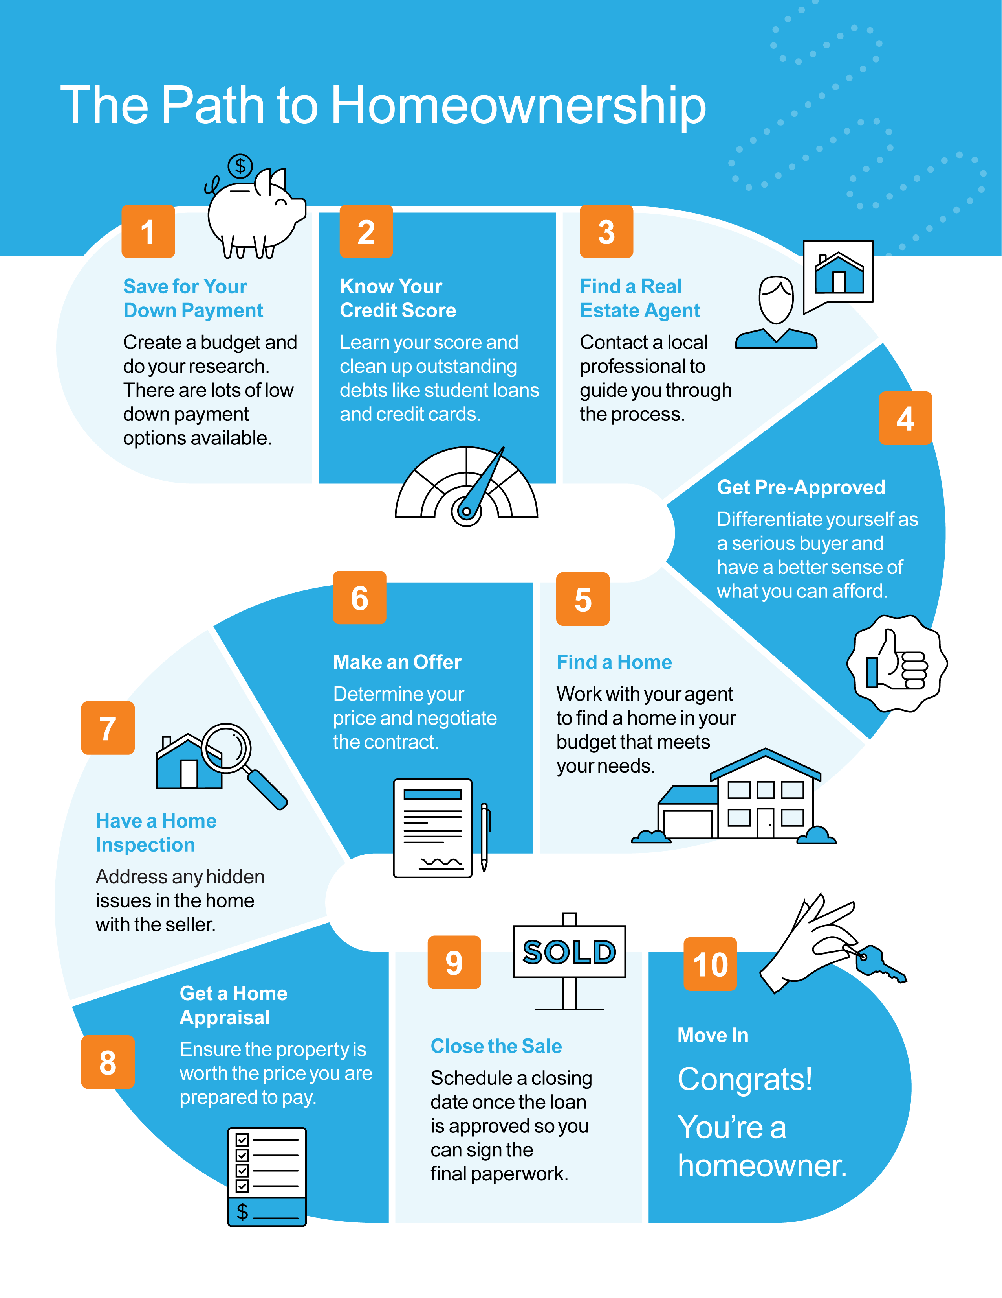

Slide 17
Do I Really Need a 20% Down Payment?
One thing that may be holding you back from buying right now is the idea of saving for a down payment. Don’t let that stop you from pursuing your homeownership dreams.
Today, there’s still a common myth that you need to come up with 20% of the total sale price for your down payment. The reality is – whether it’s your first home or you’ve purchased one before – you most likely don’t need a 20% down payment.
If saving that much money sounds daunting, you might be ready to give up on the dream of homeownership before you even begin – but you don’t have to.
The 2020 Profile of Home Buyers and Sellers from the National Association of Realtors (NAR) notes how the median down payment hasn’t been over 20% since 2005, and even then, that was only for repeat buyers, not first-time homebuyers.
The most damaging down payment myth—since it stops the homebuying process before it can start—is the belief that 20% is necessary.
- Freddie Mac
Notes:
https://sf.freddiemac.com/articles/insights/down-payments-helping-future-borrowers-bridge-the-awareness-gap
https://www.nar.realtor/research-and-statistics/research-reports/highlights-from-the-profile-of-home-buyers-and-sellers

Slide 18
Median Down Payments
Today’s median down payment is less than 20%
Common Misconception: 20%
NAR
What does this mean for potential homebuyers?
If you’re a first-time buyer and putting down 7% still seems challenging, understand that there are programs allowing qualified buyers to purchase a home with a down payment as low as 3.5%. There are even options like VA loans and USDA loans with no down payment requirements for qualified applicants.
It’s important to know you likely don’t need a 20% down payment, but you do need to do your homework to understand the options available. When you’re interested in learning more about down payment assistance programs, information is available through sites like downpaymentresource.com. Be sure to also work with trusted professionals from the start to learn what you may qualify for in the homebuying process.
Bottom Line Don’t let down payment myths keep you from hitting your homeownership goals. If you’re hoping to buy a home this year, let’s meet up to review your options.
Notes:
https://www.nar.realtor/research-and-statistics/research-reports/highlights-from-the-profile-of-home-buyers-and-sellers
https://www.hud.gov/buying/loans
https://www.benefits.va.gov/homeloans/index.asp
https://www.rd.usda.gov/newsroom/news-release/usda-rural-home-loans-offer-100-financing-and-no-down-payment
https://downpaymentresource.com/

Slide 19
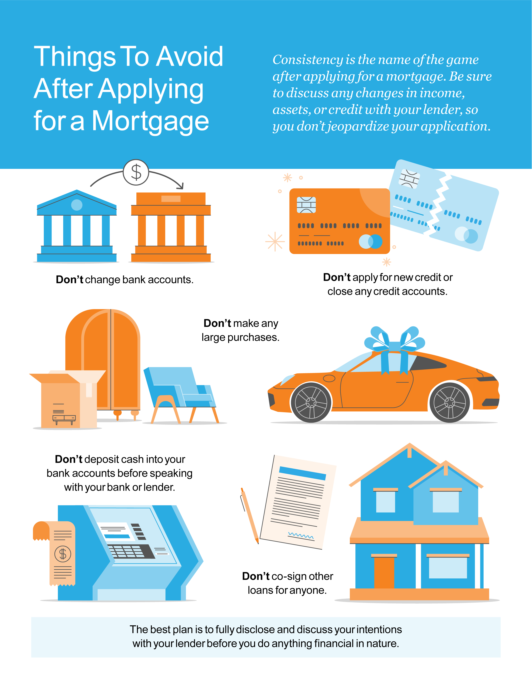

Slide 20
5 Tips for Making an Offer
Even though the number of homes for sale is rising, it’s still lower than historic norms. With this combination of low supply and high buyer demand, a multi-offer scenario is the new normal. If you’re buying a home, you’ll want to do what you can to stand out from the competition. Here are five things to keep in mind when you’re ready to make an offer.
1. Know Your Numbers
A complete understanding of your budget and how much home you can afford is essential. That’s why you should connect with a lender to get pre-approved for a loan early in the homebuying process.
Taking this step shows sellers you’re a serious, qualified buyer and can give you a competitive edge in a bidding war.
2. Brace for a Fast Pace
According to the Realtors Confidence Index from the National Association of Realtors (NAR), the average home is on the market for just 17 days – that means from start to finish, a house for sale in today’s climate is only active for about 2.5 weeks. A skilled agent will do everything they can to help you stay on top of all possible opportunities. As soon as you find the right home for your needs, a real estate professional will help you draft and submit your best offer as quickly as possible.
Notes:
https://cdn.nar.realtor/sites/default/files/documents/2021-07-realtors-confidence-index-08-23-2021.pdf

Slide 21
3. Lean on a Real Estate Professional
While homebuying may seem like a whirlwind process to you, local real estate agents do this every day and know what works. That expertise can be used to give you a significant leg up on your competition. A local real estate professional can help you consider the right levers to pull that might be enticing to a seller, like minimizing contract contingencies (conditions you set that the seller must meet for the purchase to be finalized).
It may seem simple, but catering to what a seller may need can help your offer stand out. Just remember, there are certain contingencies you don’t want to give up, like the home inspection.
“Resist the temptation to waive the inspection contingency, especially in a hot market or if the home is being sold ‘as-is’, which means the seller won’t pay for repairs. Without an inspection contingency, you could be stuck with a contract on a house you can’t afford to fix.”
- Freddie Mac
4. Make a Strong, but Fair Offer
Let’s face it – we all love a good deal. In the past, offering at or near the asking price was enough to make your offer appealing to sellers. In today’s market, that’s often not the case. According to the latest Realtors Confidence Index from NAR, 50% of offers were above the list price in July.
In such a competitive market, emotions and prices can run high. Use an agent as your trusted advisor to make a strong, but fair offer based on market value, recent sales, and demand.
5. Be a Flexible Negotiator
If you followed tip #3, you drafted the offer with the seller’s needs in mind. That said, the seller may still counter with their own changes. Your trusted real estate advisor can help you understand the seller’s request and navigate the conversation, all the while keeping your best interest at heart.
Bottom Line Today’s competitive landscape makes it more important than ever to make a strong offer on a home. Let’s connect to make sure you rise to the top along the way.
Notes:
https://myhome.freddiemac.com/blog/homeownership/20201019_5_rules_for_making_an_offer_on_a_home.page
https://cdn.nar.realtor/sites/default/files/documents/2021-07-realtors-confidence-index-08-23-2021.pdf

Slide 22
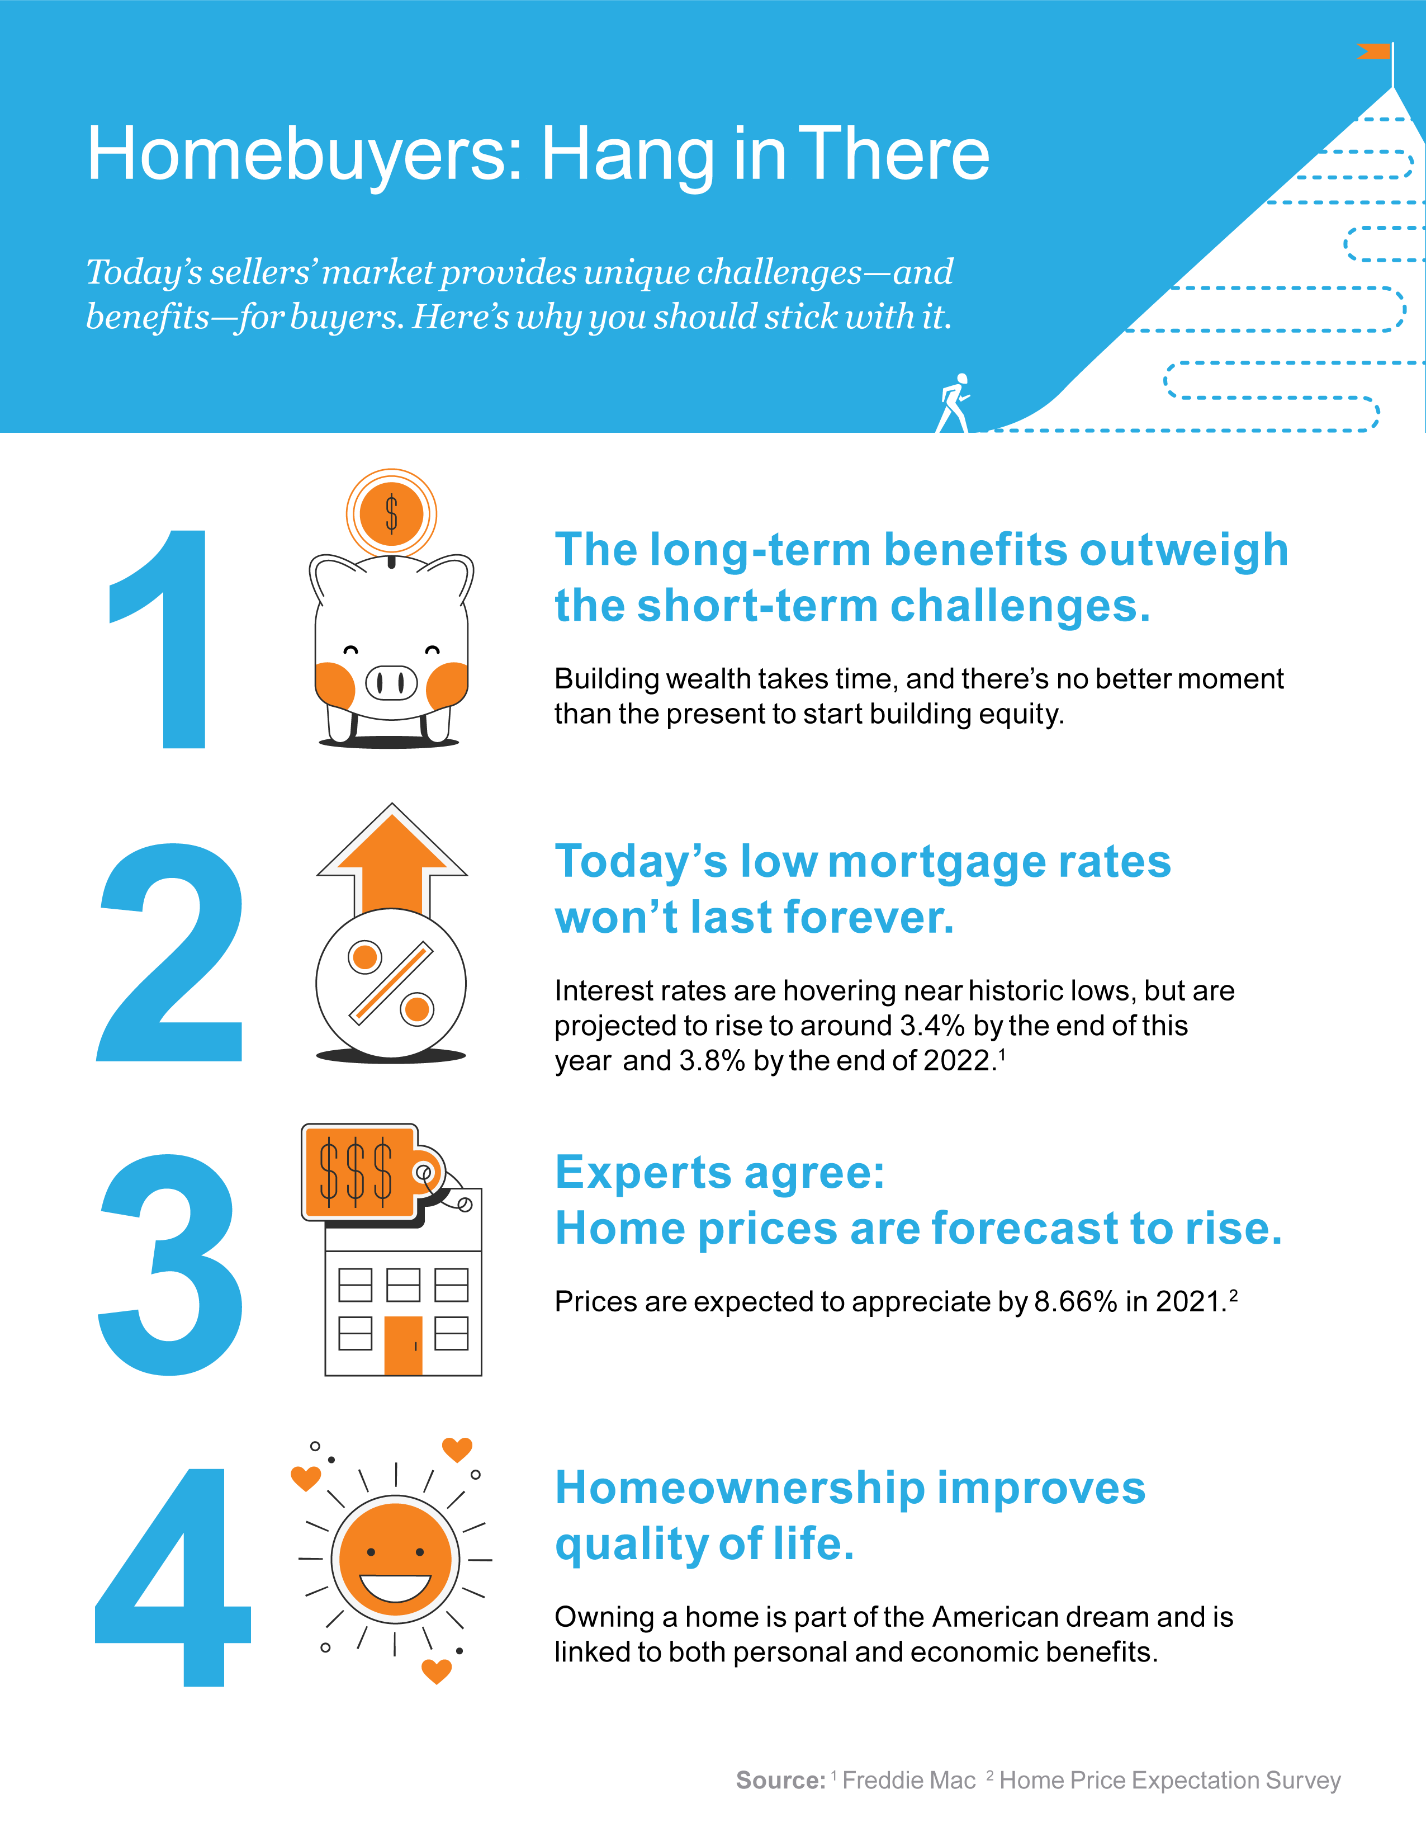
Notes:
http://www.freddiemac.com/research/forecast/20210715_quarterly_economic_forecast.page?
https://pulsenomics.com/surveys/#home-price-expectations

Slide 23
“A home, now more than ever, has become a top priority for American households.”
- Odeta Kushi, Deputy Chief Economist, First American
Notes:
https://blog.firstam.com/economics/pandemic-accelerated-roaring-20s-of-millennial-homeownership-demand

Slide 24
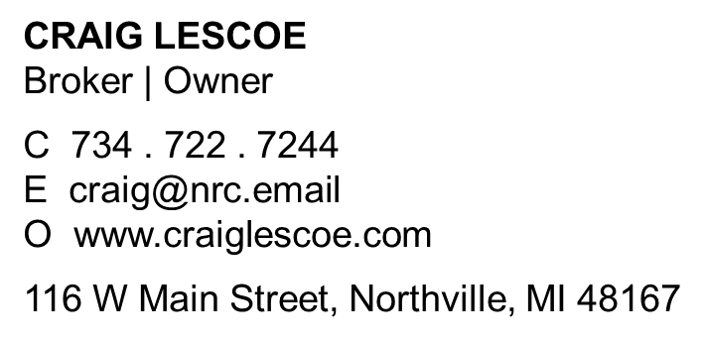
Let’s Chat.
I’m sure you have questions and thoughts about the real estate process.
I’d love to talk with you about what you’ve read here and help you on the path to buying your new home. My contact information is below, and I look forward to working with you.
FALL 2021 EDITION

